Slide 1
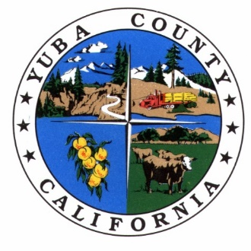
The Nevada-Placer-Yuba Disaster Livestock Pass Program
An Overview
California State Association of Counties - November 2023
Dan Macon
Livestock & Natural Resources Advisor – Placer-Nevada-Sutter-Yuba
County Director – Placer-Nevada
Nevada-Yuba-Placer Unit

Slide 2
Overview
Mega fires and impacts ranching communities.
Multi-county operations require a multi-county approach.
Grassroots organization was critical!
Program elements
The Real World – Lessons from the Winding, Rices, and Mosquito Fires (2022)
New Frontiers – Nevada County Ag Pass Program
Questions

Slide 3
Mega Fires and Ranching Communities
Photo: Kent Nishimura, LA Times

Slide 4
Mega Fires and Ranching Communities
Since the Rim Fire, the scale and rate of spread has increasingly impacted ranchers on public and private land.
Rate of spread has made gathering and evacuating livestock before fire arrival difficult to impossible.
Lengthy evacuations can keep ranchers from caring for livestock, leading some to opt for sheltering in place.
Tracy Schohr (Plumas-Sierra-Butte) and Mathew Shapero (Santa Barbara-Ventura) developed initial pass programs after local/regional fires.
Photo: LA Times

Slide 5
Multi-County Operations
Commercial rangeland-based livestock production requires large landscapes.
Rangeland ownership is increasingly fragmented (which means many operations must lease multiple properties to achieve scale)
Most operations still “follow the green” (modified transhumance systems)
Rangeland (late fall to late spring)
Irrigated pasture or mountain meadows (late spring to fall)
Many foothill ranches operate in multiple counties.

Slide 6
Grassroots Organization was Key!
Based on conversations with ranchers in my counties, I convened a webinar in October 2020 to discuss:
Livestock Pass Programs
Rangeland Fire Protection Associations
Key outcome: 3-county rancher steering committee formed to create a consistent pass program matching CalFire’s NEU Unit.
Ranchers invited the agencies to the table!
CalFire, local law enforcement, and Ag Departments signed off on program in Spring 2021
N-P-Y Livestock Pass Steering Committee
Laura Barhydt, Rancher
Joe Fischer, Rancher
Roger Ingram, Rancher/UCCE
Kevin Pharis, Rancher
Carrie Richards, Rancher
Justine Dutra, Yuba-Sutter Farm Bureau
Chris DeNijs, Nevada County Ag Commissioner
Josh Huntsinger, Placer County Ag Commissioner
Steve Scheer, Yuba County Ag Commissioner
Dan Macon, UCCE

Slide 7
Program Elements
Definition of “commercial livestock operation.”
4-hour initial training + 1-hour renewal training.
Program overview
Fire behavior/safety and Incident Command System
Ranch-level Disaster Planning
Emphasis on access into evacuation zone (not evacuating livestock)
Release of liability consistent across all 3 counties
Key element – CalFire and local agencies are involved in training! This creates relationships!

Slide 8
The Real World…

Slide 9
2022 Data (Continued)
Average passholder had livestock on 2.4 properties in 1.5 counties.
28% of passholders had operations in more than one county.
35% of passholders had more than one species of livestock.

Slide 10
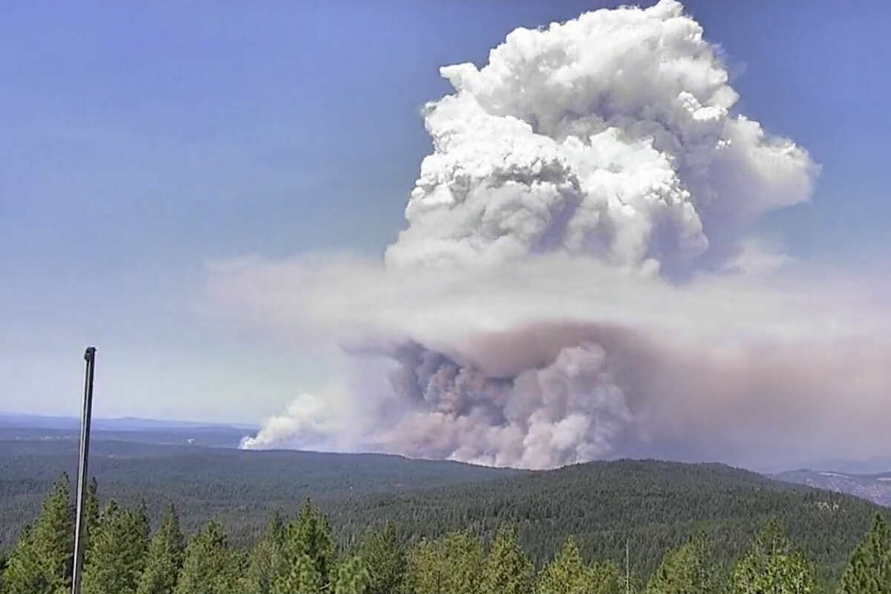
Lessons Learned in 2022
Winding Fire (Yuba County)
Rices Fire (Nevada County)
Mosquito Fire (Placer County)
No atheists in foxholes – people wanted to renew after a fire started! Recording the renewal training was critical.
Need better outreach to the targeted grazing community and out-of-area USFS/BLM permittees.
Crop agriculture in foothills is also impacted.
Relationships are CRITICAL!
Photo: SF Gate

Slide 11
New Frontiers
Statewide Program has raised profile of these programs but has been slow to develop consistent curriculum.
Foothill crop and cannabis producers face similar challenges accessing their operations during evacuations.
Other types of disasters – floods, foreign animal diseases, etc. need to be on our radar.
Nevada County Ag Pass Program
Commercial crop production
Permitted commercial cannabis production
Commercial horse training/breeding operations

Slide 12
Questions?

