Slide 2
4 Issues with the Gas Tax
1. FUEL EFFICIENCY GAINS Gas-powered vehicles are becoming more fuel efficient, so owners are buying less gas and government receives less fuel tax.
2. INCREASE IN ZERO EMISSION VEHICLES Vehicles that do not use gas, such as electric vehicles, do not pay any fuel taxes.
3. INFLATION AND LOSS OF PURCHASE POWER Ongoing inflation reduces how much a static gas tax can purchase. In addition, highway construction costs typically increase faster than overall inflation.
4. UNEVEN FUEL TAX BURDEN Newer and more expensive vehicles tend to be more fuel efficient. Owners of older, less fuel-efficient vehicles pay more to use the road. The fuel tax burden is uneven and inequitable.

Slide 3
What is a Road Charge?
Road Charge is an innovative funding mechanism intended to replace the current gas tax, and more accurately ensures that all drivers are paying their fair share to use the road. Road Charge allows drivers to support local road and highway maintenance based on how many miles they drive, instead of how many gallons of gas they use.
California is studying Road Charge as:
A replacement for the gas tax
One per mile rate for all passenger vehicles
Revenue neutral, not a tax increase
Aims to stabilize funding, not change behavior
No change in how funding is spent: existing formulas and programs remain

Slide 4
What drivers pay under the Gas Tax

Slide 5
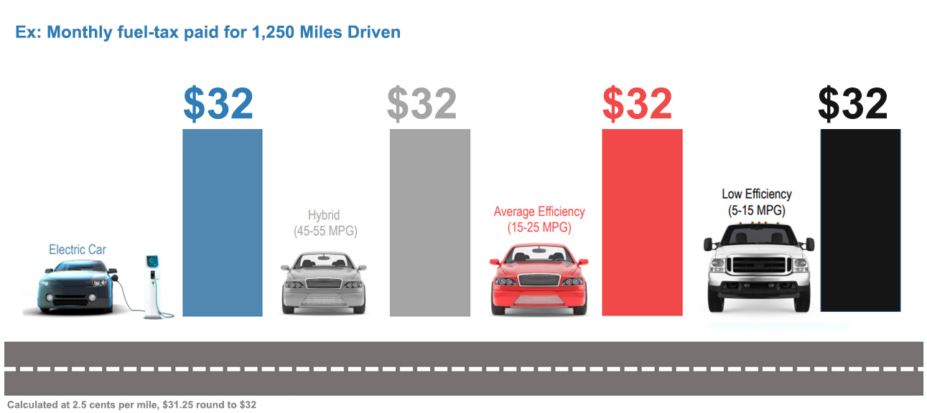
What drivers pay under Road Charge

Slide 6
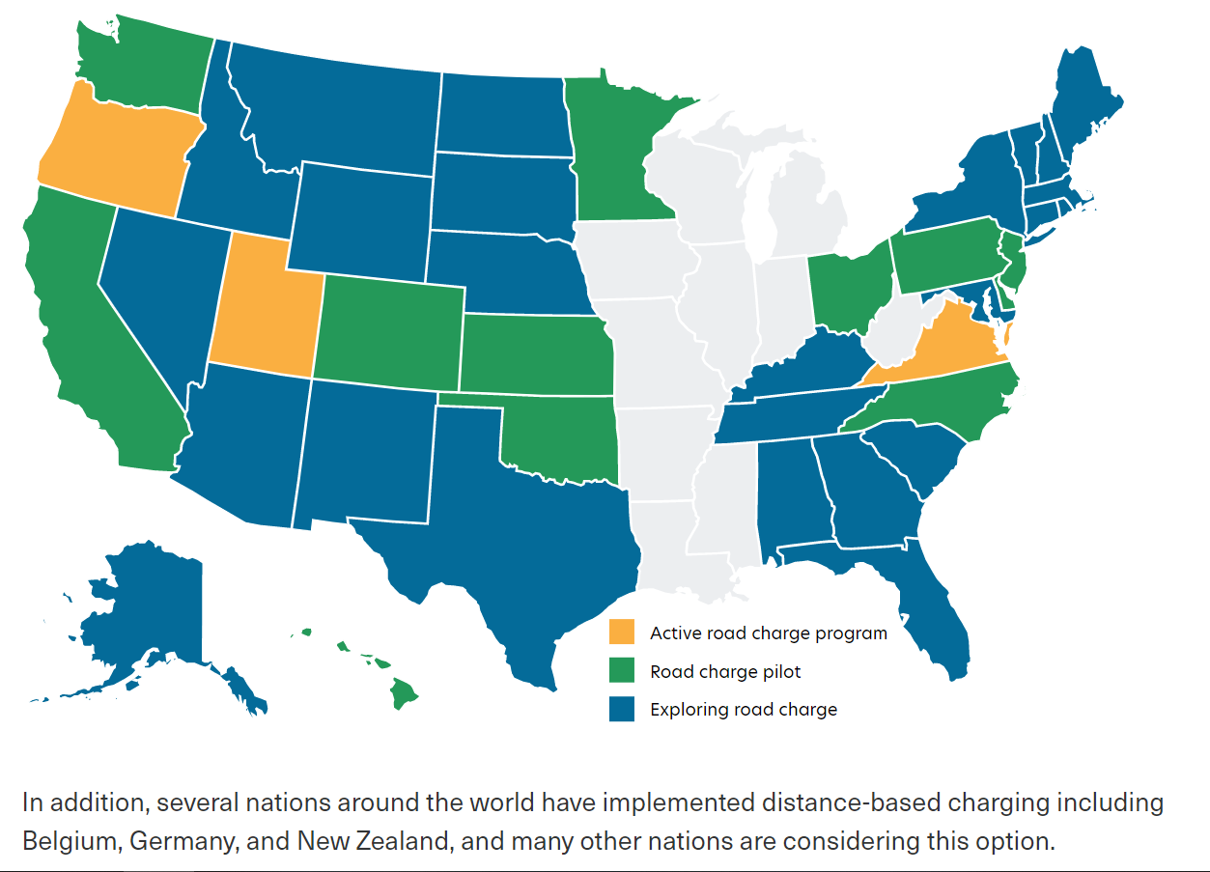
The National Picture

Slide 7
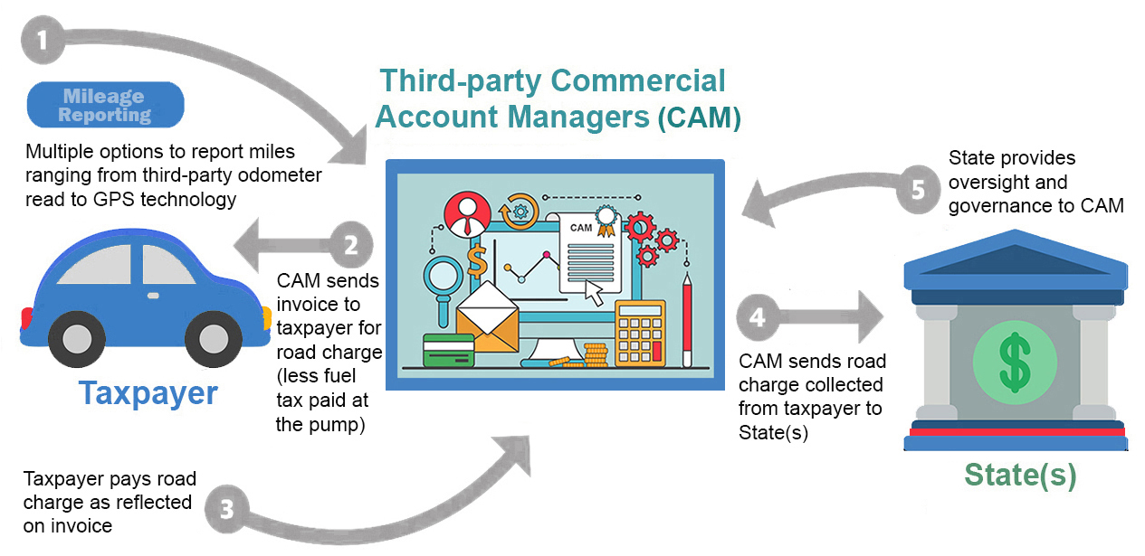
Road Charge System Structure

Slide 8
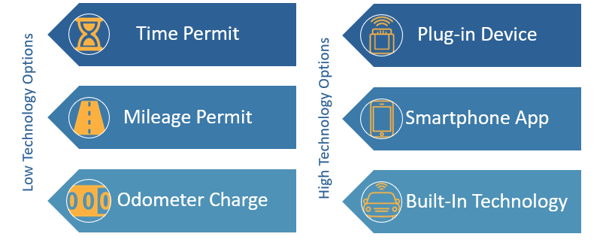
Mileage Reporting Methods

Slide 9
With the Governor’s Executive Order banning the sale of gas-powered vehicles in 2035, can a Road Charge be implemented in time?
Based on the experience of other states, and given the size and complexity of California, we expect the Legislature would want to explore a phased approach to potential implementation.
Such a phased rollout could likely be accomplished in 10-12 years.
As long as ZEVs are transitioned before 2035, there will not likely be long-lasting impacts to revenue.

Slide 10
2017 Road Charge Pilot
The 2017 Pilot was very successful, had high levels of approval among participants, and generally demonstrated the feasibility of a road charge system.

Slide 11
2021 Four Phase Demonstration
Four technology phases to test with road charge integration:
Live from January - June 2021
Key Goals and Objectives: | Fulfill key recommendation form 2017 Pilot Final Report to study Pay at the Pump potential Explore emerging technologies’ ability to provide an easy user experience

Slide 12
Other Projects
RUC West Interoperability Pilot
Caltrans partnered with the Oregon Department of Transportation through RUC West to test a central clearinghouse for processing multi-state road charges.
UC Berkeley Research on Impacts to Disadvantaged Communities
Researchers from the Transportation Sustainability Research Center at UC Berkeley are working with Caltrans to study how a road charge system may impact low-income households and underserved communities across the state. Building upon previous studies, the researchers will conduct surveys and interviews to help understand the potential impacts of road charge on social equity, such as cost, affordability, payment options, and preferred methods for reporting mileage.
RUC West Rural Study Update
California is currently leading an update of a state-by-state analysis of the financial impact to rural drivers in switching to a road charge system.
RUC West Study on Impacts to Super Commuters
California will be leading a study on how a road charge system may impact Californians with long commutes.

Slide 13
Upcoming Pilots
PUBLIC/PRIVATE ROADS PROJECT
The project is the first in the nation specifically focused on engaging rural and tribal communities to understand their concerns and priorities for a road charge system.
This project will explore the ability of current GPS technology to differentiate between public and private roads in a road charge system.
We will partner with the Transportation Corridor Agencies to test a tolling agency as a commercial account manager.
Live in 2023.
ROAD CHARGE COLLECTION PILOT
In 2021, the State Legislature passed Senate Bill 339.
Authorizes CalSTA to implement a pilot program that collects actual revenue from participants, with recommendations from the CTC’s Road Charge Technical Advisory Committee.
Offers an opportunity to test state administrative systems.
Tests two different rate structures.
Live in 2024.

Slide 14
Questions?
Lauren Prehoda Road Charge Program Manager, Caltrans lauren.prehoda@dot.ca.gov 916-654-4227
www.caroadcharge.com

