Slide 2
What is Economic Development?
The process of improving the economy, society, and well being of people. It happens when there is an increase in business output and an improved standard of living. With careful economic development, businesses can thrive, higher levels of employment can be achieved, and industries, in some cases new industries, can grow.
Attraction
Expansion
Retention
How does EDC do economic development?
Business Output
Standard of Living
Unemployment
Vacancy Rates
Marketing
Partnerships

Slide 3
DATA USAGE
We utilize data to target industry sectors (Industry Analysis)
We used wage indicators, employment growth indicators, and contract (neo hire performance) indicators to rank our local industry sectors based on their historical performance within the NEO program.

Slide 4
Industry Rankings
Most recent Year-Over-Year change
Construction;
6.04% establishment growth
4.97% weekly wage growth
6.69% employment growth
Healthcare and Social Assistance;
5.95% establishment growth
2.73% weekly wage growth
3.32% employment growth
Overall Rankings
Construction
Wholesale Trade
Manufacturing
Healthcare and Social Assistance
Retail Trade
Finance and Insurance
Professional, Scientific, and Technical Services
Transportation and Warehousing
Other Services
Accommodation and Food Services
Administrative and Support and Waste Management and Remediation Services
Information

Slide 5
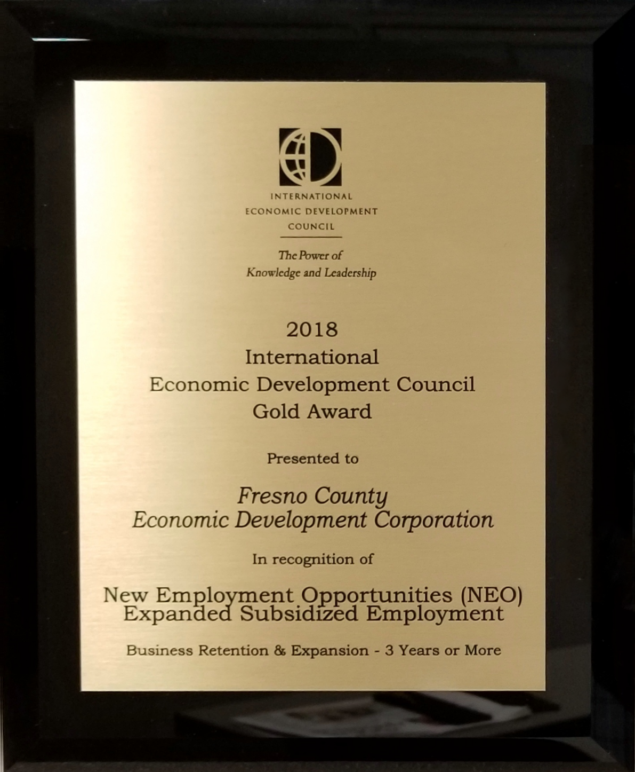
Award winning

Slide 6
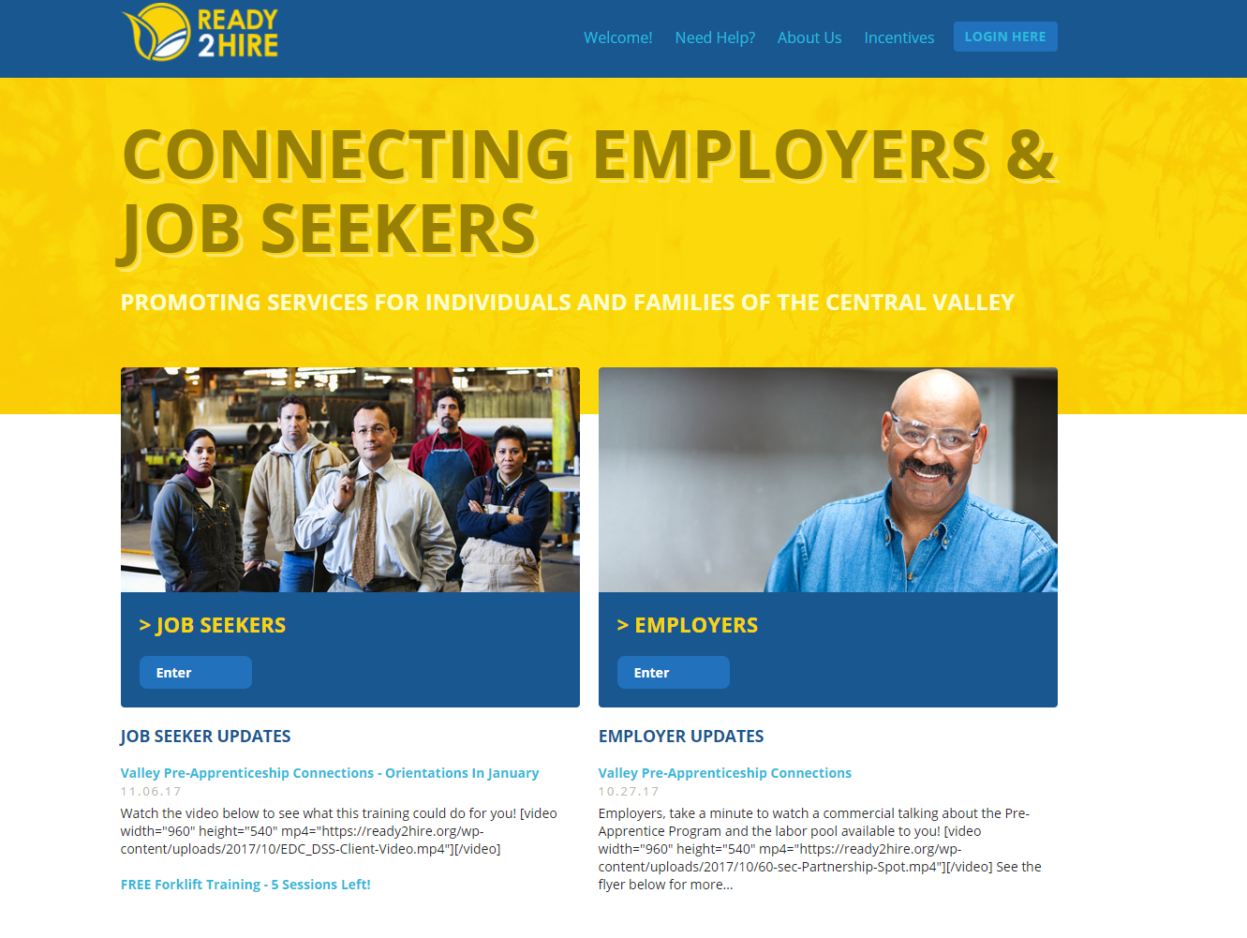
Ready2hire.org
New Employment Opportunity-Expanded Subsidized Employment (NEO-ESE)
Initial 6 Month Placement | Wage Reimbursement
Weeks 1-13 | 100%
Weeks 14-26 | 75%
The NEO Program responds to the needs of enrolled job seekers and provides an incentive to job creators.

Slide 7
NEO
New Employment Opportunities
Businesses Registered | 301
Unsubsidized Businesses | 89
Subsidized Jobs Offered | 1,662
Subsidized Job Placements | 1,504
Training Placements | 264

Slide 8
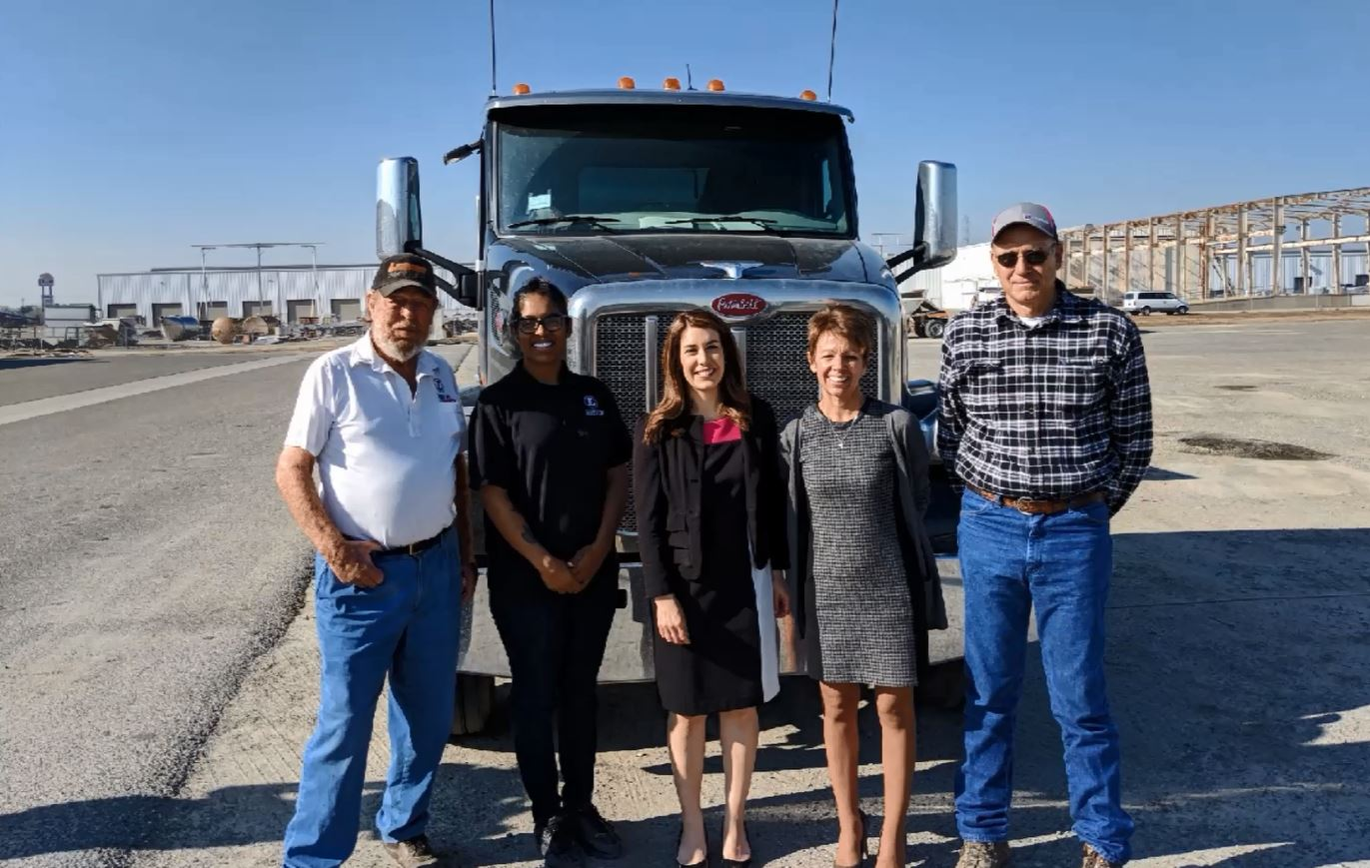
John Lawson, President of Lawson Rock & Oil, a graduate of the truck driving program, Amanda Venegas (ABC 30) and Glen Wills, instructor with the truck drivers training program participate in an ABC 30 news segment on the success of the program. There have been 31 cohorts of the program with over 212 graduates to date.

Slide 9
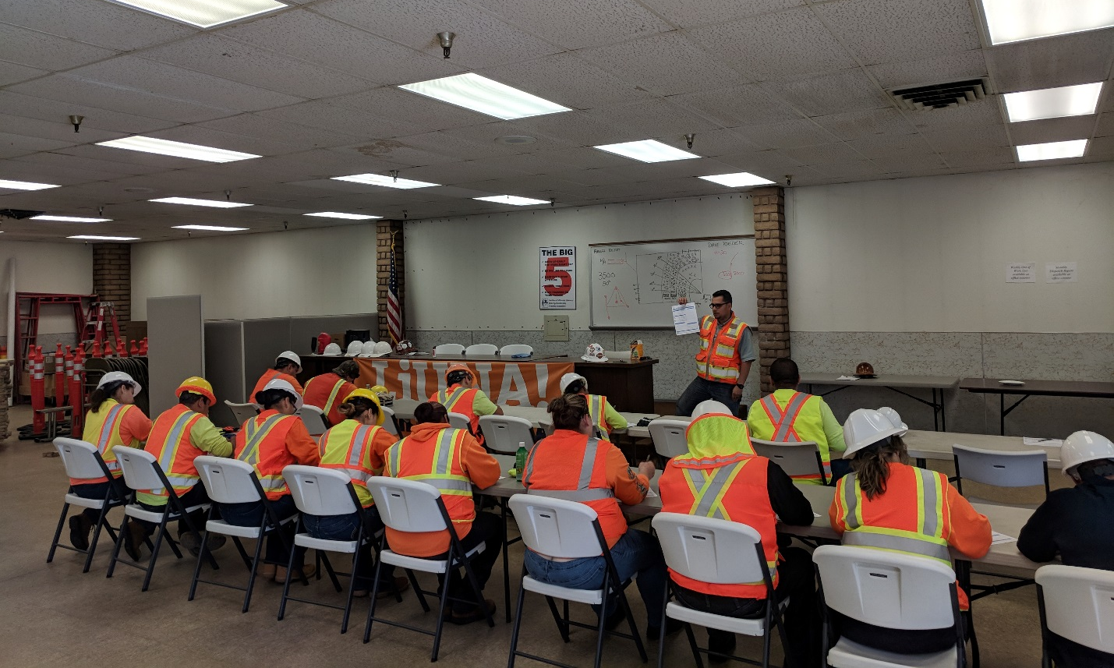
CalWORKs jobseekers participate in the Valley Apprenticeship Connection’s Pre-Apprenticeship program. To date, there have been 9 cohorts with 96 graduates.

Slide 10
Thank You!
fresnocountyedc
Fresno County EDC
fresnoedc
@FresnoEDC
Lee Ann Eager, President & CEO
Contact us at: leager@fresnoedc.com
559-476-2513

