Slide 1
Subsidence: Implications and Effects on Infrastructure
Martin McIlroy, CEG, PE
Principal
Taber Consultants
2015 CSAC 121st Annual Meeting
CEAC Land Use Committee
Wednesday, December 2, 2015

Slide 2
Drought Impacts
Western United States

Slide 3
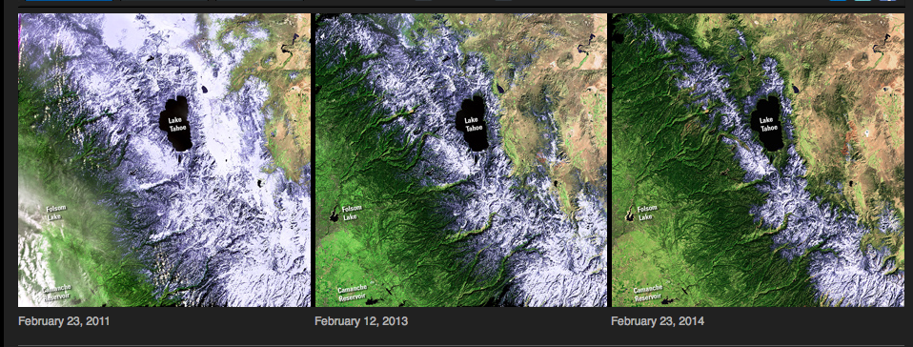
Lake Tahoe Snowpack
2011
2013
2014

Slide 4
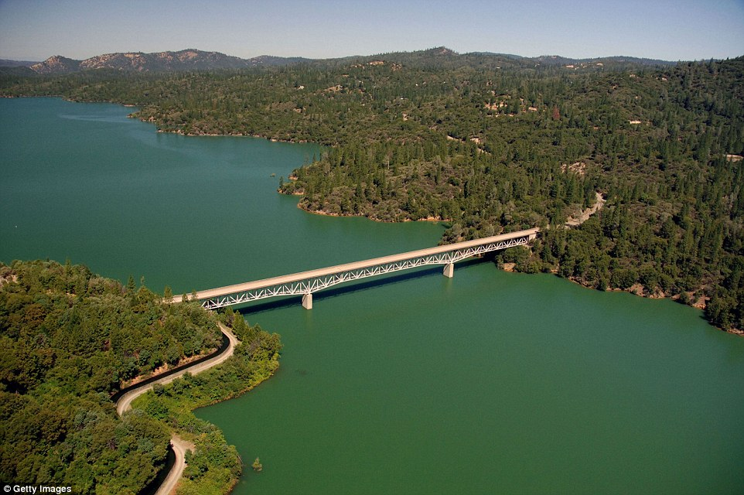
Lake Oroville in 2011

Slide 5
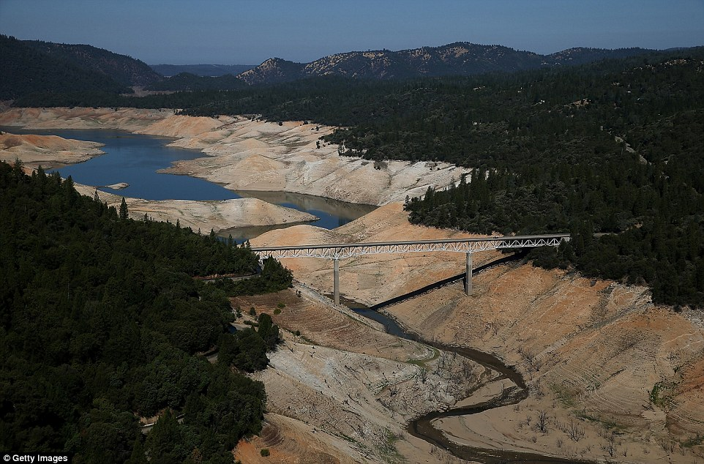
Lake Oroville in 2014

Slide 6
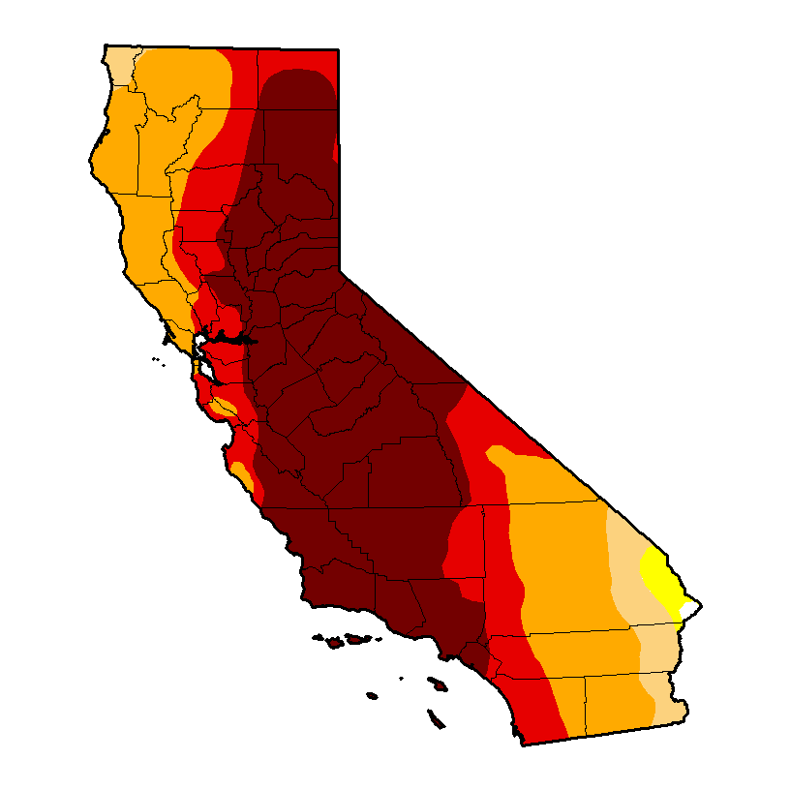
May 2015
California Drought Intensity
Source: USDA United States Drought Monitor

Slide 7
Subsidence
How does this happen?

Slide 8
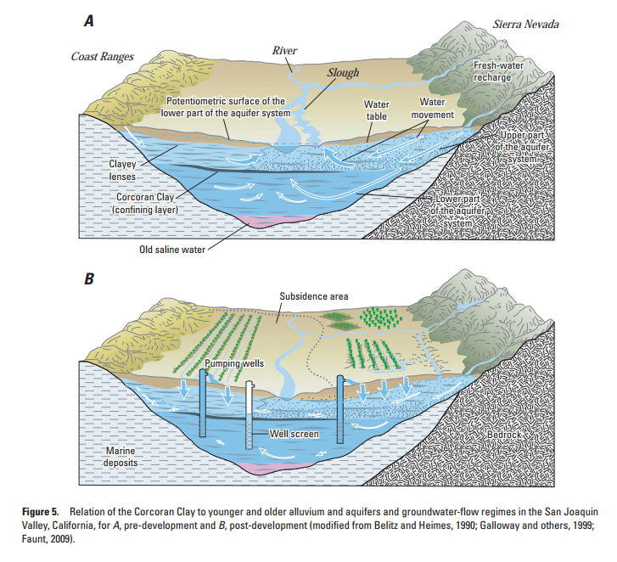
Subsidence Defined
Subsidence is the compaction/compression of unconsolidated and partly consolidated sediments
Causes include
Mining Resources
Water mining
Salt Mining
Gas/Oil

Slide 9
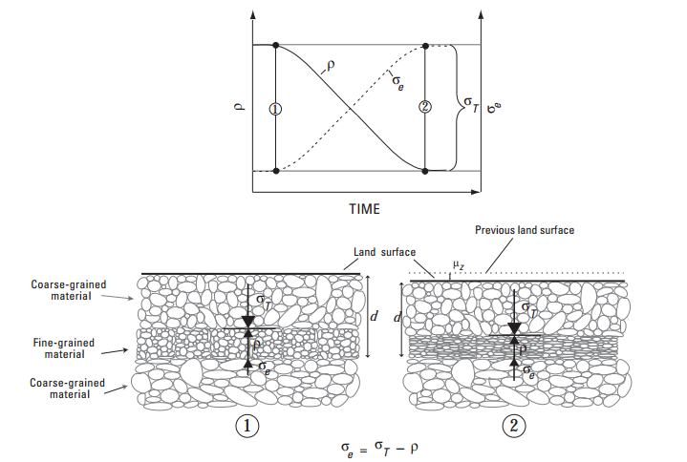
Mechanisms for Consolidation
As water is taken out of the fine-grained and porous layer, the material loses pore-fluid pressure, causing the vertical stress to overcome stasis and compress the fine grained layer.
As a result, the apparent land surface elevation decreases.

Slide 11
CA Groundwater Basins and Water Budget Understanding

Slide 12
San Joaquin Valley and
Groundwater Extraction
Irrigation Groundwater Extraction
In the San Joaquin Valley
Pumpage
(acre-feet
in millions)
Notes:
By 1930, low groundwater levels required pumps to extract water.
By 1955, ¼ of the total groundwater for irrigation in the United States was pumped out of the San Joaquin Valley.

Slide 13
San Joaquin Valley and
Groundwater Extraction
25% of
total US
Groundwater
Pumping
Notes:
By 1930, low groundwater levels required pumps to extract water.
By 1955, ¼ of the total groundwater for irrigation in the United States was pumped out of the San Joaquin Valley.
As the California drought continues, surficial water supply is reduced
Non-drought years 40% of water from groundwater.
Drought years 65% water from groundwater.
Subsidence rates increase -- 1 ft per year last 4 years in valley
Subsidence recovery take decades and may not rebound.
USACE predicts that 17 feet of subsidence will occur in the El Nido bowl in the next 45 years.
ed greatly, forcing us to turn to groundwater pumping.

Slide 14
Subsidence
Examples of Groundwater Pumping, Drawdown and Effects

Slide 15
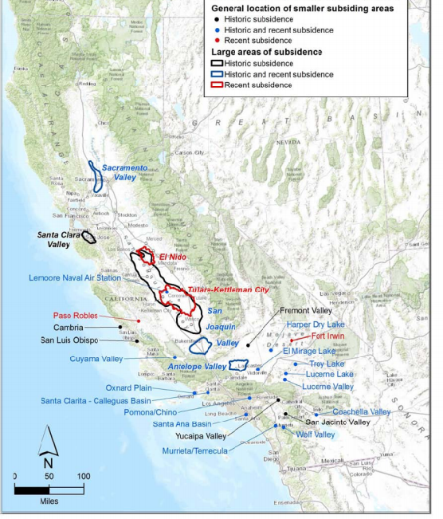
California
Current and
Historic
Subsidence
Locations
Sacramento and San Joaquin Valleys
Central Coast
Antelope Valley
Santa Ana Basin
Mojave Desert
Coachella Valley
Source: Ludhorff and Scalmanini, 2014

Slide 16
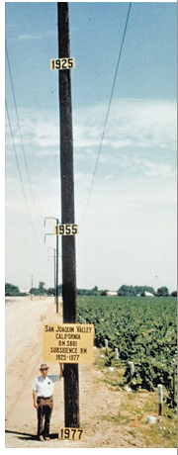
General Effects on Infrastructure
Damages the roads, railways, bridges and pipelines, putting them at risk for structural failure.
Subsidence reduces channel and canal flow capacity and freeboard; increases flooding.
Gravity dams require raising to maintain hydraulics.
Earth fissures can create harm to humans, animals and rapidly damage infrastructure
Constantly changing elevation datum

Slide 17
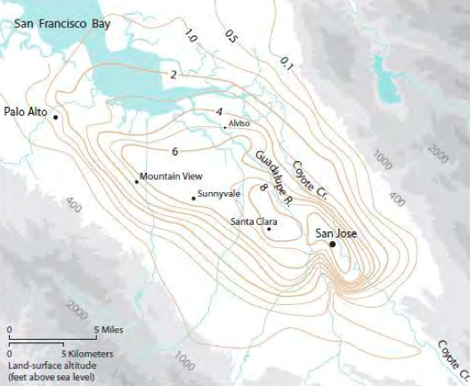
Santa Clara Valley Subsidence
Source: Ludhorff and Scalmanini, 2014

Slide 18
Subsidence: Economically Quantified*
Santa Clara Valley
Water well damage/repair - $35 million.
Sanitary Sewer Pump Stations - $48 million.
Operations - $28 million
Roads/Bridges - $12 million
Bayfront Levees - $305 million
Stream Channels – $32 million
Storm Drainage Pump Stations - $12 million
Operations - $283 million
$756 Million estimated on subsidence remediation.
*2013 Inflation adjusted dollars

Slide 19
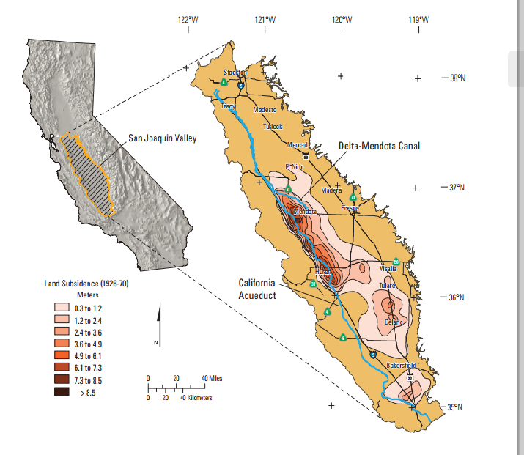
Subsidence as it occurs in the San Joaquin Valley: where?
Notes:
Subsidence has been most damaging to the San Joaquin Valley, centered around Mendota.
Switching from row crops to fruit and nut trees exacerbated subsidence and groundwater pumping.

Slide 20
Subsidence: Economically Quantified*
San Joaquin Valley
Friant-Kern Canal Repairs -- $ 15 million
17 miles, recompaction, raising, new liner, drainage and pumping plants on new foundations, another $25 mil planned upstream
Federal Canals and Drains - $ 88 million
Replacement water wells (300) - $114 million
Delta-Mendota Canal, the Outside Canal, the Friant-Kern Canal, and the San Luis Canal -- $134 million.
San Joaquin Valley incurred ~$1.3 billion from 1955 to 1972.
*2013 Inflation adjusted dollars
Notes:
Subsidence from Tulare to Wasco for Friant-Kern

Slide 21
San Joaquin Subsidence
Capacity Quantified*
5200 sq. mi. area affected by > 1 ft subsidence
Central Valley aquifers lost 125 million-acre feet in capacity since folks settled the Central Valley.
20 million acre-feet lost in last 10 years.
80 million acre-feet lost since 1960.
Quantity equals 4 Lake Mead volumes
$2 billion in repair costs for Santa Clara and San Joaquin Valley alone.
*2013 inflation adjusted dollars
Notes:
Connecticut is 4,800 square miles.

Slide 22
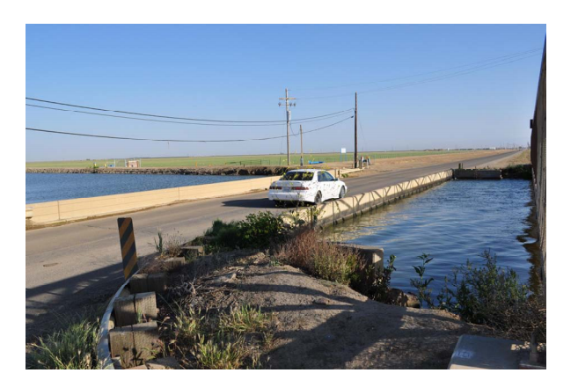
Russell Avenue Bridge at Delta-Mendota Canal: bridge used to be inspected by
boat under the bridge – Replacement estimated $2.5 million

Slide 23
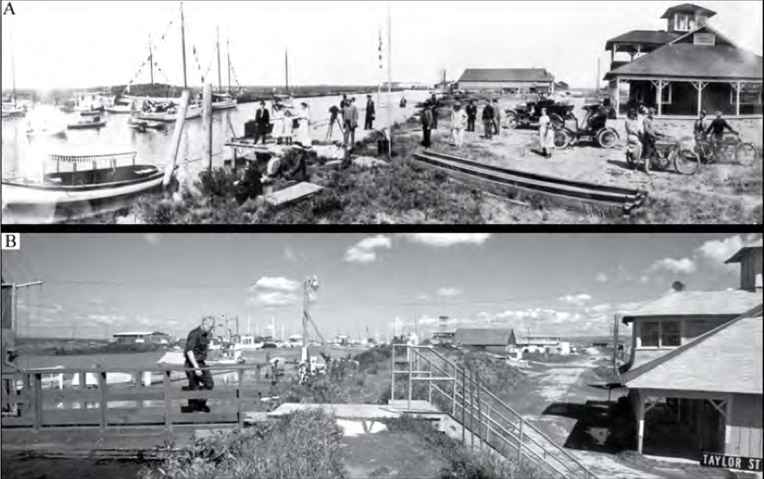
Alviso Yacht Club in southern San Francisco Bay – top 1914 bottom 1987 10-ft of dikes were required due to subsidence of the land below adjacent sea level

Slide 24
Drought and Groundwater Over-pumping Impacts
Degrading groundwater quality
Increased salinity (coastal and delta areas)
Potential increased contamination
Increased electricity costs.
Pumping water from greater depths
2011 City of Fresno - $9 million on electricity
In California, $454 million to pump groundwater during drought

Slide 25
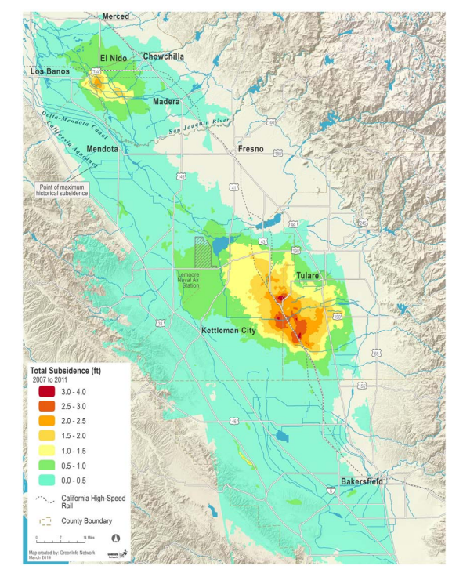
Central Valley
Subsidence
2007 to 2011
Concentrated in new areas
California High Speed Rail

Slide 26
Subsidence
Earth Fissures

Slide 27
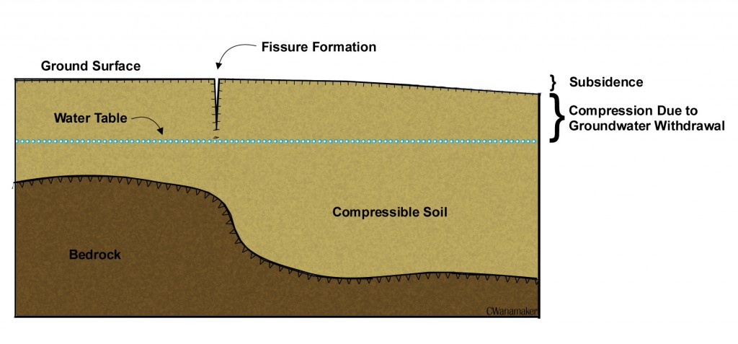
Spontaneous Earth Fissures
Earth fissures are large ground cracks that are formed from differential land subsidence.
Tension cracks are formed and the ground opens.
Can potentially be hundreds of feet deep and miles long.

Slide 28
Spontaneous Earth Fissures Hazards
Cracked and collapsing roads
Broken Pipes and Utilities
Damaged or breached canals
Cracked foundations/separated walls
Livestock and wildlife injury or death
Severed/Deformed railroad tracks
Damaged wells
Deflected/damaged drainage
Surface contamination transport to aquifer
Human injury or death

Slide 29
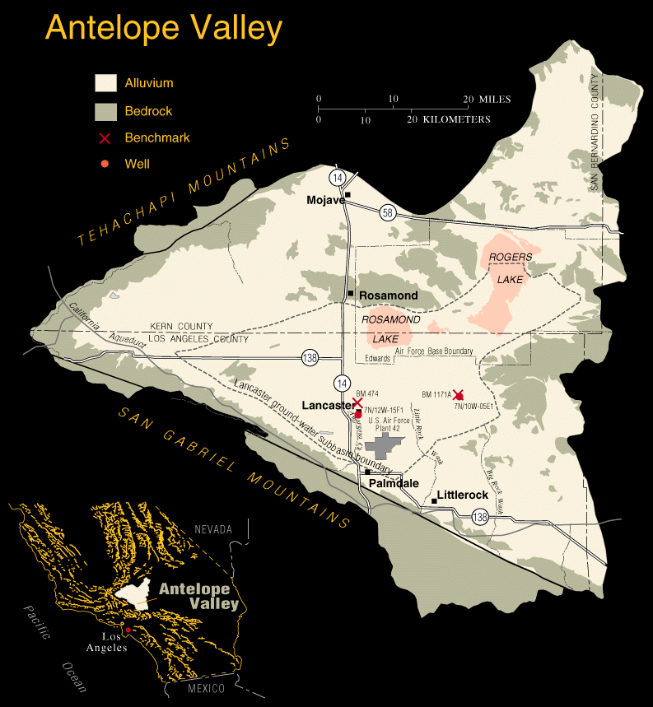
Subsidence: Antelope Valley
90% agricultural and urban use from groundwater.
300 ft decline in groundwater level since 1930s
1,900 foot long x 7.4 foot deep earth fissure opened northeast from Lancaster
Edwards Air Force Base -- sink-like depressions, polygonal cracks, and large fissures on the lake bed of Roger’s lake affected runways.
Subsidence mostly north of Lancaster

Slide 30
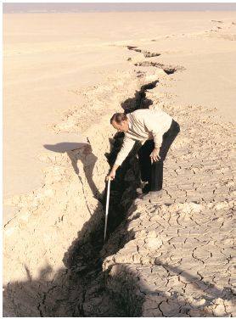
Subsidence: Antelope Valley
Edwards Air Force Base -- sink-like depressions, polygonal cracks, and large fissures on the lake bed of Roger’s lake affected runways.

Slide 31
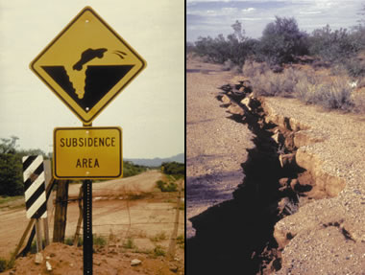

Slide 32
What Do We Do Now?
Management, Conservation and Legislation

Slide 33
Recent California Legislation
2002 – Senate Bill 1938
Prepare and implement a groundwater management plans
monitoring and management of groundwater levels
groundwater quality degradation
subsidence, surface flow changes and surface water quality
2009 – Senate Bill X7 6
authorized CADWR to establish permanent and locally-managed groundwater elevation monitoring for 515 alluvial groundwater basins.
2014 – Sustainable Groundwater Management Act (SGMA)
Three bill package providing the monitoring and reporting framework for local authorities that form of Groundwater Sustainability Agency (GSA)
Adopt sustainability plans in 5 to 7 years with 5 year evaluations
By 2040±, achieve sustainability in high to medium priority basins
2015 – Senate Bill 13 Amending SGMA
Allows DWR to referee GSA applications, overlapping basins and over reach into other basins
Notes:
SGMA Bills
AB 1739 (Dickinson),
SB 1168 (Pavley), and
SB 1319 (Pavley),

Slide 34
What Do We Do Now?
Develop comprehensive basin management plans
Defining subsurface geology is key
Increase basin water budget understanding
Identify safe yield of each basin
Model aquifer properties
Local districts use existing USGS, DWR and other agency data
Develop subsidence monitoring networks
Provide funding for oversight and expertise

Slide 35
What Do We Do Now?
Plan for Subsidence?
Increased freeboard requirements for infrastructure?
Increase planned maintenance budgets, how?
Develop requirements for well permits
Stanislaus County
groundwater modeling and sustainability

Slide 36
What Do We Do Now?
Groundwater Recharge and Storage?
Recharge Injection Wells/Recharge Ponds
Complications with SWRCB Resolution 68-18 (non-degradation policy)
$900 to $1,100 per acre-foot
Develop Storage
Raising Dams/Expanding Reservoirs
$1,700 to 2,700 per acre-foot
Reverse Osmosis/Desalinization
Convert sea or brackish water for recharge
$1,900 to over $3,000 per acre-foot
Increased gray water usage
Notes:
Stanford Study is the basis for the Groundwater costs numbers

Slide 37
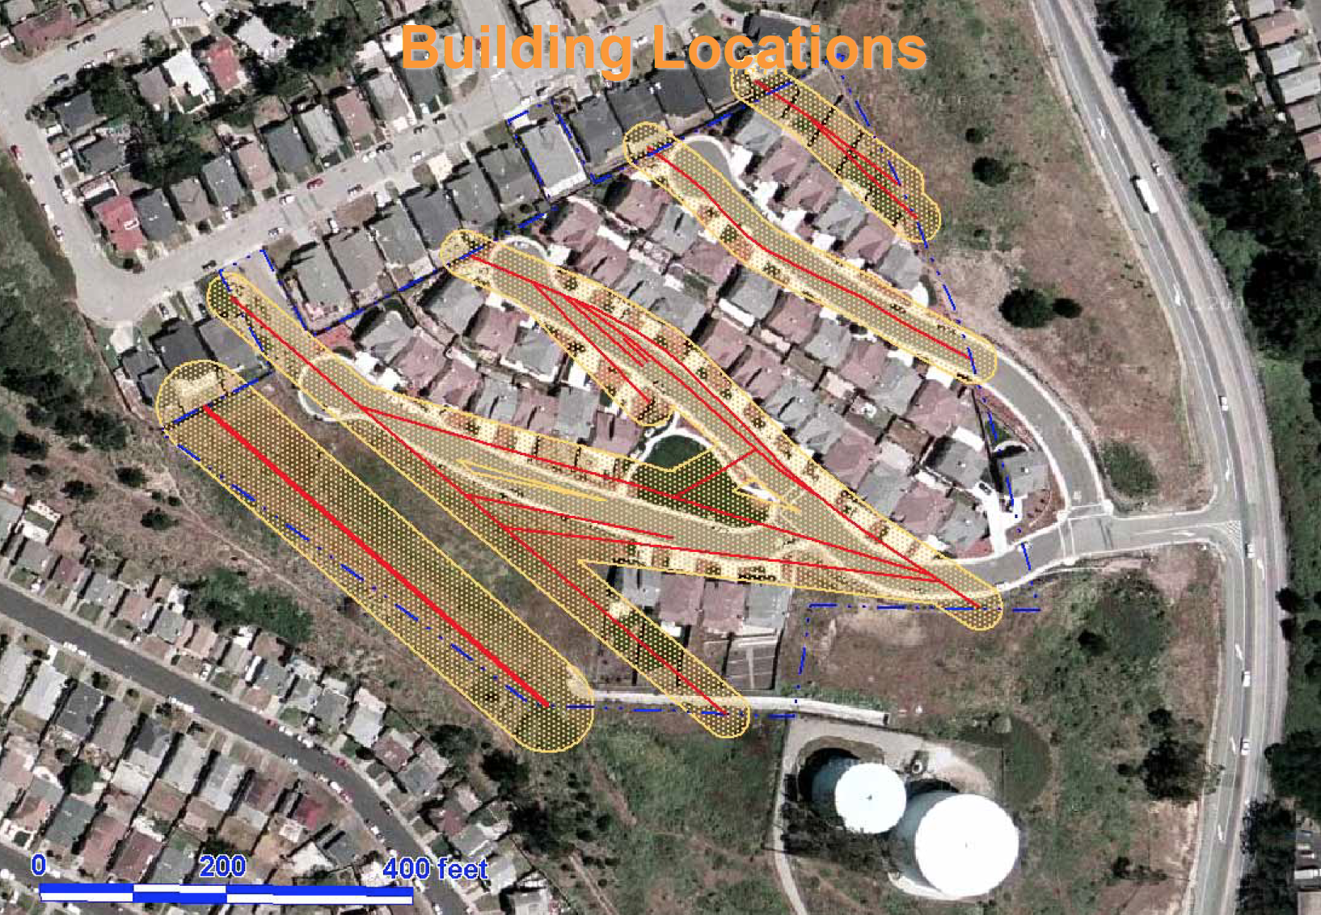
What Do We Do Now?
Alquist Priolo
Source: Ludhorff and Scalmanini, 2014
Notes:
Stanford Study is the basis for the Groundwater costs numbers

Slide 38
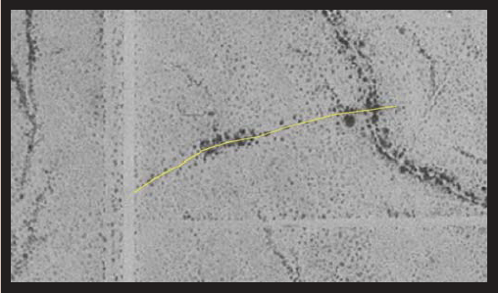
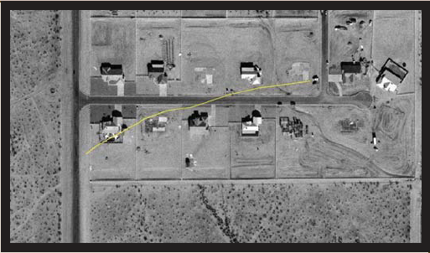
What Do We Do Now?
Source: Arizona Geological Survey
Notes:
Stanford Study is the basis for the Groundwater costs numbers

Slide 39
What Do We Do Now?
Land Use Strategies
Develop geologic hazard criteria
Avoid/mitigate problem areas
Staff education and data repository
Work with other agencies to develop minimum study and reporting criteria
CGS Publications SP 42, SP 117, etc.
Arizona Land Subsidence Group
Technical Advisory Committee
Still requires a sustainable groundwater plan
Notes:
Stanford Study is the basis for the Groundwater costs numbers

Slide 40
Online Resources
Understanding California’s Groundwater
http://waterinthewest.stanford.edu/groundwater/
Groundwater Ambient Monitoring and Assessment Program (GAMA)
http://www.waterboards.ca.gov/gama/
USGS California Water Science Center
http://ca.water.usgs.gov
California Water Foundation
http://californiawaterfoundation.org
California Department of Water Resources – Groundwater Page
http://www.water.ca.gov/groundwater/
For a PDF Copy of the Slides, Email: mmcilroy@taberconsultants.com
Notes:
Stanford Study is the basis for the Groundwater costs numbers

Slide 41
Online Resources
Water Availability and Use Pilot: Methods Development for a Regional Assessment of Groundwater Availability, Southwest Alluvial Basins, Arizona
http://pubs.usgs.gov/sir/2011/5071/
Arizona Department of Water Resources
http://www.azwater.gov/azdwr/
http://www.azwater.gov/AzDWR/IT/Groundwater.htm
USGS Water Data for Nevada
http://waterdata.usgs.gov/nv/nwis/nwis
State of Nevada Division of Water Resources
http://water.nv.gov
For a PDF Copy of the Slides, Email: mmcilroy@taberconsultants.com
Notes:
Stanford Study is the basis for the Groundwater costs numbers

Slide 42
Questions?
Notes:
Stanford Study is the basis for the Groundwater costs numbers

Slide 43
Selected References
Association of California Water Agencies – Sustainable Groundwater Management Act of 2014 Fact Sheet, http://www.acwa.com/sites/default/files/post/groundwater/2014/04/2014-groundwater-fact-sheet.pdf, accessed October 14, 2015.
Association of California Water Agencies – Sustainable Groundwater Management Act of 2014 website, http://www.acwa.com/content/groundwater/groundwater-sustainability, accessed multiple dates 2015.
Bryant, William, Alquist Priolo Earthquake Fault Zoning Act, Surface Fault Displacement Workshop, Berkeley, California, May 20-21, 2009
Department of Water Resources, Sustainable Groundwater Management Website, http://www.water.ca.gov/groundwater/sgm/index.cfm, accessed October 14, 2015.
Harris, Ray and Allison, M. Lee, Hazardous Cracks Running through Arizona, Geotimes, August 2006, pgs. 24-27
Luhdorff and Scalmanini, Land Subsidence from Groundwater Use in California, April 2014
Arizona Geological Survey, Land Subsidence and Earth Fissures in Arizona, Arizona Land Subsidence Group, Contributed Report CR-07-C, December 2007.
Notes:
Stanford Study is the basis for the Groundwater costs numbers

