Slide 1
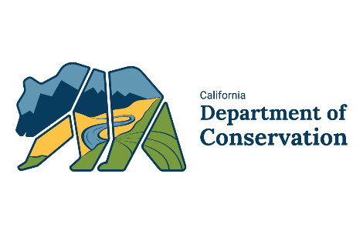
California Geological Survey
  Overview of CGS Products and Activities for Seismic Mitigation
  Timothy Dawson
  Senior Engineering Geologist
  California Geological Survey
  (650) 350-7307
  Timothy.Dawson@conservation.ca.gov
California State Association of Counties
Regional Meeting – Santa Rosa, CA
October 10, 2019

Slide 2
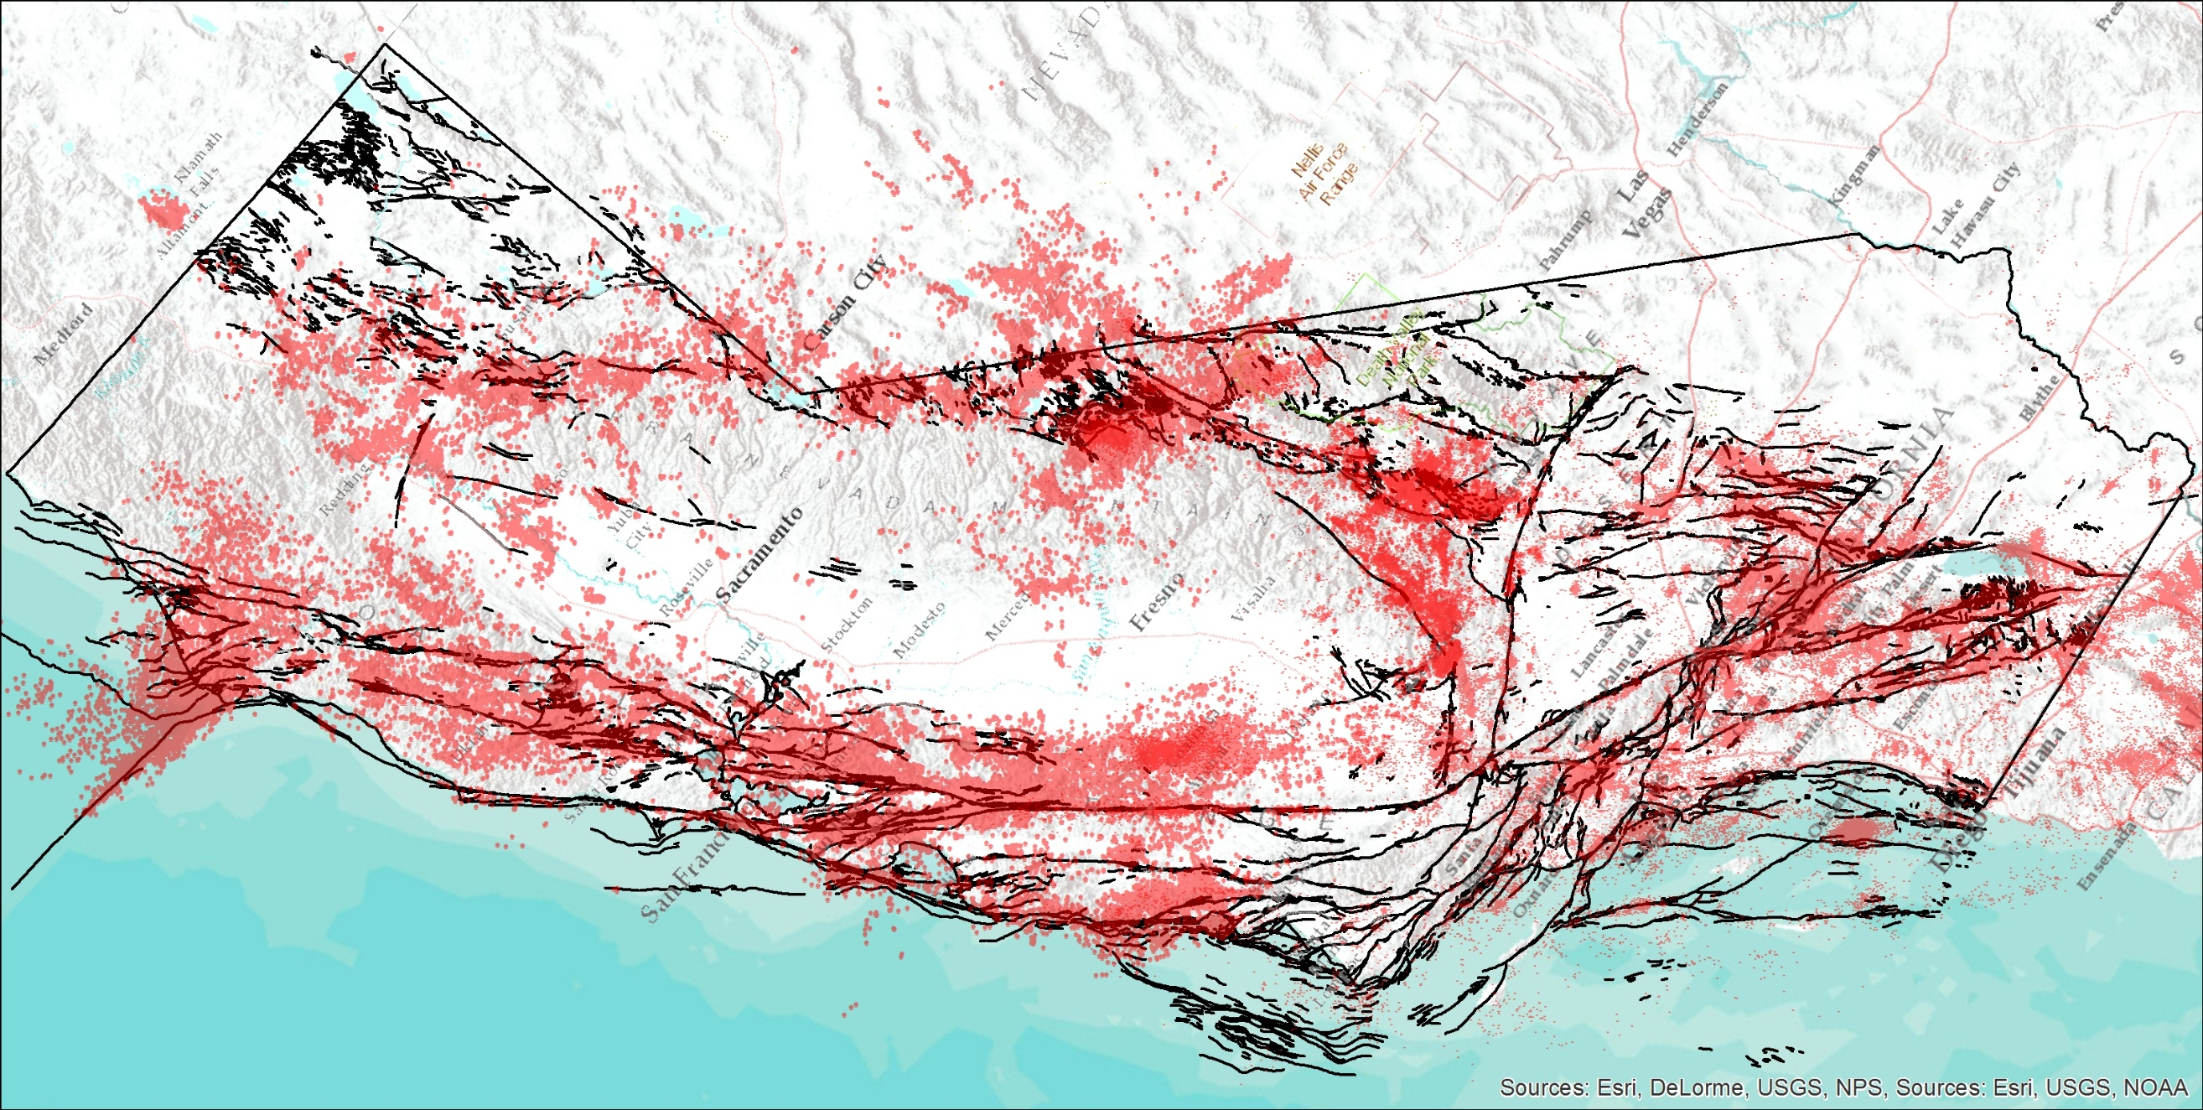
California is Earthquake Country

Slide 3
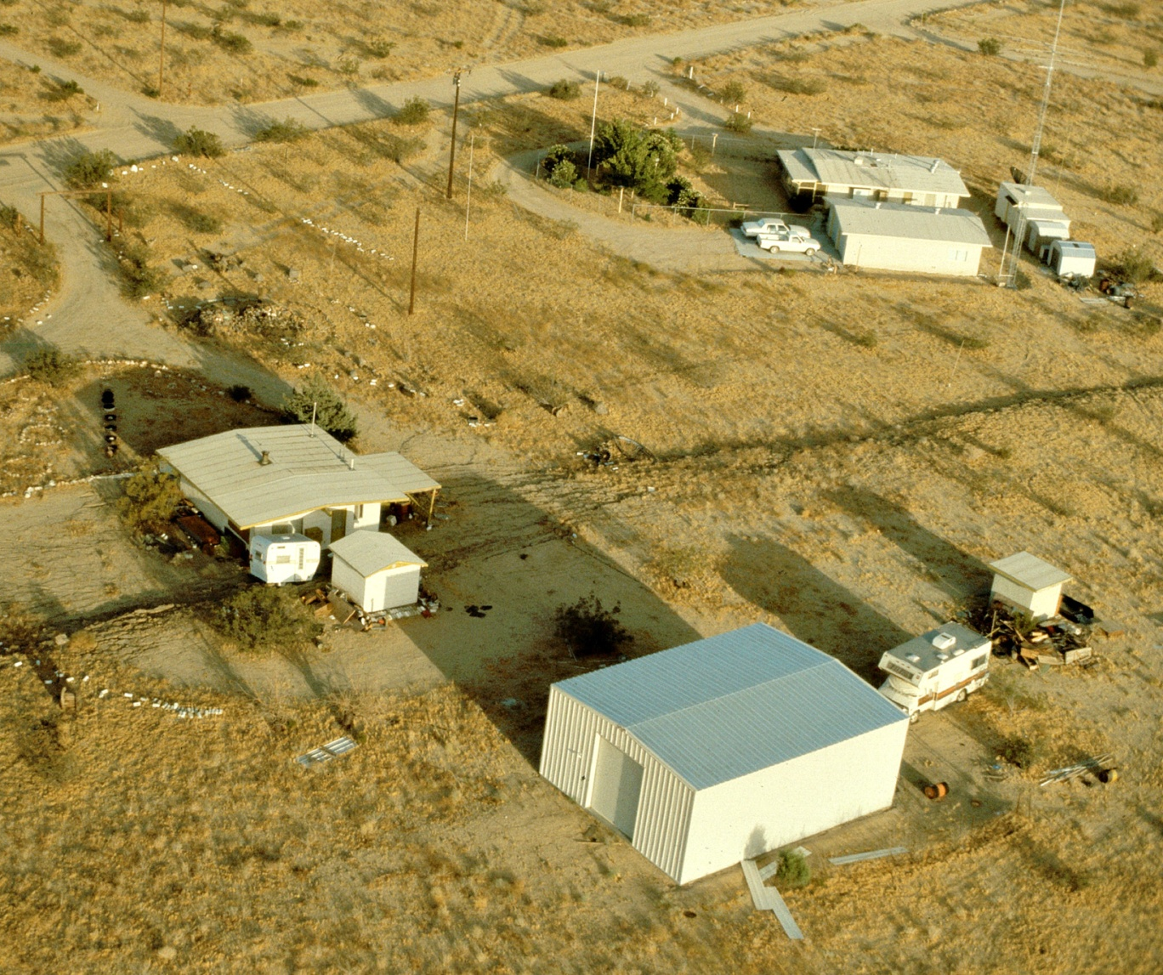
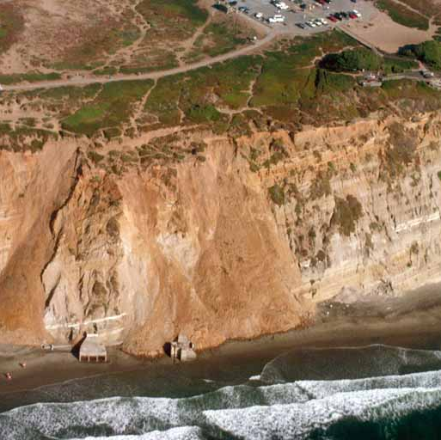
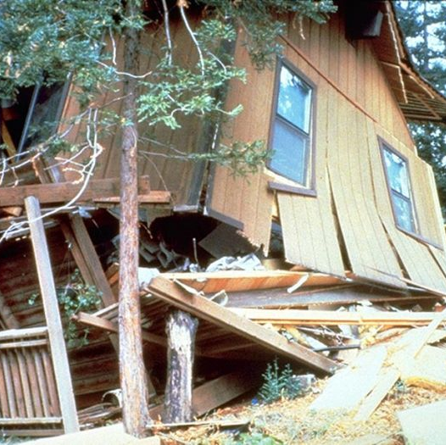
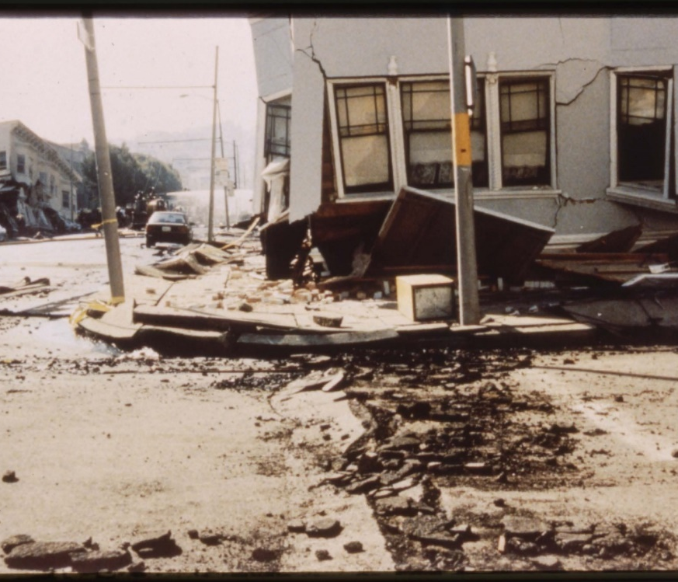
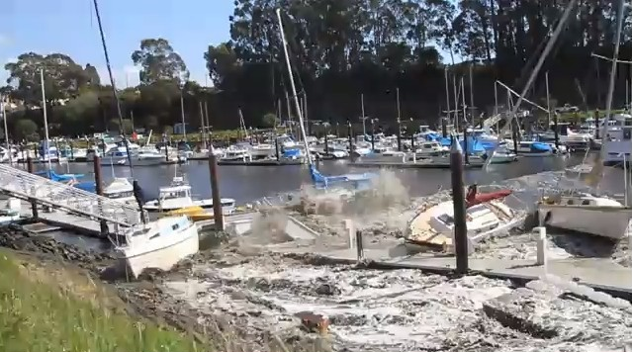
California Seismic Hazards
Strong ground motion (California Building Code)
Surface fault rupture (Alquist-Priolo (A-P) Earthquake Fault Zoning Act)
Liquefaction (Seismic Hazards Mapping Act)
Earthquake-induced landslides (Seismic Hazards Mapping Act)
Tsunamis (Seismic Hazards Mapping Act)

Slide 4
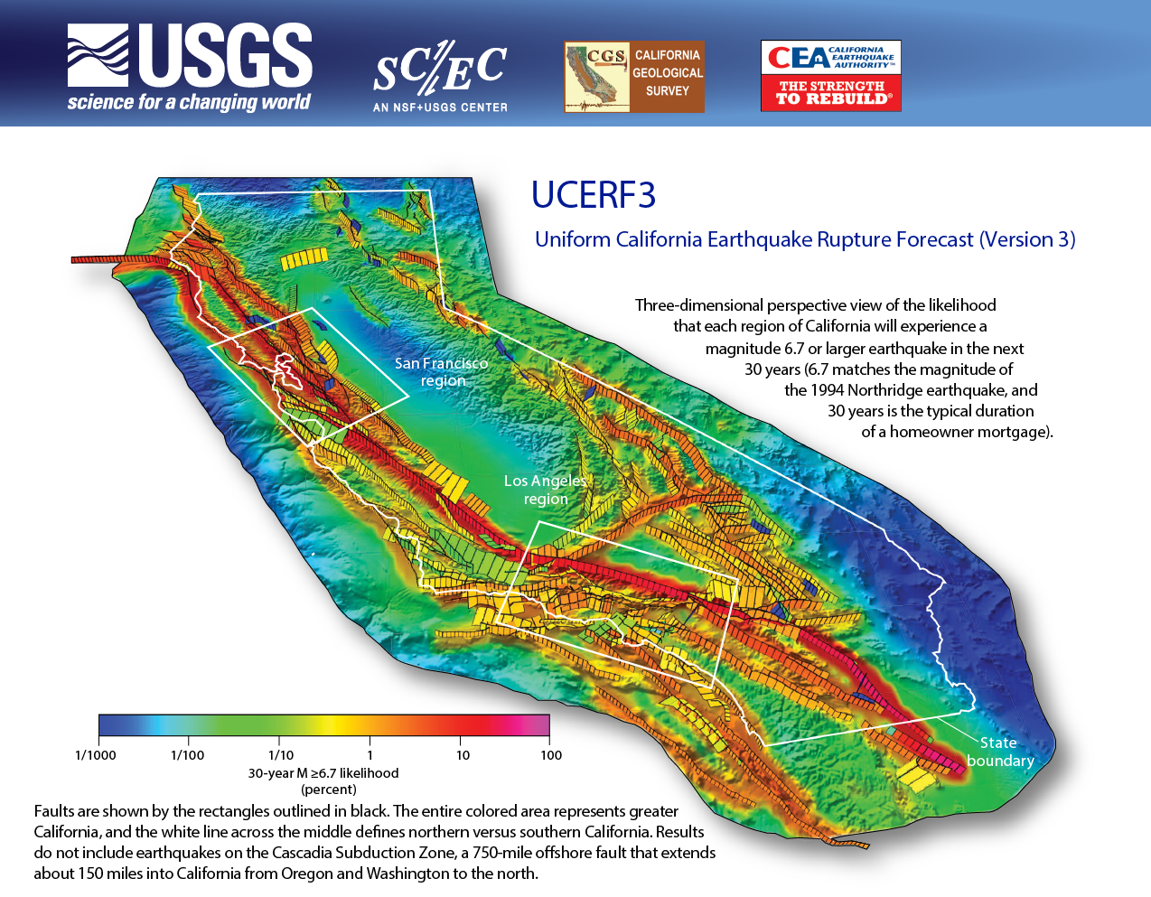
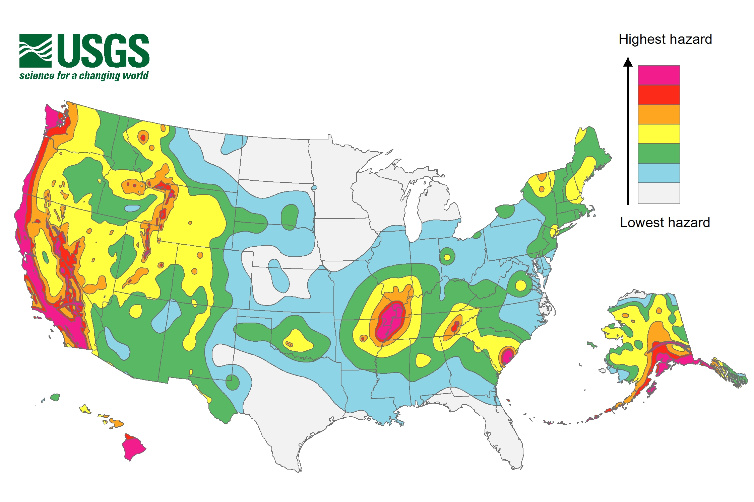
Earthquake Rupture Forecasts and Seismic Hazard Maps
Earthquake Rupture Forecasts: Probability of how often and where large earthquakes are expected
Seismic Hazard Maps: Probability of expected shaking (root cause of damage), feeds into building design.

Slide 5
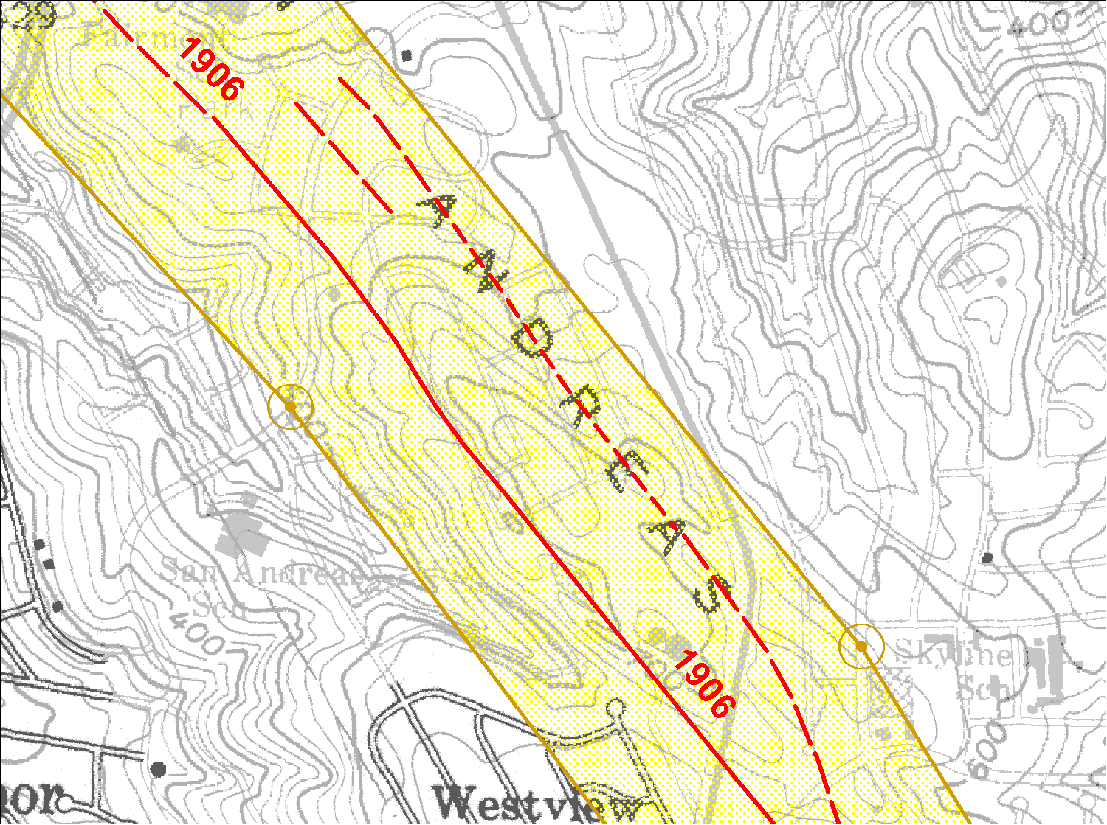
Seismic Ground Failure Zonation
Alquist-Priolo Earthquake Fault Zoning Act of 1972
Seismic Hazards Mapping Act of 1990
Surface fault rupture
Liquefaction and seismically-induced landslides, tsunami inundation zones

Slide 6
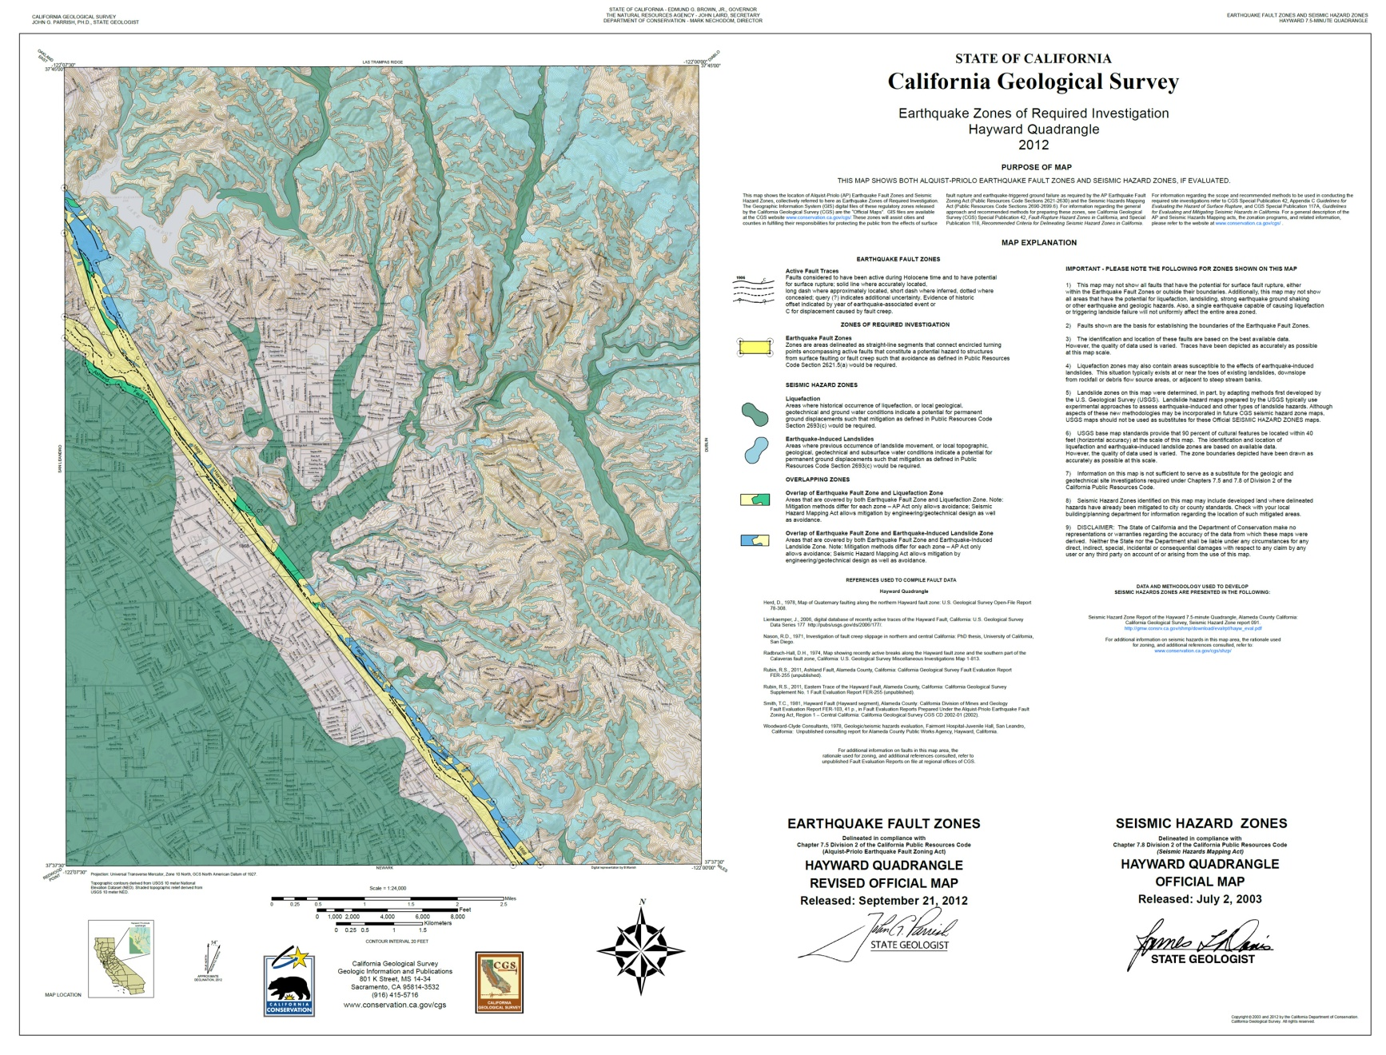
Example of Earthquake Zone of Required Investigation Map
Regulatory Earthquake Zones of Required Investigation for earthquake ground deformation.
Includes:
Earthquake Fault Zones (A-P Zones)
Seismic Hazards Zones (liquefaction and earthquake-induced landslides). Coming soon: Tsunami Zones
Developments must conduct fault investigations within these zones prior to development.
If a hazard is identified at the site-specific level, it must be mitigated.
Notes:
These maps show where site-specific geological and geotechnical studies are required prior to development.

Slide 7
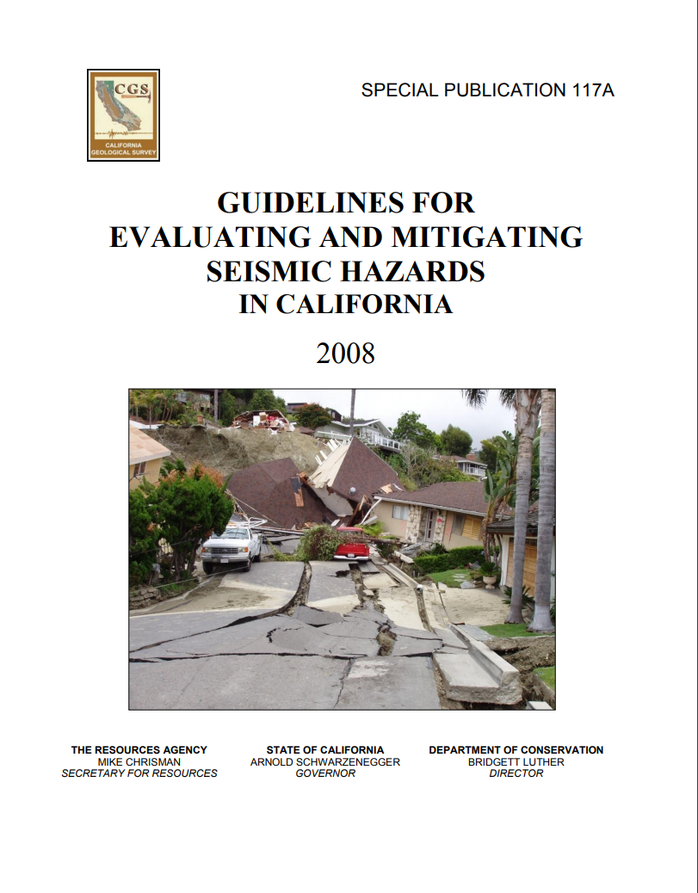
Guidance Documents
Special Publication 42
Special Publication 117
Special Report 241
Notes:
Guidance to CGS on best approaches to delineate zones was published internally in 1992, as required by the Act, and then officially in 1999 as SP 118 after SHMAAC input. These guidelines were last updated in 2004.
Guidelines for lead agency reviewers and consulting engineers and geologists was published first in 1997 as SP 117, and revised in 2008. The release of SP 117 was significant because for the first time there was a document that presented best practices in evaluating and mitigating seismic hazards throughout the state. It emphasized the importance of lead agency review of engineering geology and geotechnical reports by engineering geologists and geotechnical engineers, and presented information on how investigations should be conducted and reports prepared.
SHMAAC was intent on informing lead agencies on the state-of-the-practice yet was purposely cautious in not being too specific to avoid creating “underground regulations.”
A result of that caution was that the city and county of Los Angeles convened their own technical committees under the auspices of SCEC and ASCE to provide more definitive guidance for the review of geotechnical investigations that address seismic hazards and mitigations. The “Implementation Committee” documents were released in 1999 for liquefaction and 2002 for landslides hazards.

Slide 8
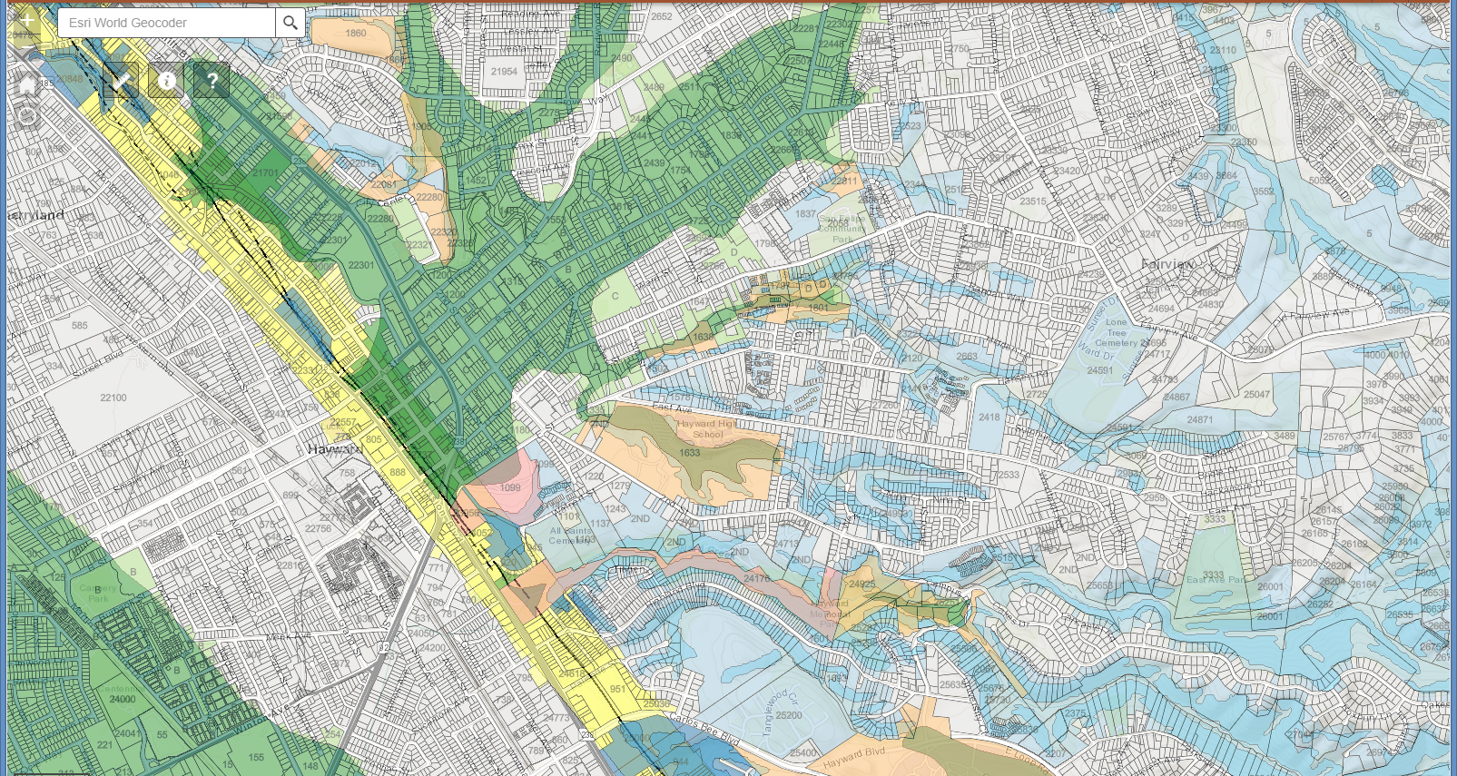
EQ Zapp
Free Online Application for
Earthquake Fault Zones and Seismic Hazard Zones
https://maps.conservation.ca.gov/cgs/EQZApp/app/
(or Google “EQZapp)

Slide 9
Some other CGS products
Statewide Landslide Database
http://maps.conservation.ca.gov/cgs/lsi/
Geologic Map of California
http://maps.conservation.ca.gov/cgs/gmc/
Fault Activity Map of California
http://maps.conservation.ca.gov/cgs/fam/
Historic Earthquakes and Felt Effects
http://maps.conservation.ca.gov/cgs/historicearthquakes/
Landslides & Fires
http://maps.conservation.ca.gov/cgs/firelandslide/
Information Warehouse
http://maps.conservation.ca.gov/cgs/informationwarehouse/
Notes:
NATE

Slide 10
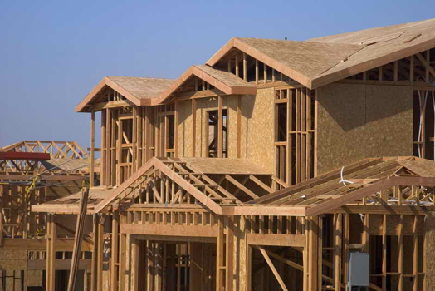
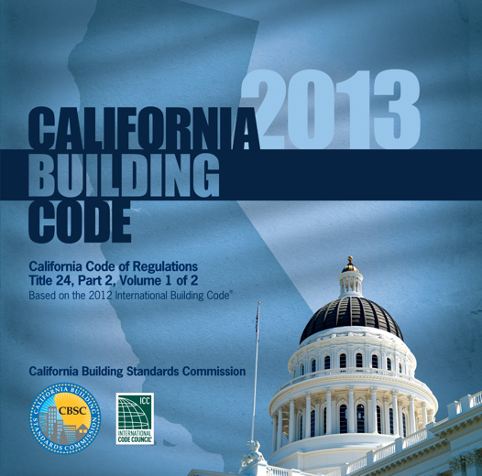
Good News: California Buildings
Are (Mostly) Well-Built
Woodframe homes do very well
School construction carefully monitored since 1933
Steadily improving building codes
Highly trained and licensed engineers and contractors
Slide courtesy of Mark Benthein (Earthquake Country Alliance)

Slide 11
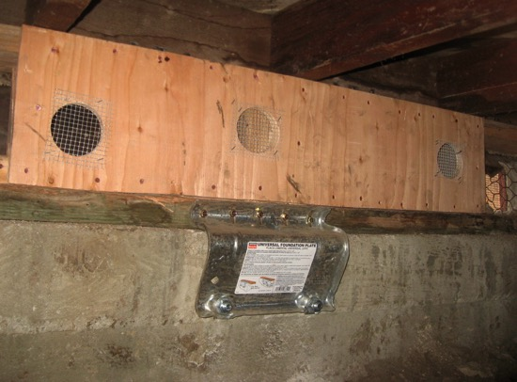
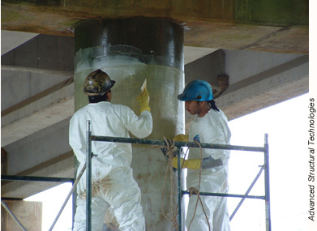
Older Buildings & Infrastructure
Many cities require retrofit of vulnerable buildings
California Earthquake Authority offers home retrofit incentives
www.earthquakebracebolt.com
Freeway bridges are retrofitted
Extensive work underway by water, power, and other utilities
Slide courtesy of Mark Benthein (Earthquake Country Alliance)

Slide 12
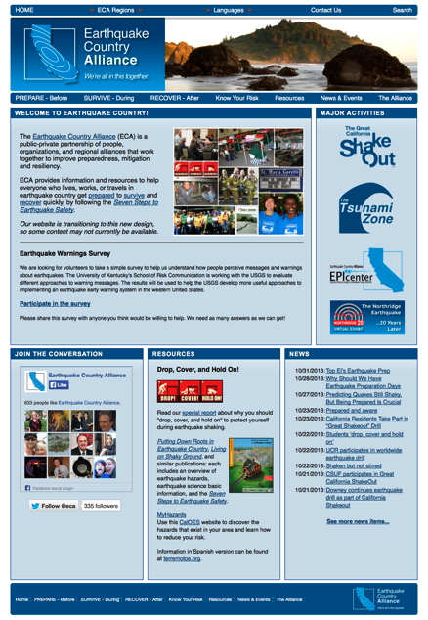
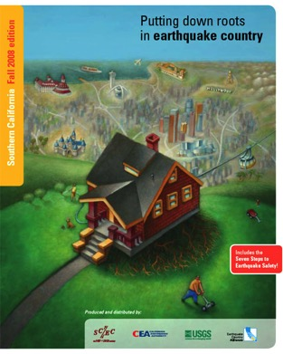
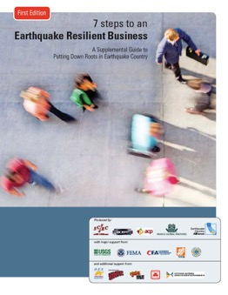
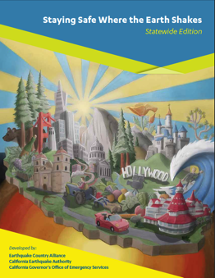
EarthquakeCountry.org
  Seven Steps to Earthquake Safety
  www.EarthquakeCountry.org/sevensteps
  Hazard and Risk Information
  www.EarthquakeCountry.org/risk
  Downloadable resources
  www.EarthquakeCountry.org/resources
  Join the ECA:
  www.EarthquakeCountry.org/alliance
  En Español:
  www.Terremotos.org
Slide courtesy of Mark Benthein (Earthquake Country Alliance)

Slide 13
THANK YOU
Questions?
Tim Dawson
Timothy.Dawson@conservation.ca.gov

Slide 14
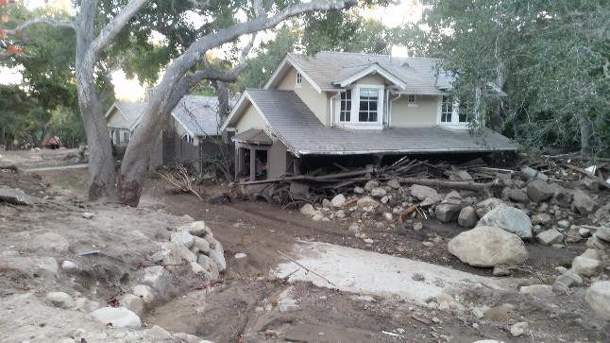
Wildfire Disaster Preparedness
Watershed Emergency Response Teams (WERT) helps communities prepare after wildfire by rapidly documenting and communicating post-fire risks to life and property posed by debris flow, flood, and rock fall hazards
The WERT teams are comprised of experts from: CAL FIRE, DOC-CGS and DWR/Waterboards
Typical analysis takes one to two weeks
  DOC Project Leads: Bill Short and Jeremy Lancaster, California Geological Survey

