Slide 1
SACRAMENTO HOMELESS SHELTERING INITIATIVES
Presentation to State Council on Homelessness
September 6, 2019
Lisa Bates
Sacramento Steps Forward
John Foley
Self Help Housing

Slide 2
CITY PRIORITIES FOR SHELTERING
Establish as many shelter beds as quickly as possible
Maintain existing sheltering programs that serve diverse populations
2
4
1
Establish shelter beds scattered throughout the City of Sacramento
Use available funds quickly and efficiently
3

Slide 3
2019 Point in Time Count
5,570 individuals experiencing homelessness
2,900 individuals unsheltered
490 available shelter beds in City
Need
Goal: 800 New City Shelter Beds
100-185 beds in repurposed downtown hotel
200 beds in two sprung shelter locations
12 beds at LGBT shelter
20 Host Homes for youth
80 new scattered site beds
Shelter
Initiative
Housing
Rehousing services for each shelter
600 new Flexible Housing Program “slots”
Notes:
Of the $36.6 million, $24 million has already been committed to new programs, addressing three critical components of the homeless system of care.
An additional $4.2 million is set aside for system improvements, investing in existing shelters and administration, leaving $8.2 million available for Council to direct to new projects.

Slide 4
CASE STUDY #1- RAILROAD SHELTER 200 Beds
Lowering Barrier
Housing First
Co-location of
on-site support services
Expanding Hours of Operations
Approach/Key Partners
Outreach
Enrollment through referral
Positive community impact
Connection to services
VOA
Pathways to Health + Home
Downtown Streets Team
Front Street Animal Shelter
Served
658 unduplicated guests
67% from within 1.5 miles of shelter
86% living with disabling condition
50% over age 50
98% below State poverty
25% enrolled with one or more pets
61% at least one year of continual homelessness
Exits/Costs
40% exited to non-unsheltered destination
27% unsheltered
28% other/unknown
Monthly cost per person: $1,055
Funding Sources: 44% Public and 56% Private
Total cost: $6,615,532
Notes:
Non-Unsheltered: Permanent housing, temporary housing, transitional housing, other homeless service
Public Funds: City General Funds and Measure U Rollover $2,877,324
Private Funds: Sutter Health, Dignity Health, UC Davis $3,738,208
TOTAL: $6,615,532

Slide 5
TAKE AWAYS
Lessons Learned
Continuing Challenges
Value of Partnerships
Community Support
Attention to Design and Community Concerns
Funding Availability
Necessity for Transparency and Accountability
Ability to Reach the “Hard to Reach”
Commitment to Reach the “Hard to Reach”
Buy-in for Low Barrier Shelters

Slide 6
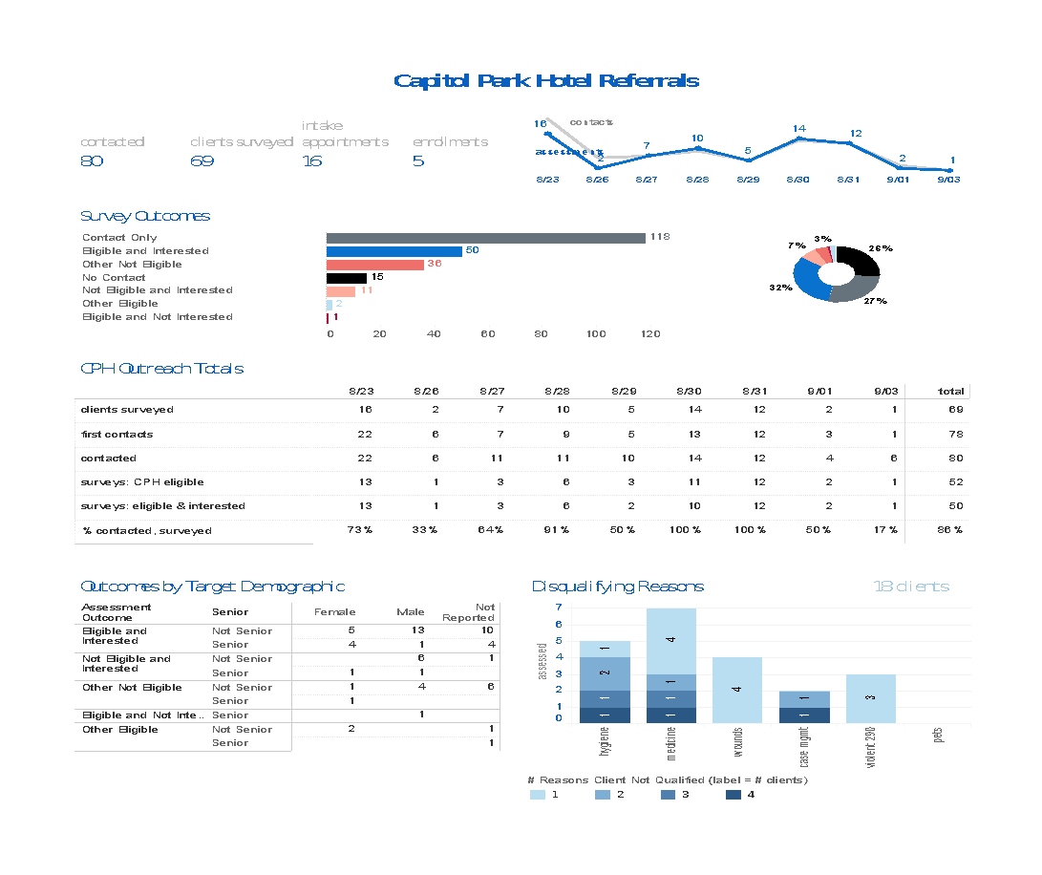

Slide 7
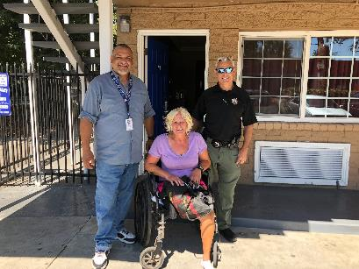
SCATTERED SITE EMERGENCY SHELTER REHOUSING PROGRAM
The goal of the Sacramento County Scattered Site Rehousing Shelter Program is to transition recently chronically homeless individuals into permanent, safe, and sustainable housing.
To that end, we meet the clients where they’re at, administer case management and supportive services, and work to find a long-term, permanent housing solution.

Slide 8
WHY SCATTERED SITES?
Our Rehousing Shelter Sites are scattered across Sacramento County.
Widely dispersed sites allow the utilization of single family homes in residential neighborhoods as shelter locations.
Each site has a House Leader who maintains a safe environment in the house and reports directly to the Operations Supervisor.
Creating a shared living situation furnishes a sense of community among the clients.

Slide 9
STEP 1 – INTAKE
Law Enforcement (Police and Park Rangers) and County Outreach staff meet and develop a rapport with unsheltered community members.
Referrals are made to the Department of Human Assistance (DHA) point-of-contact.
SSHH Operations Team meets with individuals wherever they are at in the community.
The participants are then transported to the shelter site.
“Participants, pets, and possessions”

Slide 10
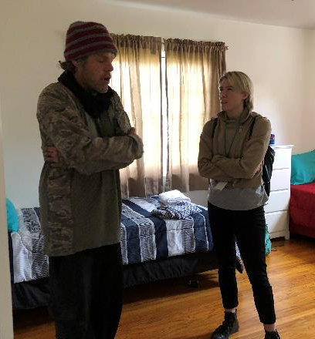
STEP 2 – CASE MANAGEMENT
The goal of providing case management services is to remove the participant’s barriers to permanent housing.
Case managers administer a barriers assessment and create a case plan with the participant. Individuals are assessed for their ability to perform activities of daily living (ADL) and may be identified for a higher level of care.
While participants reside at the scattered-site shelter they receive supportive services such as: assistance with medical and psychiatric appointments, transportation, applying for public assistance and social security, and establishing In-Home Supportive Services (IHSS) and independent living services.

Slide 11
STEP 3 - REHOUSING
The goal of this program is to transition recently chronically homeless individuals into permanent, safe, and sustainable housing. Once we have removed the appropriate barriers, we work to find housing.
SSHH Housing Locators work closely with shelter participants to identify tangible housing options.
Participants are assessed for a variety of housing options such as Permanent Supportive Housing (PSH), shared housing, and market-rate housing.
Follow up – once in housing, housing locators follow up with the participants for up to 6 months.
Since the start of the program, 114 participants have transitioned into permanent housing.

Slide 12
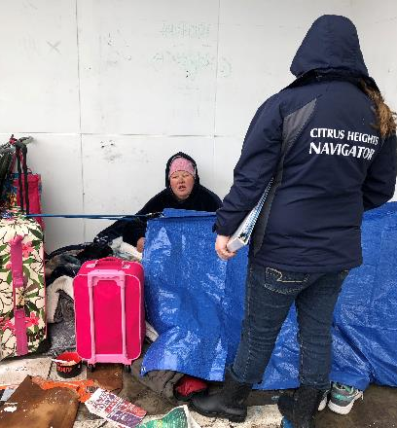
HOMELESS OUTREACH NAVIGATORS
The goal of the Homeless Outreach Navigator Program is to provide services to individuals and families living on the street.
SSHH has navigators in Citrus Heights, Elk Grove, Rancho Cordova, North Sacramento, South Sacramento, Folsom, Arden Arcade, and on the American River.
Navigators work with partner nonprofits, local governments, the Sheriff's Department, Code Enforcement, and the local PD to identify, find, and assist the local homeless.
HART groups provide navigators with volunteer mentors, bus passes, scholarships, transitional housing units, and other resources with the end goal of getting the local homeless housed.
HART or Homeless Assistance Resource Teams are independent nonprofits dedicated to assisting the homeless in their community's. SSHH has assisted in creating 9 HART groups across Sacramento: Citrus Heights, Elk Grove, Rancho Cordova, North Sacramento, South Sacramento, Midtown, Arden Arcade, Carmichael, and Folsom.

Slide 13
A Snapshot of homeless services in Chico, Butte County
Presentation to Governor’s council on regional homeless advisors::
September 6, 2019

Slide 14
Butte County Homelessness
2,304 :: Countywide
sheltered, unsheltered and FEMA housed homeless adults and children
891 unsheltered
420 sheltered
993 people sheltered with FEMA support
Undercounted families, children, youth (source: BCOE/CUSD)
16% increase from 2017 (1,983)
389 Unsheltered were in Chico
2019 PIT Survey Data
Notes:
The Chico community collected 55% of the surveys
Number of people located and interviewed within 24 hours
Does not represent a full count – to state it as such, does not fully represent the housing, human, and community crisis
Confident in this not an inflated number - de-duplicated number
76% increase in BC; 92% in Chico
Increase due to increase in homelessness or change in methodology… or both
Because of that, it is more important to focus on what we do know... There were at least 1,000 people in Chico on January 26 who reported being homeless

Slide 15
Community Homeless Service Flow current
Outreach/Referrals from other agencies/211/
Transitional Housing: Esplanade, Jesus Center, Torres Shelter
Permanent Supportive Housing: CHIP, NVCSS, BCBH, Caminar, CHAT
Sober female Shelter Program: Jesus Center
Low Barrier Shelter: Torres Shelter & Safe Space Winter Shelter
Jesus Center :: Resource Center; Day Center; meals; vocational

Slide 16
Community Homeless Service Flow proposed
Formal Outreach/Referrals from other agencies/211/
Transitional Housing: Renewal Center, Esplanade, Jesus Center, Torres Shelter
Sober/recovery Shelter Program: Jesus Center
Special Population Shelter: Renewal Center
Low Barrier Shelter: Torres Shelter & Safe Space Winter Shelter
Renewal Center:: Single Point of Entry; Resource Center; Day Center; meals; vocational
Permanent Supportive Housing: Jamboree, CHIP, NVCSS, BCBH, Caminar, CHAT

Slide 17
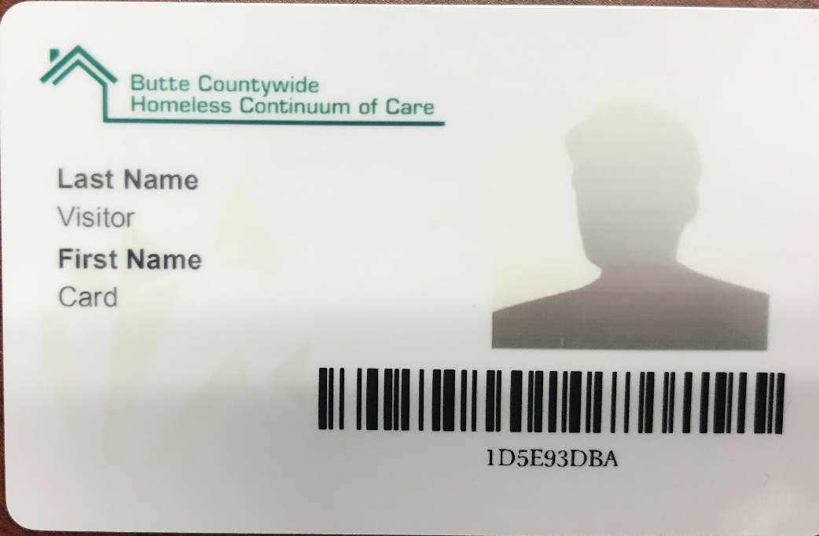
Signs of Coordination
Primary shelter became 24/7, low barrier in January
New Family shelter opened in August
Shared housing model for outflow
New PSH provider coming
County taking over Lead Applicant, Lead Agency, HMIS
Service Card
Moving from Pilot to implementation on Coordinated Entry
Building the Renewal Center Project

Slide 18
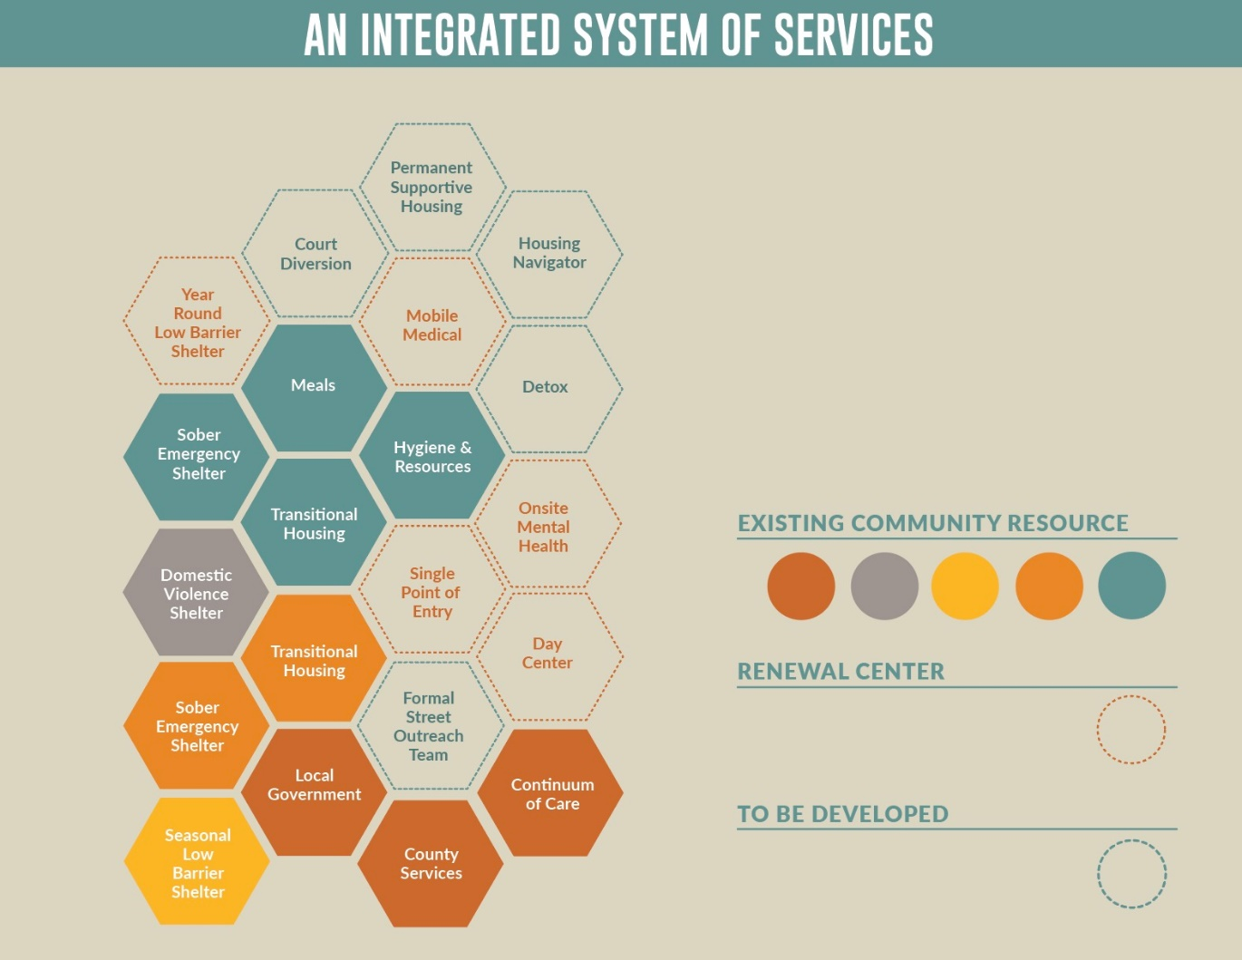

Slide 19
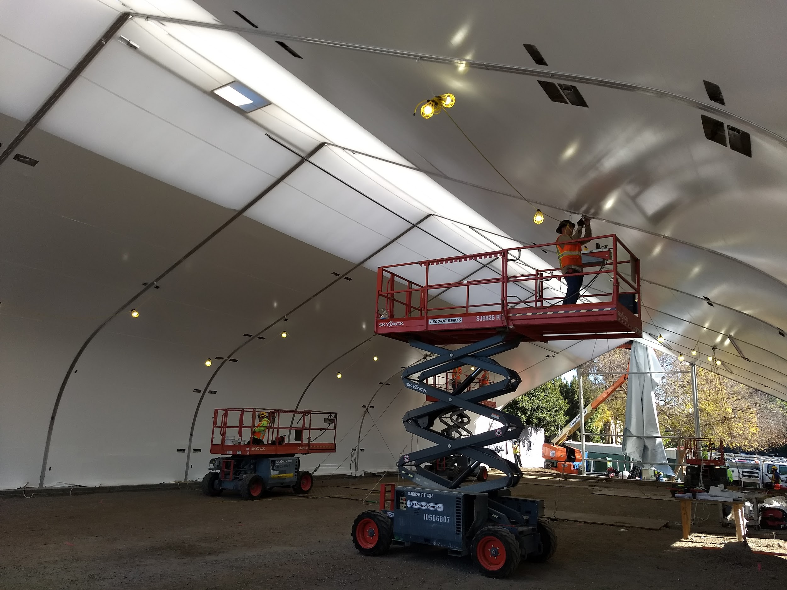
Interim Housing Models for
Los Angeles
9/6/2019

Slide 20
Notes:
a) Overview of local demographics: appx 59k countywide from 2019 count, 36K in City of LA, 3 out of 4 unsheltered (due to derth of shelter resources), significant scaling up of permanent housing resources, yet inflow into homelessness drove overall increase. Will describe LA’s process of developing a homeless housing gaps analysis which drove decision making around interim housing goal

Slide 21
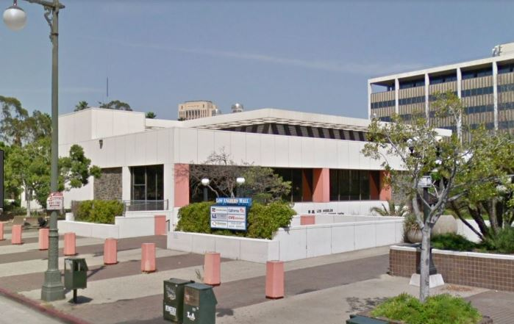
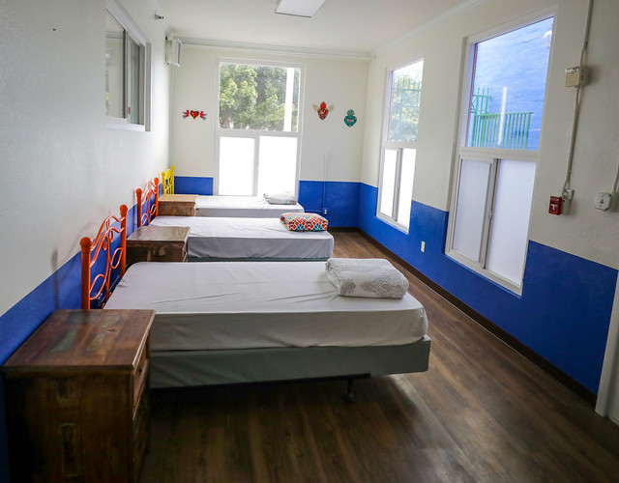
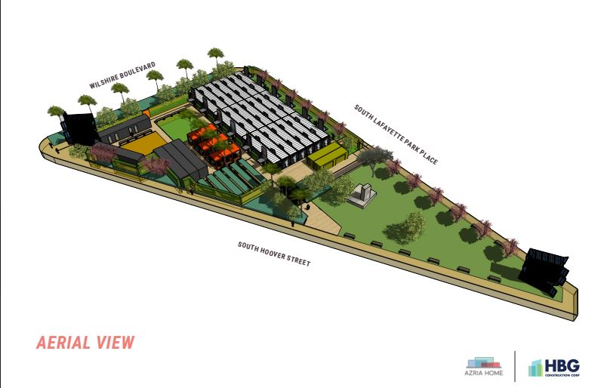
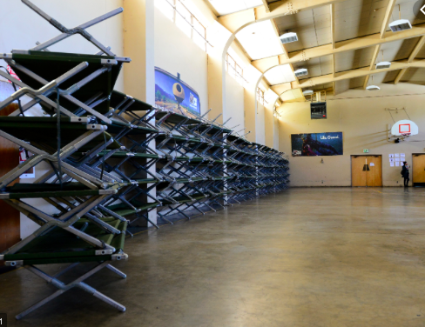
Every Model, Every Approach
Notes:
Overview of the Model/Approach to shelter provision: all of the above approach, exploring every modality, embracing low barriers/housing first/harm reduction philosophies. Winter shelters vs crisis housing vs bridge housing, aiming to create community based resources, descrive “A Bridge Home” Initative. Will describe aging shelter infrastructure vs newer facilities, the range of bed rates, city/county partnership on city funding capital and county funding services.

Slide 22
Interim Housing for Individuals with Complex Health and Mental Health Issues ( licensed care and supervision not required)
Notes:
Critical to include information on persons who are homeless who need more enriched clinical services in an interim housing program. Aging homeless population results in more acute health needs, which are important to consider in standing up appropriate shelter settings.

Slide 23
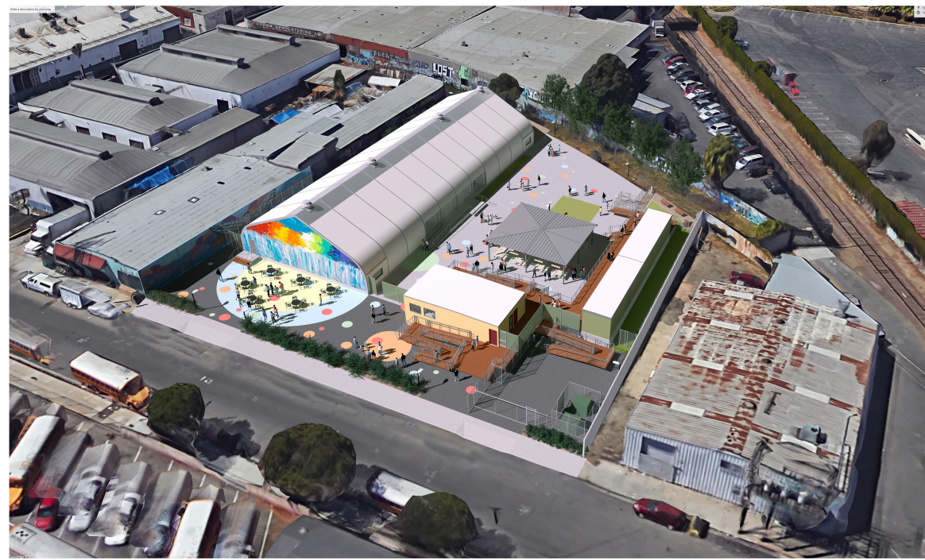
Outcomes, Successes, Challenges...
Notes:
Will discuss siting challenges, creative community engagement strategies, balance between funding temporary solutions and permanent housing, importance of system throughput, how State and Federal disinvestment averages $496M annually since 2008; how shortage of rental subsidies creates bottleneck in interim housing

Slide 24
Navigation/SAFE Centers: Shelters as they Should Be
Report on HSH Navigation Centers

Slide 25
HSH Resources to Address Homelessness
Coordinated Entry
9 Access Points
Assessment 4,000 people per year
Problem Solving
1,500 Eviction Prevention slots
800 Homeward Bound slots
Outreach
~200 chairs in Resource Centers
HOT, ERT, & Street Medicine teams
Temporary Shelter
3,397 beds of varying types
Housing
11,525 permanent housing beds
961 short and long-term subsidies
Housing Ladder
75 Moving On Initiative subsidies
Pipeline for FY20
Expanding prevention and diversion
585 temporary shelter beds
387 master leased housing
117 new PSH units
300 new rent subsidies

Slide 26
HSH Output and Outcomes
Intake and assessment of 8k people/year
Outreach encounters with 5k people/year
Provide 800 people with family reunification
Provide over 1,200 people housing/subsidies
Help 100 people/year exit PSH
Prevention and Diversion services to 1,500
House or Shelter over 12,500 daily
Help 50 people exit homelessness weekly
Approximately 150 newly homeless weekly
2019 PIT Count was 8,011
27% reduction in TAY homelessness from 2015-2019
23% reduction in homelessness in public schools from 2014-2018
11% reduction in veterans homelessness since 2017
33% increase in adult homelessness since 2015
17% increase in overall homelessness since 2015, which compares favorably with large CA counties that saw an average increase of approximately 30%

Slide 27
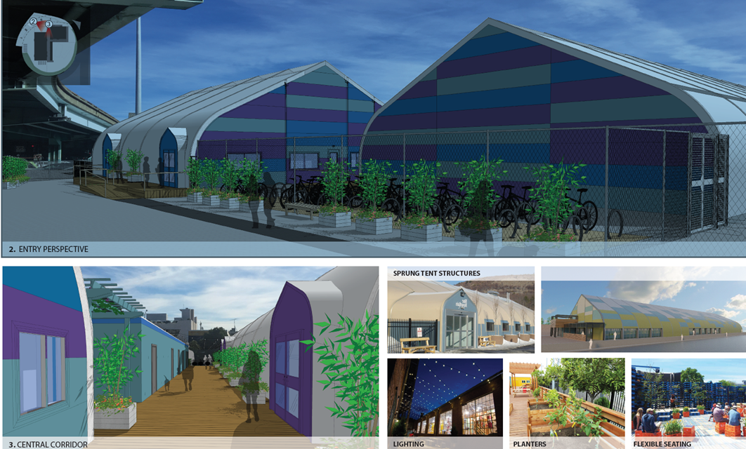
Navigation Centers Portfolio
Current
Central Water Front – 64 beds
Civic Center – 113 beds
Division Circle – 186 beds
Hummingbird – 29 beds
125 Bayshore – 128 beds
Bryant Street – 84 beds
Current Total: 604 beds (6 sites)
Closed: 195 beds (2 sites)
In Development: 405 beds (2 sites)
Planned: 210 beds (1-2 sites, including programing for TAY and women)

Slide 28
What are Navigation Centers?
Navigation Centers are low barrier to entry shelters designed to help clients get respite from the streets while working to exit homelessness
More simply put, they are shelters as they should be.

Slide 29
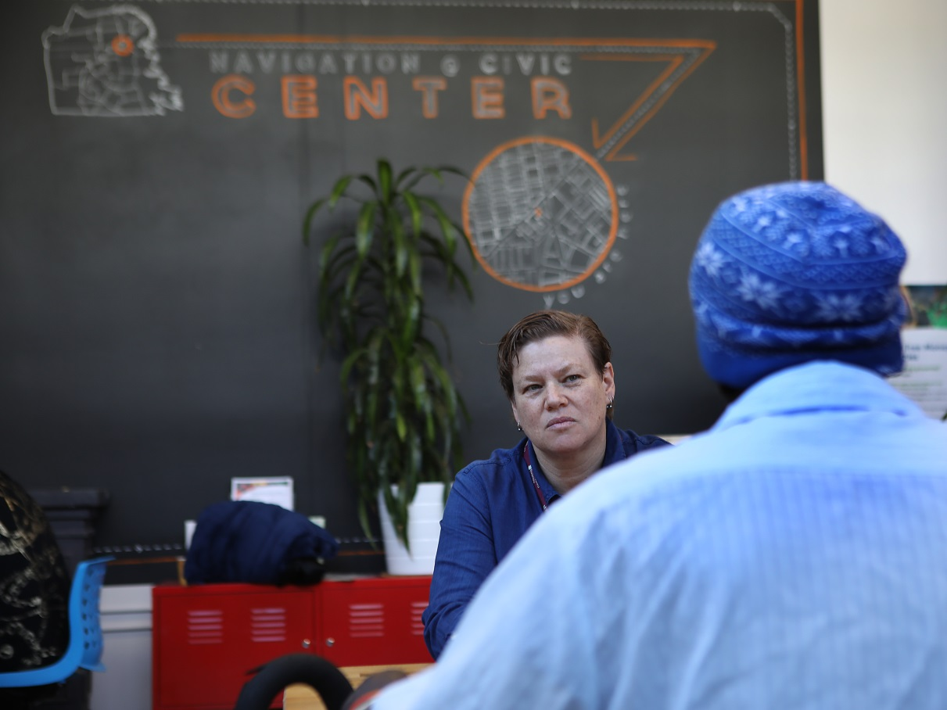
What is the role of Navigation Centers?
Provide temporary shelter for people sleeping outdoors
A tool for the Homeless Outreach and Encampment Resolution Teams
An attractive alternative to people who have not typically used other types of shelter
A service rich environment to link people with case management, benefits enrollment, access to health care, and housing assistance
Shelter for clients with a pathway to housing based on their CE assessment
Opportunity for other clients to find exits from homelessness

Slide 30
Navigation Center Model
Pets, partners and possessions
Triage/Assessment
Connection to medical services
Co-location of benefits workers
24/7 staffing
Unsheltered
Appropriate staff to client ratio
Encampments
Long-term homeless
Harm reduction approach
Meals and other amentias
Staff training
Staffing
Service Rich Environment
Welcoming
Target Population

Slide 31
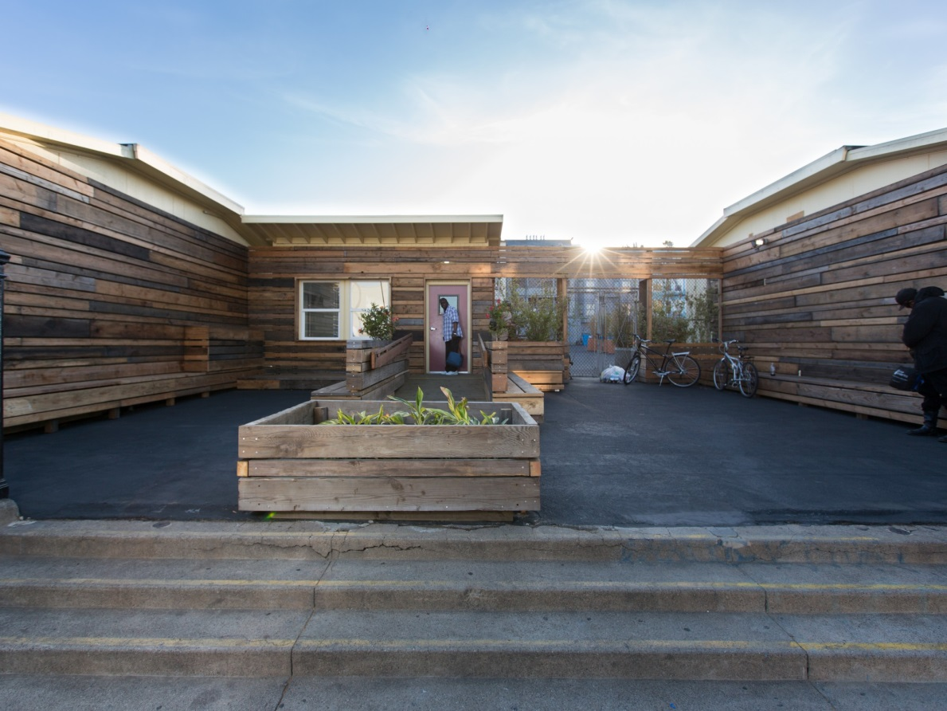
Other Elements of the Navigation Center Model
Well designed
Create greater sense of privacy
Open 24-7
Flexible, client-focused house rules
Not part of the shelter reservation system
They are accessed by “invitation only”
Some sites designed to be closed or moved

Slide 32
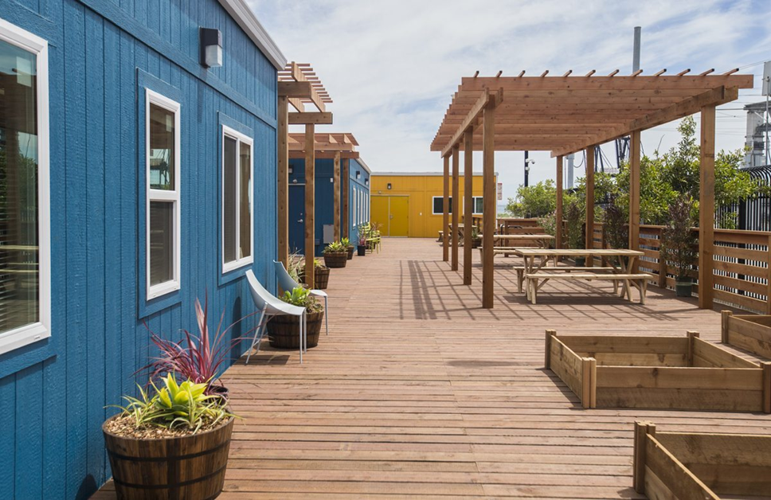
Navigation Center Beds
Types of Stays at Navigation Centers:
Homeward Bound (1-2 nights) for people who are in the Homeward Bound program preparing to travel to another community
Emergency Beds (7 day stays) for people in crisis brought to a center by SFHOT or SFPD. Will be assessed for a longer stay.
Time Limited beds (30 days+) for people exiting encampments who are not priority 1 for housing. Extensions are granted if the guest is working toward their exit plan or addressing medical issues.
Pathway to Housing (unlimited) for people who are prioritized for housing and stay until housing placement (long term homeless w/a disability)
Specialty Beds are dorms for women, seniors and other populations with special needs.

Slide 33
Navigation Center Data

Slide 34
Lessons Learned
Short-term stays do not lead to positive outcomes; 7 day beds are being phased out and time-limited stays are being extended
Developing good neighbor agreements helps address NIMBY issues and leads to better operations
Original concept of small sites (50-75 beds) only open for 3-5 years is not cost effective in terms of operations and capital; looking to larger sites (150-250 beds) that are semi-permanent. San Francisco is now calling these SAFE Centers
Low barrier approach should be applied across the shelter system when funding is available
Lower-cost shelter alternatives should also be considered depending on your community goals

Slide 35
Biggest Lesson Learned
Navigation Centers can be an important tool in most communities but they do not solve homelessness…..
…and should not be marketed as an alternative to building an effective, data-driven homelessness
response system built around coordinated entry, housing-first and trauma-informed practices

