Slide 1
Jobs and Housing: Signs of Strength
September 2016
Ben Ayers, Senior Economist

Slide 2
The labor market remains the engine of growth for the economy
U.S. labor market conditions
August 2016
Change in nonfarm payroll employment (L)
Civilian Unemployment Rate: 16 years+ (R)
Jobs (thousands)
Percent
Sources: BLS/Haver Analytics
Notes:
The labor market is quite strong – with +200,000 monthly job gains and an unemployment rate that is approaching full employment. These trends are supporting consumer spending and wider economic growth.

Slide 3
Wage pressures are slowly building – a signal of tighter labor markets
Wage growth measures
August 2016
Average hourly earnings
Percent, year-to-year change
Atlanta Fed wage growth tracker
Sources: BLS/FRB Atlanta/Haver Analytics
Notes:
Real GDP remains held down by weak exports and government spending. Core GDP growth is stronger – supported by strong trends in consumer activity.

Slide 4
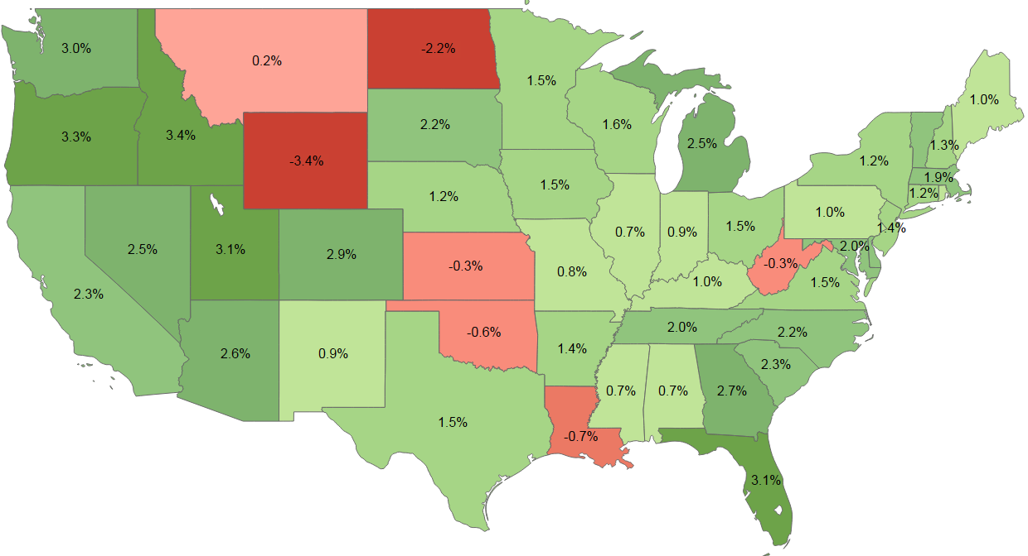

Most states show solid job growth (except in the energy sector)
Job growth by state
Twelve-month growth rate, August 2016
Sources: Bureau of Labor Statistics (BLS)/Haver Analytics
Notes:
Job growth is widespread across the country, except in areas with a high concentration of energy production.

Slide 5
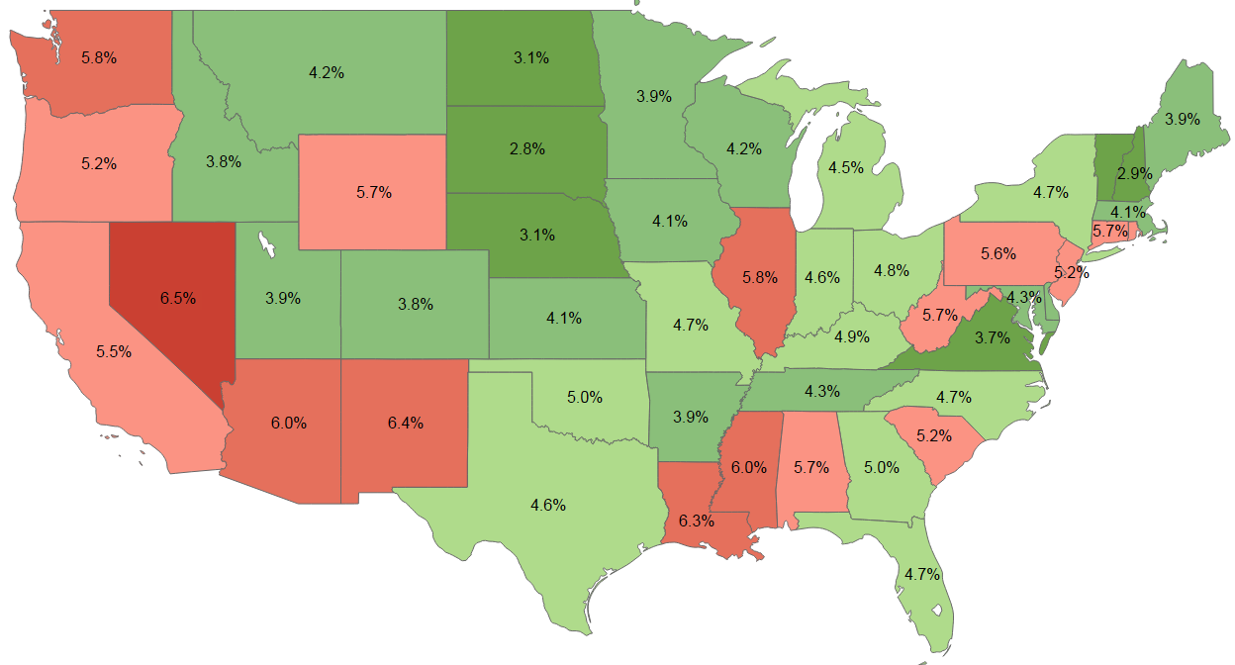

Despite energy weakness, areas of lower unemployment rates are expanding
Civilian unemployment rate by state
August 2016
Sources: Bureau of Labor Statistics (BLS)/Haver Analytics
Notes:
Unemployment rates are falling across the country as the economy expands and job growth remains strong.

Slide 6
Still low oil prices are providing a boost for consumer spending and overall economic growth
Crude oil, West Texas Intermediate
September 13, 2016
$ per barrel
Sources: Energy Information Administration/Haver Analytics; Shaded areas depict recessionary periods
Notes:
Oil prices are holding down costs for consumers – raising consumer spending power while also lowering inflation.

Slide 7
Riding strong demand, home sales are back to pre-boom levels
Total home sales (new + existing)
July 2016
Millions
Current value
Sources: Census Bureau; NAR; Haver Analytics
Notes:
Overall inflation remains held down by lower energy prices. Core inflation is stable and below the Fed’s 2.0 percent goal – but there are signs of a pick-up in recent months.

Slide 8
House prices are up amid tight supply/demand balance, although affordability remains positive with low mortgage rates
National house prices
July 2016
Percent, year-to-year change
CoreLogic HPI
CoreLogic HPI, ex-distressed
Sources: CoreLogic/Haver Analytics
Notes:
Real GDP remains held down by weak exports and government spending. Core GDP growth is stronger – supported by strong trends in consumer activity.

Slide 9
More MSAs at an all-time price peak, but no housing bubble
Current House Prices vs. Pre-crash Peak (2005-07)
ABOVE
PAR
BELOW
Sources: CoreLogic/Haver Analytics

Slide 10
LIHHM Rankings: Things look good today (other than a few energy markets)
Nationwide’s Leading Index of Healthy Housing Markets (LIHHM)
2016Q2
Performance Rankings:
+4
POSITIVE
0
NEUTRAL
- 4
NEGATIVE
See more at: www.inthenation.com/housing

Slide 11
California housing markets look solid
Historical LIHHM Rankings – California MSAs
Performance Rankings:
+4
POSITIVE
0
NEUTRAL
- 4
NEGATIVE
See more at: www.inthenation.com/housing

Slide 12
The Fed has committed to a cautious approach to policy tightening
Federal Funds Rate
August 2016
Percent
Sources: Federal Reserve; CME Group; Haver Analytics
Notes:
The Fed should tighten very soon (probably in December). The path of policy rates remains divergent for 2016-18 with market expectations well-below the Fed’s own forecast and our own.

Slide 13
“Lower for longer” is the expectation, but higher rates are coming
Effective federal funds rate, year-end
Actual
Forecast
Source: Federal Reserve Board; Haver Analytics; Nationwide Economics

Slide 14
Important disclosures
The information in this report is provided by Nationwide Economics and is general in nature and not intended as investment or economic advice, or a recommendation to buy or sell any security or adopt any investment strategy. Additionally, it does not take into account any specific investment objectives, tax and financial condition or particular needs of any specific person.
The economic and market forecasts reflect our opinion as of the date of this report and are subject to change without notice. These forecasts show a broad range of possible outcomes. Because they are subject to high levels of uncertainty, they will not reflect actual performance. We obtained certain information from sources deemed reliable, but we do not guarantee its accuracy, completeness or fairness.
Nationwide, the Nationwide N and Eagle and Nationwide is on your side are service marks of Nationwide Mutual Insurance Company. © 2016 Nationwide.

