Slide 1
Lessons Learned and National Trends in Abusive Partner Intervention and Engagement
Danielle Pugh-Markie
Director of Judicial Education and Leadership
Notes:
BD and JCA

Slide 2
Center for Court Innovation
Notes:
The Center for Court Innovation seeks to help create a more effective and humane justice system by designing and implementing operating programs, performing original research, and providing reformers around the world with the expert assistance they need to launch new strategies.
We have three major components of our work: 1) RESEARCH - We conduct evaluations of systems and reform efforts and disseminate research on best practices and promising models for improving justice systems; 2) OPERATING PROGRAMS – We conceive, plan, and operate programs that seek to test new ideas, solve difficult problems, and achieve system change. An example of this is our community-based violence prevention projects. 3) EXPERT ASSISTANCE – We provide hands, on assistance to jurisdictions around the world who are hoping to improve their justice system response. Our Gender & Family Justice team specializes in helping communities enhance their response to gender-based violence. We are practitioner-based (as in all our staff have worked with survivors in some capacity), victim safety and offender accountability focused, data-driven, and community-oriented.

Slide 3
Gender and Family Justice & Research Practice Strategies
Site Visits
Strategic Planning
Needs Assessments
Targeted Training
Evaluation
Notes:
As background: Talk about our work on pre-trial and bail reform, risk assessment, victim centered responses, and our work in NYC and nationally.
TA is targeted to the individual needs of each site.
Build relationships with grantees and the partners within their community at local and statewide levels, helping them to “kick the tires” of their own system, look at data, observe court sessions/BIPs/etc and walk-through service centers, talk to survivors and other stakeholders to get a real sense for where gaps lie and to develop solutions collaboratively
Continually assess needs, soliciting feedback from the community especially underserved populations, and ongoing training & cross-training that is responsive to where needs lie

Slide 4
Learning Objectives
Describe research around abusive partner intervention programming – history, trends, innovations
Introduce guiding principles for abusive partner intervention work
Identify strategies for engaging fathers who have been abusive

Slide 5
Where do abusive partner intervention programs fit in to Accountability, Intervention and Engagement?
Notes:
TRANSITION SLIDE

Slide 6
The Rise of Batterer Programs
Origin
Proliferation
Late 1970s response to lack of sentencing options in domestic violence (DV) cases (Pence and McMahon 1997)
One prong in a coordinated community response (Pence and McDonnell 1999)
More than 2,200 programs nationwide in 2007 (Labriola et al. 2007)
Required by many states (e.g., CA, FL, RI, and OR) for certain DV offenders (e.g. Austin and Dankwort 1999; Labriola et al. 2007)
About 80% of participants court-ordered (Bennett & Williams 2004)
Notes:
Context about the history of programs over the past several decades
ORIGINS: As DV became more criminalized, need to figure out appropriate outcome for offenders because of lack of sentencing options. At same time, need to be part of CCR (various stakeholder groups like health services, law enforcement, judicial and legal services, shelters and protection services, schools and other education institutions, religious and cultural groups) coordinate efforts to deliver comprehensive and timely support to those facing family violence to ensure accountability and safety.
PROLIFERATION – Our research showed more than 2,000 across the nation (as of 2007); many states require APIP through statutes if convicted or plead guilty to DV crime; 80% of participants were court-ordered

Slide 7
Simultaneous Developments
Increased funding for victim services
Rise of pro-arrest policies
More aggressive prosecution strategies
Greater use of protection orders
Intensive probation
Pre- and post-disposition judicial monitoring
Specialized domestic violence courts
Notes:
Over past 20-30 years
Increased funding for VS from OVW and state agencies
Pro-arrest policies ensure people are arrested for DV instead of just telling people to take a walk around the block after a disturbance
Dedicated DV prosecution teams
More use of POs – growing trend that APIPs can be ordered for civil as well
Probations sometimes run programs, sometimes people mandated to probation and program
Pre-trial release post-disposition judicial monitoring – check up on compliance of program
Specialized DV courts – court part of CCR

Slide 8
Major Program Models
Educational
Cognitive-behavioral
Couples (individual or group format)
Culturally-specific
Restorative Justice/“Circles of Peace”
Accountability
Notes:
Different program models developed to address DV
Most popular – educational programs with CBT --> psychoeducational
Couples counseling – can be dangerous (e.g., equal responsibility, victim blaming, collusion)
Culturally specific (e.g., MSV AA group) – issues related to culture are brought up in group and raised as strengths/barriers
Recent – looking into RJ approaches (or combining with regular APIP)
Drug/alcohol treatment in combination with APIP
Accountability – strict accountability model – psychoeducational approach but programs are tool of court to enhance compliance and accountability

Slide 9
Cognitive Behavioral Therapy
Key Elements:
The Present: current people, places, and behaviors
Thinking Errors: legal cynicism, external locus of control, sense of hopelessness, sense of victimization
Cognitive Restructuring: effort to disrupt the automatic thoughts & feelings that lead to (e.g.) violence
Address Lack of Empathy: effort to show connection between actions and hurtful effects on others
Focus on Decision-Making: train to avoid impulsive reactions; use nonviolent communication
Multiple Needs: Adaptable to many needs
Notes:
Research (Radatz & Wright) supports the use of cognitive-behavioral and social learning techniques for the general criminogenic population. It is the most effective in reducing recidivism (which is just one piece of the puzzle for DV – also want to look at safety, autonomy, etc.
Many APIP programs around country utilize CBT strategies.
Key elements
Present – change current behaviors, thinking about present and surroundings (e.g., Spheres of Influence)
Thinking Errors – thought process is key. Lots of legal cycnicism (e.g., don’t trust the system), external locus of control (e.g., minimizing/denying/blaming as a tactic, someone else made me do it), hopeless (connection between sense of hopelessness and violent crime, more on this later), think they are the victim
Cognitive Restructuring -- Basic concept is that the circumstances around an event, along with our related thoughts, feelings and beliefs, impact how we choose to react or behave. With the right tools, participants can disrupt these elements, changing their behavior to move away from abuse and towards the program goals of dignity and respect.
Lack of empathy – look at hurtful and harmful behaviors
Focus on Decision Making -- change external locus of control to internal and relating to others and impact of abuse

Slide 10
Key Goals of Batterer Programs
Recidivism Reduction: Reduce violence:
Rehabilitation: Change internalized thoughts, attitudes, and decision-making strategies
Deterrence: Increase the costs of noncompliance
Accountability: Serve as relevant sanction when jail is not an option (e.g., vs. fine or nothing). Implies:
High program completion rate; and/or
Use of jail or other sanctions for noncompliance
Social Change: Directly or indirectly influence norms related to domestic violence (e.g., Men Stopping Violence)
Notes:
What are the goals of some of the programs?
Recidivism – courts and and communities want the violence to reduce/stop and use recidivism as a measure of this.
Accountability – appropriate sanction when jail is not an option
Social Change – Systemic goal of changing norms around domestic violence, MSV intentionally engages participants to think about how their community can support them (e.g., peers, community project) and works within community to train on issues as well

Slide 11
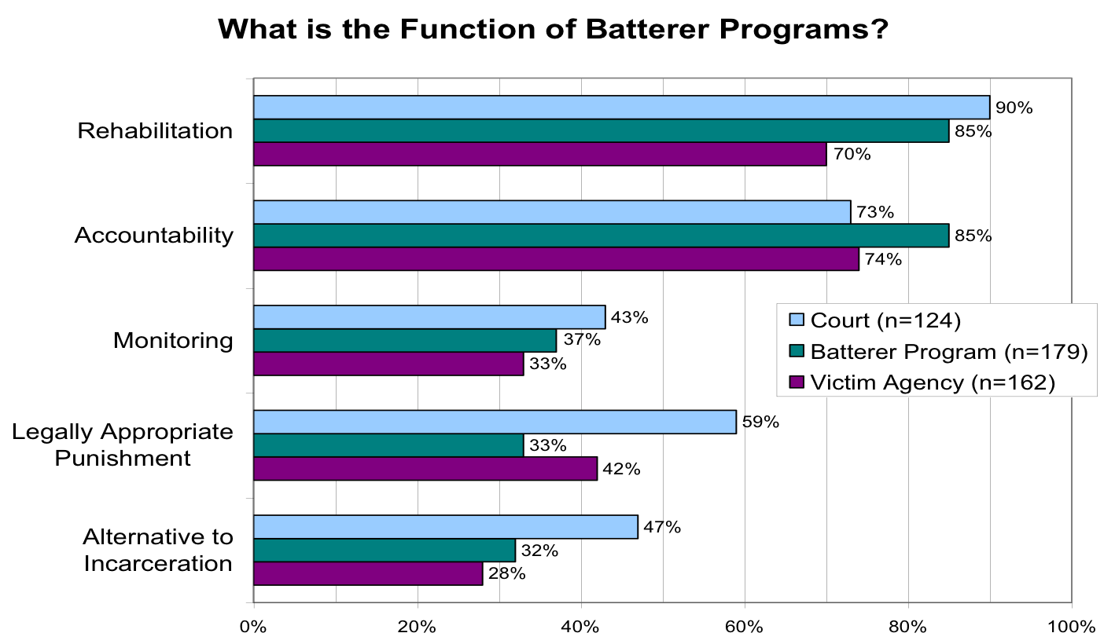
Common Program Goals (Cont.)
Source: Labriola, Rempel, O’Sullivan, Frank, et al. (2007).
Notes:
From CCI’s national survey in 2007 about APIP programs (courts, providers, and victim advocates gave input)
Same type of responses re: goal of programs – accountability, appropriate sanction
This ties to system accountability and collaboration because you can see these 3 system players have different views of what a program should do

Slide 12
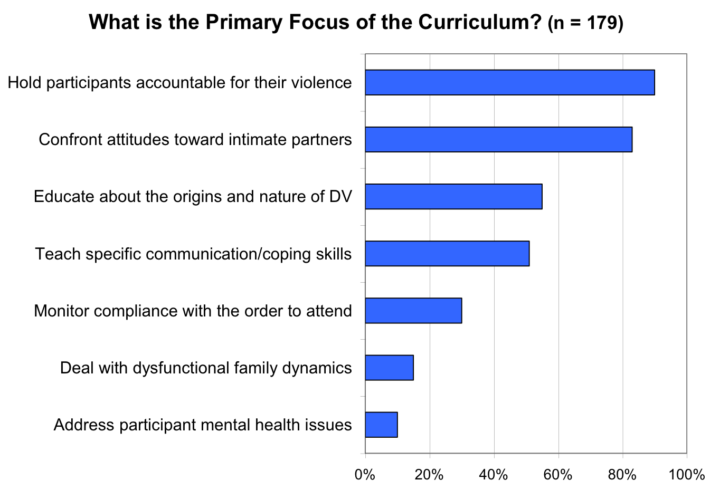
Focus of Curricula
Notes:
Asked about the focus of curriculum – accountability, changing attitudes, education, and lower is addressing other co-occurring issues
Notice that the programs surveyed were really criminal focused. These might look different for programs who have volunteer clients or those referred from family court.

Slide 13
What Does the Research Say about Effectiveness?

Slide 14
What were researchers measuring?
Changed Attitudes or Beliefs
Reduction in Re-Arrests or DV Re-Arrests
Reduction in Victim Reports of Re-Abuse
Notes:
You can say here that Mirabel study in UK looked at victim autonomy and parenting and child safety as well, there is a trend to start looking at other things aside from physical violence or criminal activitiy….
IE we will talk about measuring changes in HOPE

Slide 15
Three Types of Research Designs
Randomized Controlled Trial (RCT) or Experiment: Study subjects are randomly assigned; those in each condition will be comparable at baseline.
Quasi-Experiment: Program participants are contrasted with naturally occurring comparison group; statistical methods increase comparability.
Non-Experiment: No comparison group. Often, completers compared to dropouts; not a rigorous test, since completers are more predisposed to compliance.
Notes:
This can be fast: There are different ways to do the research. The study the CCI did in the Bronx was RCT (this is like what they do with medical experiments)

Slide 16
Overview of Findings
More than 60 batterer program evaluations
Early Research (mostly 1980s and 1990s):
Generally report high success rates
Nearly all non-experiments without a comparison group
Minimum Standards of Rigor (see Feder and Wilson 2005; Miller et al. 2013)
Four Quasi-Experiments: 1 reduction, 1 increase, and 2 no-effects on re-arrest (Dutton 1986; Harrell 1991; Chen et al. 1989; Gordon & Moriarity 2003)
Five Experiments: 1 reduction, 1 mixed, and 3 no effects
Models: All psycho-educational or cognitive-behavioral
Notes:
More recent research has come out with mixed results. In last few years there is a focus on other types of outcomes: survivor safety and autonomy (Study in the UK); RJ with APIP (Circles of Peace in Utah; study by Linda Mills); and separating out family violence vs IPV (Chicago) showing more promising results.

Slide 17
Research: Takeaways
At present, “effectiveness” results are mixed.
One can candidly convey this conclusion without discounting that effective programs may work.
To pursue changed behaviors, thoughts and beliefs: either high-quality cognitive-behavioral approaches or other models with a proven evidence base are essential.
Implementation factors may be critical (as they generally are in research on other populations).
Notes:
Implementation means: support and training for staff, using the curriculum as it was intended, using risk assessment to only put folks in a program who should be in a program, etc.

Slide 18
Survivor Feedback
Impact on Satisfaction (Bronx Study): Victims whose cases were assigned to a batterer program were more satisfied with the sentence (77%) than those whose cases were not assigned to a program (52%)
Reasons for Dissatisfaction:
49% because outcome not harsh enough
30% because offender did not receive a treatment program
9% because outcome too harsh
12% for other reasons
Source: Labriola et al. (2008).
Notes:
Critical to this work is centering survivor voices and understanding what they think/feel/want related to the program
Survivors were MORE satisfied when partner was assigned to BIP – wanted them to get some type of programming
Some reasons for dissatisfaction – not harsh enough for just program (still in fear), did not get treatment in addition (substance, mental health), sometimes too harsh
Important to be in collaboration with advocates

Slide 19
What’s happening nationally and locally with APIPs?
Notes:
TRANSITION SLIDE

Slide 20
National Innovations
Risk Needs Responsivity
Trauma-Informed Care
Use of Hope Science
Intersectionality
Community Impact
Notes:
These are a few recent national innovations. There is a lot of conversation occurring about these issues nationally, including on the AQUILA listserv which is a national listserv of abusive partner intervention programs. Programs are starting to incorporate these things into their models.

Slide 21
Risk Needs Responsivity
Comprehensive assessment with validated risk tool
Programming that addresses multiple needs
Separation by risk level
Fidelity to model and training
CBT programming with structured delivery
Notes:
Risk-need-responsivity (RNR) model is a well-known model for the assessment and treatment of court-involved populations.
The risk principle states that you should match the level of service to the offender’s risk to re-offend.
The need principle states that you should assess criminogenic needs and target them in treatment.
The responsivity principle states that you should maximize participant’s ability to learn by providing a cognitive behavioral treatment and tailoring the intervention to the learning style, motivation, abilities, and strengths of the participants.
First, in order to accurately assess the risks and needs of participants, you can use validated risk tools – DVRNA, trauma assessment, ACEs, etc.
Second, RNR research shows that programs that address multiple needs are more successful in reducing recidivism (e.g., substance use, employment, challenging peers).
Third, another key piece of RNR literature is separating participants by risk level.
Fourth, a huge component of successful programs is ensuring there is sufficient training and support given to the facilitators so they understand the curriculum and are implementing it well.
Finally, we’ve already touched about CBT but RNR research supports the use of CBT with social learning techniques as well.

Slide 22
Adverse Childhood Experiences
Personal & Household Adversities (Conventional ACEs) | Community Adversities (Expanded ACEs)
Physical abuse Substance using household member Emotional abuse Mentally ill household member Witnessed domestic violence Sexual abuse Incarcerated household member Emotional neglect Physical neglect Parents divorced or separated | Witnessed violence Felt discrimination Unsafe neighborhood Experienced bullying Lived in foster care
Notes:
Unresolved participant trauma is both a risk factor and a responsivity factor. Many studies have examined the relationship between adverse childhood experiences and a variety of known risk factors for disease, disability and early mortality. Trauma can also alter the brain and hinder development of key skills such as emotional regulation and feeling recognition needed to successfully navigate interpersonal relationships (Terri’s article).
To best understand participants’ past harm and trauma that may impact and inform their abusive behaviors, we will assess for adverse childhood experiences during the comprehensive assessment. The original ACE Study measured 10 types of childhood trauma seen on left; five are personal (e.g., physical abuse) and the other five are household adversities (e.g., incarcerated household member). More recently, researchers identified the potential limitations of the ACES tool, as those studied tended to be white, middle-class and insured. Researchers created the Expanded ACES to identify adverse experience that reflect the realities of a more diverse population. The Expanded ACES includes five additional factors: witnessed violence, felt discrimination, unsafe neighborhood, experienced bullying, lived in foster care.

Slide 23
Trauma-Informed Strategies
Comprehensive assessment including adversity assessment or trauma screen
Trauma-informed interviewing techniques (e.g., motivational interviewing)
Person-centered, strengths-based treatments based on needs (i.e., not one-size-fits-all approach)
Incorporate mindfulness (e.g., breathing exercises) and coping strategies to manage emotional and behavioral responses to triggers
Facilitators must understand, recognize, and respond to the effects of trauma; create a safe environment, build trust, and demonstrate authentic partnership (Voith et al., 2019)
Notes:
Trauma lens has been adopted for interventions for other high-risk populations (e.g., substance users, sex offenders)
Trauma as a risk and responsivity factor for IPV
Psychoeducational and CBT only programs may not be sufficient to address deep emotional, psychological, and physiological aspects of trauma. Facilitators must understand, recognize, and respond to the effects of trauma.
ACES, MI, curriculum not all negative and draws on the strengths and resilience of participants and how they can work to heal the harm they’ve caused for themselves, their partners, their families, and their communities. Research shows that wellbeing, positive behavior and achievement are more likely to occur when pupils are aware of their cognitive and character strengths and have opportunities to demonstrate and further develop them. When individuals engage their strengths they tend to learn more readily, perform at a higher level, are more motivated and confident, and have a stronger sense of confidence and satisfaction.
Facilitators must work hard to build trust and rapport with participants to facilitate the change process.
If ask about D&R: theDignity & Respect curriculum is not a therapeutic group or designed as a mental health treatment, so participants with significant trauma needs will be referred to appropriate counseling or related services. We will start to unpack how past trauma is related to IPV perpetration, however, of course, emphasizing that it is not an excuse for causing harm.

Slide 24
Assessing for Hope
Recent research on men in an abusive partner intervention program in Baltimore found that “No hope for the future” was the greatest contributor to IPV perpetration. (Holliday et al., 2018)
More than 2,000 studies have been published on the psychology of hope, and they all show that hope is the single best predictor of well-being (Hope Rising, 2019).
Dignity & Respect program goal is to increase participants’ hope.
Notes:
An emerging trend in abusive partner intervention work is incorporating the science of hope into the curricula. This is based on evidence regarding the importance of hope in addressing past harm and trauma and changing future behavior.
One of the program goals is to increase participants’ hope and the curriculum will work with participants to strengthen their hope.
High hope leads to: Improved pro-social behaviors, Increased ability to self-regulats, Serves as a coping resource (e.g., cancer, HIV, spinal cord injury)
Predicts goal attainment, Protects against burnout, Reduces the intensity of physical suffering, Predicts substance abstinence, Predicts lower recidivism Improves well-being, Higher energy (zest), Perseverance toward goals (grit), Ability to regulate thoughts and emotions (self-regulation), Expectation toward a positive future (optimism), Appreciation toward others (gratitude), Desire to seek out new things (curiosity), Awareness of others feelings (social intelligence)

Slide 25
Hope Scale
Waypower
Goals
Willpower
Notes:
According to hope research, there are three main components of hope, which is defined as a future expectation of goal attainment. The science of hope teaches that we have a role to play in making our future better.
Goals refer desired outcomes that are attainable, clearly articulated, and measurable.
Waypower (pathways) refers to roadmaps in our mind that allows us to meet our goals. Hopeful people can generate multiple pathways toward their goals and possess the capacity to change to alternative pathways when needed.
Willpower (agency) refers to the capacity to exert mental energy to the pursuit of a pathway. This includes self-control, regulating beliefs, attitudes, and behaviors during goal pursuit, especially during stress and adversity.
The Adult Hope Scale (Dr. C.R. Snyder) measures for these components of hope.
Dignity & Respect – conducted at intake with participant and upon completion of each Dignity & Hope phase to evaluate if hope is rising.

Slide 26
Example from NYC
Seeding Generations
Need for multiple pathways and programs
Fostering an environment where participant has own stake in accountability, growth, community connection, and liberation
Ensuring services operate in connection to survivors and/or survivor advocacy to further accountability and safety
Holding space for trauma-informed behavioral change over time—with a focus on transformative
Healing in order to repair harm and interrupt generations of violence including historical oppressions and generational trauma
Integrating differential and risk assessments to align safety considerations with interventions responsive to each individual causing harm
Enabling case management and wrap-around services to support and maintain behavioral change
Notes:
Seeding Generations assessed the scope of current abusive partner intervention programming in NYC and recommended new solutions to create healthy relationships and communities. As part of Seeding Generations, more than 80 people, including survivors, people who have caused harm, advocates, and policymakers, were engaged in discussions about abusive partner intervention programming.

Slide 27
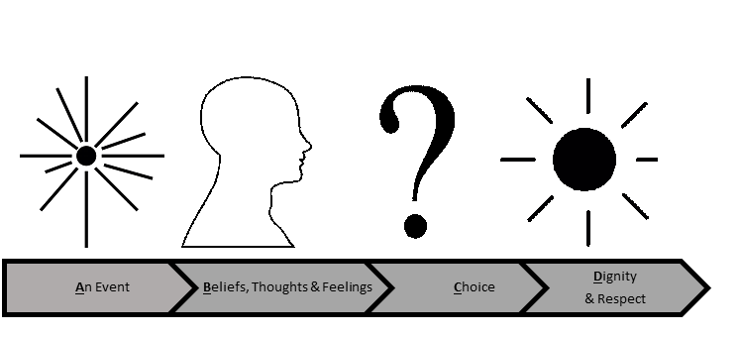
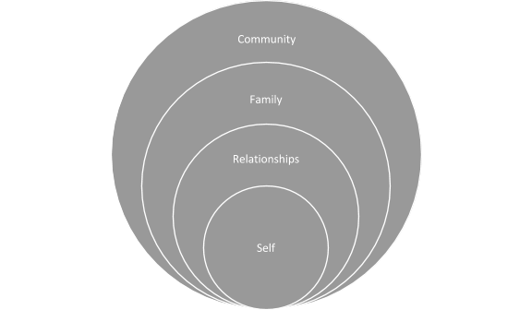
Dignity and Respect Curriculum
Definition of Dignity
Compehensive Intake, including ACES, HOPE and Risk
16 or 26 weeks
Spheres of Influence and Why We do What We Do
CBT with motivational interviewing, trauma-informed
Notes:
In NYC, we helped create the Dignity and Respect curriculum, launching in 2020.
The curriculum strives to teach participants how to move away from abusive behavior towards acting respectfully and with dignity to all people in their lives.
The Spheres of Influence represent the core relational spheres of one’s social network that can be impacted – both positively and negatively – by one’s actions, including the choice to abuse. The spheres include the self, relationship, family, and community.
The graphic on the bottom right represents CBT framework. Social learning techniques used in the Dignity & Respect curriculum include modeling, skill-building, cognitive restructuring (effort to disrupt the automatic thoughts and feelings that lead to violence), and role-playing. The goal is to make the program more interactive verses lecture-based to meet the needs of adult learners.
Incorporated hope theory and RNR

Slide 28
Abusive Partner Accountability and Engagement Training & TA
Funded by OVW
Holistic, trauma-informed civil and criminal responses
System-wide responses that are correlated to evidence-based best practices of risk, need, and responsivity of offenders
Addressing sustainability, support, and training for programs and community partners to enhance a holistic, coordinated response
Holistic responses to female defendants, LGBTQG defendants, youthful offenders, fathering after violence programs, and culturally specific programming
Notes:
The Center for Court Innovation's Abusive Partner Accountability and Engagement Training and Technical Assistance is designed to help jurisdictions interested in enhancing their current approaches to domestic violence offender accountability and engagement.

Slide 29
Our Partners
Futures Without Violence
Expert Consultants:
Alma Center
Hon. Berryl Anderson – Dekalb Magistrate Court
Cheryl Davis – Consultant
James Henderson – Alliance for Hope
Men Stopping Violence
Sojourner Family Peace Center
Wica Agli
Notes:
Diverse group of experts

Slide 30
Guiding Principles for Intervention and Engagement
Accountability is active and relational
Survivor voices are centered
Restores hope and dignity
Reflects and values culture and community
Responsive to needs and strengths
Notes:
Working with Futures Without Violence (headquartered in San Fran) and a diverse group of national experts, the Center created guiding principles to inform its work with jurisdictions seeking to enhance their response to abusive partner intervention and engagement

Slide 31
What would it mean to expand the definition of Accountability to include:
Creating relational pathways to responsibility, healing and hope for one's self, others and one's community
Notes:
Think to our values we generated

Slide 32
Think, Pair, Share:
By yourself, then with a partner, then with your table discussion:
How would this definition change the way I see:
My role in accountability?
The role of programs?
How we define success?

Slide 33
Abusive Partner Accountability and Engagement Training & TA
Webinars
National clearinghouse
Training institutes
On-site training and TA
Notes:
On-site work with jurisdictions seeking to enhance domestic violence offender
accountability and engagement.
Practitioner-to-practitioner learning opportunities through webinars.
Dissemination of model documents and emerging best practices in the field.
Guidance with creating holistic responses to offender accountability, promoting victim safety,
and developing effective partnerships with other agencies.
Regional Training Institutes for multi-disciplinary teams to learn from national experts and
develop strategies to bring back to their communities.

Slide 34
Contact Us
Email us at dvaccountability@courtinnovation.org
Visit us and join our listserv at dvcourts.org

