Slide 1
CA2030:
A Future-Ready California Aging Network
Recommendations and Next Steps
Susan DeMarois, Director

Slide 2
Ushering in a New Era
Region​ | 1980​ Population Age 60+​ | 2020 Population Age 60+ | 2060​ Population Age 60+​ | Percent Change​ (1980 to 2060)
Inland Empire​ | 259,843 | 880,108 | 1,531,777 | +490%
Sacramento Area​ | 154,283 | 540,473 | 825,551 | +435%
Orange County​ | 230,574 | 730,566 | 1,127,126 | +389%
San Joaquin Valley​ | 296,986 | 776,825 | 1,216,070 | +309%
San Diego Area​ | 281,621 | 751,181 | 1,129,101 | +301%
Greater Bay Area​ | 752,611 | 1,898,684 | 2,862,852 | +280%
Central Coast​ | 212,191 | 554,964 | 681,939 | +221%
Los Angeles County​ | 1,054,622 | 2,213,965 | 2,937,456 | +179%
Northern and Sierra​ | 171,203 | 413,664 | 387,716 | +126%

Slide 3
Ushering in a New Era
Notes:
Minority 60+
Low-Income 60+
Medi-Cal Eligible 60+
Geographic Isolation 60+
SSI/SSP 65+
Lives Alone 60+
Non-English 60+
HPSA Primary Care
HPSA Mental Health
Population Growth 60+
HIV 60+
IHSS Severely Impaired
AIAN 60+
Veterans 65+
Alz/Dementia Prevalence 60+
Housing Cost Burden 60+
Disability 65+
National Risk Index

Slide 4
Ushering in a New Era

Slide 5
Seizing Momentum
Statewide Initiatives & Investments
Year 4 of California's Master Plan for Aging (MPA)
CalHHS Agency 2024 Program Priorities
Administration for Community Living (ACL) 2024 Final Rule to update the Older Americans Act (OAA)

Slide 6
CA2030: A Comprehensive Network Assessment
Expert Consultation
Representative Steering Committee
250+ Stakeholder Interviews
33 Area Agency on Aging (AAA) profiles
Statewide Survey of 17,000+ Older Adults
Four Public Webinars
Research & Data Analysis

Slide 7
Ideal Traits of a Future-Ready Aging Network
Aging & Disability Forward
Inclusive & Equitable
Well-Known & Accessible
Consistent
Locally Responsive
Strategic & Action-Oriented
Performance-Based & Outcome Driven
Integrated

Slide 8
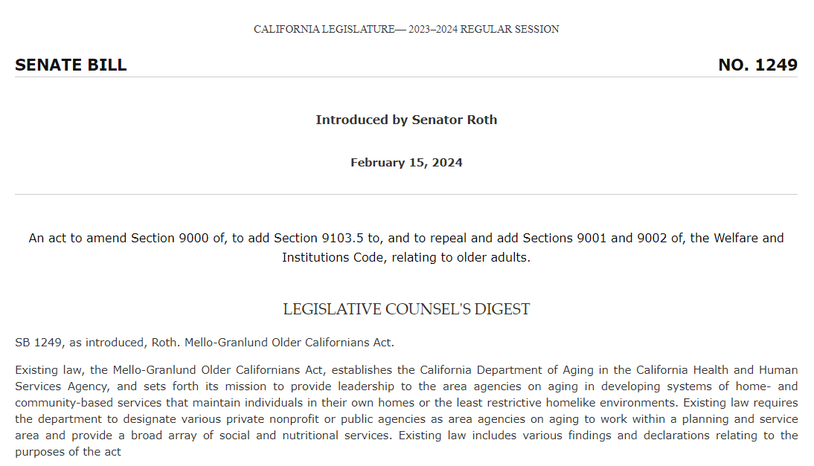
CA2030: An Agenda for Action
SB 1249 (Roth) – Sponsored by CA Commission on Aging

Slide 9
CA2030: Access the Final Report

Slide 10
Questions?
Subscribe to CDA & the Master Plan for Aging News and Events

