Slide 1
Wendy Tully
Criminal Justice Unit Chief
wendy.tully@caloes.ca.gov
916.845.8122

Slide 2
Office of Grants Management

Slide 3
Cal OES’s Office of Grants Management is responsible for the administration of approximately $1.6 billion in funds for:
homeland security;
emergency management;
criminal justice; and
victim services programs.
A majority of these funds are distributed to local and regional entities, and community-based organizations, to enable the most effective prevention, detection, response, recovery and victim services efforts.
Improving and enhancing local agencies'​ capabilities through grant funding is one of Cal OES’s most important missions.

Slide 4
Victims of Crime Act (VOCA) Victim Assistance Formula Grant Program

Slide 5
VOCA Victim Assistance Formula Grant Program
2014 Allocation – $51,829,052
2015 Allocation – $232,722,931
Increase of $180,893,879

Slide 6
VOCA Victim Assistance Formula Grant Program Requirements
Funds must support direct services to victims of crime, which include:
Responding to the emotional and physical needs of crime victims
Assisting primary and secondary victims of crime to stabilize their lives after a victimization
Assisting victims to understand and participate in the criminal justice system
Providing victims of crime with a measure of safety and security

Slide 7
VOCA Victim Assistance Formula Grant Program Requirements
Subrecipients are required to match funds at 20% of the total project cost:
Match can be cash or in-kind
Examples
Grant of $400,000 requires a local match of $100,000
(total project cost is $500,000)
Grant of $250,000 requires a local match of $65,500
(total project cost is $315,500)

Slide 8
VOCA Victim Assistance Formula Grant Program Requirements
The Office for Victims of Crime (OVC) indicated in writing that OVC “expects that VOCA Administrators will meet with key stakeholder coalitions and groups, including those that represent the VOCA statutory priorities—domestic violence, sexual assault, and child abuse prevention—to conduct strategic planning for funding new programs and services and enhancing existing initiatives.”
Cal OES convened a VOCA Steering Committee
Identified gaps in victim services and training needs

Slide 9
New Funding Opportunities
Under Victims of Crime Act (VOCA) Funding

Slide 10
New Funding Opportunities
American Indian Child Abuse Treatment Program
Child Abuse Treatment Program
County Victim Services Program
Domestic Violence Housing First Program
Elder Abuse Program
Legal Assistance Program
Sexual Assault Response Team Program
Statewide Child Abuse Training & Technical Assistance Program
Transitional Housing Program
Tribal Crisis Response Program
Unserved/Underserved Victim Advocacy & Outreach Program
Victims with Disabilities Program

Slide 11
How to Find Funding Opportunities on the Cal OES Website

Slide 12
Cal OES Website
www.caloes.ca.gov
http://www.caloes.ca.gov/cal-oes-divisions/grants-management/search-for-grants

Slide 13
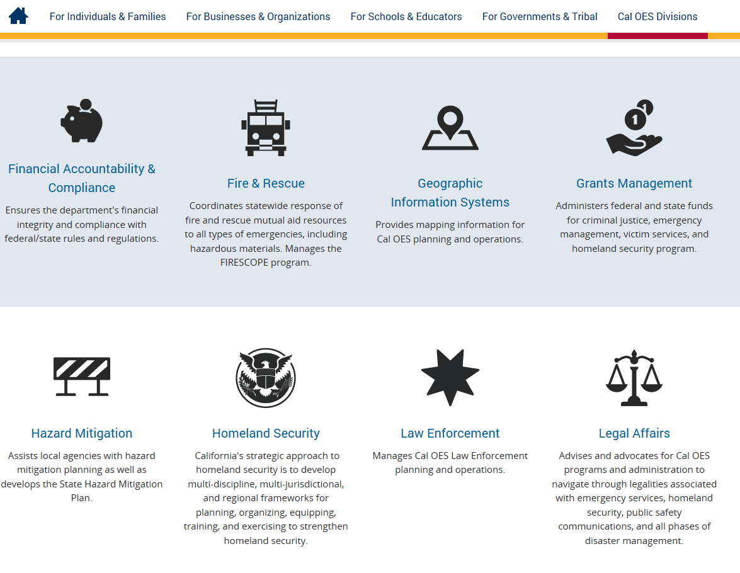
Cal OES Website
www.caloes.ca.gov
http://www.caloes.ca.gov/cal-oes-divisions/grants-management/search-for-grants

Slide 14
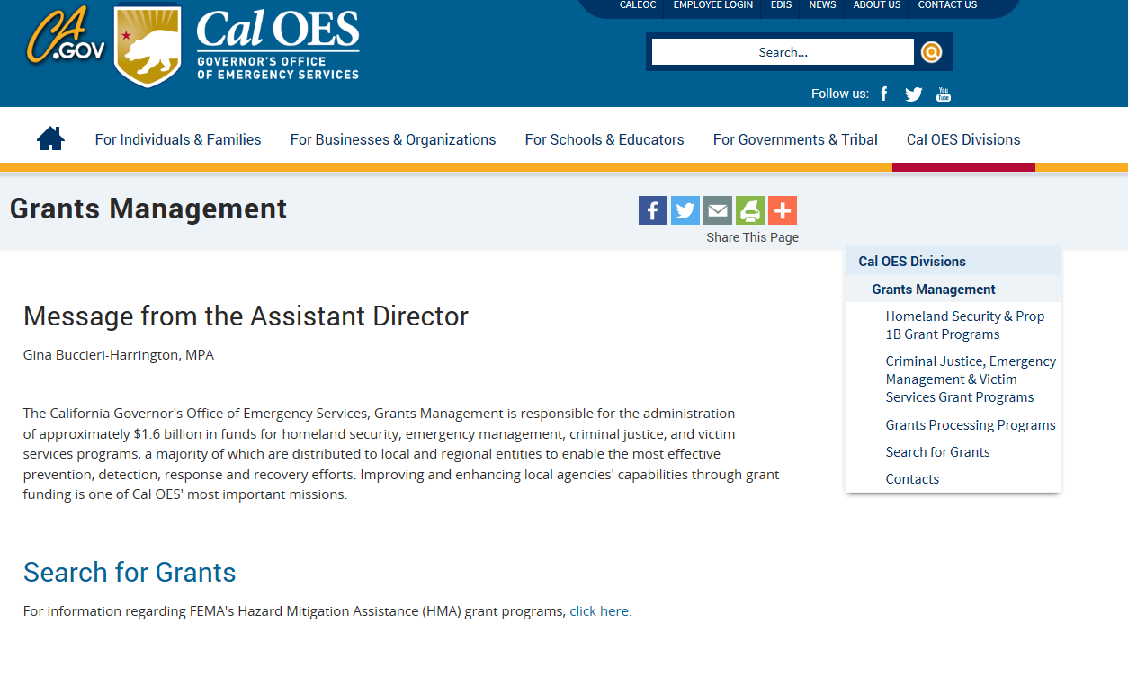
Cal OES Website
www.caloes.ca.gov
http://www.caloes.ca.gov/cal-oes-divisions/grants-management/search-for-grants

Slide 15
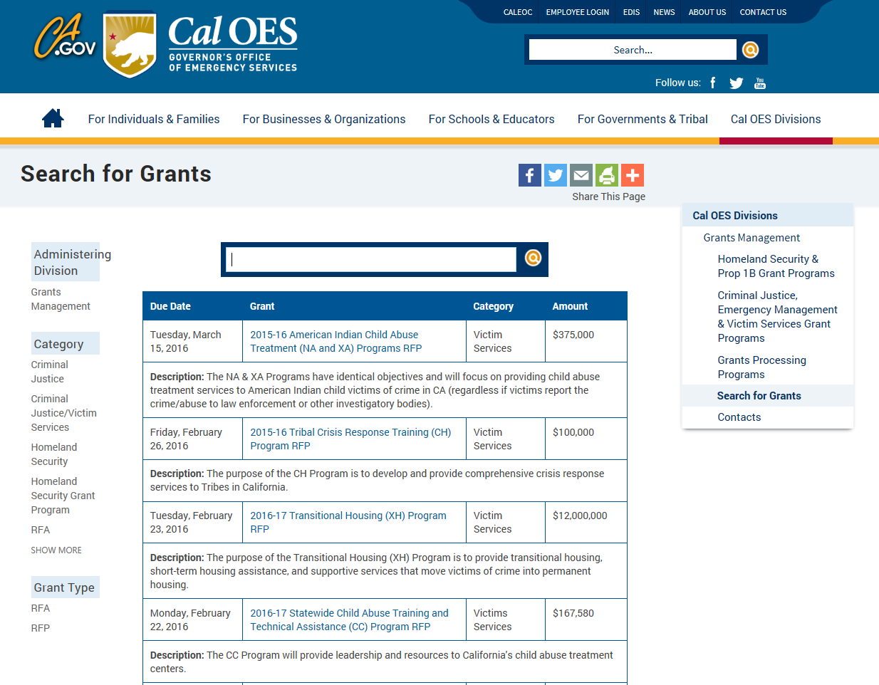
Cal OES Website
www.caloes.ca.gov
http://www.caloes.ca.gov/cal-oes-divisions/grants-management/search-for-grants

Slide 16
County Victim Services Program Overview

Slide 17
County Victim Services Program
p\or as a stand-alone program.
Purpose: | Provide one-time funding to support each of California’s 58 counties, and the City of Los Angeles, in providing direct services to victims.
Eligibility: | Counties and the City of Los Angeles
Anticipated Release: | March 1, 2016; RFA will be posted on the Cal OES website and a link to the RFA will also be sent out by CSAC
Due Date: | April 12, 2016
Anticipated Funding: | $40M. Each county will receive a base amount of $125,000 with the remaining funding allocated based on population and violent crime statistics
Anticipated Grant Period: | July 1, 2016 – June 30, 2018 (24-month period)

Slide 18
County Victim Services Program
p\or as a stand-alone program.
Specific Criteria: | Each county and the City of Los Angeles, must implement a “Victim Services Steering Committee” (VSSC). The VSSC will be tasked with establishing a plan, to include measureable objectives, to address identified victim services gaps/needs. The plan must be submitted with the application and must include the following: Victim services gaps/needs identified Plan to address the identified victim services gaps/needs

Slide 19
County Victim Services Program
p\or as a stand-alone program.
Specific Criteria (continued): | The name of the county agency selected to administer the Grant Subaward from Cal OES, and act as the single point of contact for the grant. The agency selected must be a county victim services provider and provide direct services to victims. Distribution of funds (i.e., even if the Mental Health Department is selected by a county’s VSSC to administer the Grant Subaward for that county, funding can still be “shared” with other county victim services providers and/or community-based organizations [that provide direct services to victims] within that county). Original signatures of all mandatory VSSC members are required on the plan. No exceptions will be made.

Slide 20
County Victim Services Program
p\or as a stand-alone program.
Specific Criteria (continued): | Each VSSC must include MANDATORY representation from the following entities: Adult Protective Services Child Protective Services Courts District Attorney Mental Health Department Police Department (at least one) Probation Sheriff Cal OES- funded Victim/Witness Program Project Cal OES-funded Domestic Violence Assistance Program Project Cal OES-funded Rape Crisis Program Project

Slide 21
County Victim Services Program
p\or as a stand-alone program.
Specific Criteria (continued): | In addition to the MANDATORY representation listed above, each county is STRONGLY ENCOURAGED to add representation from the following entities: Office of the Ombudsman Disabilities Community Emerging Victim Populations Hospitals/Medical Providers School Districts/Schools Teen/Transitioning-Age Youth Tribes/Tribal Groups

Slide 23
Questions?

