Slide 1
Ending DV through Family Intervention and Healthy Relationships
Matt Huckabay, Executive Director
The Center for Violence-Free Relationships

Slide 2
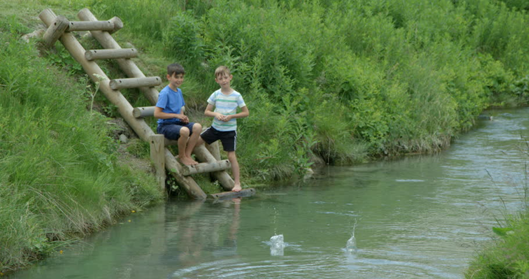

Slide 3
Our brains are wired for connection, but trauma rewires them for protection. That’s why healthy relationships are difficult for wounded people.”
- Ryan North – Co founder One Big Happy Home

Slide 4
The Center for Violence-free Relationships
Building Healthy Relationships, Families and Communities
Intervention/Prevention Services for:
Victims/Survivors - 40 years
Children – 10 years
People Who Cause Harm – 25 years

Slide 5
Positive Solutions
Intervention/Prevention program for people who cause harm
325 Clients Annually
70% Court Mandated & 30% Voluntary
7 Weekly Groups
2 for women / 5 for men

Slide 6
Positive Solutions
73% Graduation Rate
93% of graduates – do not re-offend
3 yrs post graduation

Slide 7
Positive Solutions
2015 Program re-design
Objectives:
Promising Practice to Best Practice
Scalable Program – Pilot Projects

Slide 8
Positive Solutions
Team Members
Joel Abueg- Program Analyst
10yrs- Technology Specialist / Project Analyst
Contra Costa County Office of Education for California Department of Corrections and Rehabilitation, Division of Adult Parole Operations, Program Development Unit.
Plan, design, manage, implement, support instructional and administrative systems for parolee education program sites throughout the state. Implement and manage data collection and analysis.

Slide 9
Positive Solutions
Team Members
Larry Beutler, Ph.D – Program Advisor / Member of BOD
Distinguished Professor of Clinical Psychology- Palo Alto University and Stanford University
Director of the National Center for the Psychology on Terrorism at the Naval Post Graduate School
Past President International Society for Psychotherapy Research
Published 23 books / 350 articles –
Instrumental in developing pragmatic treatments that are directly supported by scientific evidence rather than relying on abstract theory.

Slide 10
Positive Solutions
Program Development - 3 years
3 Client Advisory Groups - Current and Graduates
Design Team members - Group Observations
30 months Curriculum Design
Program Components
Facilitator Training
Curriculum – Facilitator Guide - PowerPoints
Protocols- Procedures (attendance, fees, conflict checks)

Slide 11
Facilitator Training
“ A healer is not someone you go to for healing. A healer is someone that triggers within you, your own ability to heal yourself.”

Slide 12
Facilitator Training- Four Objectives
1. Become familiar w/ curriculum content and structure primarily through observation of and experience in the facilitation process.
2. Provide experiential training of being in the group, designing processes for their facilitation and group management.

Slide 13
Facilitator Training- Four Objectives
3. Increase facilitators ability to go beyond simply training to facilitate a healing environment; to one that supports participants ability to identify feelings & core wounding that underlie violence while learning tools and techniques to overcome the behaviors and patterns of violence.
4. Work w/ facilitators to create a community of support and practice where those doing harm support each other in releasing the feelings that trigger violence while developing the behaviors that increase self love, loving relationships and healthy families.

Slide 14
Curriculum
3 core competencies - 9 modules - 52 sessions
What’s the problem - Identification of behaviors
3 Modules / 15 Sessions
Where do these behaviors come from – Core Wounds/Feelings/Needs
3 Modules / 15 Sessions
How to change these behaviors – Tools and Techniques
3 Modules / 22 Sessions

Slide 15
Curriculum
Session Structure
Feelings Check In / “Stretch” report out
30 min Topic Presentation
90 min Practical Application of Topic
Accountability – “Stretch” Homework

Slide 16
Assessments - Challenges
Pre and Post test differences of raw scores are poor measurements
Challenge w/ most readily available assessment tools is they are designed for measuring change in an individual receiving 1:1 services.
Assessments have to be constructed to measure individual change with in a group setting.

Slide 17
Assessments
3 Areas of Focus
What is the quality of the relationship between Facilitator and Client – perceptions of both client and facilitator of themselves and of each other
What change is occurring in the individual.
What is the facilitator doing that is producing the change in the individual.

Slide 18
Assessments – Individual Change
3 Basic Phases of Change
Change from Hopelessness to Hopeful (6-10 sessions)
Change in Symptomology (11-30 sessions)
Change in Character (30-52 sessions)
Assessments need to be done at end of each phase.
Solidify one phase of change before moving to the next phase.

Slide 19
Assessments - Pilot
Selected three assessments to pilot
Measuring efficacy, feasibility and client compliance w/ assessment process
Converting to electronic format
Launch assessment pilot January 2020
Pilot Goals
Which are the most essential
Identify if we need all or parts of each assessment

Slide 20
We need you!
Create a Best Practice Program w/ Empirical Data
    Pilot Program Expansion
    Facilitator Training
    Organizational Readiness

Slide 21
Final Thought
“Trauma is a fact of life, It does not however have to be a life sentence.”
Contact Info:
MattH@thecenternow.org

Slide 22
The origin of the word ‘trauma is the Greek for ‘wound’. If I wounded you, if I cut your flesh, the healing would involve scar tissue forming. If the wound was great enough, you’d get a big scar, and it would be without nerve endings so you wouldn’t feel, and it would be much less flexible than your normal tissue.
Trauma is when there is a loss of feeling and there is a reduced flexibility in responding to the world this is a response to a wound.
Dr. Gabor Mate

