Slide 1
California’s Clean Economy
F. Noel Perry Founder of Next 10

Slide 2
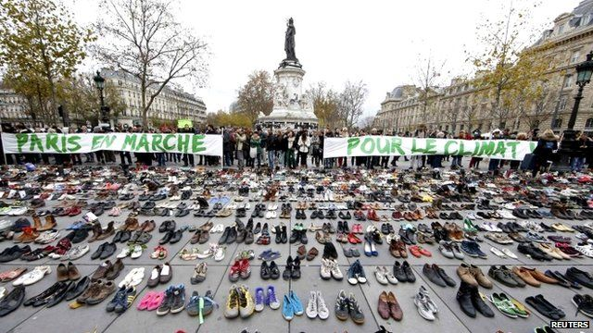
Right Now In Paris

Slide 3
Right Now In 58 California Counties
Chapter 14 CSAC Climate Change Policy Guidelines
General principles: Fiscal, land use, transportation, housing, water, forestry, agriculture, recycling
Transportation, housing, and transit are key to meeting climate goals

Slide 4
What is Next 10?
Independent, Nonpartisan, Nonprofit Organization founded in 2003
Next 10’s Focus: Clean Energy Economy, State Budget, Governance
Next 10 commissions expert research to educate, engage and empower Californians
Next 10 makes tools: California Budget Challenge, California Choices, Cool California

Slide 5
Recent Work
Transportation Scorecard An analysis grading 489 neighborhoods within a ½ mile radius of a rail station and 6 rail systems: MUNI: B, BART: B-, LA Metro Rail & Sacramento Regional Transit: C, San Diego Metropolitan Transit & Santa Clara VTA: C-
Water Issue Brief California ranks high in water usage, but innovation in the water industry can help meet water demands
Manufacturing and Energy Efficiency Issue Brief CA ranks #2 in Electricity Productivity -- generating much more GDP per dollar spent on electricity than other states. CA ranks #1 in Manufacturing with the most output, jobs, and exports

Slide 6
Presentation
California Efforts
California, the 8th largest economy in the world ($2.2 trillion GDP), is a global leader in reducing emissions
Regional Efforts
California regions benefit from environmental policies, new clean economy businesses, jobs and health benefits
International Efforts
California will continue to be a model for the world through policies that meet emission reduction targets

Slide 7
California GHG Emission Goals
AB 32: Reduce emissions to 1990 levels (431 MMT) by 2020
Executive Orders: Reduce emissions 40% below 1990 levels by 2030 and 80% below 1990 levels (to 86 MMT) by 2050
SB 350: 50% of electricity from renewables, increase energy efficiency standards by 50% by 2030
Key to meeting 2030 and 2050 California emissions goals is solving transportation challenge

Slide 8
CA Foundation: Pioneering Public Policy
LA Air Pollution Control District
1977 Appliance Efficiency Standards (Title 20)
New Building Efficiency Standards (Title 24)
1982 Utility revenue decoupling
CA Renewable Portfolio Standard
Vehicle Emission Standards (Pavley AB 1493)
CA Global Warming Solutions Act (AB 32)
The policies and many others provide community benefits and create jobs.
Notes:
Building efficiencies adopted have saved Californians more than $74 billion in reduced electricity bills since 1977, creating over 1.5 million full time jobs
Our renewable portfolio standard has increased renewable energy generation jobs by 61% over the last decade, with more than 42,000 today

Slide 9
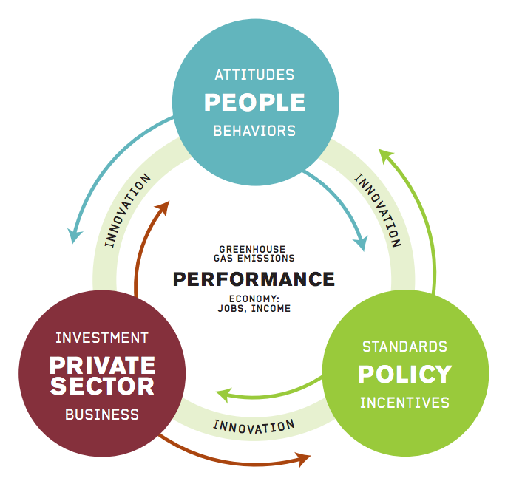
How? California Working Together
Counties and Cities
People of California: polling
Senate, Assembly and the Governor
Agencies: CEC, CPUC, CARB
Research Institutions: Lawrence Berkeley National Laboratory, University of California
Entrepreneurs, Business

Slide 10
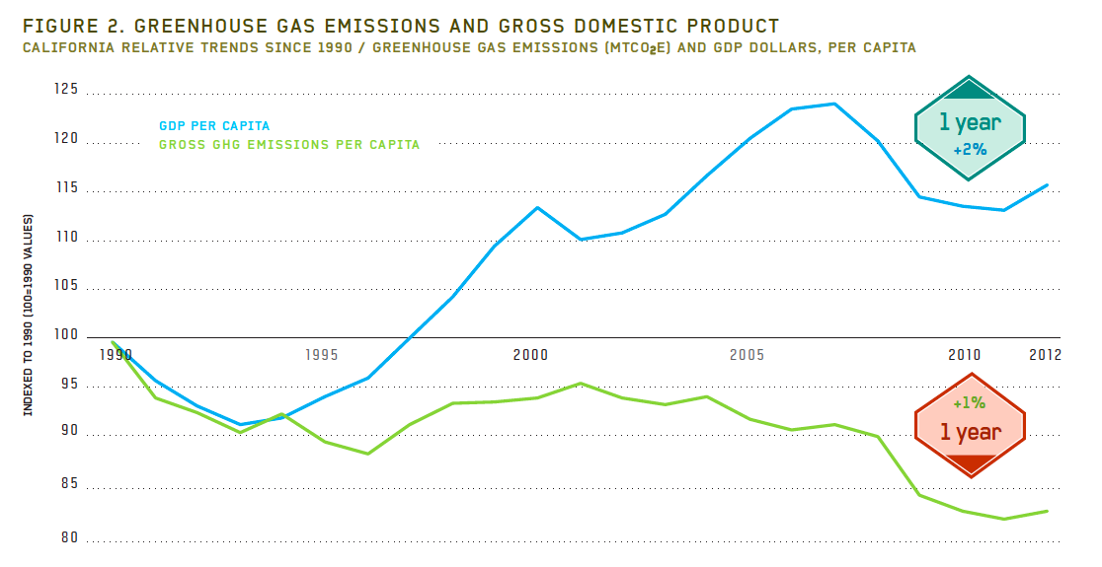
Result: GHG Emissions & GDP

Slide 11
Under2MOU.org

Slide 12
California’s Regional Clean Economies
Bay Area: Advanced transportation, energy storage, building energy efficiency
LA and Orange Counties: Electric and hydrogen fuel cells, alternative fuels such as compressed natural gas (CNG) and renewable natural gas derived from waste, energy storage and smart grid
San Diego and Imperial Counties: Smart grid, biorenewables
Sacramento Area: Electric vehicle deployment, energy efficiency technologies and solar panels, waste to energy development
San Joaquin Valley: Water and agriculture convergence, renewable energy development

Slide 13
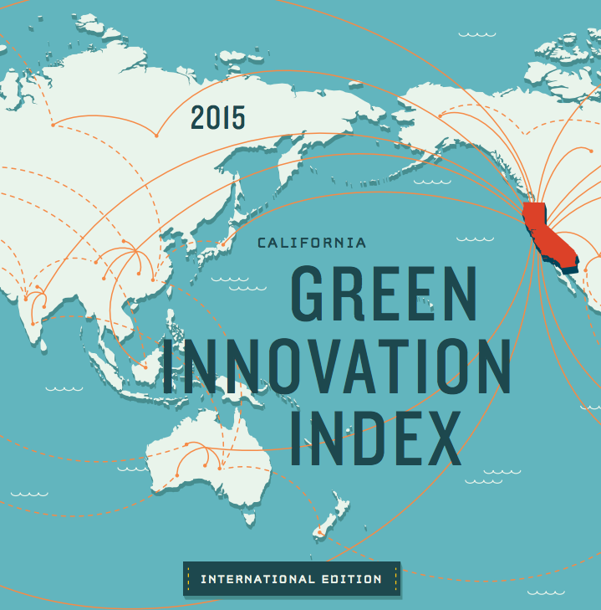
California Green Innovation Index International Edition

Slide 14
Good News: 2014 Global Emissions Decreased
The world may have reached an important tipping point away from fossil fuels and to clean energy
Globally, we are now adding more capacity for renewable power annually than fossil fuels
In 2014, the world economy grew but carbon emissions did not, according to the International Energy Agency
This decoupling shows worldwide what we’ve seen in individual countries and here in California: you can grow the economy while cutting greenhouse gas emissions

Slide 15
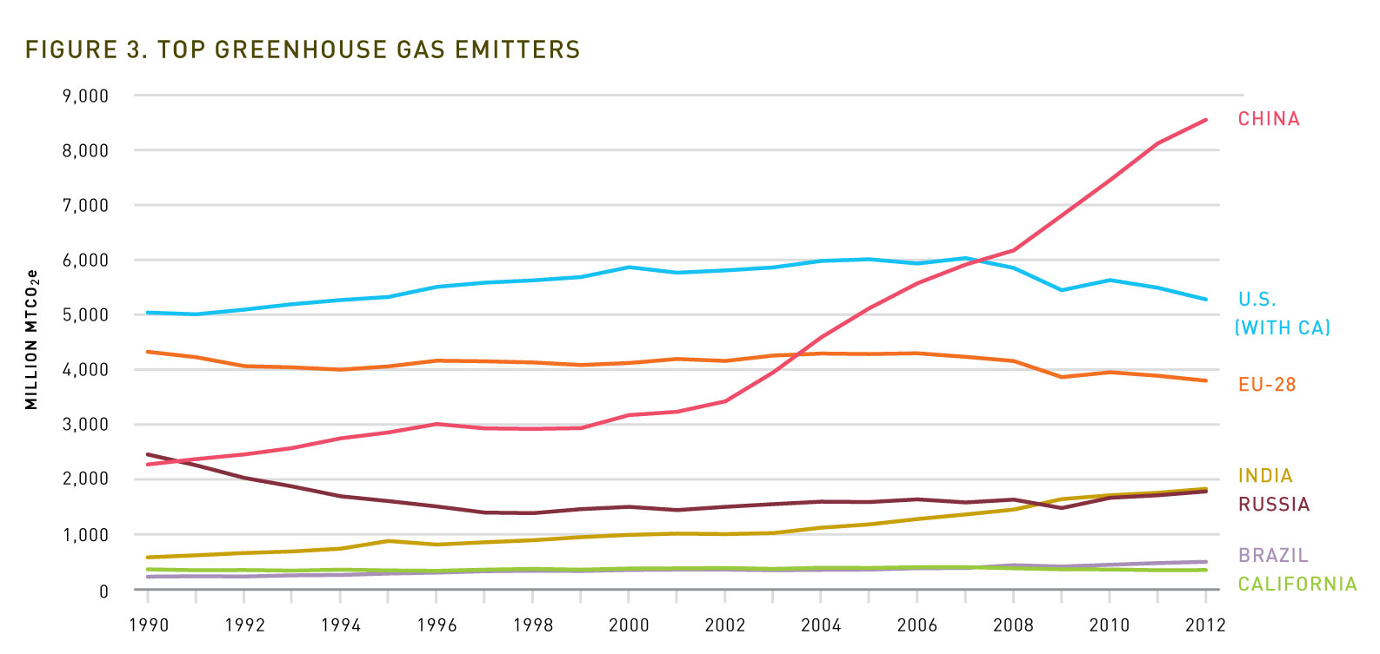
Bad News: 1990-2012 Global Emissions Increased 51%
Notes:
Worldwide, greenhouse gas emissions have increased 51% since 1990
At the same time, California’s emissions increased, but with policies in place, we will be at 1990 levels by 2020 or before

Slide 16
Summary of Rankings out of Top 50 Polluters
 | Highest GHG Emissions | Lowest Emissions Per Capita | Lowest Energy Per Capita | Lowest Electricity Per Capita | Lowest Carbon Intensity | Highest Energy Productivity | Highest Share of Renewable Electricity | Highest Total Renewable Electricity
China | 1 | 20 | 16 | 18 | 46 | 44 | 26 | 3
United States | 2 | 44 | 44 | 46 | 16 | 19 | 15 | 2
EU-28 | 3 | 25 | 30 | 30 | 10 | 9 | 6 | 1
India | 4 | 5 | 4 | 5 | 42 | 37 | 22 | 10
Russia | 5 | 36 | 39 | 33 | 44 | 47 | 35 | 27
Japan | 6 | 34 | 33 | 39 | 7 | 3 | 18 | 7
Germany | 7 | 33 | 35 | 35 | 9 | 6 | 2 | 4
South Korea | 8 | 41 | 40 | 44 | 28 | 31 | 33 | 28
Iran | 9 | 27 | 26 | 16 | 48 | 48 | 39 | 37
Saudi Arabia | 10 | 46 | 45 | 42 | 41 | 42 | 43 | 43
Canada | 11 | 43 | 46 | 48 | 14 | 26 | 23 | 13
Brazil | 12 | 8 | 10 | 14 | 6 | 16 | 13 | 9
United Kingdom | 13 | 28 | 28 | 27 | 5 | 4 | 9 | 11
South Africa | 14 | 32 | 23 | 24 | 45 | 40 | 37 | 35
Indonesia | 15 | 6 | 6 | 4 | 29 | 27 | 16 | 20
Mexico | 16 | 11 | 12 | 11 | 23 | 21 | 20 | 15
Australia | 17 | 45 | 43 | 45 | 18 | 12 | 21 | 19
Italy | 18 | 19 | 24 | 26 | 3 | 2 | 3 | 6
France | 19 | 18 | 34 | 36 | 1 | 7 | 19 | 12
California | 20 | 31 | 37 | 37 | 2 | 5 | 4 | 8

Slide 17
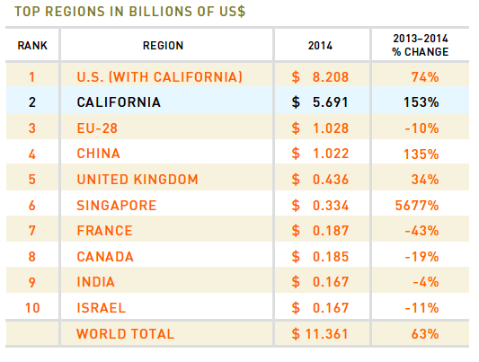
VC Investment in Clean Tech

Slide 18
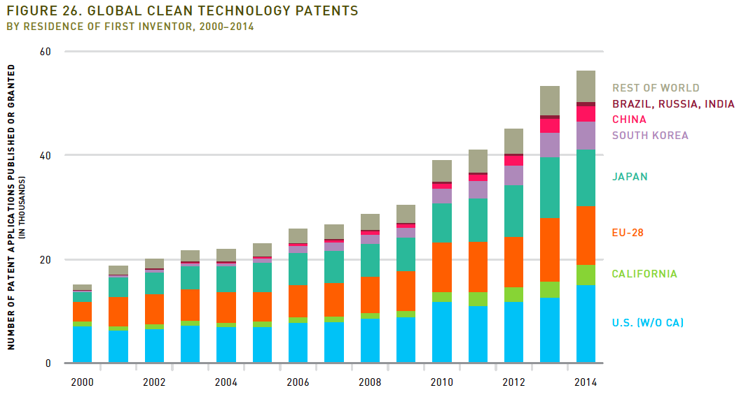
Global Clean Tech Patents 2000-2014

Slide 19
Upcoming Work
Compare 50 Re-released data charting website comparing 50 states on over 100 indicators
Economic Issue Briefs Policy studies on CA’s business climate, employment by income, energy use, net migration, housing, and state spending
California Carbon Challenge 2030
2016 California Green Innovation Index
Notes:
Slide purpose: to introduce Next 10

Slide 20
