Slide 1
Legislative Coordinators Meeting
129th Annual Meeting
November 15, 2023

Slide 2
Statewide Initiative 23-0015A1:
“The Government Transparency Act”
Eric Lawyer, Legislative Advocate, CSAC
Jessica Sankus, Senior Legislative Analyst, CSAC

Slide 3
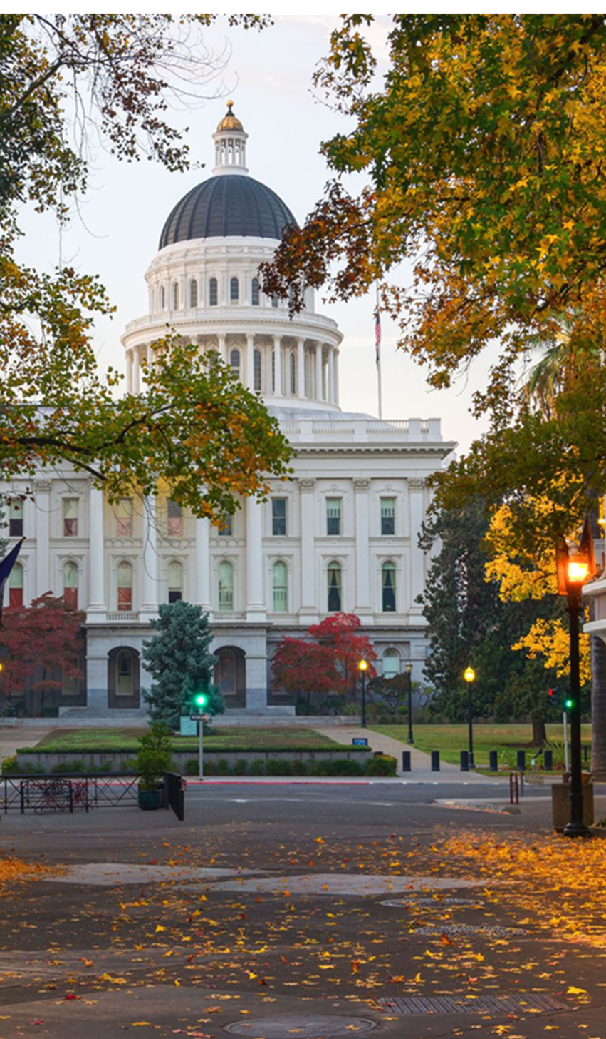
Advocacy Team
CSAC staff work diligently with legislators and their staff, as well as with local government partners to help shape the bills that impact counties.
Please reach out to the CSAC Advocacy Team to stay updated on the latest developments concerning the status and impact of pending legislation.
www.counties.org/csac-advocacy
Eric Lawyer
Legislative Advocate
elawyer@counties.org
Jessica Sankus
Senior Legislative Analyst
jsankus@counties.org

Slide 4
“The Government Transparency Act”
Makes sweeping changes to California’s Public Records Act and the Legislative Open Records Act—fundamentally changing how public records are disclosed and maintained.
The scope and scale of the changes to existing law affects all public agencies and levels of government.
Sponsor: Consumer Watchdog

Slide 5
“The Government Transparency Act”
Where is the measure now?
Filed with the Attorney General’s Office in August 2023.
Intends to qualify for the November 2024 statewide ballot.
Cleared by the Attorney General’s Office for circulation to gather signatures.
Requires 546,651 signatures to qualify.
Signatures due to county governments by April 3, 2024.

Slide 6
Access to Governmental Agency Public Records
Requires agencies to provide records within 30 calendar days of the request (and up to 90 calendar days only for “extraordinary circumstances”).
Prohibits assessing fees for the staff labor to procure records.
Limits fees to the direct cost of duplicating records, or a fee of $0.10 per page, whichever is less.
Severely limits ability to withhold or redact records.

Slide 7
Private Contractor Records
Exposes records maintained by private contractors for work conducted on behalf of public agencies to the Public Records Act.

Slide 8
Required Postings of Documents
Requires agencies to post a broad, specified list of documents within 10 calendar days of their creation, on a webpage titled “Public Records Available for Review,” or something similar. Documents include:
Settlement agreements;
Court records in which the agency is a party;
Government tort claims received by the agency;
All contracts and annual budgets.

Slide 9
Retention of Records
Requires local and state government agencies to retain records for no less than five years.

Slide 10
Impacts on the Legislature:
Requires lawmakers to disclose the location, date, time, and purpose of meetings with lobbyists, public events, and fundraising events.
Expands public access to legislative records to include individual lawmakers.
Requires access to lawmaker or legislative staff misconduct records.
And more.

Slide 11
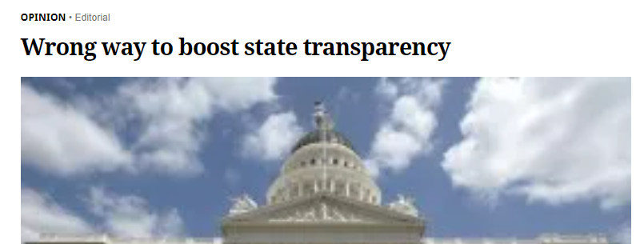
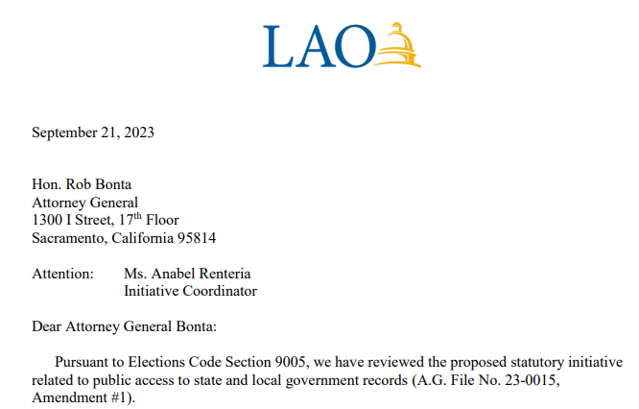
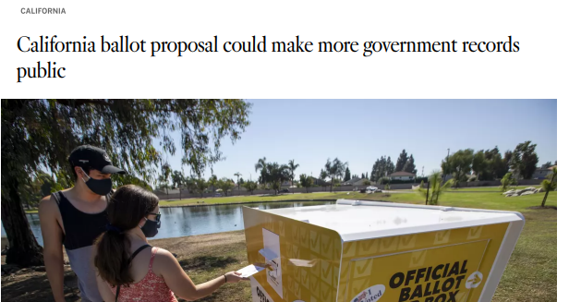
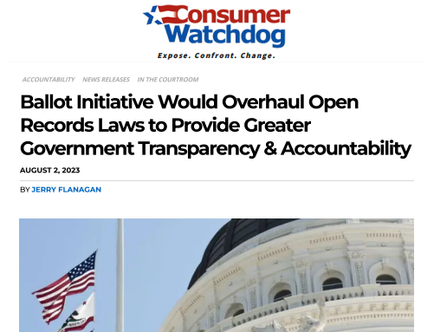
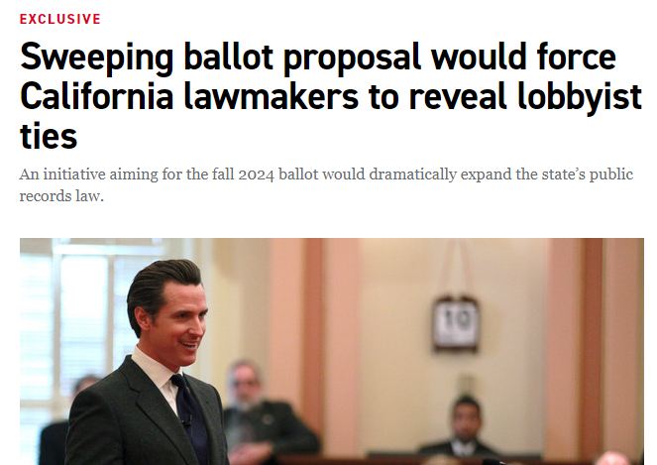
What Are People Saying?
Legislative Analyst’s Office:
“We estimate that this measure would result in net increased costs on state and local governments—likely reaching over $1 billion annually depending on how this measure is implemented.”

Slide 12
What’s Next? We want to hear from you!
How would this measure affect your county?
Would you like to share your experience administering the Public Records Act?
Look out for communications from CSAC on this issue in the near future!
Contact us: elawyer@counties.org or jsankus@counties.org

Slide 13
THANK YOU
Copyright 2023 by California State Association of Counties®

