Slide 1
Undocumented & Uninsured The Fight for Health4All
Ronald Coleman
Government Affairs Manager
California Immigrant Policy
CSAC Annual Conference
December 3, 2015

Slide 2
Founded in 1996, CIPC is a non-partisan, non-profit statewide organization that seeks to inform public debate and policy decisions on issues affecting the state’s immigrants and their families in order to improve the quality of life for all Californians. CIPC engages in policy advocacy, and also provides technical assistance, training and education on immigrant issues.

Slide 3
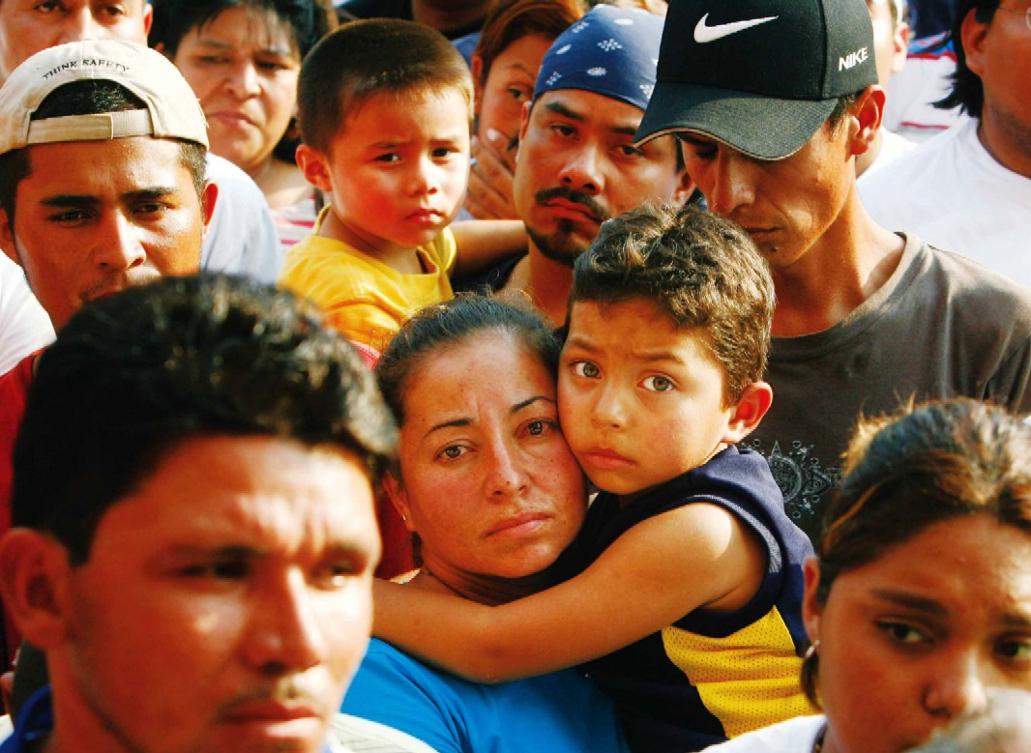
Undocumented Immigrants in the U.S.
11 million undocumented immigrants nationwide
2.7 million are in the state of CA
Prior to Admin. Relief: Deportation Raids
2 million deportations under the President Obama Administration
Fear and mistrust
in immigrant
communities

Slide 4
The Path to Health for All: California Takes Steps to Integrate Immigrants
Driver’s Licenses – AB 60 (Alejo), 2013
TRUST Act – AB 4 (Ammiano), 2013
Professional Licenses SB 1159 (Lara), 2014
and State Bar Dream Act AB 1024 (Gonzalez, 2013)
Protections for Workers – Anti-Retaliation, E-Verify
Full Scope Medi-Cal for All Low-Income Lawfully Present Immigrants; Transitioning to Covered California Soon

Slide 5
What Has California Done to Ensure Access to Healthcare for Immigrants?
What more should be done?

Slide 6
Immigrants and the Affordable Care Act
Eligibility
All lawfully present immigrants are eligible for the ACA and financial assistance (Deferred Action for Childhood Arrivals recipients are not eligible)
Undocumented immigrants are not eligible to purchase coverage through our state’s exchange Covered CA or for full scope Medi-Cal
Barriers
Mixed status families – confusion about eligibility, fear, lack of information.
Complexity of U.S. healthcare system
Undocumented people and DACA recipients were wrongfully charged a tax penalty for not having health insurance

Slide 7
Immigrants and Covered California
Barriers
Mixed status families – confusion about eligibility, fear, lack of information.
Complexity of U.S healthcare system
Language and cultural access
Eligibility
Lawfully present immigrants are eligible for the Exchange and subsidies/assistance.
DACA/DAPA recipients are not eligible for the exchange but are eligible for full-scope Medi-Cal
Undocumented immigrants are not eligible to purchase coverage through Exchange or for full scope Medi-Cal

Slide 8
Undocumented Californians and Health Access
The Affordable Care Act (ACA) has expanded health coverage to millions of Californians
Remaining Uninsured
UC Berkeley Labor Center study- After the full implementation of the ACA, there will be 2.7-3.4 million Californians who will remain uninsured
About 1.2 million will be undocumented Californians
Band-Aid Care
Patchwork of coverage for the undocumented.
County Coverage: Some counties offer coverage, other counties don’t offer any coverage, and some offer limited scope/duration coverage.
Emergency and charity care

Slide 9
Administrative Relief: Deferred Action
2012 – DACA – Approximately 300,000 Californians
2014 – Approximately 1.3 Million Eligible with Expanded DACA and DAPA
Protection from Deportation – Work Permit
TX Lawsuit
Recent DOJ appeal
Timelines
Expectations

Slide 10
DACA/DAPA Recipients & Medi-Cal
Deferred Action for Childhood Arrivals (DACA) Program passed in June 2012
President Obama’s announcement to excluded DACA’s from the ACA
PRUCOL eligibility category
PRUCOLs are eligible for many safety net programs in California, including full scope Medi-Cal.
Therefore, DA recipients are eligible for full scope Medi-Cal, if they meet the income requirement of 138% of the FPL
Issues: enrolling for Medi-Cal, youth being turned away, county workers not knowing DACA status and/or procedure
DHCS MEDIL “memo” released- clarifies DACA eligibility for Medi-Cal

Slide 11
CA Programs Available Regardless of Status
Emergency Medi-Cal
Prenatal care (Medi-Cal)
Access for Infants and Mothers (AIM)
Long-term care
Early Breast Cancer Detection
Breast and Cervical Cancer Treatment
California Children’s Services (CCS)
Children’s Health Initiatives
Health Programs in some counties (Healthy SF, Healthy Way LA Unmatched)
Community clinics
Child Health and Disability Prevention Program (CHDP) and CHDP “Gateway”
Family PACT
Minor consent services
Mental health services
Regional Center Services
Women Infants and Children (WIC)
School lunch and breakfast

Slide 12
What type of care do immigrants receive?

Slide 13
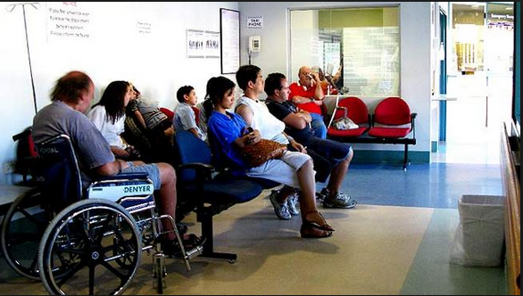
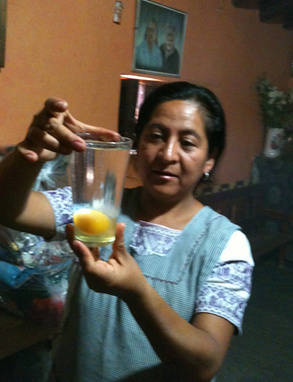
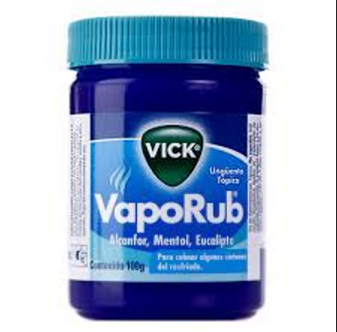

Slide 15
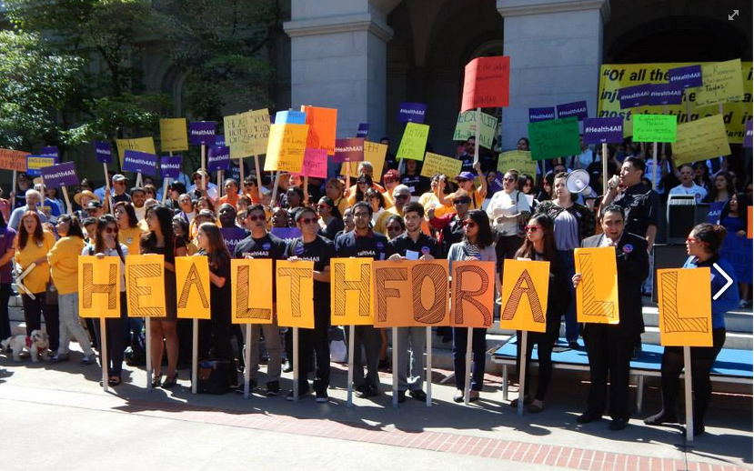
HEALTH4ALL

Slide 16
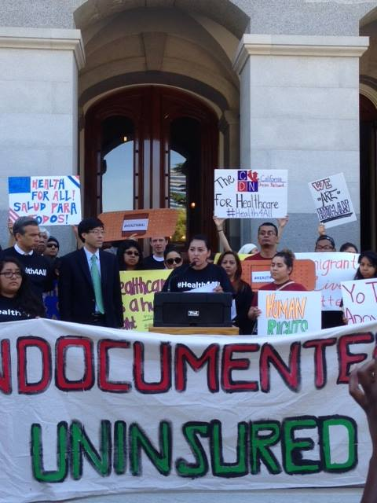
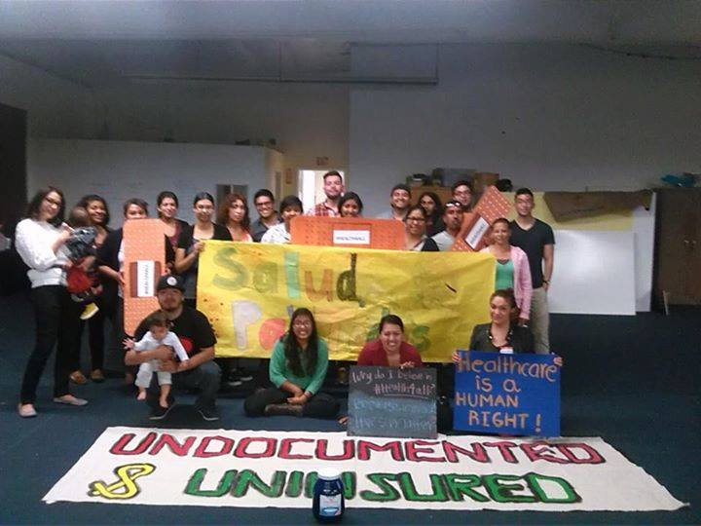
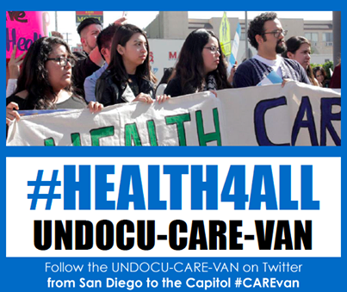
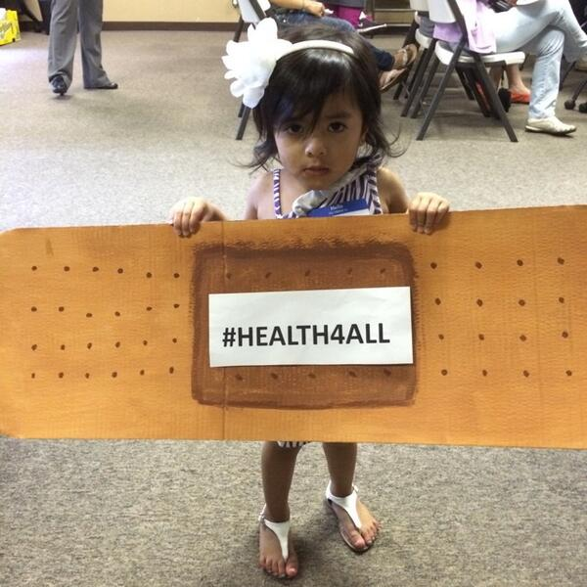
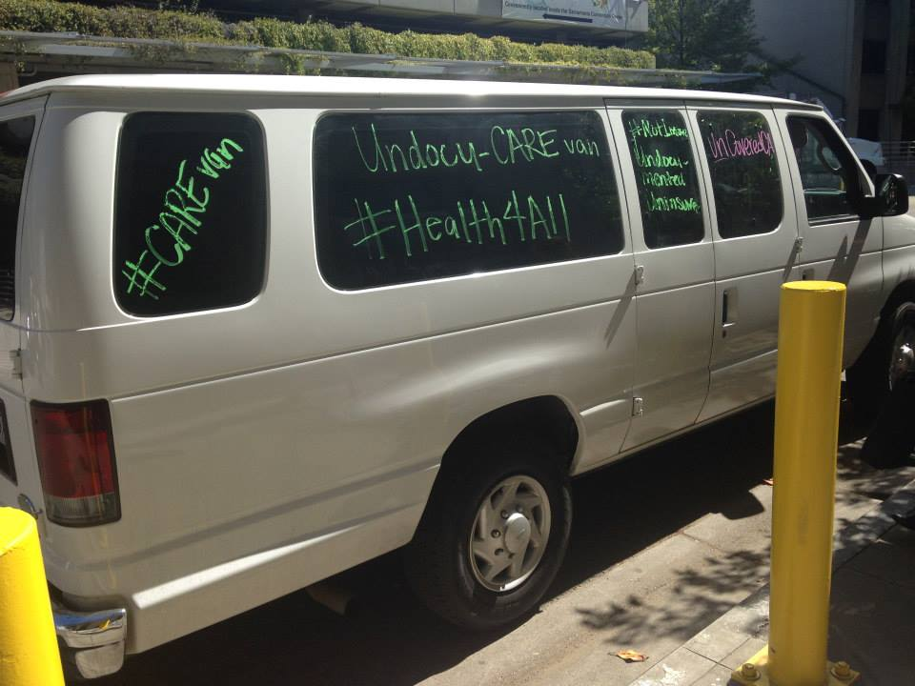
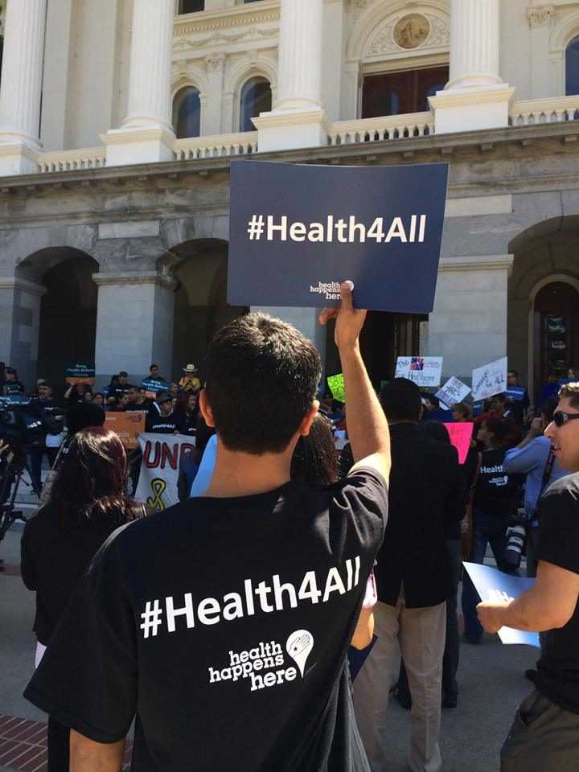
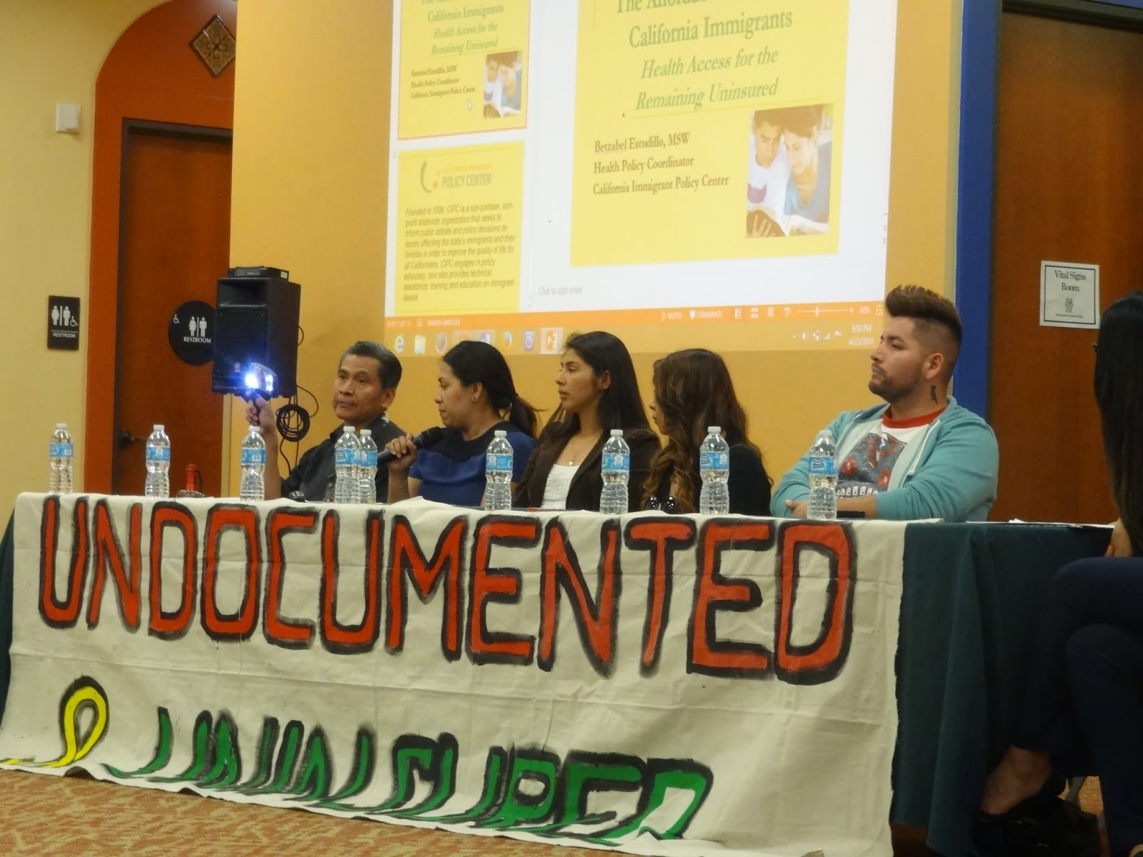
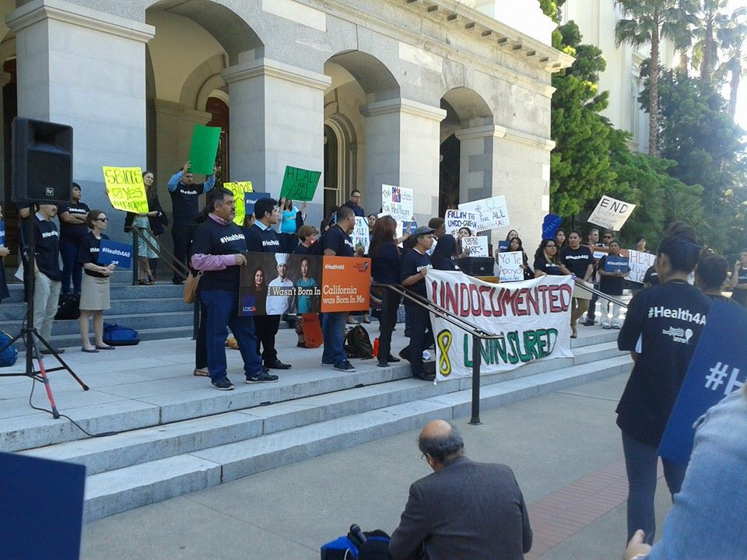

Slide 17
Why is Health4All important?
Though the state provides health care services through programs with limited scope or duration, and some counties provide coverage regardless of immigration status, it is not enough.
Health Care system works better when everyone participates
Emergency room treatment is expensive
Everyone deserves comprehensive and adequate care
Healthy Parents, Thriving Families
Undocumented immigrants are a major economic engine for California, and contribute to the state’s revenue
Health is a Human Right
Undocumented Immigrants Contribute Greatly -- $3.2 B in taxes – 9% of CA’s workforce

Slide 18
Pro-Immigrant Investments in 2015-2016 Budget
The 2015-2016 state budget included exciting and historic package of investments that will help lift up our immigrant communities.
In regards to immigrant health, this year’s budget lays the foundation for improving access to health for immigrant communities by:
Investing an initial $40 million and an ongoing $132 Million commitment in state funds to expand access to Medi-Cal for undocumented children, regardless of immigration status.

Slide 19
SB 4 (Lara)
First introduced By Senator Ricardo Lara in 2014 as SB 1005
Re-introduced in December 2014 by Senator Ricardo Lara
The proposal will ensure that undocumented children in our communities have easy/seamless access to quality and affordable healthcare if they are currently enrolled in Restricted Scope Medi-Cal
Coalition Building: Diverse coalition of immigrant rights groups, health and consumer advocates, labor, and many others
Signed by Governor Brown on October 9, 2015!

Slide 20
SB 4- Building Blocks Towards Health4All
Building upon recent budget actions, SB 4 (Lara) will ensure the successful and seamless enrollment in full-scope Medi-cal for all eligible undocumented children. As amended, SB 4 contains important “technical fixes” to ensure that:
Undocumented children who will be eligible for comprehensive Medi-Cal under the state budget will transition from restricted scope Medi-Cal to full scope Medi-Cal without barriers to continued enrollment.
Children with serious medical conditions that require specialty care, who are being newly enrolled in the program, will be properly evaluated and referred
What to Do Today: ENROLL YOUR CHILDREN IN MEDI-CAL

Slide 21
Next Steps on Health4All
SB 10 – Legislation and Budget
Seeks to allow undocumented adults to receive comprehensive Medi-Cal, if funding is made available.
Allow all Californians, regardless of immigration status, to purchase coverage through Covered California with their own money by requiring the state to apply for a federal Section 1332 waiver (a formal request to the federal government).
County Efforts Continue
Federal Effort: Exchange Inclusion for a Healthy America Act of 2015

Slide 22
Budgetary Challenges to Next Steps
Fiscally Prudent Governor
Expiration of Prop 30 and 2018-2019 Deficits
HHS Budget: General, MCO Tax, and 1115 Waiver
Other Priorities

Slide 23
What can you do?
Outreach Fairs to Enroll Children in Restricted Scope Medi-Cal
Cover Adults with Children Moving to Medi-Cal
Town Halls in Your Communities to Engage Constituents in Your Efforts
Partner with Advocacy Groups and CBOs
Start An Effort in Your Community to Create, Expand, Support State Effort, etc.
Participate in legislative visits
Join community actions, town halls, information sessions
Share and Collect constituent stories
Share information on social media
#Health4All

Slide 24
Ronald Coleman
Government Affairs Manager
California Immigrant Policy Center
Los Angeles I Oakland I Sacramento
rcoleman@caimmigrant.org

