Slide 1
The Coverage Gap: The True Costs of Undocumented Care
Richard Figueroa
The CA Endowment
CA State Association of Counties
December 3, 2015

Slide 2
Current Landscape – Recent Wins
Millions of Californians have gained health coverage.
Governor Brown and the Legislature agreed to extend access to full-scope Medi-Cal to all low-income children regardless of immigration status
Counties across the state are expanding their indigent care programs

Slide 3
However, California May Have 3 Million Remaining Uninsured

Slide 4
Who Needs More Help?
Especially on affordability, some folks will need more help:
Uninsured, undocumented immigrants
Those in “family glitch”: family members of workers with employer based coverage affordable for just themselves
Some over 400% federal poverty level (typically older, in high-cost areas) who don’t have affordability guarantee
Those in Exchange who find monthly premiums/cost sharing still a burden, and may/may not decline coverage.

Slide 5
Who Are the Remaining Uninsured
Nearly 2/3 of the remaining uninsured are Latinos
Over half of the uninsured speak Spanish at home, (both alone and in addition to English)
Over 1 million Californians are locked out of health coverage due to immigration status
Notes:
31.3% speak English and Spanish at home; 19.9% speak Spanish at home.

Slide 6
Our Current Safety-Net
Uninsured live sicker, die younger, and are one emergency from financial ruin.
Emergency Rooms: But only to stabilize emergencies; bills and debt afterwards
Private providers: clinics, hospital charity care
Counties as the final safety-net option:
Counties have a “17000” obligation to provide basic care
How, what and to whom they provide care and services varies, especially based on income & immigration status.
Amidst 58 counties, 12 have public hospitals;
Eleven counties have clinics, or contract with private providers; or are a hybrid
Thirty-five small rural counties in County Medical Service Program

Slide 7
Progress for County Safety-Net Programs
There is a trend toward expanding access to the undocumented: Sacramento, Contra Costa, Monterey, and 35 rural counties in CMSP expanded their eligibility, including offering a limited benefit to include the undocumented. Fresno, after suing to not serve the undocumented, has established a program to fill a gap in specialty care for the undocumented.
Some counties are enhancing their safety-net, with programs like My Health LA and Healthy SF, and most recently in Santa Clara.
The proposed Medi-Cal Section 1115 Waiver seeks more flexibility with DSH and Safety-Net Care Pool (SNCP) funds to create new financial incentives & imperatives for public hospital counties to provide preventive & primary care services, and medical homes and coverage-like services, to the remaining uninsured. One year of SNCP funding is committed, but other years of funding likely through the waiver.
All of these efforts are bridges to a statewide solution.

Slide 8
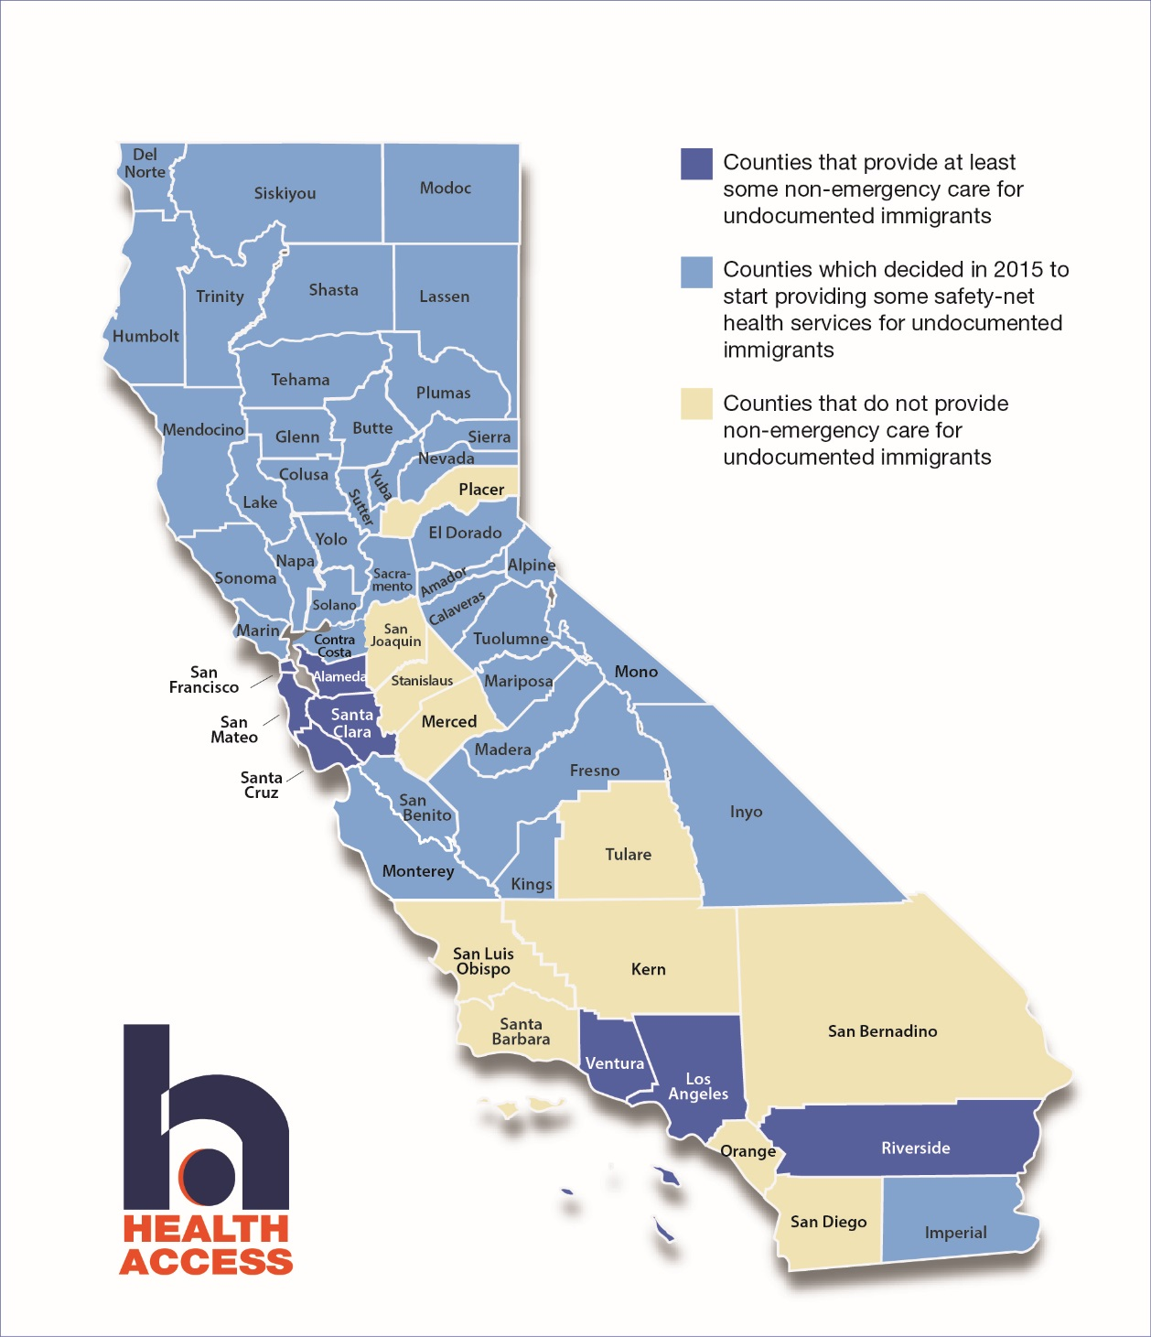

Slide 9
California’s New Steps to Statewide #Health4All
Continuing California's coverage of "Deferred Action“ immigrants: The President's Executive Action had the impact of expanding the category of immigrants covered by state-funded Medi-Cal. This was affirmed in the new state budget but is on hold by the federal court.
Winning full Medicaid (Medi-Cal) coverage for all children at or under 266% FPL-regardless of immigration status. This is an $132 million state General Fund annual commitment to fully cover an estimated 170,000 children.
Pending for next year, Senate Bill 10 (Lara) would expand Medi-Cal to all adults regardless of immigration status, and would seek a federal waiver to allow undocumented adults to buy into Covered California with their own money.

Slide 10
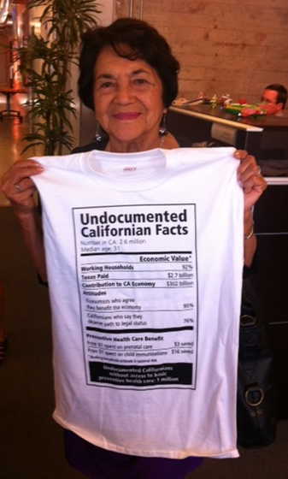
Possible Financing for #Health4All
These Californians are already in our health system today, getting
care in the most expensive, least efficient way.
More effective use of existing dollars:
Maintain federal $ for restricted scope ER Medicaid
Savings from existing programs
Natural recoupment from county safety-net
More effectively use state-only Medicaid
Opportunities under Medicaid waiver
President Obama’s executive action and deferred action
Decisions to deal with the remaining costs:
Additional revenues face a 2/3 vote
Making this a budget priority, against other priorities
Phasing in/starting with a down payment with a proposal under a certain dollar amount.

Slide 11
#Health4All Campaign

Slide 12
Taking The Next Steps: What We Believe
ALL Californians, regardless of immigration status, should have access to affordable preventive health care.
Access to health coverage is a basic human right.
Our health care system works best when everyone participates. A health care system that excludes anyone, hurts everyone.
It’s up to us to finish the job here in California and make sure everyone has access to health coverage they need.

Slide 13
How: Outreach Campaign
Changing the Narrative
Spanish Media Partnership: Univision, Telemundo and La Opinion
Media Advocacy
Boots on the Ground
Building Healthy Communities Partnerships
Core partners
Notes:
Our goal is to bring in the voices of the undocumented into this conversation.

Slide 14
Core Messages
Investing in California: Undocumented Californians are an economic engine for the state. An overwhelming percentage work and pay taxes. They are an economic asset. Investing in them is investing in our state.
Prevention Makes Economic Sense: Emergency room treatment is an expensive substitute for preventive care. It makes economic sense to invest in preventive services that minimize the risk of chronic disease and more chronic treatment later on.
Increasing Access to Affordable Care is the Responsible Thing to do: Everyone—regardless of ability to pay or immigration status—should have access to affordable health care. After Obamacare, the remaining uninsured, including the undocumented, should have access to affordable care, including a comprehensive set of preventive services and a health home.

Slide 15
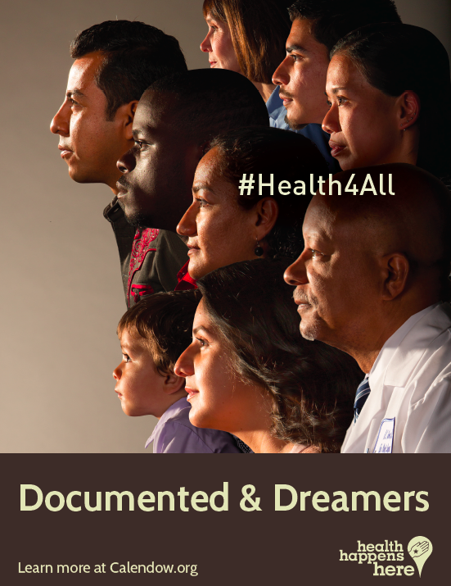
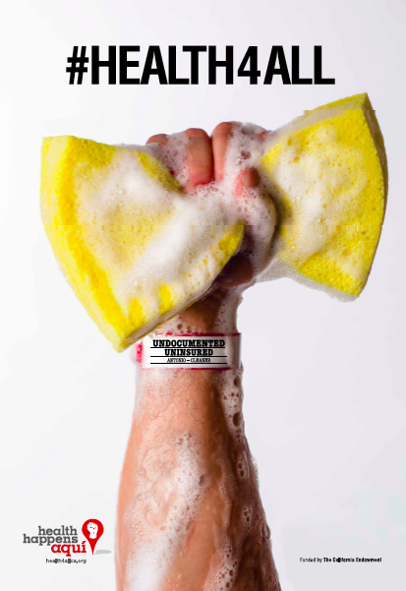
Paid Media

Slide 16
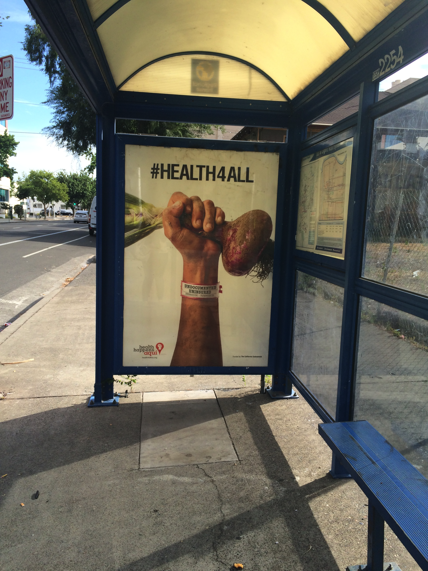
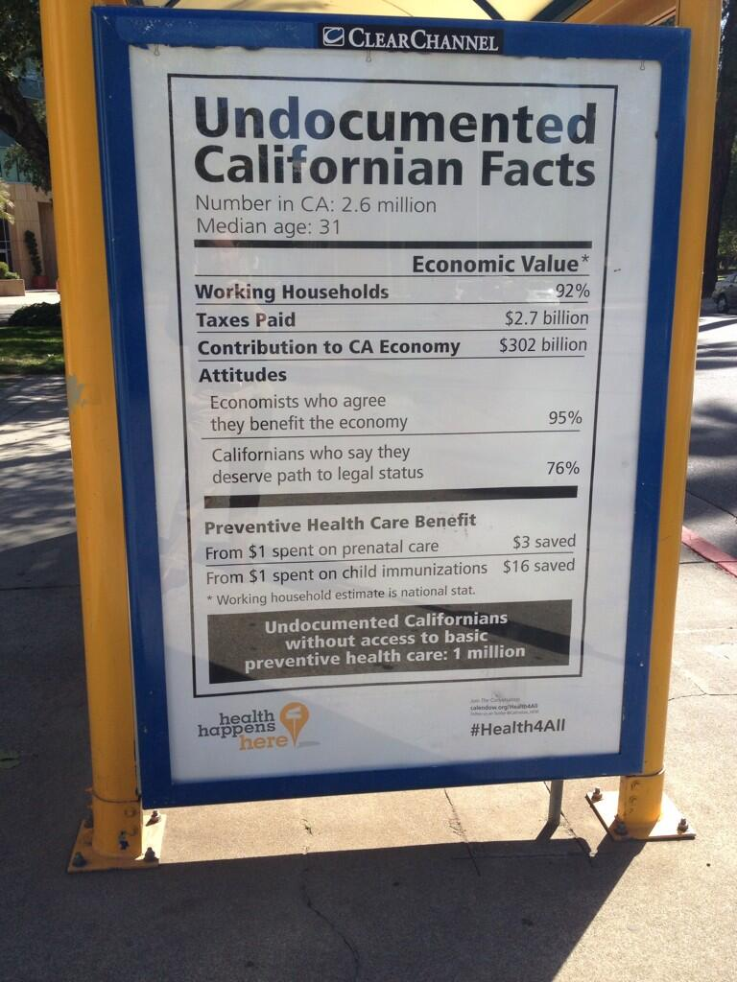
Paid Media

Slide 17
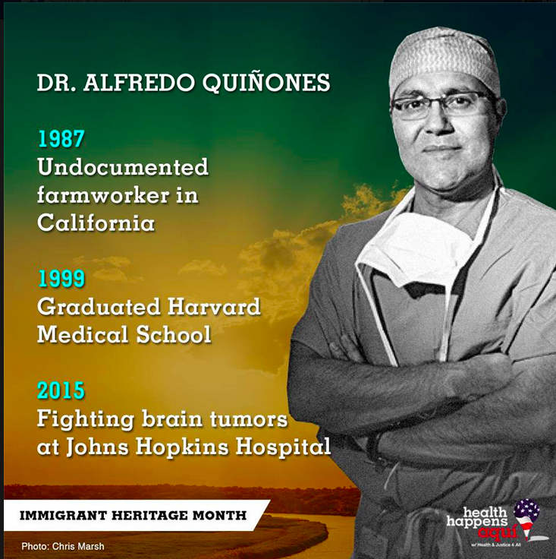
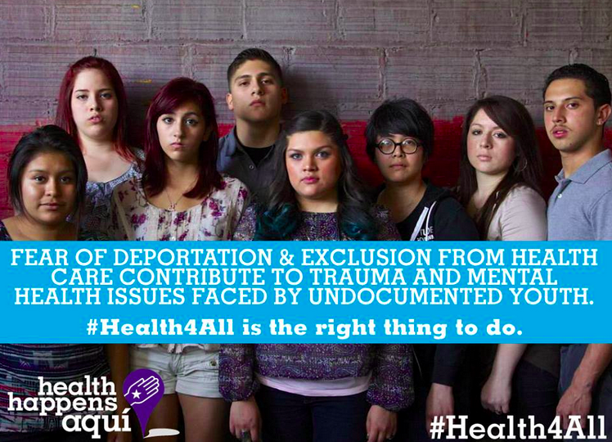
Social Media

Slide 18
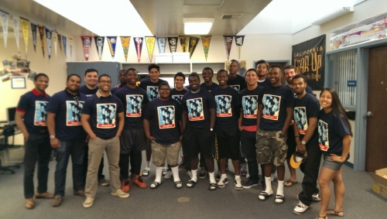
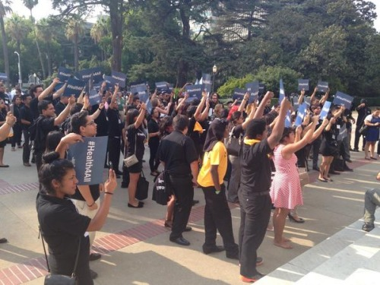
Community Events

Slide 19
California Voters Support Providing Health Coverage for All
800 telephone interviews with registered voters statewide
Oversample of an additional 154 African-American voters, with data statistically weighted to reflect the true ethnic composition of the electorate
Interviews conducted August 24-31, 2014
Interviews in English and Spanish and on landlines and wireless phones
Margin of sampling error of +/- 3.5%
Bipartisan research team of Fairbank, Maslin, Maullin, Metz & Associates (FM3) (D) and GS Strategy Group (R)

Slide 20
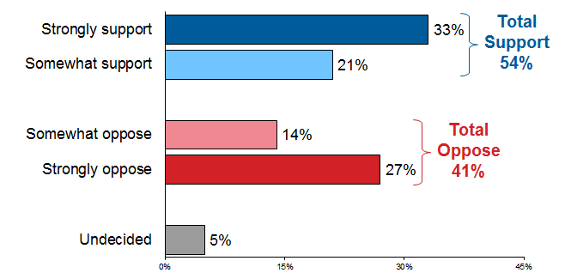
Most Californians in the state support the policy.
To prevent costly emergency care, some people have proposed expanding access to affordable health coverage through Medi-Cal and Covered California to cover all low-income Californians – including those not currently eligible because of their immigration status. Does this proposal sound like something you would support or oppose?
State

Slide 21
For many, support is guided by a conviction that it’s the “right thing to do.”

Slide 22
Survey Takeaways
Young voters and communities of color- the future of California - support expanding access to health care for all.
Broad bipartisan consensus in favor of improving access to preventive care.
The numbers are encouraging – with the right framing and messaging, voters across the political spectrum can be moved.

Slide 23
Field Poll Results
63 percent of Californians agree that immigrants benefit the state, an increase of almost 10 percent over the course of the campaign.
53%
63%

Slide 24
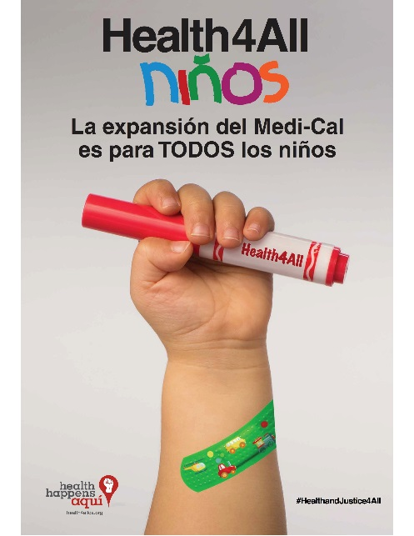
Health4All Kids

Slide 25
Health4All Kids: Strategy
The California Endowment aims to drive a robust education effort through targeted earned and paid media, emphasizing our Spanish-language media and community partners and “boots on the ground” partnerships.
In order to maximize enrollment when Medi-Cal expands, The
California Endowment – from now until early 2016 – aims to
raise awareness and educate all eligible families with
undocumented children, alerting them to the new opportunity
and encouraging them to enroll or renew their children in
Restricted-Scope Medi-Cal.

Slide 26
Health4All Kids: Timing
SB4: Created a “lift & shift” guarantee, ensuring a smooth transition from Restricted-Scope Medi-Cal to Full-Scope Medi-Cal once implementation happens after May 2016.
In order for families to take advantage of the expanded access for their children as soon as possible, parents should be taking steps now to enroll their children kids into Restricted-Scope Medi-Cal.
If children already have Restricted-Scope Medi-Cal, parents should make sure to renew.

Slide 27
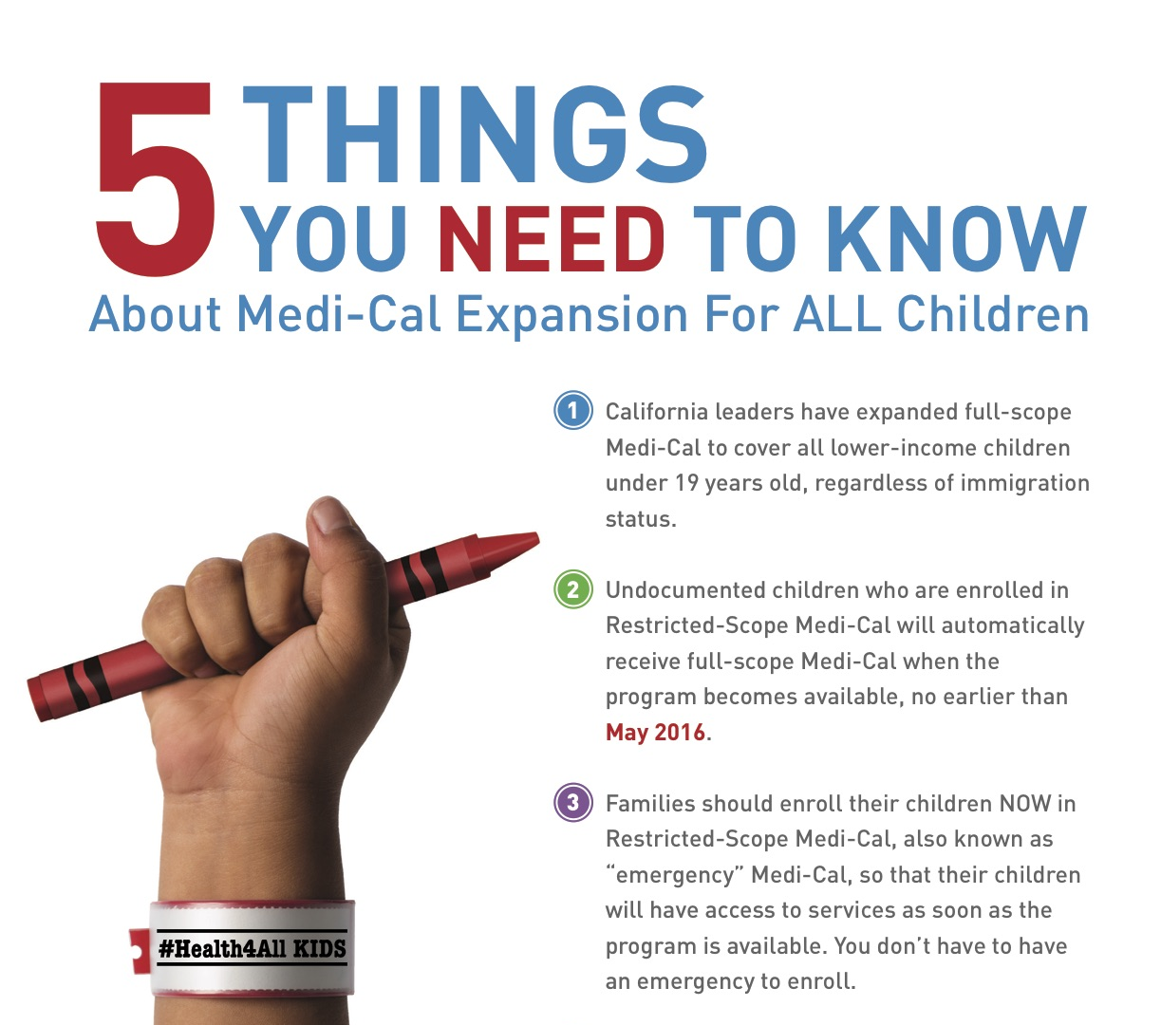
Health4All: Collateral

Slide 28
Health4All Kids: Paid Media
Our paid media plan focuses incorporates three phases:
PHASE ONE: The Curtain Raiser (starting November 2015)
This phase is broad-based and is designed to alert the target audience of the upcoming expansion and encouraging those eligible to apply and those already enrolled to renew.
PHASE TWO: Targeted & Focused (beginning early 2016)
The second phase will be a much more targeted effort—focused on neighborhoods with the highest number of remaining uninsured, mixed status families. The message will be about enrollment and breaking down some of the barriers to enroll. Families will also be reminded to renew.
PHASE THREE: Creating Urgency
Part three will bring urgency to the effort. We will target Spanish and English speaking mothers of households who self-select as remaining uninsured as well as the older children of the households who may be eligible or help their parents navigate the Medi-Cal expansion.

Slide 29
Example of Spanish Language Ad

Slide 30
Health4All Kids: Boots on the Ground
Starting in early 2016 with messaging correlated to Paid Media
Focused on counties with higher proportions of undocumented children
Trusted CBOs, including community clinics
Leveraging existing DHCS county/CBO partners
CCHI members
Health Consumer Alliance
Schools
Multi-Foundation Collaboration

Slide 31
For Questions and Comments, Contact:
Richard Figueroa
The California Endowment
rfigueroa@calendow.org
Special Thanks to Health Access for the use of some slides and data
Gracias!

