Slide 1
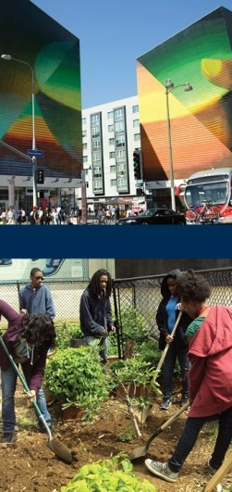
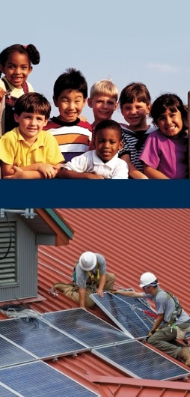
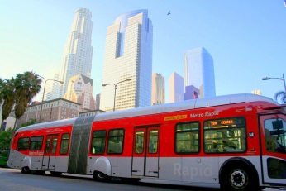
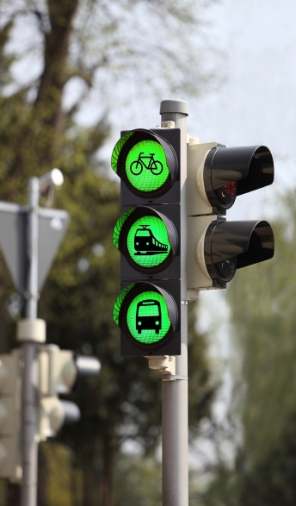
Guide to Greenhouse Gas Reduction Fund Program Designs, Expenditures, and Benefits December 2, 2015 Kelsey Jessup Project Manager
Notes:
Thank you so much for having me, I am …
Introduce myself (no JR, me instead)
Today I will be speaking about the Greenhouse Gas Reduction Fund (GGRF)
Familiar with Cap and trade? GGRF?

Slide 2
How it works?
Cap-and-Trade Auctions
Greenhouse Gas Reduction Fund (GGRF)
Annual Budget Appropriations
State Agencies
Authority
California’s Climate Investments
Adapted from ARB Public Workshop Presentation, 6/22/2015
Notes:
major emitters of greenhouse gas emissions, GHGs, are required to purchase pollution permits through the Cap-and-Trade auction system. This includes major industrial sources and electricity producers.
The auction revenues go to 2 main places. The first route is from investor owned utilities to their customers. The State is providing utilities with some free carbon allowances that they sell in the Cap and Trade market. The State is requiring that the revenues generated by the sale of these free allowances are given back to customers, in order to reduce any potential price increase from Cap and Trade. This can be seen as a bi-annual credit on electricity bills, reducing customer costs.
The other and the main place that auction revenues go is the Greenhouse Gas Reduction Fund or the GGRF. This is a large and growing funding source. Through the State’s annual budget process, the Legislature and Governor appropriate dollars from the GGRF to state agencies and their funded programs. These programs fall into 3 main categories: sustainable communities and clean transportation, energy efficiency and clean energy, and natural resources and waste diversion.
It is critical to note that the Legislature and the Governor will be required to agree year after year on specific priorities. Due to the yearly review, there will be new developments over time. The funding criteria for each program area are still being defined. In particular, what benefits, direct and indirect, are designated to DACs are designed program to program and the legislature will influence this on a year to year basis. There are 4 programs that have been specifically earmarked (I will go into this in more detail a little later).
What is important: explain that state legislature is going to retain control over how funding is spent across programatic agencies; it can change!
The leg and governor are going to agree year after year on specific priorities
However, Ear marked 60% to go to 4 programmatic areas
There will be new developments over time
Need to understand: the funding criteria for each prgoram area are being defined; what benefits (direct and indirect) in DACs are being designed program to program (state leg is influencing this on a year to year basis)

Slide 3
Auction revenues from California’s Cap-and-Trade Program are a large and growing funding source
Notes:
The original cap was only over electricity generators and heavy industry, this year it has been expanded to the transportation industry
By the end of the year, we expect there to be $2.2 billion dollars available in the GGRF
There are 2 primary reasons why we expect the GGRF will grow:
The minimum sell price for allowances will rise 3% per year automatically through 2020
The number of allowances will go down as the emission target lowers each year
The combination of price increasing and the number of allowances decreasing will likely lead to increases in the GGRF

Slide 4
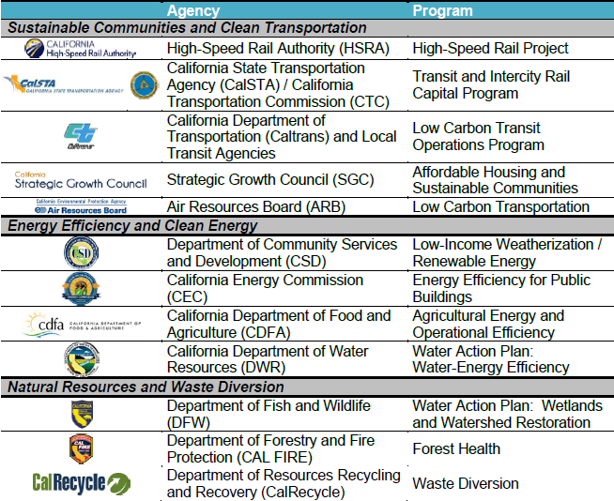
Notes:
This is a lot of info, slide deck will be available
Through the State’s annual budget process, the Legislature and Governor appropriate dollars from the GGRF to state agencies and their funded programs. These programs fall into 3 main categories: sustainable communities and clean transportation, energy efficiency and clean energy, and natural resources and waste diversion.
This means, each funding area has typically at least one agency with which it is associated.

Slide 5
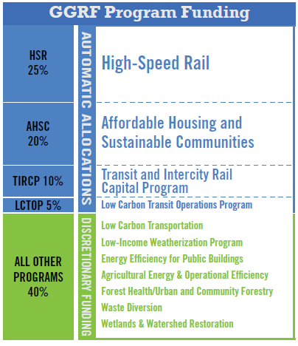
Source: Ben Russak. 2015. Advantaging Communities: Co-benefits and Community Engagement in the Greenhouse Gas Reduction Fund. Liberty Hill Foundation
Notes:
Earmarking is happening for the 4 programs in particular. However, as mentioned earlier, even these programs are likely to change over the years due to shifting priorities.

Slide 6
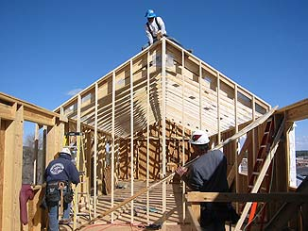
SB 535 (de León)
Ensures a minimum of 25% of climate investments (via the Greenhouse Gas Reduction Fund) benefit disadvantaged communities
Requires at least 10% of the investments are for projects located in disadvantaged communities
Directs CalEPA to define “disadvantaged communities”
Notes:
The GGRF can only invest in projects that reduce emissions. This is the #1 priority. However, there are 2 other bills that also dictate how the funding is allocated.
SB 535 (de Leόn) establishes a framework to direct investments to disadvantaged communities. Requires that at least 25 percent of the money in the GGRF go to projects that provide benefits to disadvantaged communities, and to allocate at least 10 percent to projects located in these communities. This is an unprecedented set-aside.
Each program defines both the benefits to DACs and the specifics regarding the location of funding in DACs differently. Applicants have to pay attention to these differences and understand how each program defines “benefit” and “located in.”
AB 1532 mandates moneys in the GGRF be used not only to reduce greenhouse gas emissions but also to maximize economic, environmental, and public health benefits. This means that projects should not only reduce GHG emissions but also produce jobs and support California businesses. Both GHG emission reductions and co-benefits will be evaluated in applications.
JR
Difference between what benefits a DAC and is located in a DAC
Each program defines this differently
Applicants have to pay attention to these differences
For applications: understand how each particular program defines benefit and “located in”
2nd point
In addition to percentage requirements, GGRFcan only invest in projects that reduce GHG emissions
The other criteria, is the co-benefits (maximizing economic, environmental and public health): will also be evaluated in applications

Slide 7
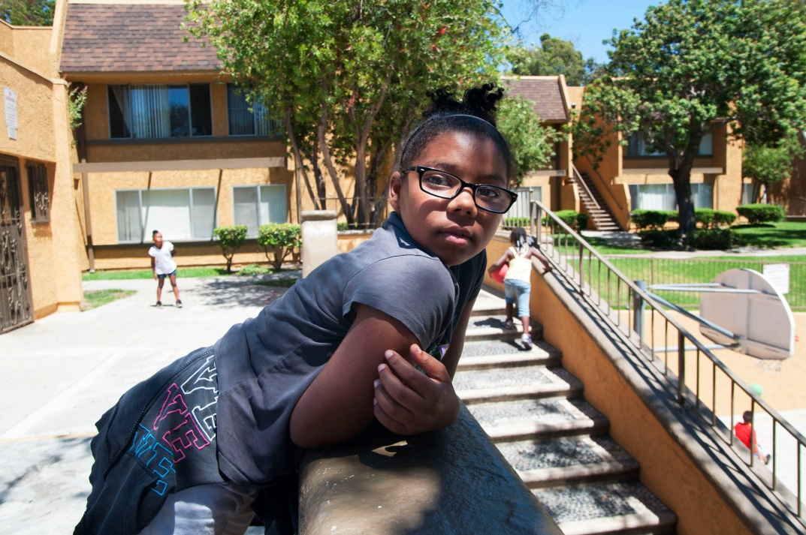
Key programs to benefit Disadvantaged Communities
Weatherization/renewables
Urban forestry
Low-carbon transportation
Affordable housing and sustainable communities
Low-carbon transit operations
Transit & intercity rail capital projects
Notes:
While there are about 15 programs, only about 6 are a focus for DACs.
I will now give some examples of projects that have been funded in the first year

Slide 8
Increasing access to affordable housing, open space and multimodal connectivity
Transit Oriented Affordable Housing Development (AHSC)
Project Team: City of National City, Community Housing Works, Environmental Health Coalition
Funding Agency: Strategic Growth Council
Project Funding: $9.2 million
Paradise Creek Homes (Westside Infill TOD)
Source: Alvaro Sanchez. 2015. California’s Climate Investments: 10 Case Studies Reducing Poverty & Pollution. Greenlining Institute.
Notes:
One of the state’s most disadvantaged communities will receive 201 apartments affordable to lower income households accessible to transit and designed to promote walking and cycling, as well as a new park, reducing CO2 by over 16,000 tons.
Environmental Health Coalition – local environmental justice nonprofit organization

Slide 9
Increasing access to multimodal transit and improving connectivity
Low Carbon Transit Operations Program
City of Gardena ($38,999)
Expanding bus services to benefit DACs
City of Montebello ($56,717)
Addition of bus service during Thursday peak hours to alleviate congestion on Line 10
Transit and Intercity Rail Capital Program
LA County Metro ($38,494,000)
Infrastructure improvement to address connectivity issues, especially in DACs
Notes:
Caltrans and Calstate Transportation Agency
Note: different amounts of funding – not just huge. City governments can also apply and receive much smaller amounts of funding
The LA Metro project is designed to revitalize and significantly improve the Willowbrook/Rosa Parks Station, addressing connectivity between the Blue Line, Green Line, and buses, and also station access, safety and connectivity with the surrounding community. All project elements have significant benefits for communities identified as disadvantaged, and contribute to increased ridership on a heavily used and congested system, as well as reduced GHG emissions. Blue Line infrastructure improvements include upgrades to the signal and crossover system and near downtown storage capacity, which prepares the Blue Line for increased service to Union Station (with Metrolink, Amtrak and future High Speed Rail connections), Expo, and Gold Line stations once the Regional Interconnector project is complete.

Slide 10
Energy Efficiency and Clean Energy: Low-Income Weatherization Program
Administering Agency: Community Services and Development (CSD)
100% to DACs
Non-competitive weatherization and solar retrofits of single/multi-family housings
CSD contracted Fresno Economic Opportunities Commission, in partnership with SunPower, to install rooftop solar systems in DACs in Fresno.
Other projects in LA, Merced, Madera, Sacramento and Tulare counties
Source: Alvaro Sanchez. 2015. California’s Climate Investments: 10 Case Studies Reducing Poverty & Pollution. Greenlining Institute.
Notes:
$4.05 million for this project (total of $75 million alloted to the low income weatherization program)
Committed 1,212 solar systems at homes of low-income residents across 6 counties

Slide 11
Bringing water and energy savings to disadvantaged communities in Riverside County
Awarded to Santa Ana Watershed Project Authority
Funding Area: Clean Energy and Energy Efficiency
Program: Water-Energy Efficiency Grant Program
Water-Energy Community Action Network Program is designed to provide:
Water savings to approx 260 homes in DACs
Energy savings to approx 1,703 homes in DACs
Grant amount: $2,339,823
Notes:
Funding agency: California Department of Water Resources
Program: Water-energy efficiency grant program
Santa Ana Watershed Project Authority project creates the Water-energy community action network program which is designed to provide water and energy savings
The proposal includes: Turf replacement, and Full house retrofit including Attic/ceiling Insulation; Water heater blanket; Caulking; Weather-stripping; Minor home repairs; Door replacement; Thermostat; Window/glass replacement; Duct repair; Water heater/range replacement; Energy efficient water devices; Heating system repairs/replacement; Electrical outlet and switch gaskets; Furnace filter replacement; Cooling system; and Microwave replacement.

Slide 12
Engaging residents to increase tree canopy in Disadvantaged Communities
Green Street through community engagement
Project Team: Koreatown Youth and Community Center (KYCC)
Urban & Community Forestry
Funding Agency: CalFIRE
Project Funding: $329,725 FY 2014-15
Partner with community residents, neighborhood associations and councils, churches, City of LA, and other organizations
Source: Alvaro Sanchez. 2015. California’s Climate Investments: 10 Case Studies Reducing Poverty & Pollution. Greenlining Institute.
Notes:
Program area: Natural resources and waste diversion
Funding agency: CalFire
KYCC and its community partners plan to plant 1120 trees in Two low-income neighborhoods removing 1,986 tons of greenhouse gases from the air, improving air quality, enhancing neighborhoods and reducing heat island effects

Slide 13
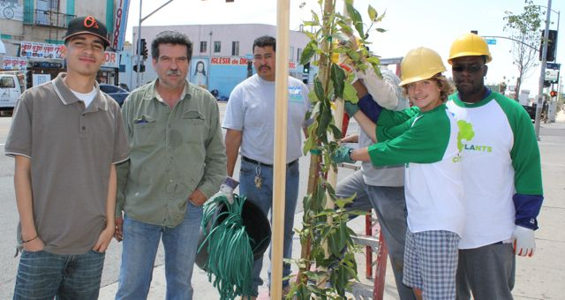
Empowering residents and bringing access to healthy food options in San Bernardino County
Montclair Community Fruit Park and “Neighborhood Grows” ($700,000)
Urban and Community Forestry Program (CalFIRE)
Partnership between CBOs, landscaping and architecture firms and City of Montclair
Helped to overcome regulatory and permitting obstacles
Photo credit: City Plants http://www.cityplants.org/
Notes:
Funding agency: Calfire via California ReLeaf
City of montclair, ontario foundation, integrated infrastructure inc, first 5 of san bernardino, supervisor Gary Ovitt
700,000 from Calfire
The city and local residents turned a one third
acre piece of underutilized public land into a park with fruit trees, providing shade,
enhanced public space, and the air-cleaning action of trees, job training, and
healthy food for local residents.
The Community Fruit Park is the first of a string of projects

Slide 14
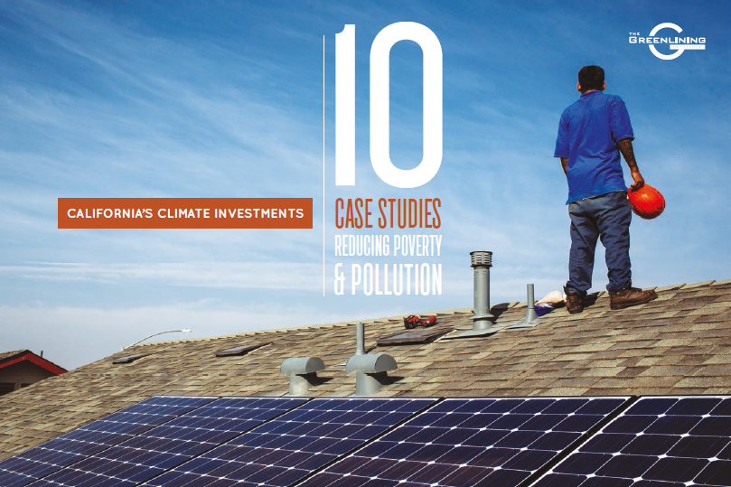
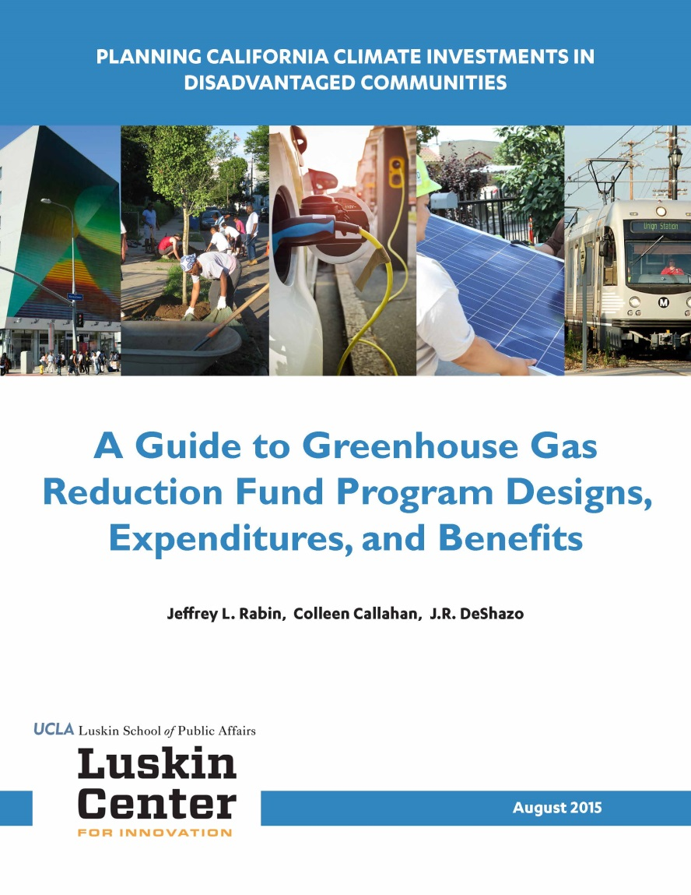
Recent reports analyzing the GGRF appropriations

Slide 15
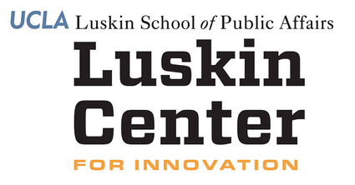
Contact
J.R. DeShazo
deshazo@g.ucla.edu 310-267-5435
www.innovation.luskin.ucla.edu
310-267-5435
Notes:
You can contact JR or myself (I have business cards)
If you would like more information on the examples I provided, leave me your info and I can connect you with the appropriate agencies or project managers.

Slide 16
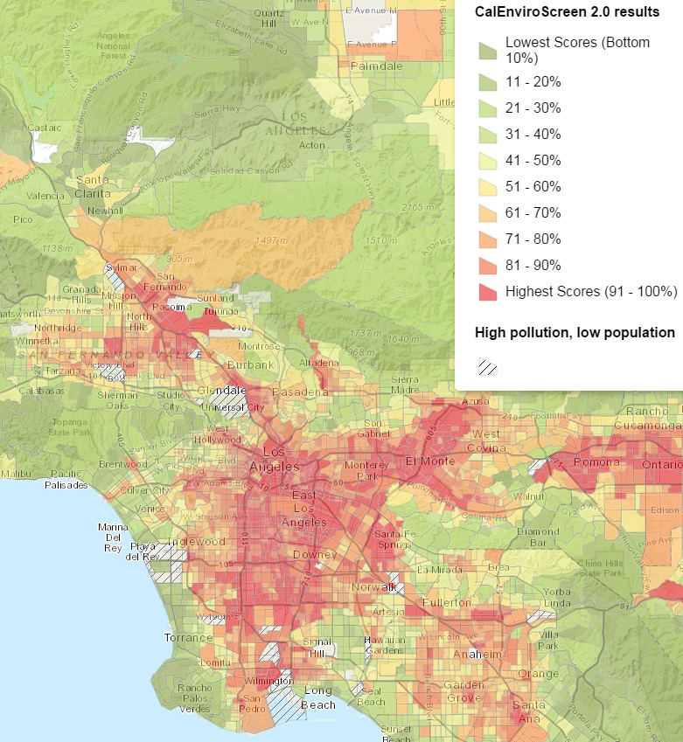
CalEnviroScreen Results: Los Angeles County
http://oehha.ca.gov/ej/ces2.html
Notes:
CalEnviroScreen is the tool developed by Cal-EPA to identify disadvantaged communities. It generates at the census tract level, environmental health risk rankings about pollution burden and other environmental indicators as well as population characteristics and socioeconomic factor indicators. High rankings to red and dark orange indicate relatively high vulnerability. The map zooms into Los Angeles County, a region that faces elevated levels of environmental health vulnerabilities. It is important to note that of the State’s 58 counties, LA County ALONE is home to about HALF of ALL of the State’s disadvantaged communities. In other words, the tool underscores that LA County County faces disproportionately high levels of environmental health threats. But this is certainly is not a guarantee for elevated funding from any specific program supported by the GHG Reduction Fund, although certain program criteria will give weight to investments in and to benefit disadvantaged communities.

Slide 17
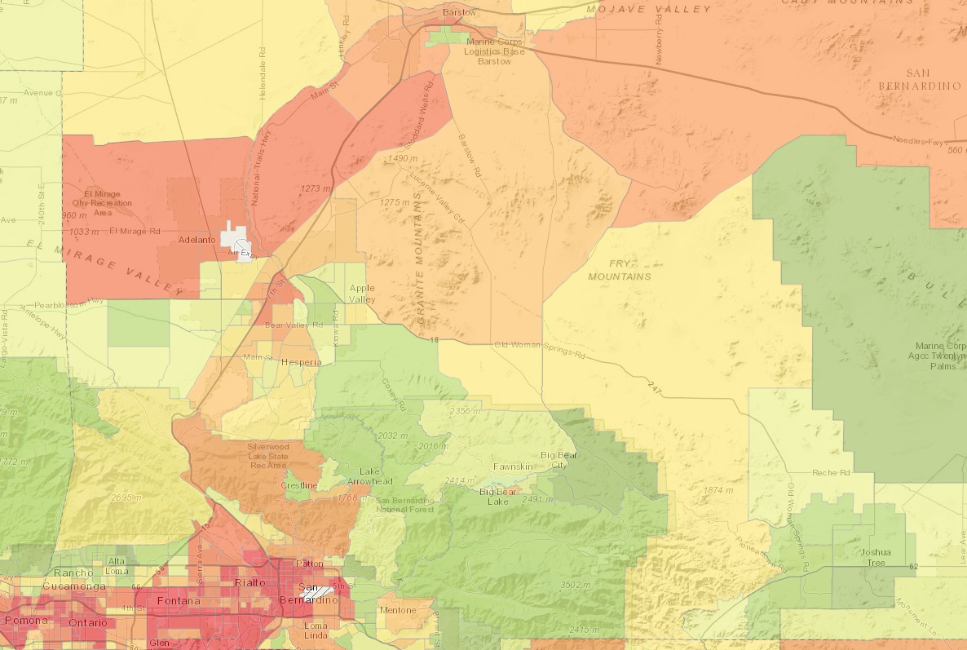
San Bernardino County (partial)
Riverside County (partial)
Notes:
There is also a high number of areas identified as disadvantaged communities in the Inland Empire.

Slide 18
How do Revenues from Cap-and-Trade get to the LA Region
Major CA GHG Emissions
Cap-and-Trade
Auction Revenues
GHG Reduction Fund
State Agencies -Program Investments in 3 Main Categories
Notes:
As Dennis described, major emitters of greenhouse gas emissions, GHGs, are required to purchase pollution permits through the Cap-and-Trade auction system. This includes major industrial sources and electricity producers. As part of the State’s phased-in approach for the cap and trade program, this calendar year the transportation sector is now included under the cap, which has added significantly to the revenue generated.
The auction revenues go to 2 main places. The first route is from investor owned utilities to their customers. The State is providing utilities with some free carbon allowances that they sell in the Cap and Trade market. The State is requiring that the revenues generated by the sale of these free allowances are given back to customers, in order to reduce any potential price increase from Cap and Trade. This can be seen as a bi-annual credit on electricity bills, reducing customer costs.
The other and the main place that auction revenues go is the Greenhouse Gas Reduction Fund or the GGRF. This is a large and growing funding source, and the focus of my presentation. I’ll talk about the budget numbers in a minute. But first, the process. Through the State’s annual budget process, the Legislature and Governor appropriate dollars from the GGRF to state agencies and their funded programs. These programs fall into 3 main categories: sustainable communities and clean transportation, energy efficiency and clean energy, and natural resources and waste diversion.

Slide 19
Process
3 Year Investment Plan
GGRF Guidelines
State Agencies
Annual Budget Appropriations
Project Applicants
State Agencies Evaluate and Make Funding Decisions
Implementation, Results Reported
Notes:
This is a little more detailed way of looking at the GGRF funding process. The California Air Resources Board is the main agency coordinating the implementation of the GGRF. In collaboration with other agencies, they have produced two foundational documents. First, is a 3 Year Investment Plan that lists what is eligible for funding from the Cap and Trade Auction Revenues in the GGRF. This is not a guarantee of funding but provides a roadmap. The vast majority of program included in the current 3 Year Investment Plan are existing state program implemented by an array of agencies. The actual annual appropriations to these agencies are determined through the State’s budget process. Legislators have until June 15th of each year to pass a budget, with June 30th as the deadline for the Governor to sign or veto.
Last year the Air Resources Board produced interim guidelines for state agencies receiving money from the GGRF are to follow to meet statutory requirements. Although we are technically in year 2 of the GGRF, this is the first fiscal year that funding is actually going to the agencies and their programs. So just late last year and earlier this year, state agencies have updated their program guidelines to meet GGRF guidelines and the laws governing the GGRF. The program level guidelines tell fundees what the agencies will fund and thus inform project applications. For most of the programs, eligible applicants are local municipalities. Many programs allow or encourage businesses to partner with local municipalities on projects.

Slide 20
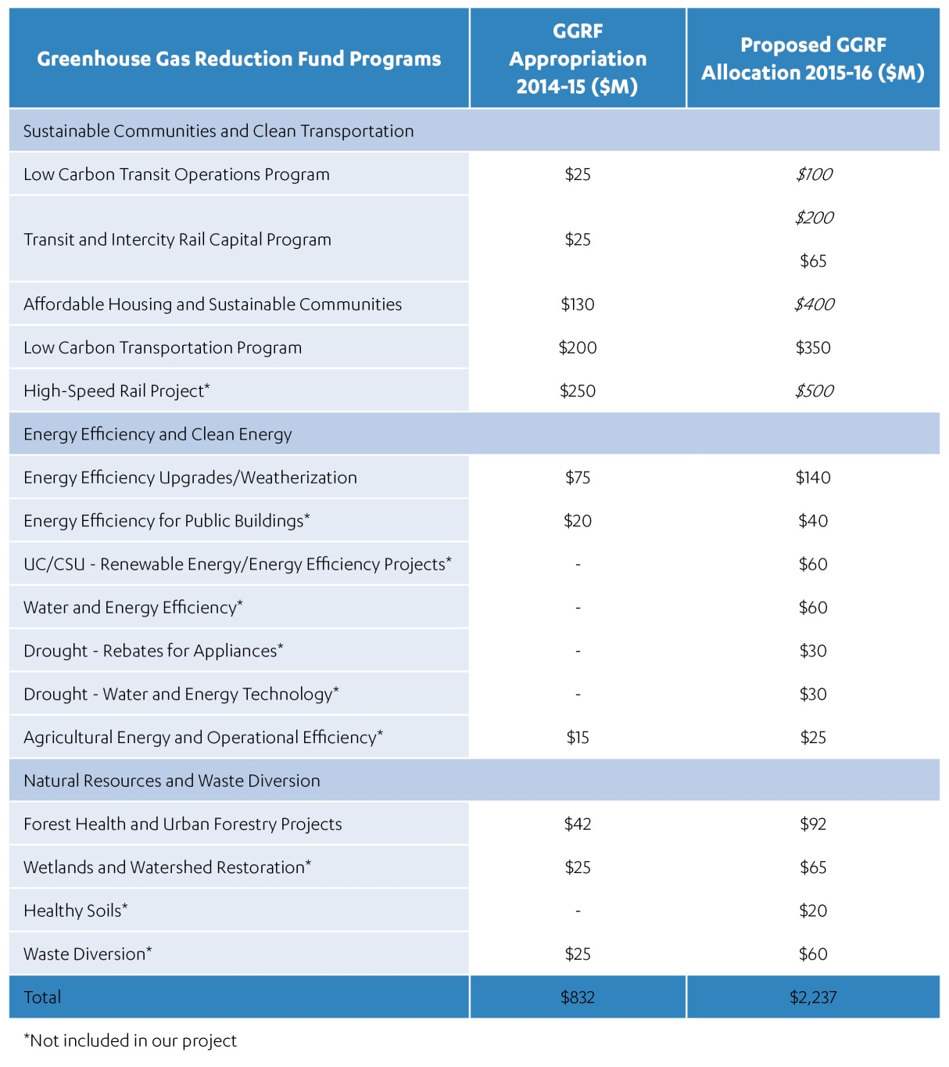
Actual/Proposed Appropriations from the GGRF Comparison of 2014-15 and 2015-16 Fiscal Years

