Slide 1
AFFORDABLE HOUSING PRESERVATION
OF SMALLER-SCALE PROPERTIES
An Opportunity for California Counties
Housing Trust Placer, Inc.

Slide 2
At-Risk Families
Many low-income families live amongst us today in Class C multifamily properties
These properties are known as naturally-occurring affordable housing (“NOAH”)
In a robust real estate market, owners of NOAH properties have an incentive to:
Install cosmetic upgrades (vinyl floors, granite countertops, refinished cabinets, etc.), and
Sell to the highest bidder under the prospect of dramatic rent increases
Families in these building are at risk of displacement
Institutional investors are aware of these opportunities and are actively seeking preservation opportunities
However, smaller buildings (9 to 40 units) are generally not on the radar screen of big investors
These buildings present an economical and relatively fast way to create permanently affordable housing

Slide 3
Challenges for County Involvement
Often we do not learn of a NOAH property until it becomes an active listing in the open market
Once an opportunity is identified, there is very little time to secure approvals and arrange soft debt to help with acquisition
How do we prepare in advance for a quick acquisition?
One solution is to create a Preservation Fund that can quickly fund acquisitions that meet specific underwriting parameters (e.g., price per unit, limit on deferred maintenance / rehab costs, location, tenant incomes, etc.)

Slide 4
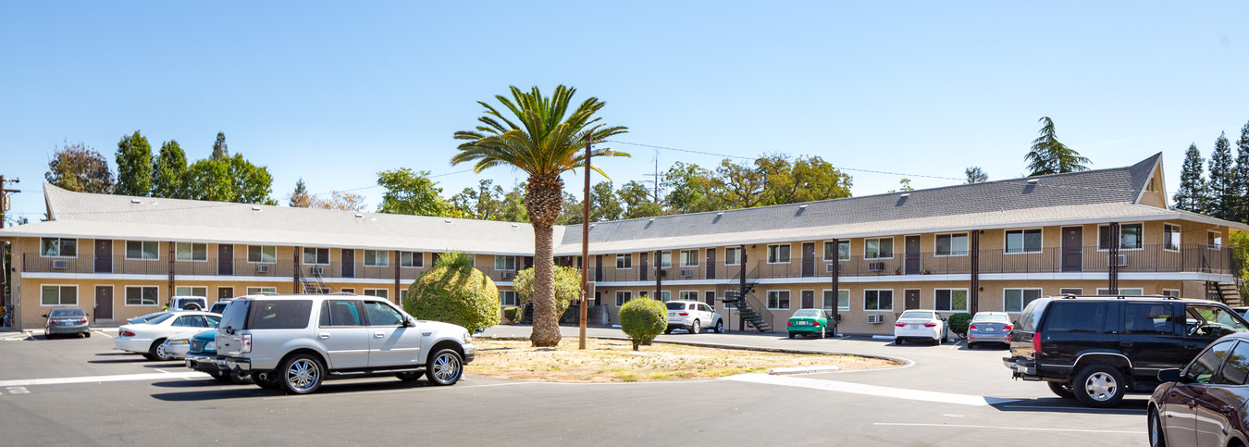
Continental Arms – Roseville, CA
39 Units
Acquisition Price: $217,949 per unit (in 2021)
Insignificant amount of rehab required

Slide 5
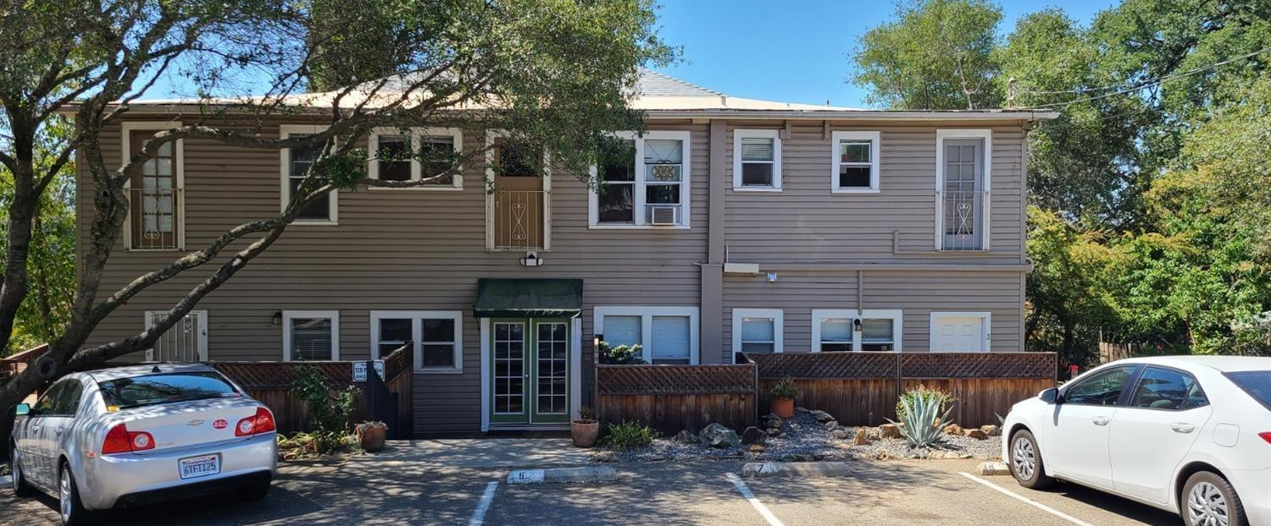
150 Foresthill Ave – Auburn, CA
Current Listing
9 Units
Acquisition Price: $205,556 per unit
Substantial deferred maintenance?
Significant rehab required?

Slide 6
Contact Info:
Dan Heldridge
Housing Trust Placer
dan@housingtrustplacer.org
Tel: 917-826-6774

