Slide 1
Economic Benefits of Cap and Trade in
California Assembly District 1
December 2, 2015
Steven Frisch
sfrisch@sierrabusiness.org
Notes:
Welcome – 3 minutes

Slide 2
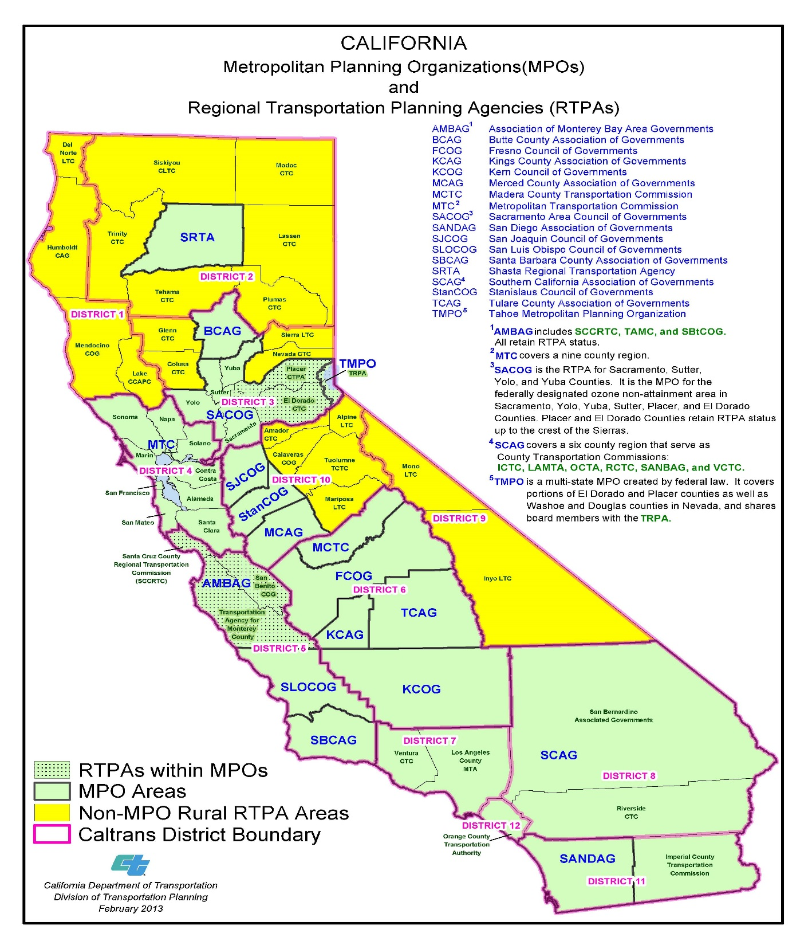
Notes:
Steve Frisch: Good afternoon and thank you for this opportunity to speak about the California Cap and Trade program and issues related to its implementation in rural regions of California. The organization I represent, the Sierra Business Council, is a regional business organization with more than 4000 members, the vast majority of them small businesses with less than 10 employees. We work on regional economic development issues with a focus on working farms, forests, ranches and service economy industries including tourism. We also provide Small Business Development Center services in northeastern California. We have been actively involved in the design and implementation of the Cap and Trade program since 2006. Much of our region is rural with economic sectors analogous to many rural regions of Oregon including strong agricultural sectors and timber production areas. California has a broad range of regional planning infrastructure, from Metropolitan Planning Organizations made up of numerous jurisdictions in the green areas on this map, to local city and county governments, the largely rural areas in yellow on this map, charged with implementing AB 32, California’s greenhouse gas reduction law and its its implementation programs including the Cap and Trade program.

Slide 3
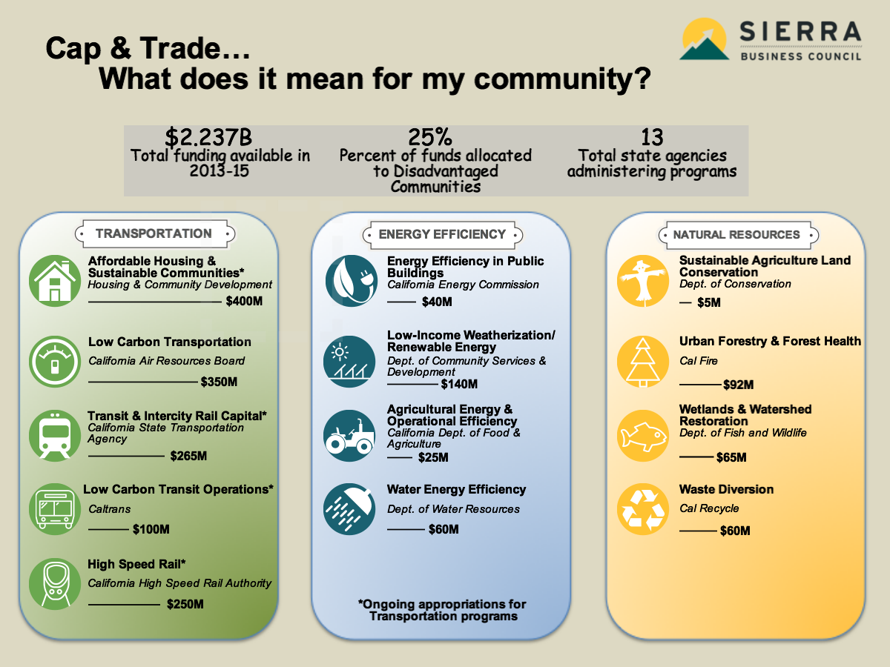
Notes:
As Gerry illustrated in his presentation the California Cap and Trade program designed to implement state climate policy has created a substantial source of funding to assist local governments, businesses, and communities adapt to and mitigate climate change. In last years 2014-2015 budget Cap and Trade generated revenues deposited into a Greenhouse Gas reduction Fund, were approximately $800 million. In California’s 2015-2016 budget there is approximately $2.37 billion dollars in Cap and Trade funding being distributed through a variety of programs to reduce greenhouse gas emissions. AS the program is fully implemented it is estimated that there will be approximately $5 billion this fund. ion per year distributed thro Those programs cover a broad range of GHG emission reduction activities, including building workforce housing adjacent to job centers; improving transportation infrastructure to reduce vehicle miles traveled; building electric vehicle charging networks; improving urban transportation; improving energy efficiency in public buildings; low income energy efficiency; agricultural energy efficiency including reducing the costs and emissions associated with moving water; forest, agricultural land and wetland management and restoration and waste diversion. These programs have been designed to meet specific targets for reductions in GHG emissions and are required to prove results.

Slide 4
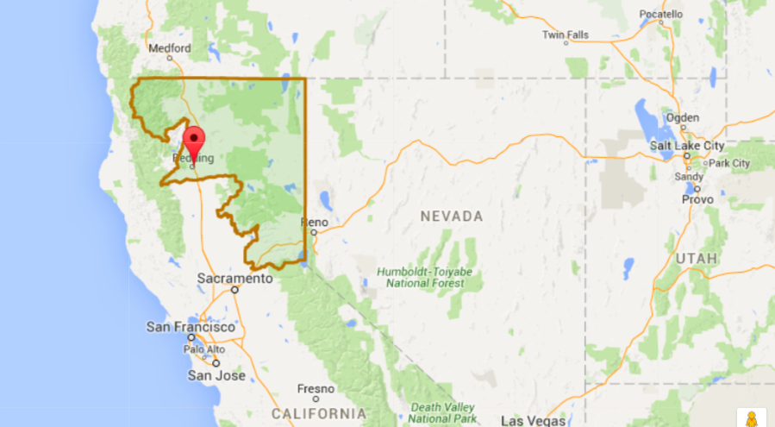
California Assembly District 1

Slide 5
AD 1 Projects Types Funded Round 1
Affordable Housing ($4 million)
Transit Infrastructure ($4 million)
Transit Services ($261K)
Wetland Restoration ($1.3 million)
Forest Restoration ($2.1 million)
Biomass Utilization ($1.4 million)
Energy Efficiency ($300K)
Notes:
California recently completed its first round of funding allocations of Cap and Trade Revenues from allocations made in the 2014-2015 budget totaling approximately $800 million. Of the $800 million allocated roughly $13.5 million was allocated in Assembly District 1 in NE California. Since California’s 80 assembly districts are roughly equal in population this means that AD 1 received slightly more than its fair share of funding in the first round. Lets’ look at two sample projects.

Slide 6
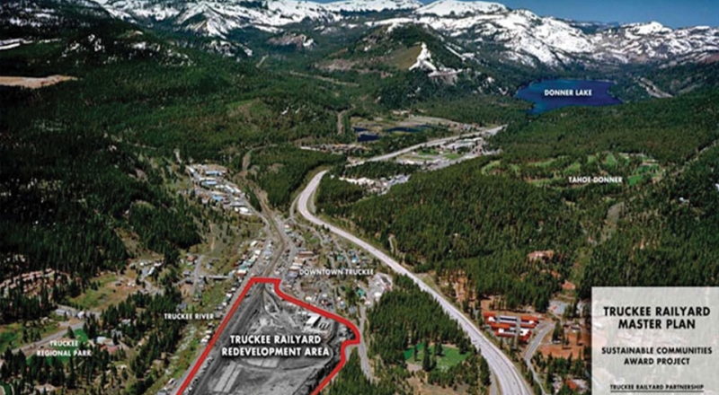
Truckee Railyard Setting

Slide 7
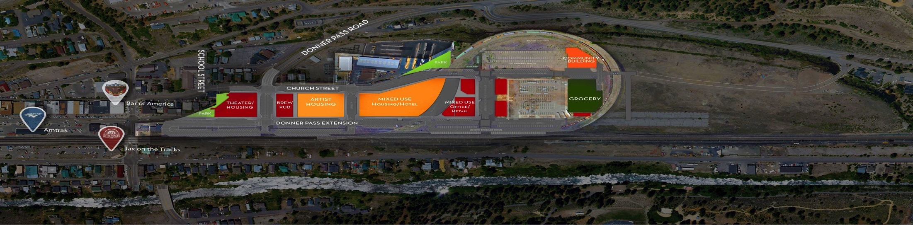
Truckee Railyard Master Plan
Phase I: 61 units affordable housing, mixed use, 20 units market rate housing, roadway/transit re-alignment.
Project will break ground April 2016
Received $8 million AHSC Grant ($4 Housing $4 Transit Infrastructure)
Leveraged $110 million private investment
IMPLAN model projects 111 temporary jobs
Notes:
The Truckee Railyard project is a three phase redevelopment of a former mill site and railroad switching yard located in Truckee Ca. The three phases total approximately 320 units of housing including affordable, market rate and live work units, 80,000 square feet of commercial space and 20,000 square feet of civic space. The project is immediately adjacent to the Town’s historic downtown providing housing next to the major job center.

Slide 8
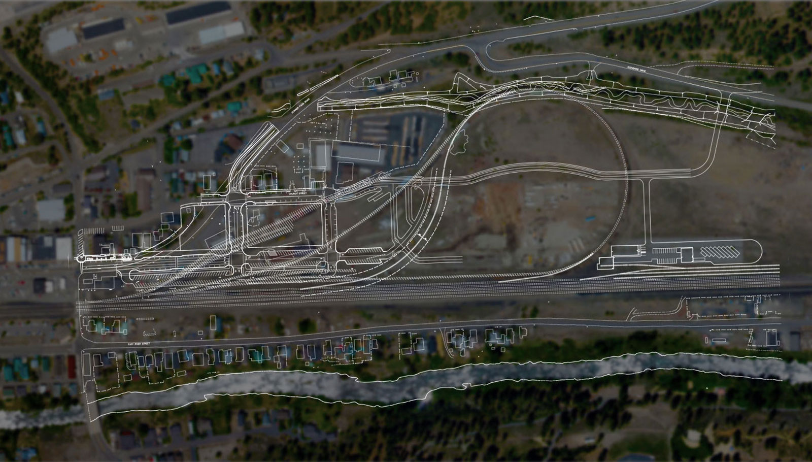
Truckee Railyard Infrastructure

Slide 9

Econometric Input/Output Model
Impact Type | Employment | Labor Income | Value Added | Output
Direct Effect | 114.9 | $7,182,625 | $8,892,819 | $21,071,900
Indirect Effect | 70.1 | $2,966,680 | $5,239,759 | $8,673,178
Induced Effect | 49.4 | $2,232,559 | $4,120,124 | $6,716,314
Total Effect | 234.4 | $12,381,864 | $18,252,702 | $36,461,391

Slide 10

Affordable Housing Sustainable Communities Guidelines
Raised maximum award amount to $20 million
Updated Transit Oriented Development standards to reduce requirements for transit infrastructure
All Integrated Connectivity Projects required to include capital investments that result in mode shift
Reduced scoring for GHG emission reduction to 50% of points.
Created a Rural Innovation Projects Area
  USDA definition of rural
    Non-metropolitan Counties
    Cities less than 40,000
  10% set aside in overall fund

Slide 11
Key Considerations
Plan for rural investment in programs
Create mechanisms to ensure equity
Update rural GHG emission methodology
Integrate objectives across programs
Value co-benefits/GHG reducing uses
Link to local economic prosperity
Invest in capacity

Slide 12
Resource Guide | Hyper-link
Understanding AB 32’s Impacts on Local Government: A Local Official’s Guide | http://www.ca-ilg.org/sites/main/files/file-attachments/resources__AB_32_Legal_Analysis_11-23-10.pdf
Evaluating Greenhouse Gas Emissions as Part of California’s Environmental Review Process: A Local Officials Guide | http://www.ca-ilg.org/sites/main/files/file-attachments/resources__CEQA-GHG_Guide_9-19-11_FINAL_1.pdf
The Co-Benefits of Sustainability Strategies | http://www.ca-ilg.org/sites/main/files/file-attachments/co-benefits_of_sustainability_final.pdf
Financing Local Sustainability Efforts | http://www.ca-ilg.org/sites/main/files/file-attachments/financing_local_sustainability_efforts_final_0.pdf
California Jurisdictions Addressing Climate Change | http://www.ca-ilg.org/sites/main/files/file-attachments/california_jurisdictions_addressing_climate_change_pdf_0.pdf
California Air Resources Board Emissions Trading Program Fact Sheet | http://www.arb.ca.gov/cc/capandtrade/guidance/cap_trade_overview.pdf
Cap-and-Trade Auction Proceeds Investment Plan: FY 2013-14 through FY 2015-16 | http://www.arb.ca.gov/cc/capandtrade/auctionproceeds/final_investment_plan.pdf
Cap and Trade: What does it mean for my community? | http://www.ca-ilg.org/sites/main/files/file-attachments/ilg_infographic_captrade_final_electronic.pdf
Cap and Trade: Investing in California Communities | http://www.ca-ilg.org/sites/main/files/file-attachments/cap_and_trade_final_0.pdf

Slide 13
Economic Benefits of Cap and Trade in
California Assembly District 1
December 2, 2015
Steven Frisch
sfrisch@sierrabusiness.org
Notes:
Welcome – 3 minutes

