Slide 1
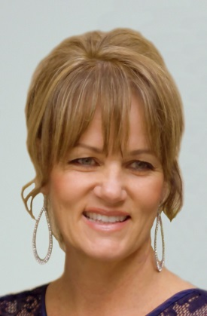



SLO CHAMBER
FAMILY-FRIENDLY WORKPLACE ACCELERATOR PROGRAM
Bruce Gibson – County Supervisor, San Luis Obispo County
Wendy Wendt – Executive Director, First 5 San Luis Obispo
Jim Dantona – CEO, San Luis Obispo Chamber
Christina Lefevre-Latner – Workforce Development Mgr., San Luis Obispo Chamber

Slide 2
The Family-Friendly Workplace Accelerator Program
A Great Example of Public-Private Collaboration That....
Helps Business
Supports Working Families
Nurtures Healthy Economies and Communities
Oh yes. AND....
Champions Kids! Which is where First 5 comes in, and where we'll start sharing our story with you.
Notes:
Wendy Intro Slide – Still need to make look pretty....

Slide 3
A Little Background....
FIRST 5
  A statewide public program locally grown
  The "Why" - Early years are critical. 90% of a child's brain is formed by age 5.
  Vision – children prenatal-5 grow up healthy, thriving, ready to learn
  Purpose/Roles – Investor, Convener, Public Awareness-Builder
WE ARE THE CARE
  A multi-stakeholder movement to address the local child care crisis
  Cross-Sector Collaboration..... focus on Family Friendly Workplace
CHAMBER and FIRST 5 as PARTNERS
  Economic Vision ("Imagine SLO") incorporates family priorities
  First 5 staff joins Chamber Board
  Chamber Committees examine child care as an economic issue
Notes:
Wendy Slide – History leading up to our collaboration. A little about First 5.
Still need to format

Slide 4
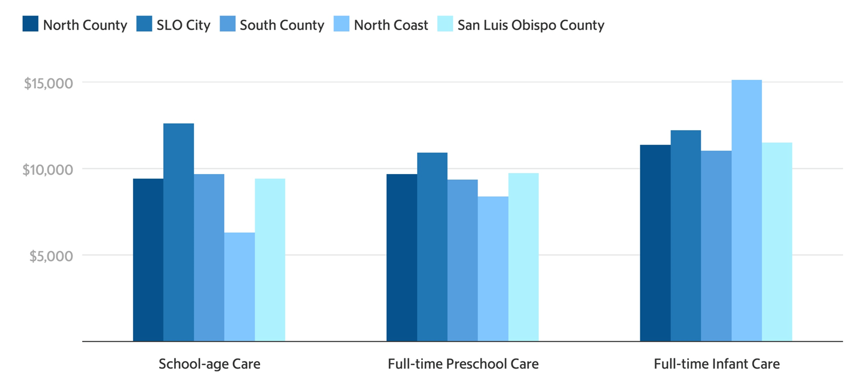
THE EVER-GROWING PROBLEM OF CHILDCARE
$6-$15k per year per child
Are you working just to pay for childcare? Stay home?
Women bore the brunt of this issue

Slide 5
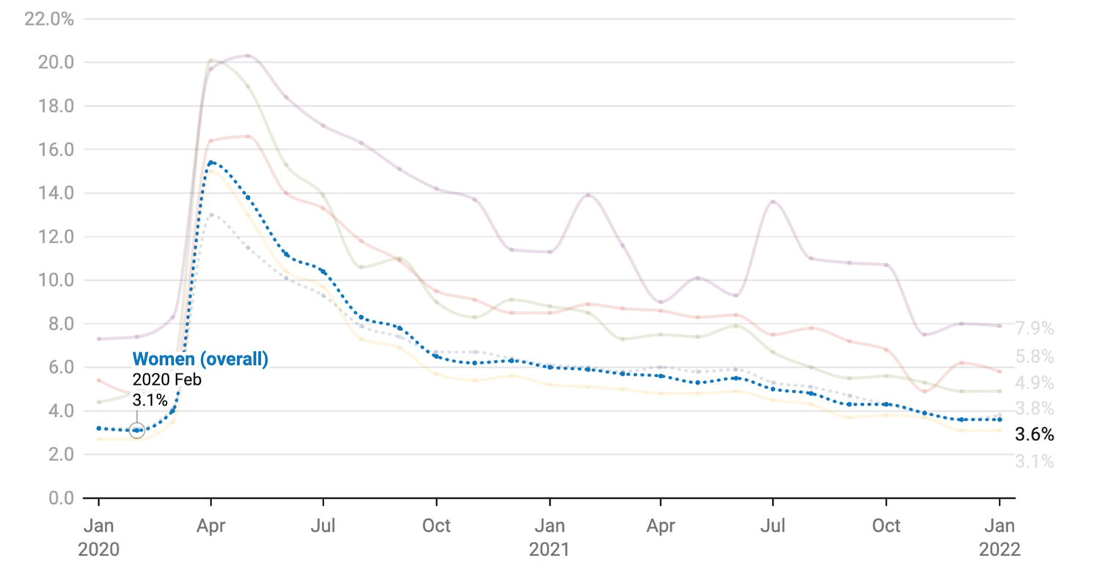
WOMEN IN THE WORKFORCE
1.8 Million less women in workforce versus Feb 2020
Family Friendly Workplace Accelerator

Slide 6
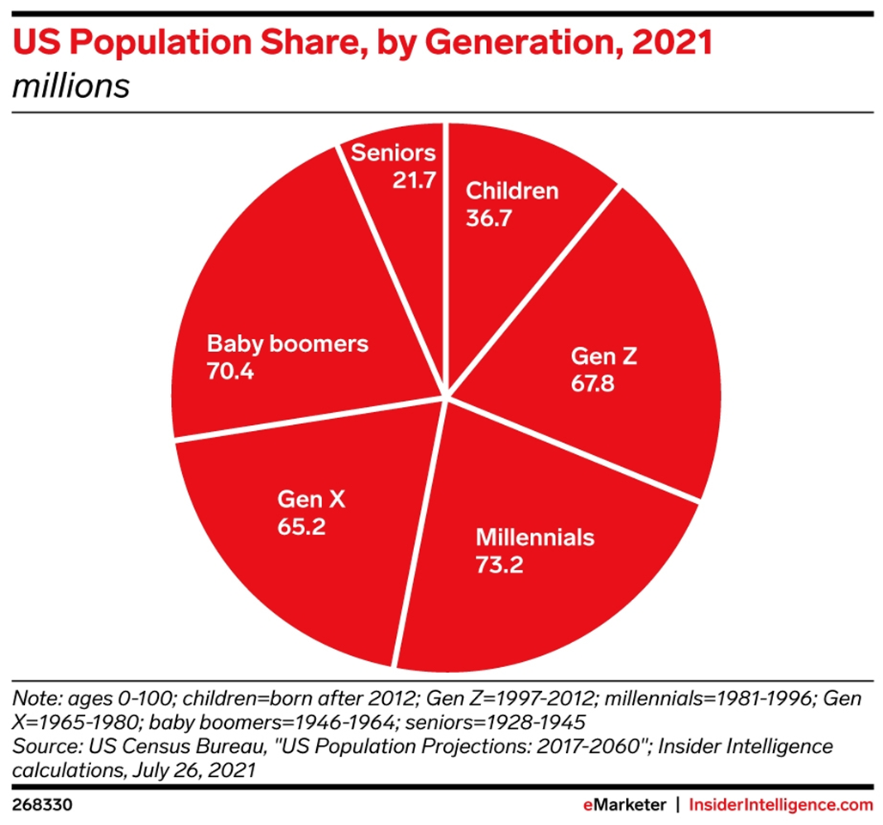
11.5 million job openings
Nearly double the available workers
Labor force participation 62.2%
1.2% below Feb 2020 (~ 3M less workers)
Peak labor force participation 1998 (67.1%)
U-3 rate steady over last three months – flat; U-6 is +3.5% and been going up.
SLO County record low 2.1% unemployment

Slide 7
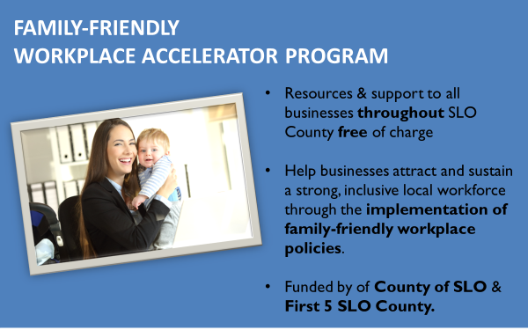

Slide 8
WHAT DOES IT MEAN
TO BE FAMILY-FRIENDLY?
What are Family-Friendly policies?
  Family-friendly policies act to meet, directly or indirectly, the needs of children, parents, disabled family members, and the oldest generation.
What is a Family-Friendly Workplace?
  A family-friendly workplace is one whose practices make it possible for employees to more easily balance family and work.

Slide 9
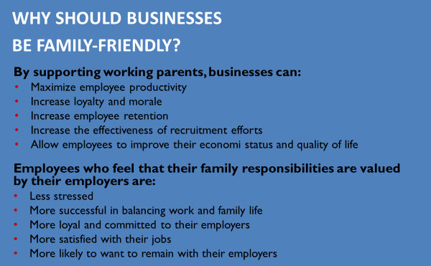

Slide 10
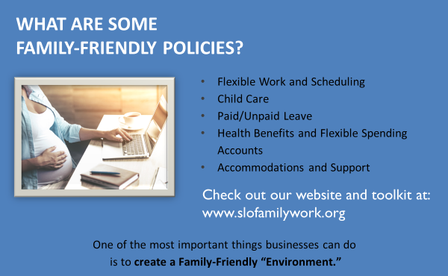

Slide 11
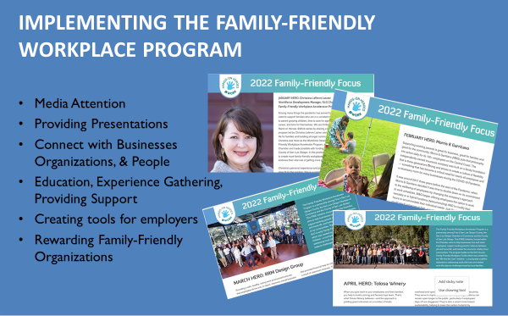

Slide 12

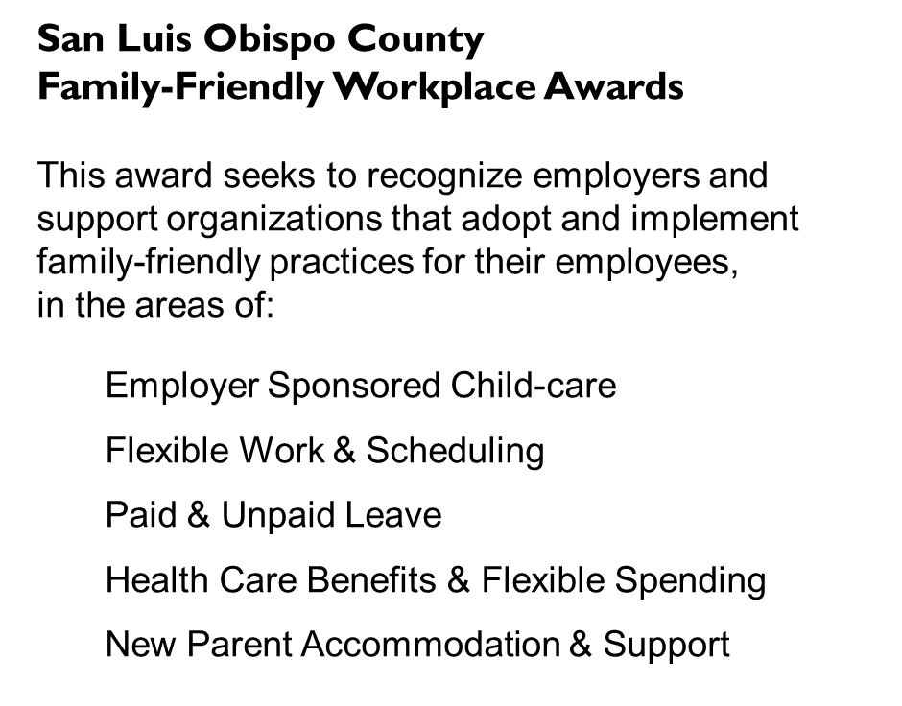



Slide 13
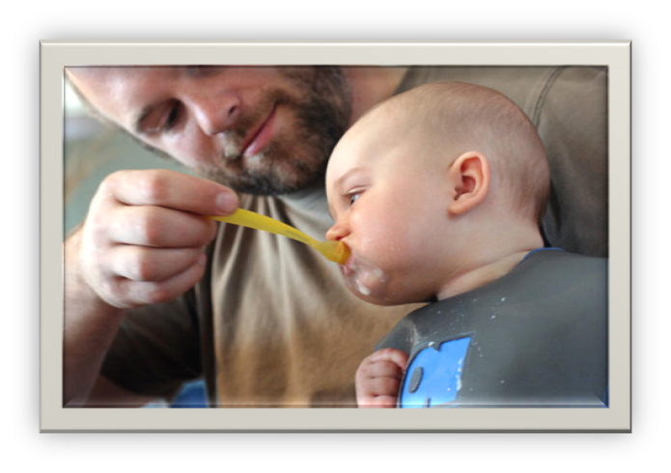
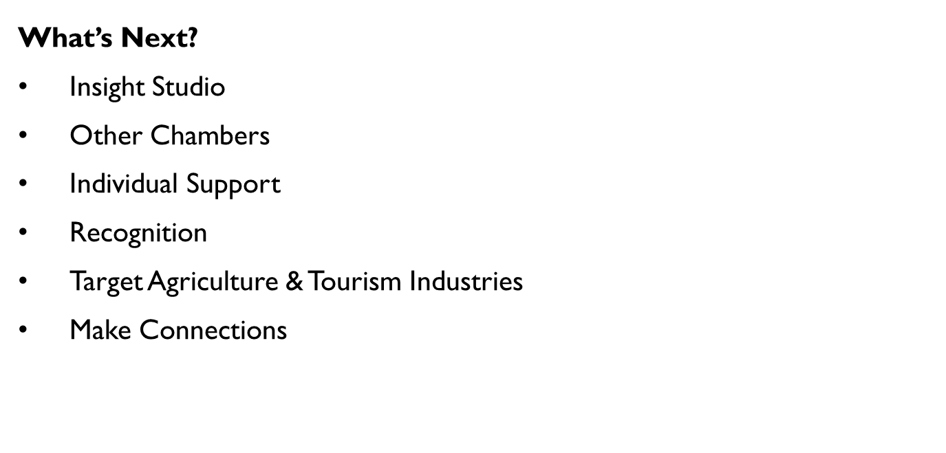

Slide 14
What is/could be County's Role in All This?
Role Model
  HR Policies/Practices
  Joint Facilities Projects
Economic Engine Stimulator
  Investor in FFW Accelerator
  Policy Shaper
    General Plan Language/Focus
    Land Use/Zoning/Permitting
    Housing
Notes:
Wendy Wrap-up Slid

Slide 15
QUESTIONS
&
DISCUSSION

