Slide 1
Joseph M. Nicchitta, Countywide Coordinator
CALIFORNIA COUNTIES CANNABIS SUMMIT
July 19, 2017
SUBTITLE

Slide 2
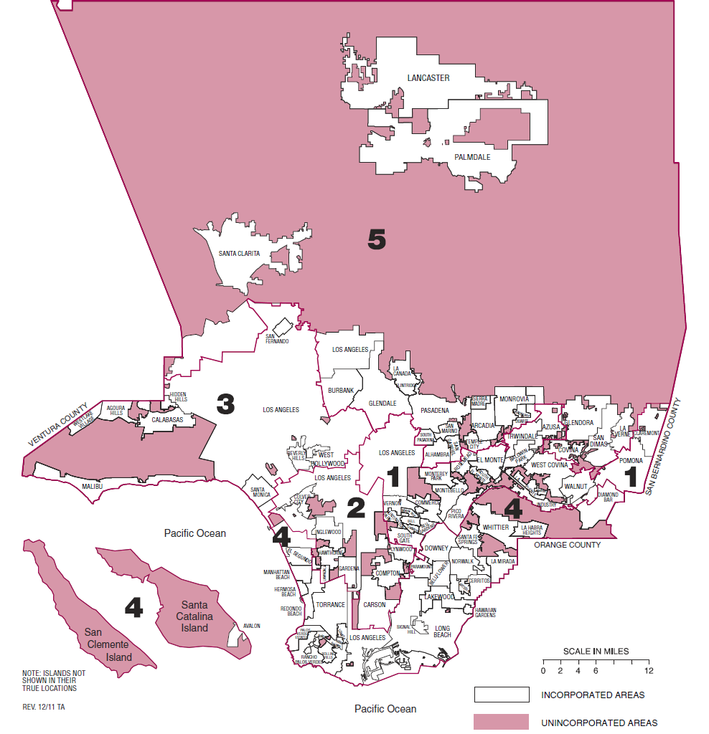
PINK AREAS = UNINCORPORATED LA COUNTY

Slide 3
COMMERCIAL CANNABIS BUSINESSES ARE CURRENTLY PROHIBITED IN LA COUNTY
2006: LA County adopts ordinance allowing medical cannabis dispensaries with a conditional use permit.
No medical cannabis dispensary was ever permitted.
2010-2017: LA County adopts series of ordinances/urgency ordinances prohibiting all medical and “adult-use” commercial cannabis activities. Currently, all commercial cannabis activity is prohibited in unincorporated areas.
February 2017: LA County Board establishes the Office of Cannabis Management and directs the preparation of regulations to allow all medical and “adult-use” cannabis business types.

Slide 4
LA COUNTY’S CURRENT APPROACH TO COMMERCIAL CANNABIS REGULATION
Board of Supervisors Directs Departments to Prepare Regulations
With respect to land use, Board motion directed:
No outdoor commercial cultivation
cultivation, distribution, and manufacturing in industrial and commercial manufacturing zones
All other associated medical and commercial cannabis related enterprises in heavy commercial zones (C-3) or higher
Special attention to community plan areas and sensitive uses, as well as avoiding overconcentration and unfair burdens to some communities
Emphasis on public engagement.

Slide 5
LA COUNTY’S CURRENT APPROACH TO COMMERCIAL CANNABIS REGULATION
What we are asking the public…
Before drafting regulations: 18 public listening sessions throughout LA County from July 13 to August 12. Seeking input on the following land use questions:
Should the County prohibit cannabis businesses from locating near certain places or “sensitive” land uses, such as schools? If so, why are you concerned about cannabis businesses locating near those places or land uses?
Do you think cannabis businesses should be located away from other cannabis businesses? If so, why are you concerned about cannabis businesses locating near each other?
Which type of cannabis business (retailer, cultivator, manufacturer, distributer, testing laboratory) most concerns you, if any?

Slide 6
LA COUNTY’S CURRENT APPROACH TO COMMERCIAL CANNABIS REGULATION
What have we noticed…
A lot of people are afraid of dispensaries.
Frequently proposed buffers: schools, day cares, parks, residences, places of worship, libraries, liquor stores, senior centers, senior housing, drug treatment facilities, group homes, affordable housing developments
How far? 2,500 feet to one mile are common responses.

Slide 7
LA COUNTY’S CURRENT APPROACH TO COMMERCIAL CANNABIS REGULATION
What have we learned…
Big difference between a “yes” vote on Proposition 64 and being okay will commercial cannabis in neighborhoods.
Fear and apprehension.
Belief that a ban will make problems go away.
Many concerns stem from perceptions about unlicensed cannabis businesses or belief that business owners are gang members or criminals.
More education is needed.

Slide 8
MORE INFORMATION
Office of Cannabis Management
cannabis.lacounty.gov
cannabis@lacounty.gov

