Slide 1
Why Kern County?
High Needs Population
Few Resources
Programming is in High Demand

Slide 2
Program Inventory
Program
Outside Case Management
Seeking Safety
Correctional Education
Electronic Monitoring - Supervision
Electronic Monitoring - in Lieu of Jail
Employment Training - Community
Inpatient/intensive outpatient drug treatment (community)
Inpatient/intensive outpatient drug treatment (incarceration)
Vocational education in jail
Work release
Day Reporting Center
Victim Impact Panel
Ignition Interlock Device
Substance Abuse Prevention
Domestic Violence - Community
Domestic Violence - In-Custody
Alcohol education
Chaplain Program
Child abuse/parenting counseling
Community service
Drug Testing
GED Preparation
Health
Life Skills
Mental health counseling
SCRAM
Sober Living Environment
Sobriety Services
Substance/Alcohol abuse counseling

Slide 3
Kern County Recidivism

Slide 4
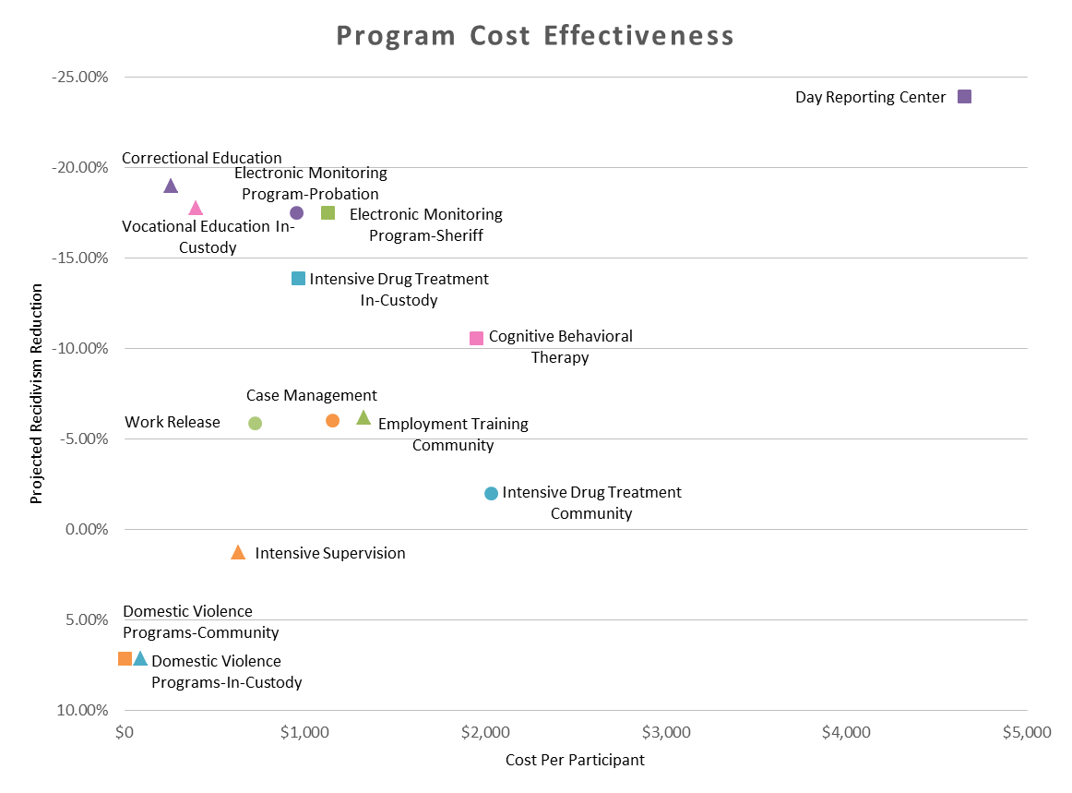
Projected Cost-Effectiveness of Adult Criminal Justice Programs

Slide 5
Changes in the County
Collaboration and Communication between Agencies
Common Measurement of Program Effectiveness
Increased Emphasis on Cost Effectiveness

Slide 6
Changes in Sheriff’s Office Programs
Assurance that Existing Vocational and Educational Programs were Effective
Identified New Evidence-Based Programs for inclusion in Inmate Programs
Increased Emphasis on Cognitive Based Therapy

Slide 7
Successes
Example of evidence-based programs
Residential Substance Abuse Treatment (RSAT)
Incorporates the Matrix Curriculum, Aggression Replacement Therapy (ART) and Moral Reconation Therapy (MRT)
Extensive aftercare post release
To date RSAT has had 450 participants - The current recidivism rate of RSAT program is approximately 22%.

Slide 8
Moving Forward
Integration
Evidence-Based Programming
Evaluation

Slide 9
Contact Information
http://www.kernprobation.com/ab109ccp-realignment/plans-and-reports/
Cassaundra Friedberg
Supervising Department Analyst, Probation
Cassaundrafriedberg@co.kern.ca.us
Ian Silva
Detentions Lenient, Sheriff’s Office
Silvai@kernsheriff.com

Slide 10
Questions

