Slide 1
2017-18 May Revision
CSAC

Slide 2
May Revision Overview

Slide 3
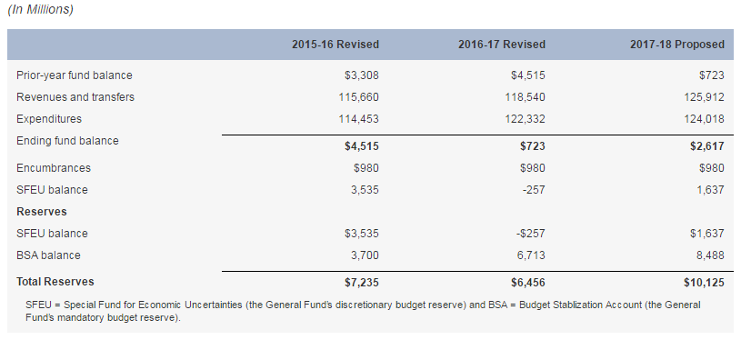
Administration’s General Fund Estimates
Administration’s General Fund Condition
Notes:
$10.1 billion total reserves. Total reserves are $701 million higher than the Governor’s January budget ($619 BSA, $83 SFEU).

Slide 4
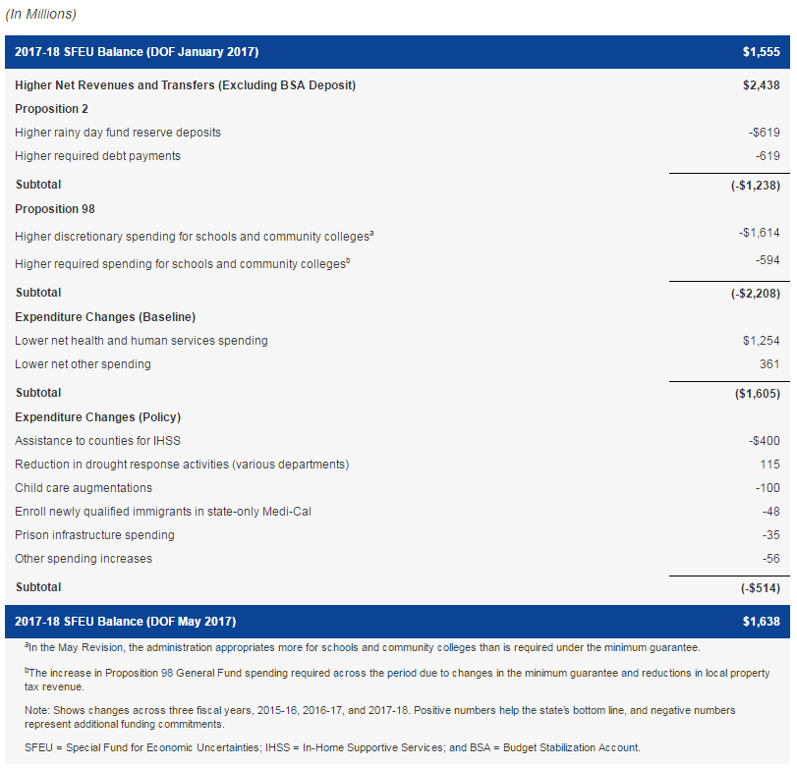
Major Features of the May Revision
Major General Fund Changes Between Governor’s Budget and May Revision
Notes:
Top line is the SFEU balance from January. The administration estimates that revenues and transfers are on net $2.4 billion higher than at Governor’s budget. The rest of the rows show the additional spending (negative) or reduced spending (positive) that results in $1.6 billion in SFEU.

Slide 5
Major Features
Revenues and transfers (excluding Budget Stabilization Account) up $2.4 billion since January (across 2015-16, 2016-17, and 2017-18).
Required reserve deposits and debt payments up $1.2 billion.
Required and discretionary spending on schools and community colleges up $2.2 billion.
Administration’s estimates of health and human services spending (due to caseload and other factors) is down $1.3 billion across three years.
Additional $514 million in other discretionary expenditures proposed.
Supplemental payment for state pensions
Notes:
Big three taxes are up $2.1 billion across the three years, largely attributable to a $3.1 billion increase in 2017-18 PIT revenues. Sales and use tax down across the three years by $1.2 billion.
Higher revenue estimates—particularly due to higher capital gains—increases BSA deposits and paying down debts.
Lower property tax revenues result in more GF needed for Proposition 98. Governor also proposes appropriating more funding to schools and colleges than is required by Proposition 98. Across the three fiscal years, these discretionary increases total $1.6 billion, resulting in a total increase for schools and community colleges of $2.2 billion over the period.
HHS down $1.3 billion. The largest component of this decrease is in Medi-Cal ($620 million in CY and $536 million in 2017-18). These Medi-Cal savings are generally attributable to savings from drug rebates in managed care, retroactive managed care rate adjustments, slower caseload growth, and the timing of certain payments.
Largest of the discretionary expenditures is IHSS ($400 million).
The administration proposes making an additional payment of $6 billion to reduce the unfunded liability of CalPERS. This payment would be funded by a loan from the state’s portion of the Surplus Money Investment Fund, which is part of the state’s short-term savings account. The General Fund would repay its portion of the loan through future required debt payments under Proposition 2.

Slide 6
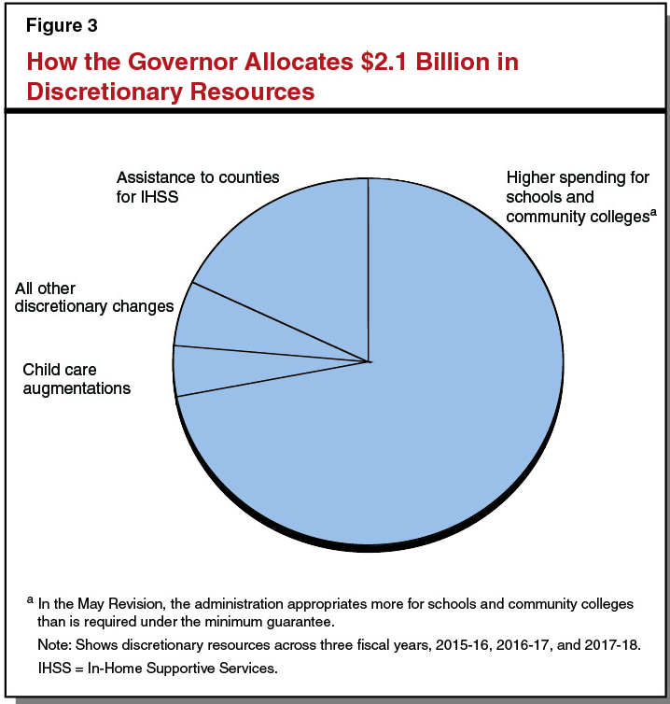
Governor Focuses on Schools and Community Colleges with Additional Discretionary Resources

Slide 7
LAO Economic Outlook

Slide 8
California Economic Scenarios
Notes:
Outlook based on the consensus economic scenario (in May we only do one scenario)
For 2017-18, reaonable to assume that there will be moderate economic growth over the next year. Both our forecast and the DOF forecast assume moderate economic growth over the next year.

Slide 9
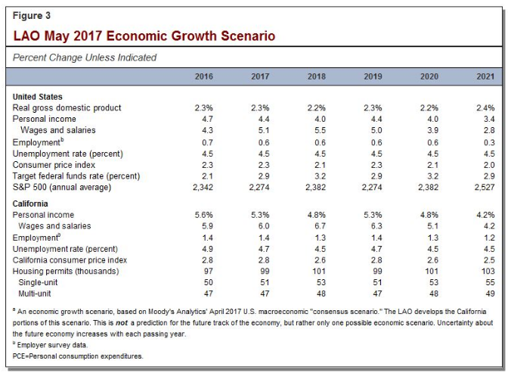
LAO Outlook: Outyears
Notes:
Eight year expansionary period—one of the longest post WWII
Various elements of economic uncertainty:
What is full employment? (Many economists believe the US economy as a whole appears to bet at or near the full employment level, while parts of California also appear to be at or near full employment. At full employment, growth can be more difficult to achieve.)
What will happen at the Federal level? Significant change seems likely (health care, taxes, immigration, trade)
Uncertainties of the stock market (stocks now may be overvalued)

Slide 10
LAO Revenue Outlook

Slide 11
LAO Revenue Estimates Only Slightly Above Administration Estimates
Notes:
Overall: Our revenue estimates are $892 million above the administration for 2016-17 and 2017-18 combined. (Our estimates in 2016-17 are over the administration’s by nearly $1 billion, but slightly below the administration’s in 2017-18. Generally, the difference is explained by our higher estimates of PIT and SUT revenues and offset by our lower estimates of CT.)
PIT
Wage and salary growth is projected to grow at a healthy pace over the next few years. Wage and salary growth is the principal driver of PIT revenue growth. While the economic growth scenario anticipates a continued slowing in job growth, it also anticipates that individuals’ salaries will increase over the next couple of years due to a tightening labor market and rising wages, among other factors.
In our revenue projections, overall taxable wages and salaries of California residents grow by 6 percent in 2017, 7 percent in 2018, and another 6 percent in 2019.
Corporation Tax
Lower refunds in 2016-17 result increases for corporation taxes in 2015-16 by hundreds of millions of dollars.
Sales Tax
Sales tax collections were well below the administration’s estimates in February and March. This weakness not only reduced revenue in 2016-17, but also established a lower base for subsequent growth.
Significant downward revisions in both our and the administration’s estimates. As a result, we both project moderate SUT growth.

Slide 12
LAO Comments

Slide 13
LAO Comments
Revenues:
Overall, our revenue estimates are quite similar
Spending:
Recommend the Legislature set the reserve levels at or above the Governor’s Proposal.
CalPERS plan promising, consider waiting to finalize borrowing plan.
IHSS Proposal very complex, recommend Legislature consider simpler, short-term solution.

