Slide 1
H.E.A.T. Watch: Systems Leading the Way A Model of Care and Collaboration
Nancy E. O’Malley, District Attorney, Alameda County
Jennifer Madden, Asst. District Attorney, Alameda County

Slide 2
What Is Human Trafficking?
Human Trafficking is MODERN DAY SLAVERY and includes both labor and sex trafficking.
Human trafficking is a criminal business that profits from enslaving people for sexual servitude and forced labor. It is the fastest growing and second largest criminal industry in the world today (second only to drug trafficking and tied with illegal arms), according to the U.S. Department of Health and Human Services.
CSEC is defined as the sexual abuse of a minor entirely or primarily for financial or other economic reasons. Economic exchanges may involve monetary or non-monetary (food, shelter or drugs)

Slide 3
What Is Human Trafficking?
Labor Trafficking can involve debt bondage:
Working in the homes without pay
Working in restaurants, salons and other industries without pay
Labor Trafficking can involve:
Working in construction, agricultural and other jobs where extortion occurs by employers against employees for under pay or no pay
Today, we will focus on Child
Sex Trafficking

Slide 4
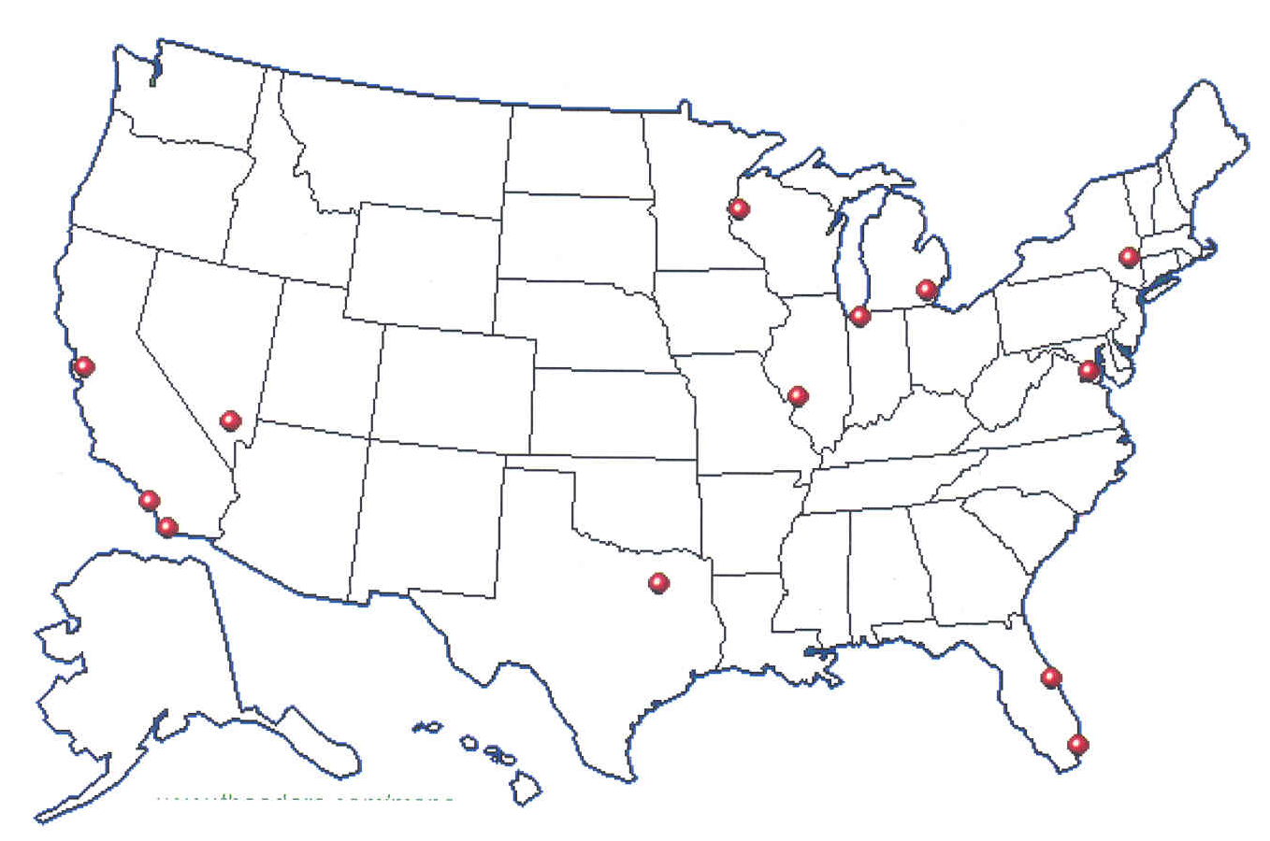
FBI Identified 13 Cities as High Intensity Child Prostitution Areas (HICPA)
San Diego
Chicago
Dallas
Detroit
Las Vegas
Los Angeles
Miami
Minneapolis
New York
San Francisco Bay Area
St. Louis
Tampa
Washington, D.C.

Slide 5
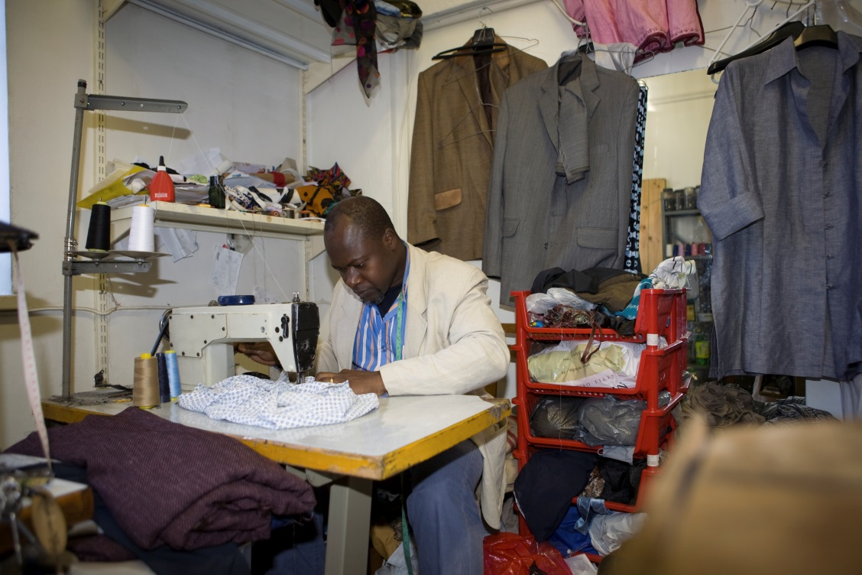
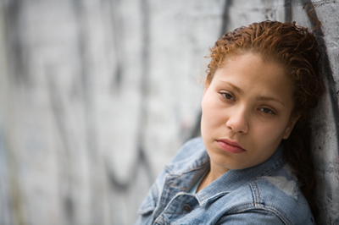
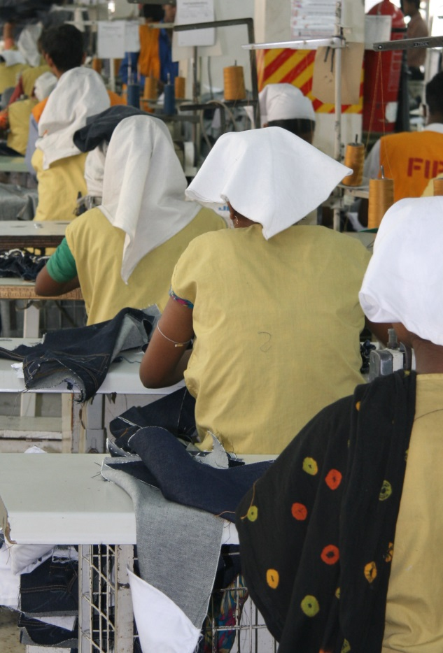
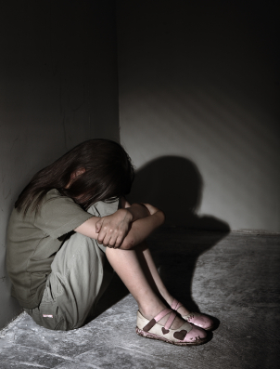
EVERY DAY
in CALIFORNIA
MEN
WOMEN
&
CHILDREN
are trafficked for profit

Slide 6
What is The National Picture?
3 of the top 13 cities for CSEC are in California: Los Angeles, Oakland and San Diego
Based on the National Human Trafficking Resource Center data from 2015:
-12/2007 to 3/2015: 19,991 Human Trafficking cases reported
-5,990 cases reported in 2015 to date
-12/2007-3/2015: 96,513 calls related to human trafficking to the hotline number

Slide 7
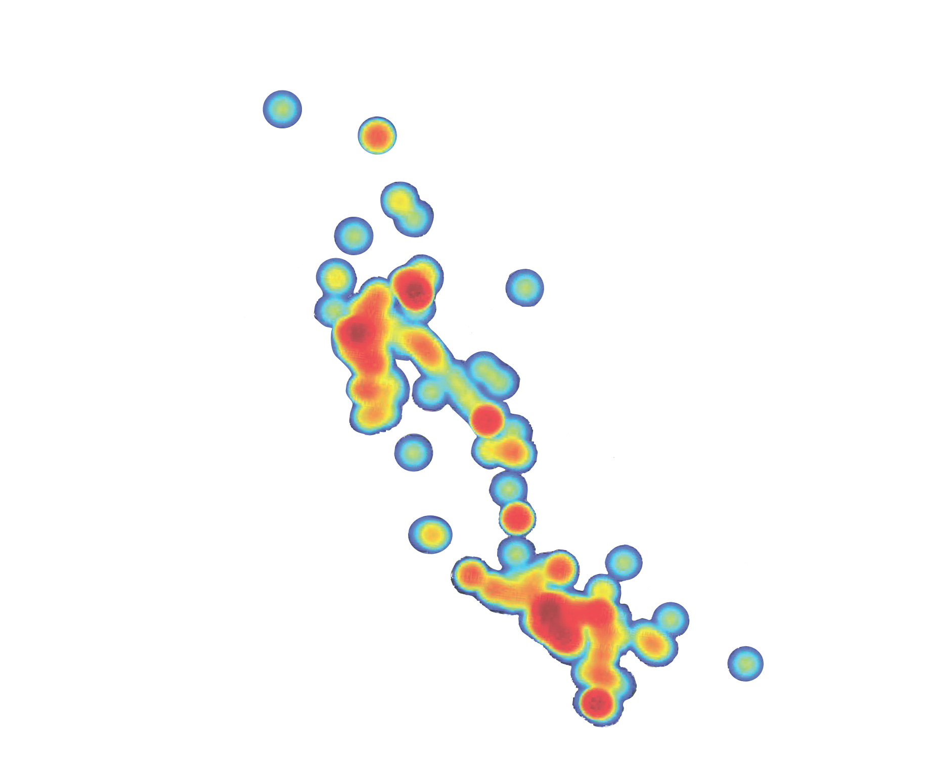
California’s human trafficking
“hot spots”
Polaris Project 2014

Slide 8
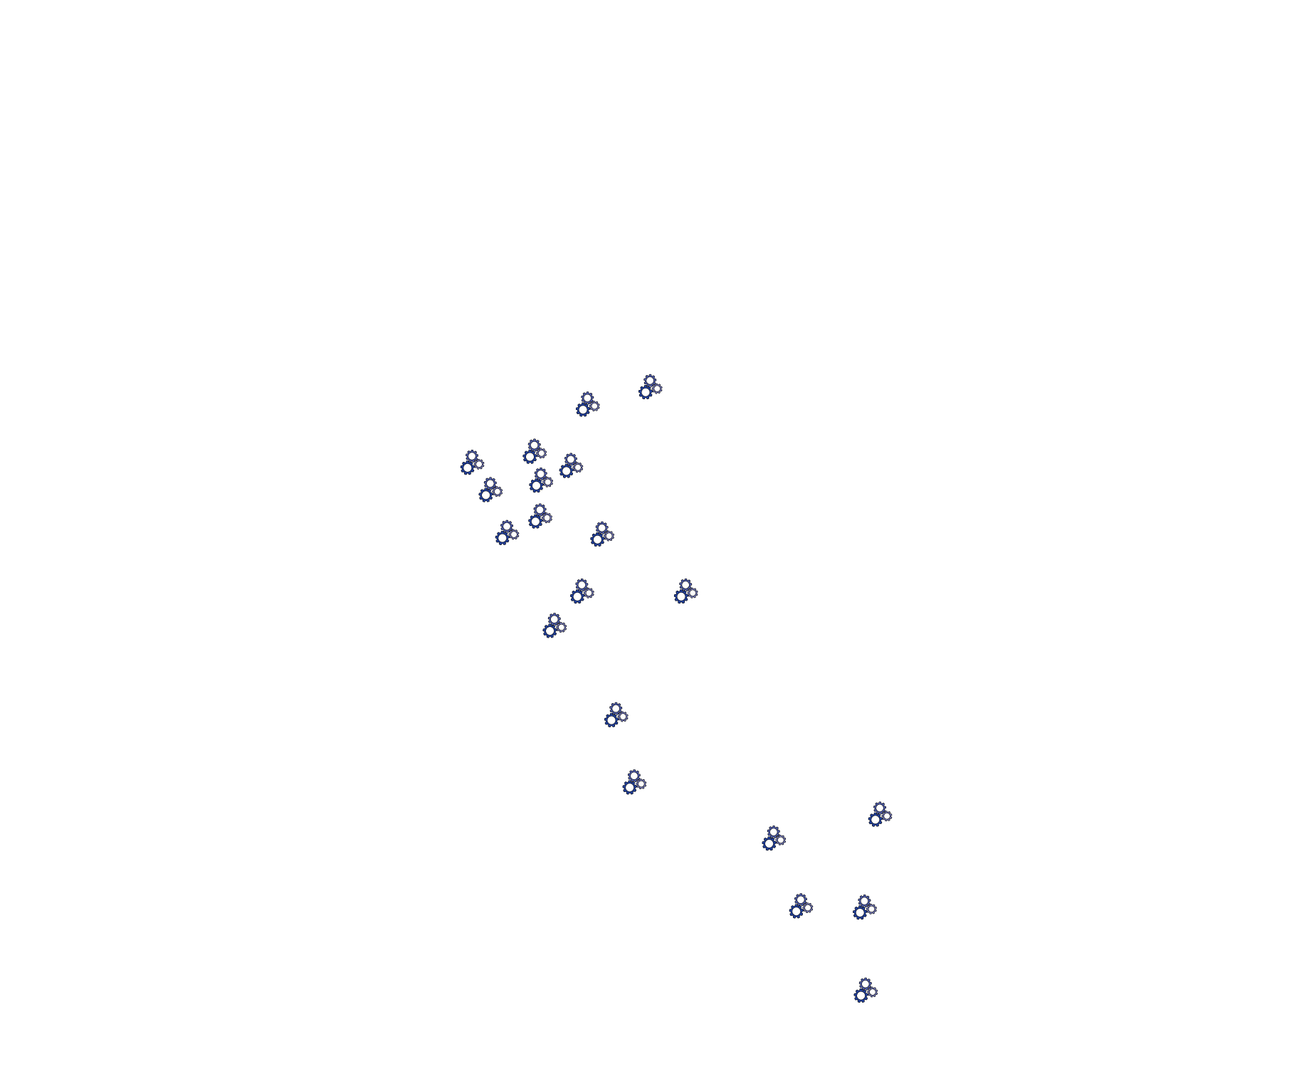
STAGES OF RESPONSE
Planning
Implementing

Slide 9
Law Enforcement
Task Force
Victim Services
Task Force
Enhanced Task Force
Cross Regional
Task Force
Collaboration

Slide 10
Family Justice Centers
with CSEC-specific services
Family Justice Centers
Collaboration

Slide 11
Courts
Girls Court
Boys Court
CSEC Court

Slide 12
Housing
Temporary housing
Permanent housing
Boarding school

Slide 13
Education
Educational programs
in schools

Slide 14
How Does It Occur?
Recruited from group homes
Kidnapped from the streets (Gorilla Pimps)
Forced by “boyfriends” (Romeo Pimps)
Recruited at school
Criminals have moved from running drugs and guns to exploiting women and children
Most are particularly vulnerable because of previous trauma

Slide 15
Who Are The Exploiters and Purchasers/Child Rapists?

Slide 16
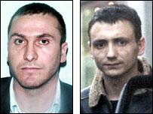
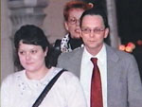
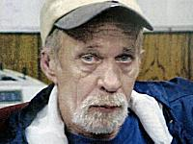
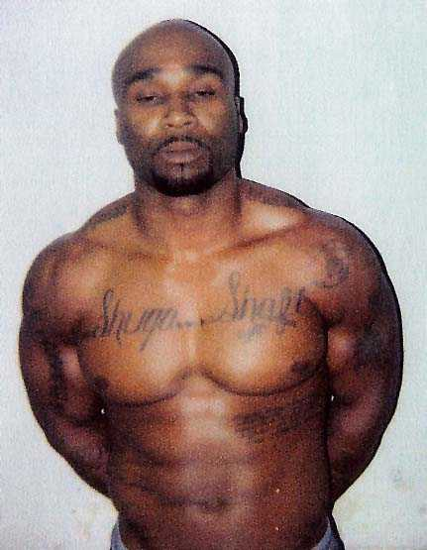
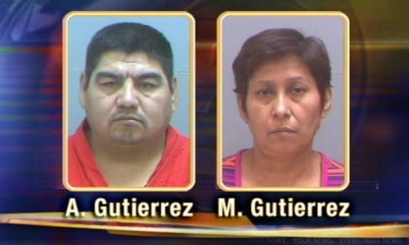
Predatory purchasers
Sex tourists
Sex traffickers
Pimps
Madams
Street gangs
Sex offenders
Pedophiles
Operators of the sex industry

Slide 17
Challenges to Identifying Victims of CSEC
Hidden nature of the crime
Lack of self-identification caused by brain-washing/control techniques of the exploiter (Stockholm Syndrome)
Lack of awareness by professionals who may interact with the victims
Lack of awareness by the general public

Slide 18
Who Is At Risk For Exploitation?
Runaway Youth are at high-risk
Children in Foster Care are Vulnerable
Victims of other forms of abuse such as physical or sexual violence are easy targets
Any child, regardless of ethnicity or socioeconomic background, is at-risk

Slide 19
WHAT CAN SYSTEMS AND COMMUNITIES DO TO COMBAT HUMAN EXPLOITATION & TRAFFICKING?

Slide 20
The H.E.A.T. Unit at the Alameda County District Attorney’s Office in 2005
-Identified Human Trafficking as a priority within our office;
-Began protocols for how victims of Human Trafficking were treated within the judicial process;
-Established protocols for vertical prosecution of traffickers.

Slide 21
The H.E.A.T Unit
Dedicated prosecutors who prosecute traffickers and care for victims in a trauma-informed manner;
Dedicated victim witness advocates and dedicated inspectors assist with support and trial preparation;
Staff who educates the legal community and the public

Slide 23
W&I 18259 et seq
Alameda County Pilot Program
Report to Legislature 4/2016
Identified CSEC who are
Detained for a violation of the law;
Placed in Civil Protective Custody on a safety hold based on a violation of 674(a)or (b) or 653.22(a)
Kept separated from detained minors

Slide 24
Created H.E.A.T. Watch, a 5-prong Community Blueprint to combat Human Trafficking of all forms
Train Law Enforcement
Vigorous Prosecution of Traffickers & Purchasers
Create and increase strong Community-based and victim services and providers
Educate Policy Makers & Advocate for change
Engage the Community

Slide 26
H.E.A.T. Watch Billboard Campaign
Human Exploitation and Trafficking
(H.E.A.T.) Watch Blueprint
1 2
3
4
5
Five Point Strategy
We empower the community by
dispelling myths & misconceptions
about this form of child abuse. We
also teach them how to identify &
report human trafficking. Our
community programs include
H.E.A.T. Watch Radio &
Neighborhood H.E.A.T. Watch.
Our Office has trained law enforcement
officers from Alameda County agency,
along eness
Notes:
A 5-point strategy to combat CSEC
Casey will talk about LE and Prosecution

Slide 27
Protect Oakland Kids Billboard (Community) Campaign

Slide 30
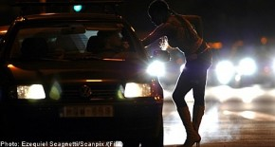
Coordinated Response
Law Enforcement
Advocacy Services
District Attorney and Defense Counsel
Social Services
Community Services
Probation
Juvenile Court
Health Services

Slide 31
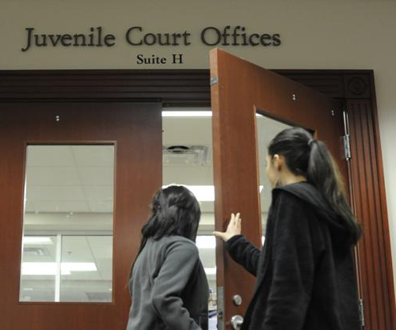
Juvenile Court as a Model for Connecting Services
Dedicated prosecutor and public defender assigned to juvenile division to address the needs of CSEC and those identified as at-risk
Dedicated Judges
Connects identified youth to services, whether they are detained or in the community
Works closely with community based organizations working with the youth

Slide 32
Girls Court: Model of Care and Best Practice
Girls Court – Began 2011 as a gender-specific calendar to address the needs of CSEC, at risk, and other high-risk girls on probation
Streamlines services to the youth and creates more collaboration between service providers
Complemented by quarterly Girls Court Committee Meetings to address ways to improve and to collaborate with stakeholders

Slide 33
SafetyNet
SafetyNet – a weekly MDT meeting to review cases of at-risk and involved CSEC. Stabilization and support services are offered.
Began 2011. Reviewed 514 cases to date
Currently, 12 agencies participate on a weekly basis (District Attorney, Public Defender, Social Services, Community Advocates and Probation)
Governed by an MOU/Confidentiality Agreement to promote trust and share information in the best interest of the youth

Slide 35
Human Exploitation and Trafficking
(H.E.A.T.) Watch Blueprint
1 2
3
4
5
Five Point StrategyOur vertical H.E.A.T. Unit consists
of two District Attorneys, a victimwitness
advocate & an inspector.

Slide 36
Educational and Therapeutic Enrichment
Young Women’s Saturday Program - 16 week educational and therapeutic program started in 2011
Includes youth who are in the delinquency system as well as youth in the dependency system (foster care or group homes)

Slide 37
On the Horizon
California Social Services CSEC Protocol
-Welfare and Institutions Code, section 300(b)(2)
-Funding for specially trained Child Welfare Workers
-CSEC specific foster care

Slide 38
What Does “Success” Look Like?
Healthy Relationships
Stable Housing
Opportunities for Academic Success
Employment Opportunities
Sustained Relationships with Support Persons

Slide 39
“Nancy’s work in Alameda County inspires my own work in Washington and [their] impressive model is one that deserves to be replicated throughout the state and country.”
Senator Dianne Feinstein, 11/2015

Slide 40
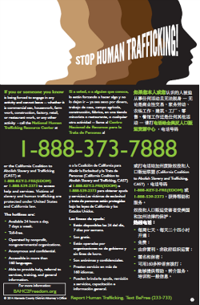
SB 1193 Campaign
Certain businesses are required by law to post the “STOP HUMAN TRAFFICKING” poster or be fined
Developed App to enforce law “app-solutely” campaign

Slide 41
A Call to Action
BLUE RIBBON PANEL PRESENTATION

Slide 42
State Leadership is Critical
Multiple Systems, One Shared Commitment
CHILD WELFARE
EDUCATION
LAW ENFORCEMENT
HEALTH
NON-PROFIT & GOVT VICTIM SERVICES
“We know we can do better by our children.
We must have the courage and the will to do so.”
Nancy E. O’Malley, Alameda County District Attorney

Slide 45
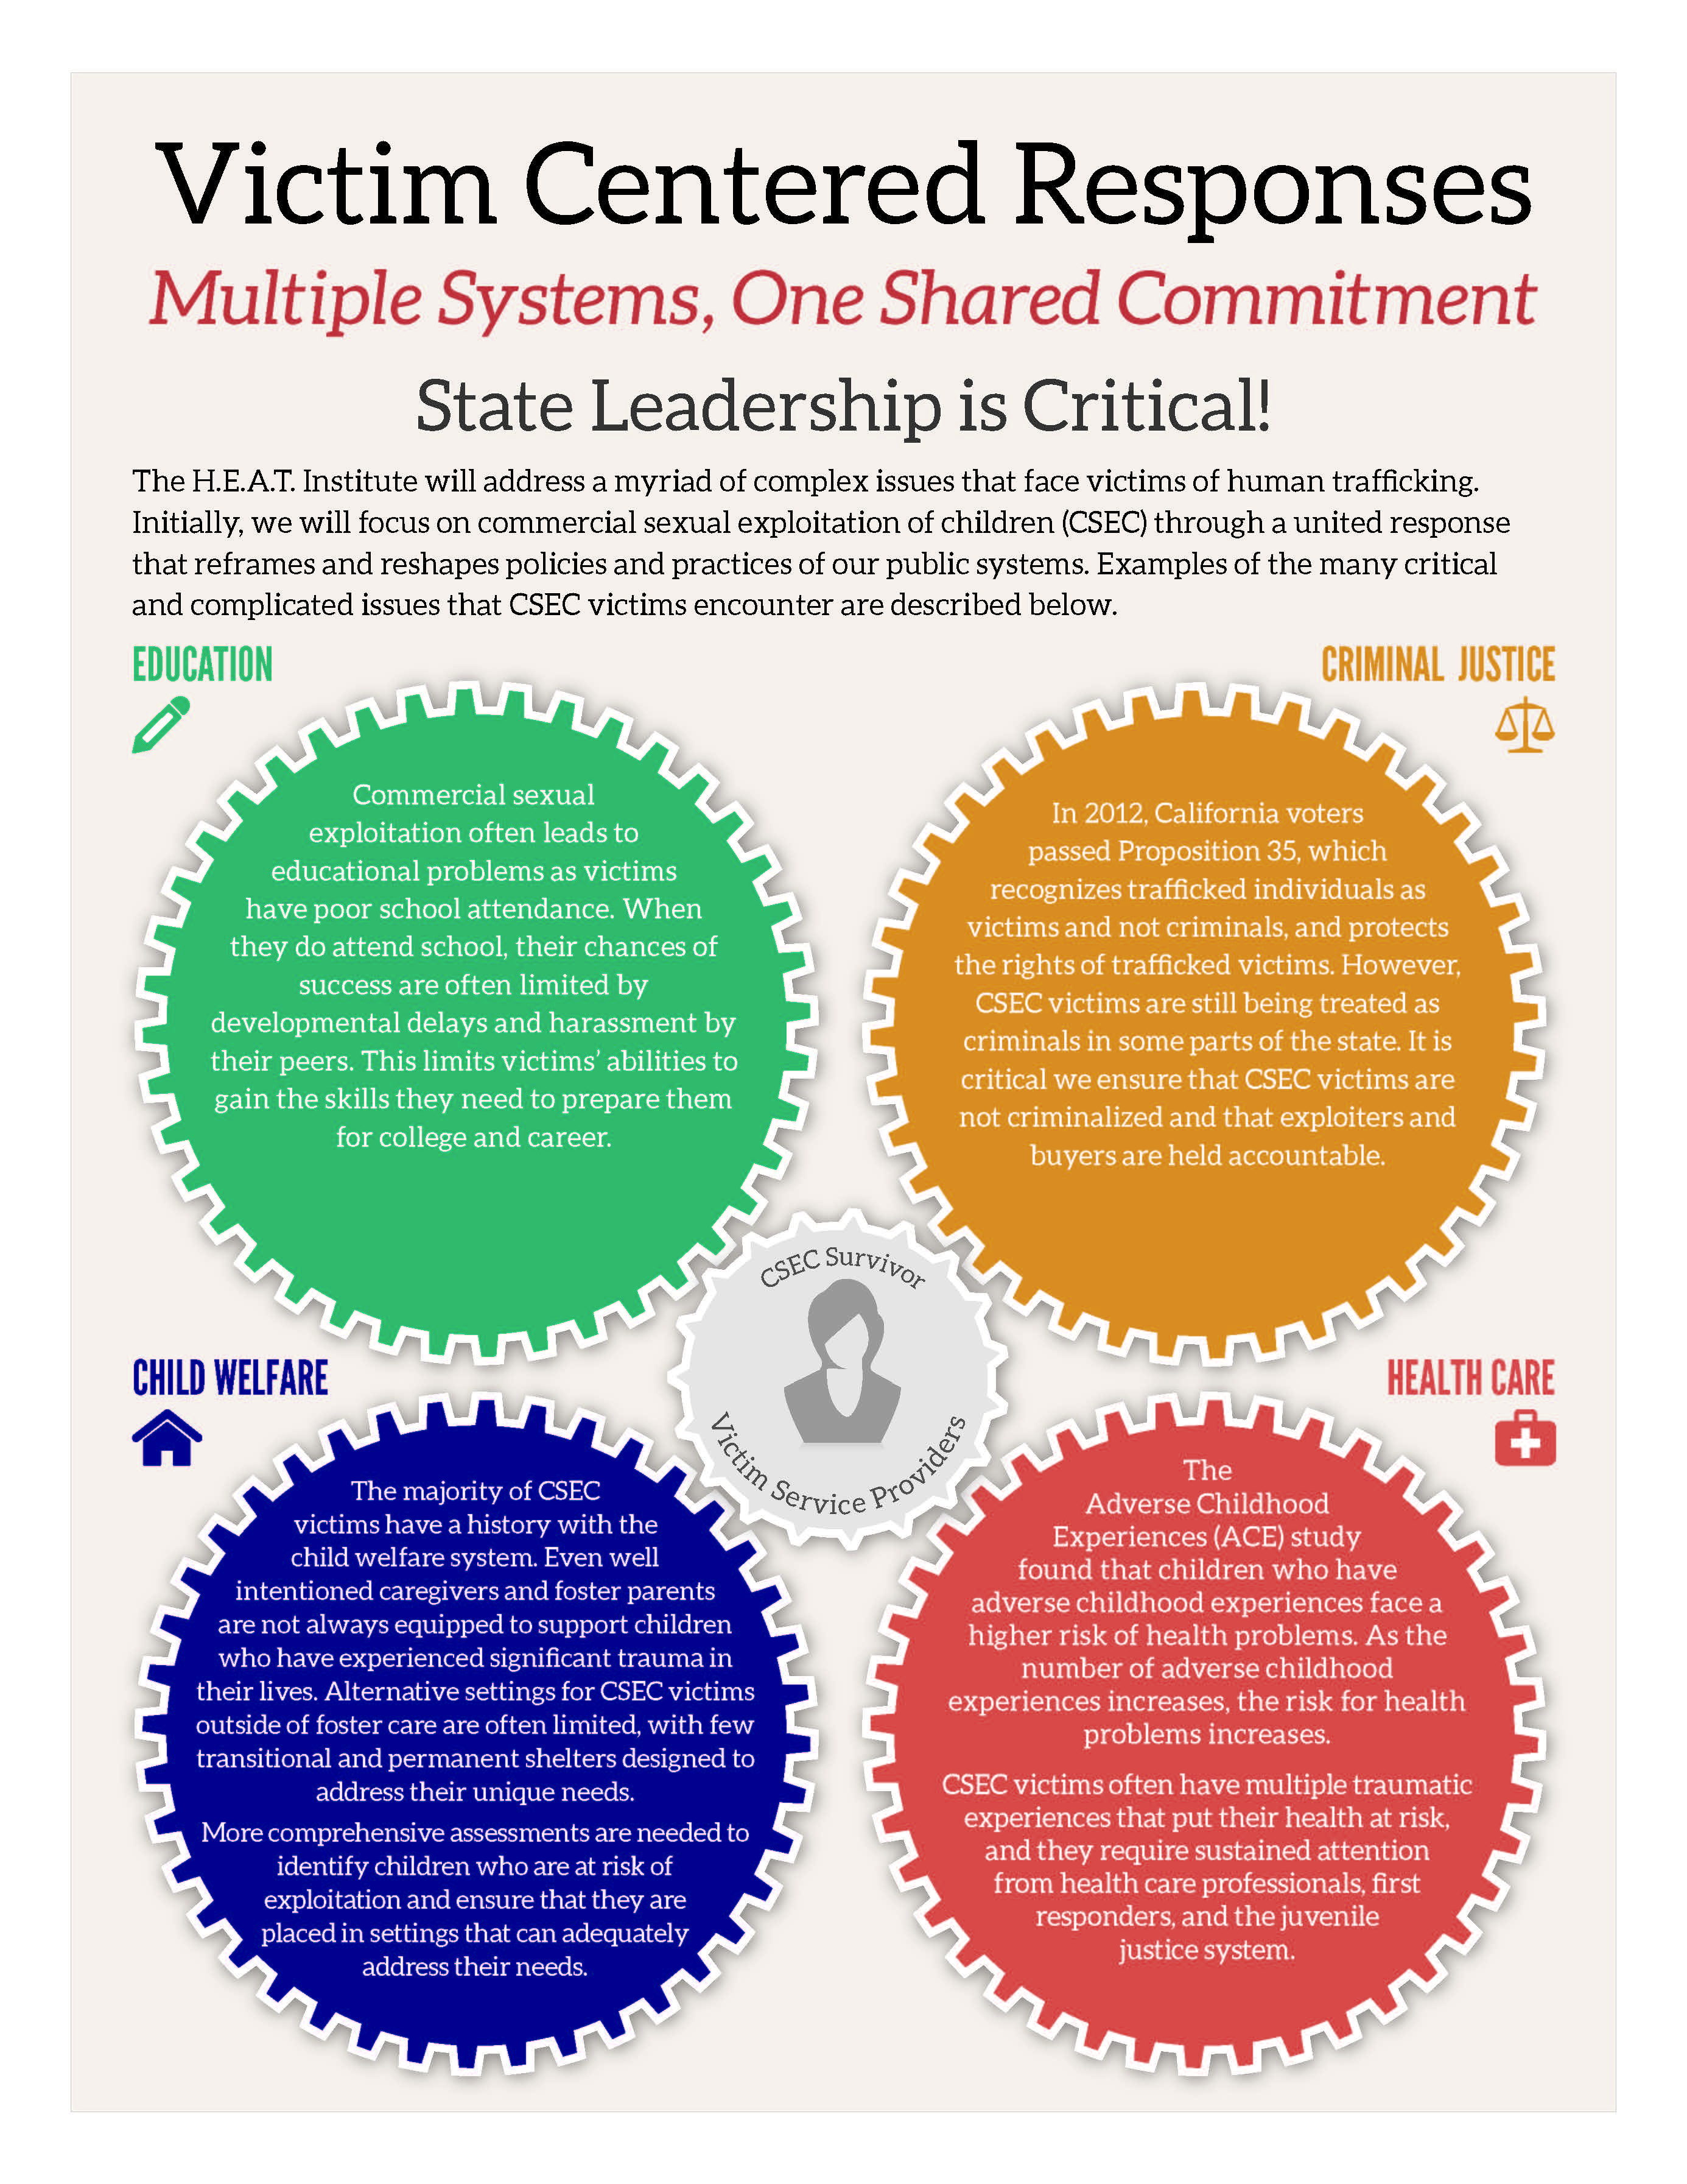

Slide 46
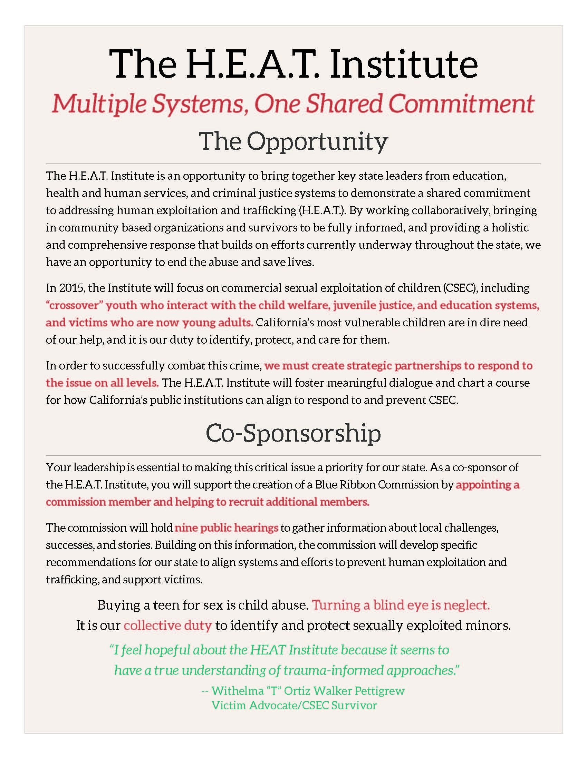

Slide 47
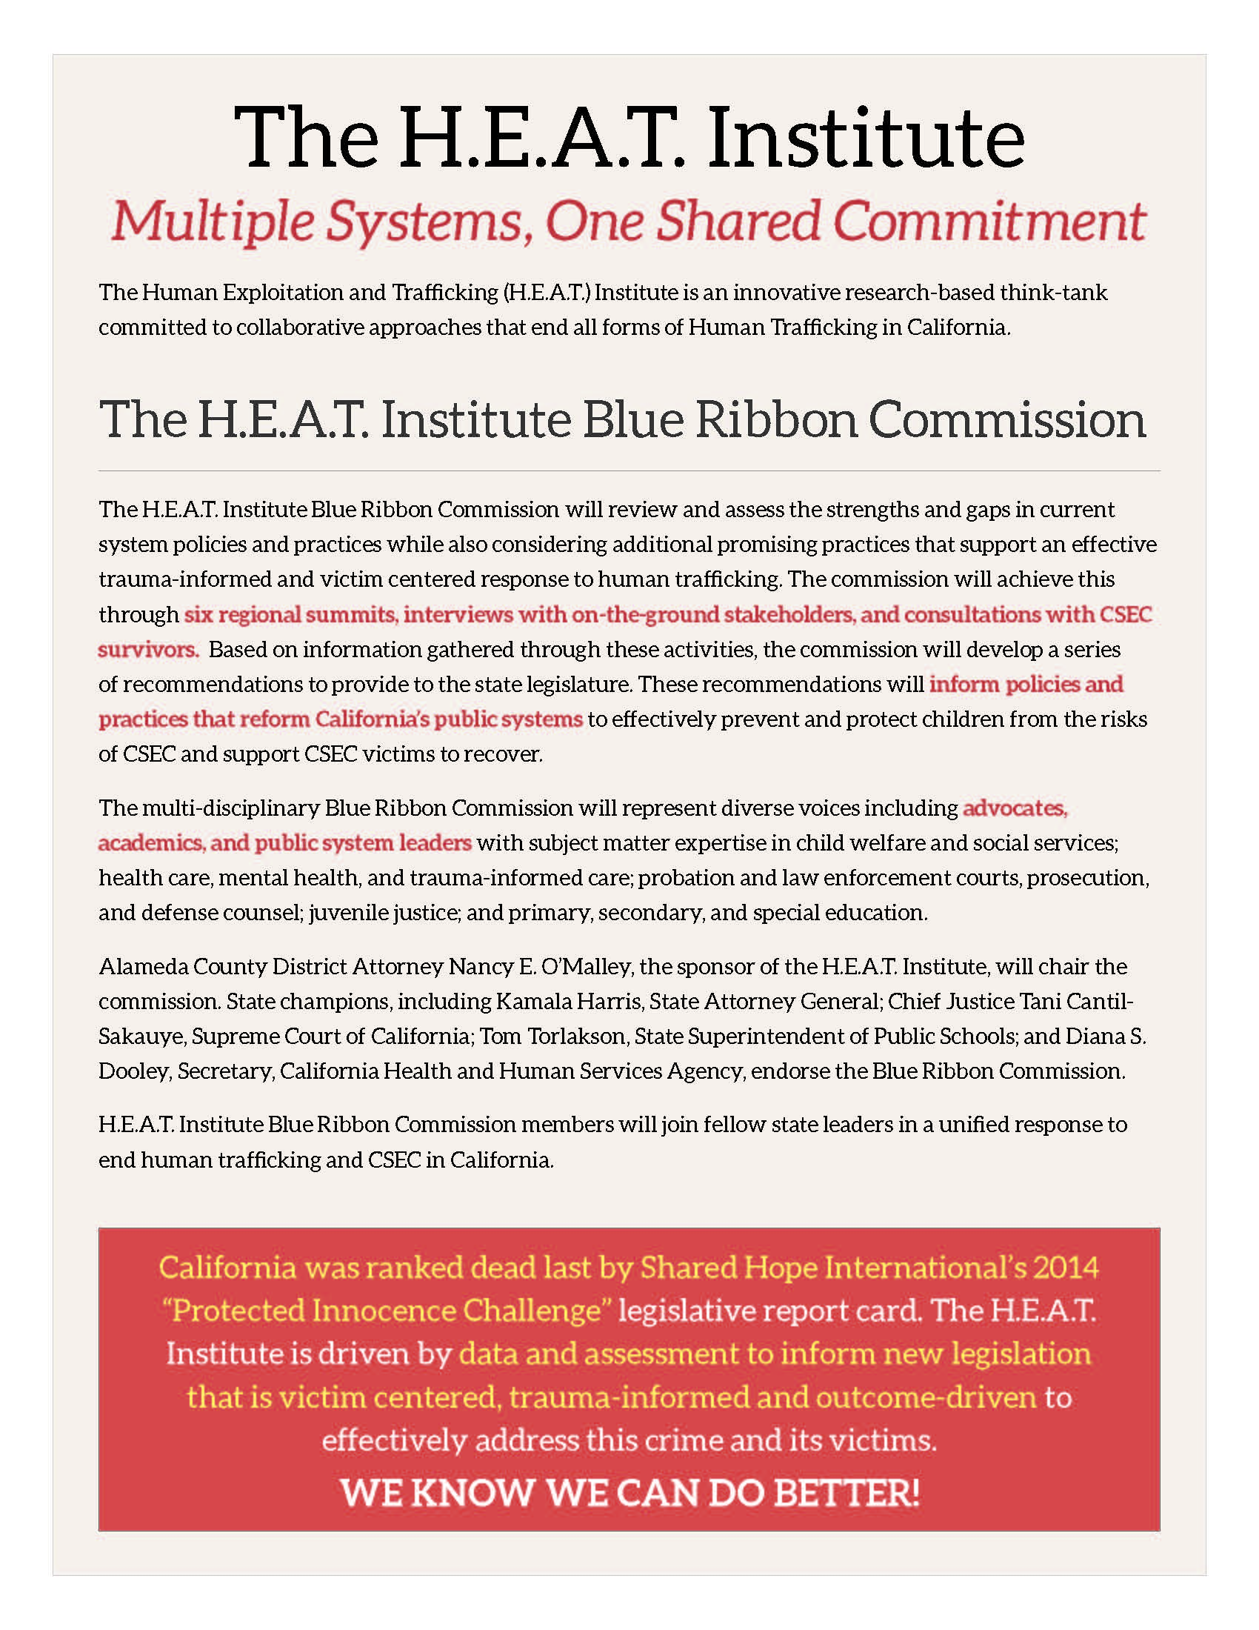

Slide 48
Blue Ribbon Commissioners of the HEAT Institute
Nancy E. O’Malley, District Attorney, Alameda County
Founder and Facilitator, H.E.A.T. Institute
Mr. Tom Torlakson
California State Superintendent of Public Instruction
Ms. Kamala Harris, Attorney General
Office of the Attorney General of California
Chief Justice Tani Cantil-Sakauye
Supreme Court of California
Mark Ghilarducci, Director
California Office of Emergency Services
Will Lightbourne, Director
California Department of Social Services
Cindy Chavez, County Supervisor
Santa Clara County, Second District
Mr. Doug Hunt, Supervising Special Agent
Federal Bureau of Investigation
San Francisco Division
Kay Buck, Executive Director
Coalition to Abolish Slavery & Trafficking
Mr. Ken Berrick, President and Chief Executive Officer
SENECA Family of Agencies
Leslie Starr Heimov
Executive Director, Children’s Law Center of California

Slide 49
Blue Ribbon Commissioners of the HEAT Institute
Danielle Molé
Policy Advocate & Grassroots Advocacy Coordinator
California Alliance of Child and Family Services
Frank Mecca, Executive Director
County Welfare Directors Association of California
Harrison Alter, MD, MS, FACEP
Executive Director
Andrew Levitt Center for Social Emergency Medicine
Chief Sheriff Jay Varney
Madera County
Tracy Schiro, Deputy Director
San Luis Obispo County Social Services Department
Dr. Stacey Katz, Executive Director
WestCoast Children’s Clinic
Fernando Giraldo
Chief Probation Officer, Santa Cruz County
Jennifer Rodriguez, Executive Director
Youth Law Center
Kate Walker, Staff Attorney
National Center for Youth Law
Karen Pank, Executive Director
California Chief Probation Officers Assn

Slide 50
Alternates Commissioners:
Allies of the HEAT Institute
Ms. Jill Habig
Special Assistant State Attorney General
California Department of Justice
Office of Attorney General Kamala D. Harris
Maria Ramiu, Managing Director
Youth Law Center
Gregory Rose, Deputy Director
California Department of Social Services
Judge Catherine Pratt
Los Angeles Superior Court
Compton Juvenile Court, Department 261
Glen Price
Chief Deputy Superintendent for California Public Instruction
Marty Parker, Special Agent
Federal Bureau of Investigation
San Francisco Division
Diana Dooley, Secretary
California Health and Human Services Agency
John Wordlaw, Assistant Secretary – Program/Fiscal
California Health and Human Services Agency
National Supporters
Linda Smith, Founder and Executive Director of Shared Hope International
Withelma T Ortiz Pettigrew, CSEC Survivor/Champion
Nola Brantley, CEO of Nola Brantley Speaks – CSEC Survivor/Champion
Brad Myles, Executive Director of Polaris Project
Esta Soler, Executive Director of Futures Without Violence

Slide 51
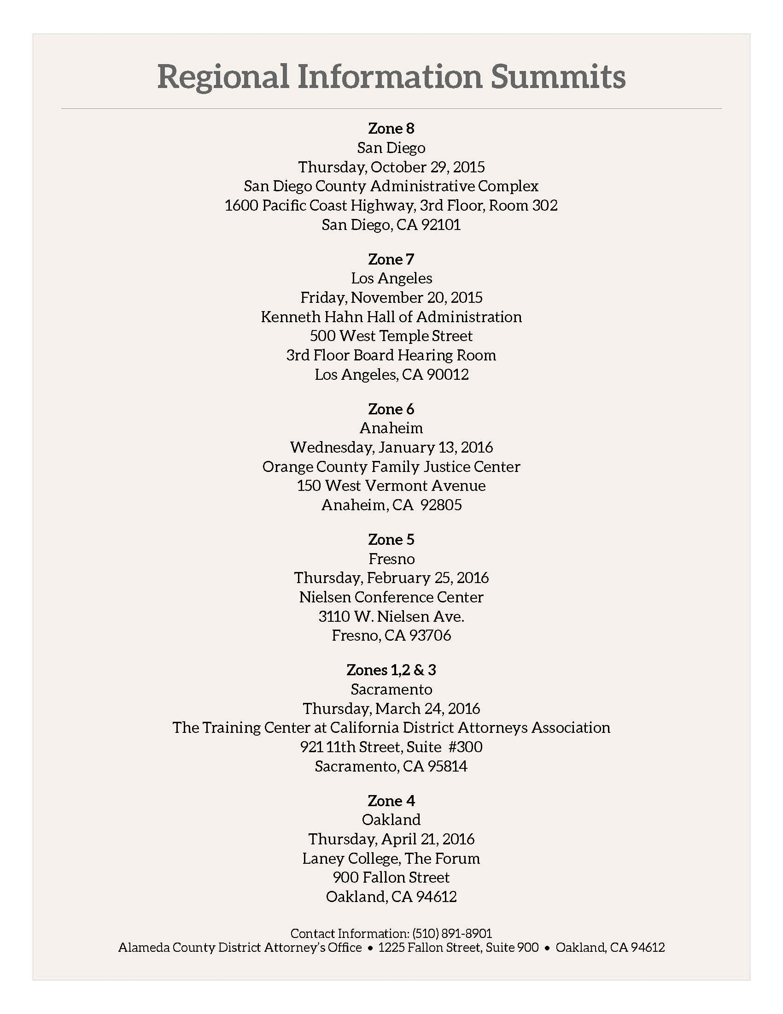

Slide 53
For More Information:
Jennifer.Madden@acgov.org
Nancy.omalley@acgov.org
HEAT-Watch.org
ALCODA.org
Alameda County District Attorney’s Office
1225 Fallon Street, Room 900
Oakland, CA 94612
510-272-6222

