Slide 1

Overview of SMARA Responsibilities for
Lead Agencies
California Department of Conservation
Office of Mine Reclamation
Leah Gardner
Senior Environmental Scientist

Slide 2
Surface Mining And
Reclamation Act
§ 2712. It is the intent of the Legislature to create and maintain an effective and comprehensive surface mining and reclamation policy with regulation of surface mining operations so as to assure that:
  (a) Adverse environmental effects are prevented or minimized and that mined lands are reclaimed to a usable condition which is readily adaptable for alternative land uses.

Slide 3
SMARA Intent - continued
  (b) The production and conservation of minerals are encouraged, while giving consideration to values relating to recreation, watershed, wildlife, range and forage, and aesthetic enjoyment.
  (c) Residual hazards to the public health and safety are eliminated.

Slide 4
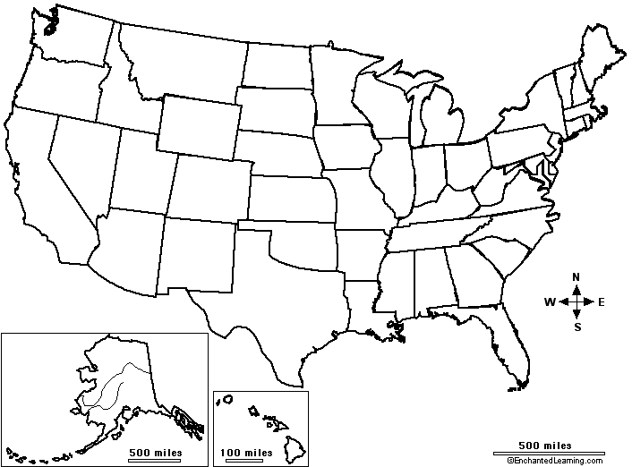
Local Control
~1350 surface mines
Only state where mining is not regulated statewide
113 lead agencies
SMGB is lead for 3 counties, 11 cities and SF Bay dredger operations

Slide 5
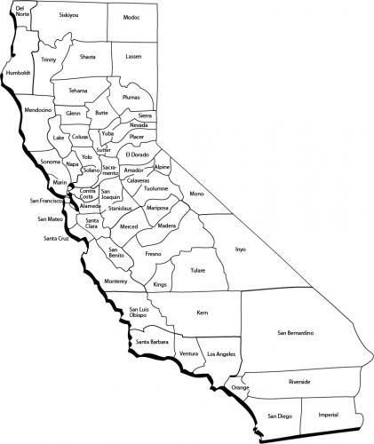
10
44
21
Number of
active mines
by county
71
15
43
42
29
22
36
15
24
10
13
12
4
7
14
11
10
25
10
32
4
4
9
26
7
6
27
15
8
8
18
5
13
17
6
8
8
30
6
18
17
80
16
2
27
40
70
114
18
16
35
7
74
42
46

Slide 6
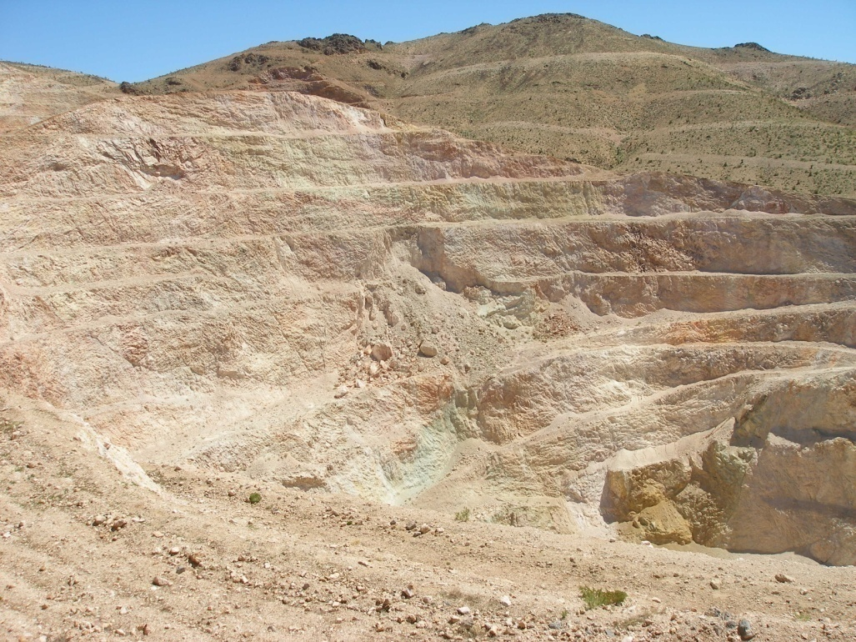
Permit
Reclamation Plan
Financial Assurance

Slide 7
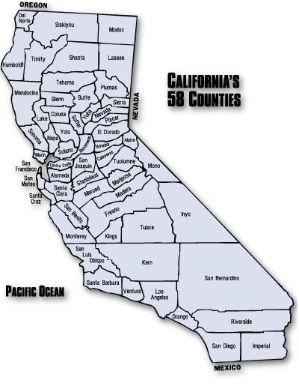


Administrative Responsibilities
Lead Agency
OMR
SMGB
Local Permitting &
Direct Regulation
Issues Permits
Environmental Reviews
Conducts Inspections
Rev. Reclamation Plan
Rev. Financial Assurance
Enforces Local Ordinance
Enforces SMARA
Technical Assistance
Review & Enforcement
Maintains Database
Maintains AB3098 List
Maintains Mines-On-Line
Rev. Reclamation Plan
Rev. Financial Assurance
Technical Assistance
Enforcement Assistance
Policy & Appeals
Adopt Regulations
Determine Policy
Reclamation Standards
FA Guidelines
Certify Ordinances
Appeals Board
Enforcement Authority
as Lead Agency

Slide 8
Lead Agency Responsibilities
Permitting, local issues
Environmental documentation and review
Reclamation plan & FACE review process
Approving reclamation plans after OMR review
Approving FACEs, FAMs
Annual mine inspections and reports
Ensuring adequate FACE/FAM
Maintaining compliance
SMARA enforcement process

Slide 9

Other Agency Roles
Federal: BLM
Forest Service
Corps of Engineers
Fish and Wildlife Service
State: Dept. of Fish and Wildlife
Water Quality Control Board

Slide 10
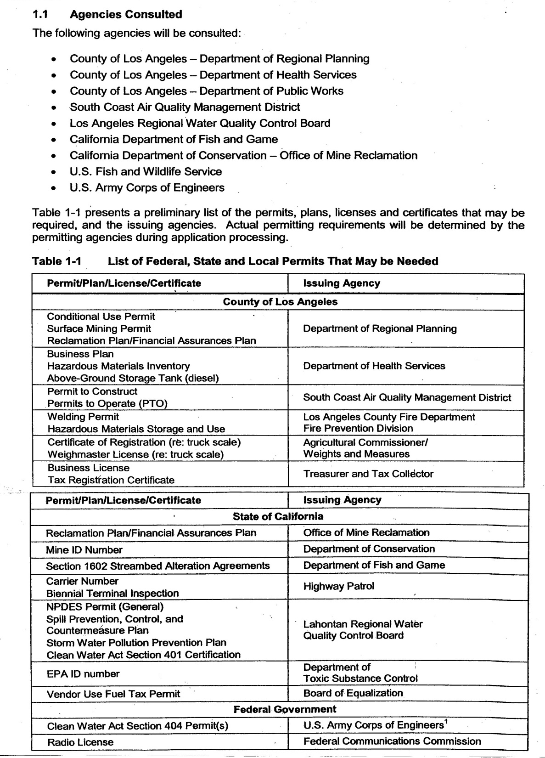
Example of other Permits and Licenses

Slide 11
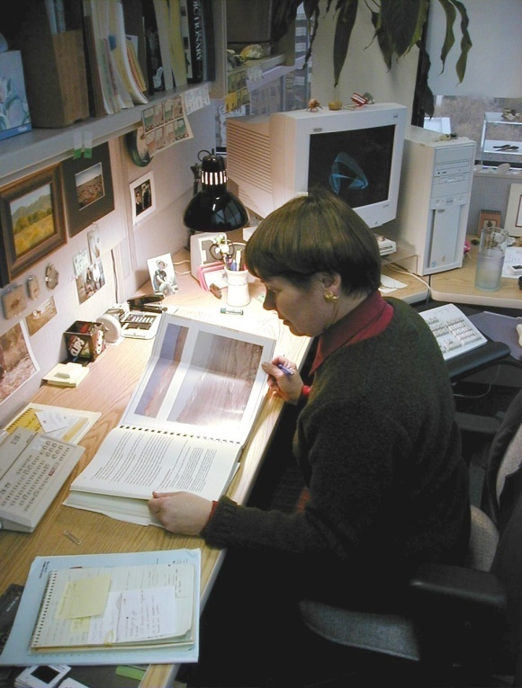
Reclamation Plan Submittals to OMR
Reclamation plans and any plan amendments that might affect reclamation (substantial deviation or not)
Complete submittals
  Signed and stamped
Certified by lead agency

Slide 12
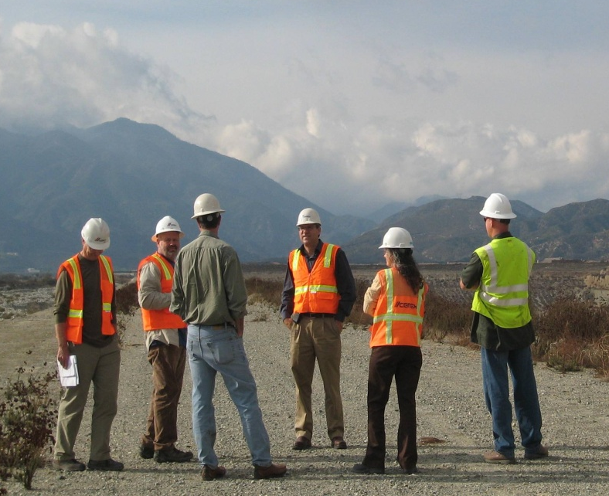
Reclamation Plan Review Process
OMR provides comments within 30 days
Response to comments from lead agency
30 day notice of public hearing

Slide 13
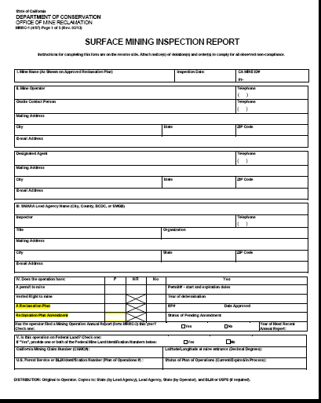
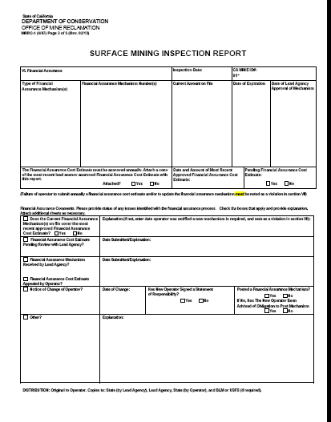
Annual Inspections are Required

Slide 14
Surface Mine
Inspection Guidelines
Adopted by the State Mining and Geology Board in Cooperation with the Department of Conservation
http://www.conservation.ca.gov/smgb/Guidelines/
Documents/Inspect_guidelns.pdf

Slide 15
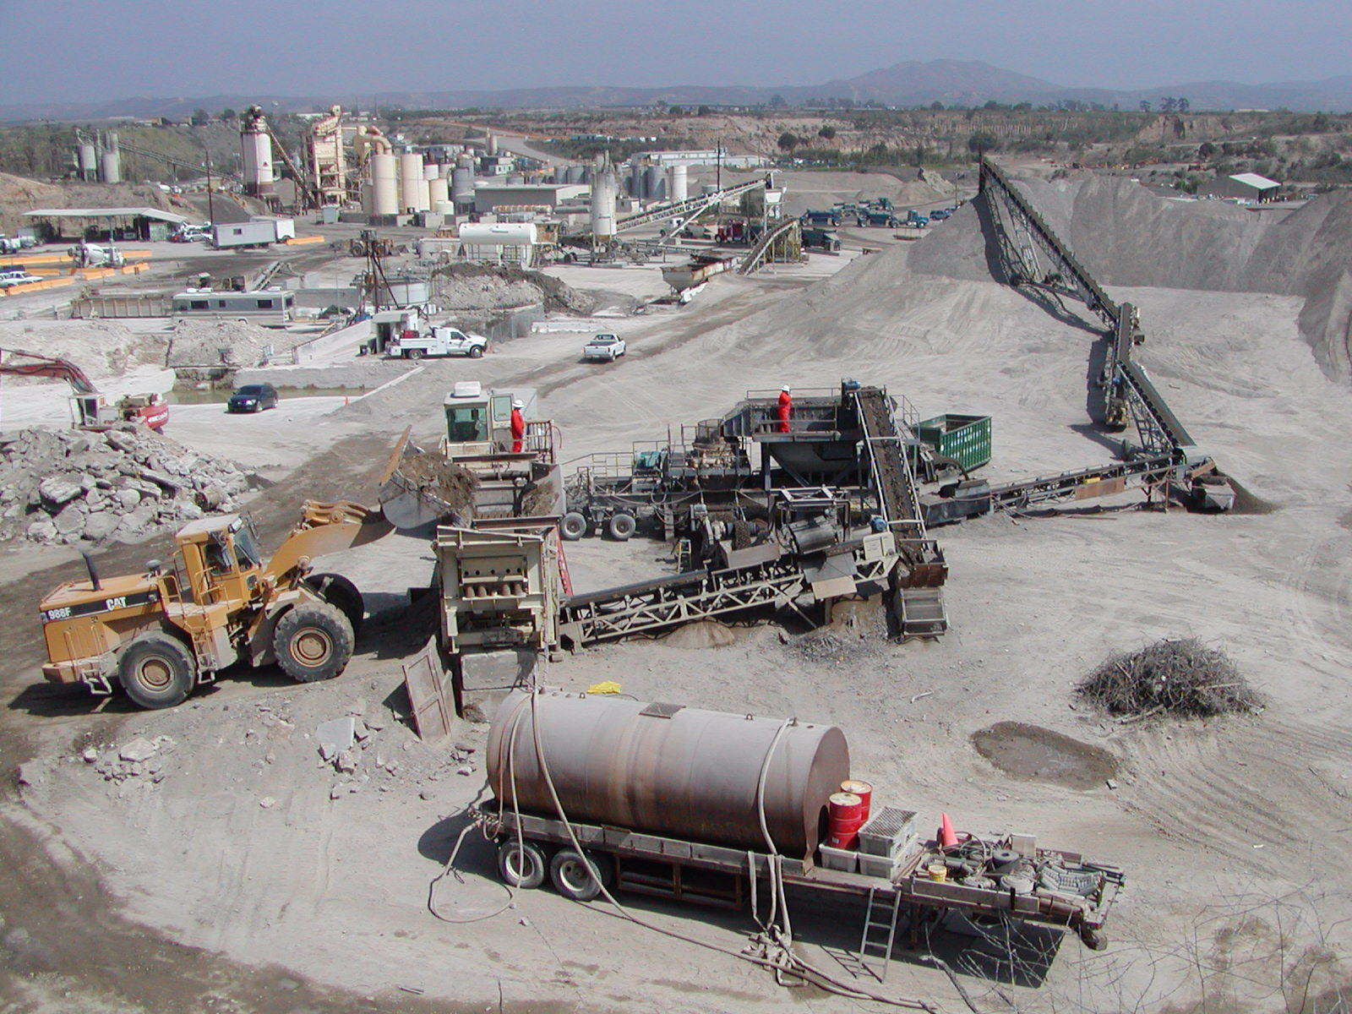
Quality annual inspections and inspection reports are key components in successful SMARA programs.

Slide 16
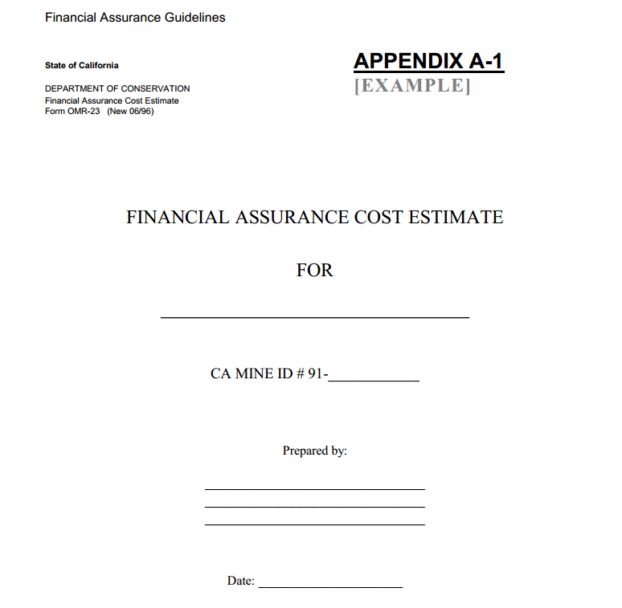
REQUIREMENTS of
Financial Assurance Cost Estimates(FACEs)
  Should be structured and easy to understand
  Possess adequate detail (see SMGB guidelines)
  FACE template is recommended
Submit annually with:
    Current Inspection Report
    Supporting Documents
    Statement of Adequacy
Notes:
SMARA does not require the SMGB form, however:
The FACE must be structured and easy to understand
The FACE must have adequate detail (The SMGB has the FA guidelines posted on their website)
The form Appendix A-1 is recommended

Slide 17
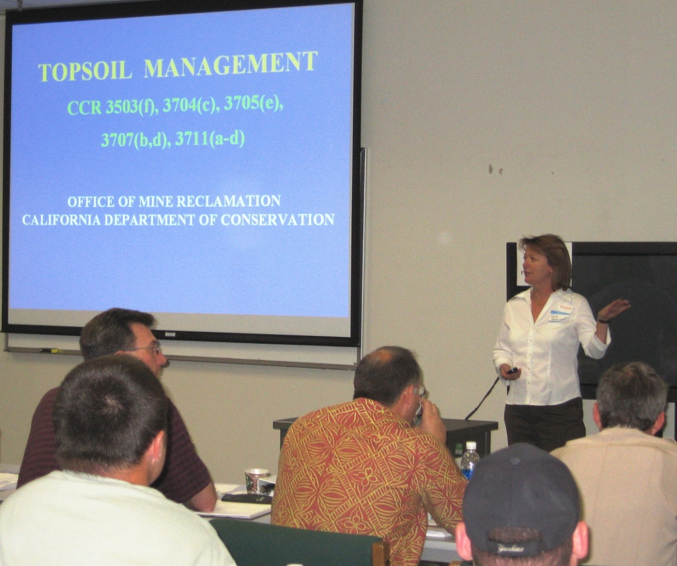
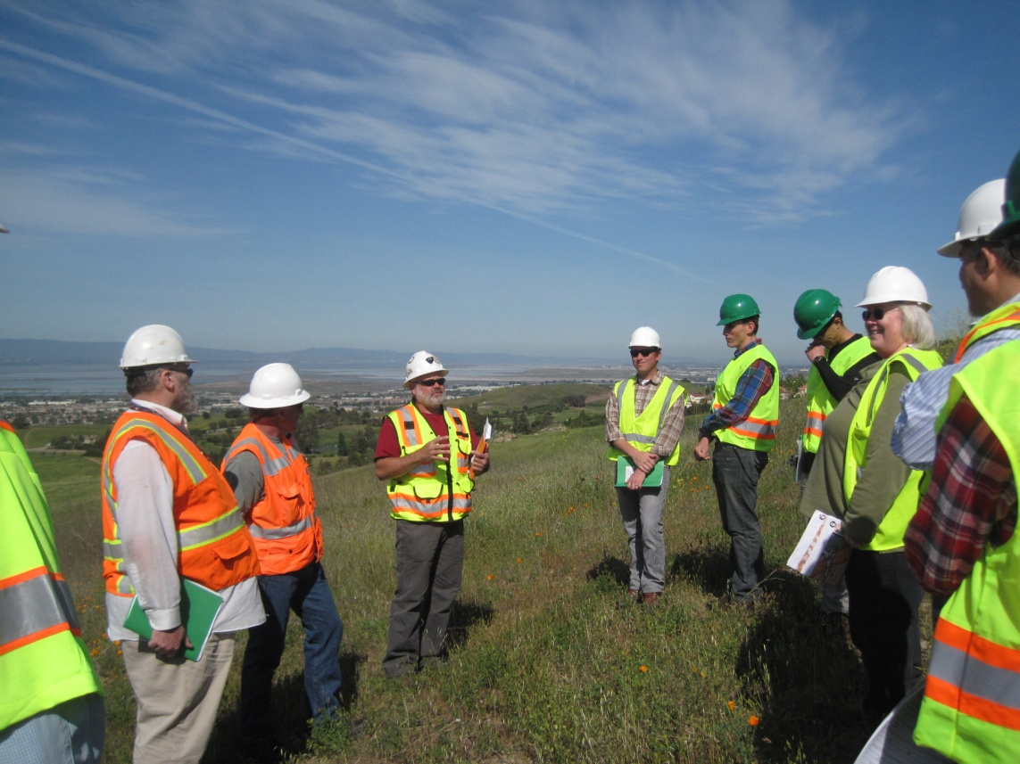
OMR Workshops

Slide 18
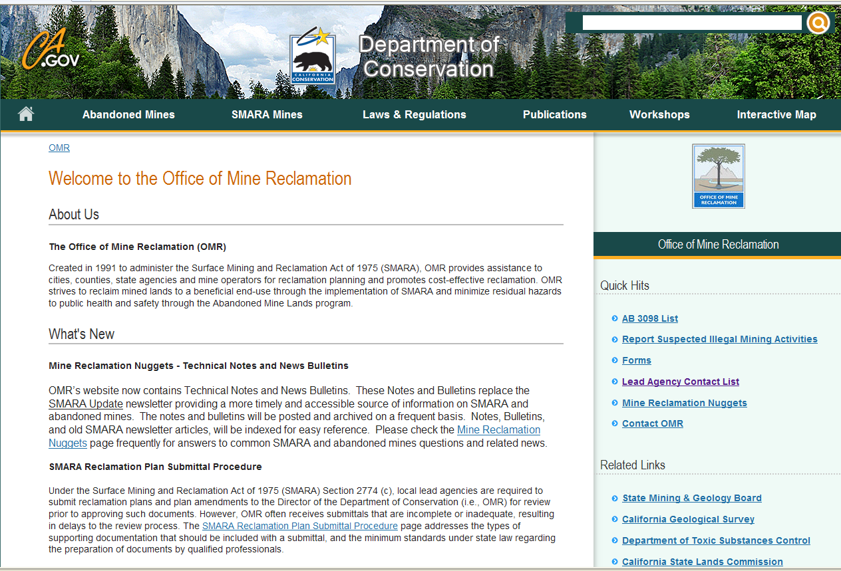

Slide 19
Potential changes - SB 1270
Licensed professionals to perform annual inspections and certify reclamation
SMGB can assign Lead Agency authority to OMR and a Lead Agency can voluntarily relinquish SMARA duties
Changes to enforcement
Annual report on abandoned mines

Slide 20
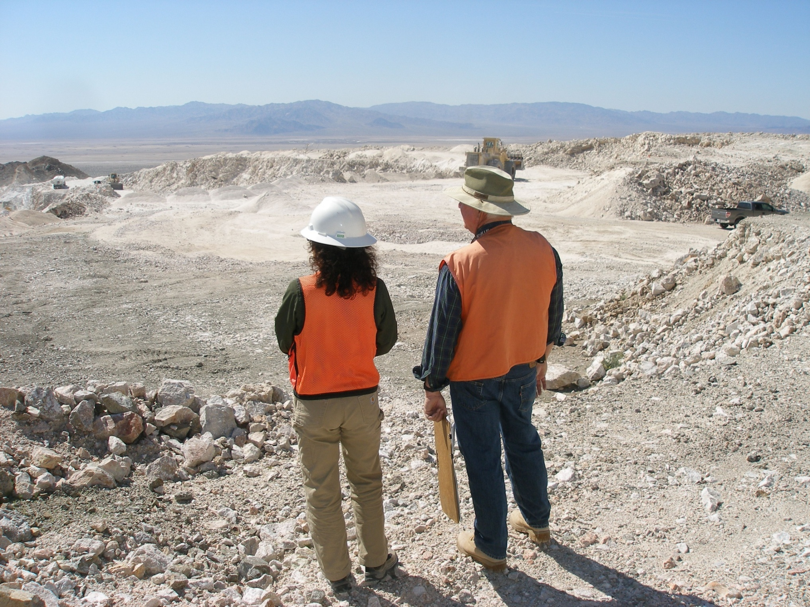
Questions?

