Slide 1


Slide 2

PARTNERS
CA Seismic Safety
Commission (SSC)
CA Business, Consumer
Services & Housing Agency
Public Relations /
Marketing Firm
Joint Venture Silicon
Valley [501(C)3]
United States Geological
Survey (USGS)
The HayWired
Partners (65+)
Financial Partners

Slide 3
OUTSMART DISASTER CAMPAIGN GOALS
Improve communication
Understand & inform actions
Build capacity to respond & recover
Notes:
Goals: https://outsmartdisaster.com/about/our-vision- and-objectives/
Improve communication of earthquake hazard science and engineering for use in decision-making processes.
Help understand and inform actions to reduce earthquake risks.
Build community capacity to respond to — and recover from — earthquakes.

Slide 4
APPROACH: THREE PHASES
1.
2.
3.
STRATEGY &
DESIGN
July 2017-March 2018
REGIONAL
CAMPAIGN
April-September 2018
STATE-WIDE
CAMPAIGN
October 2018 & Ongoing

Slide 5
CAMPAIGN STRATEGY
Promote the findings of the HayWired research to operate from a common framework.
Make information more user-friendly for businesses, individuals and communities.
Promote the work of organizations are already working on mitigation and resiliency.
Serve as a launch pad for information, resources and actions.
Provide tool-kits to help companies with their own resiliency efforts
Use the Partner Network to amplify message.
Develop “Calls to action.”

Slide 6
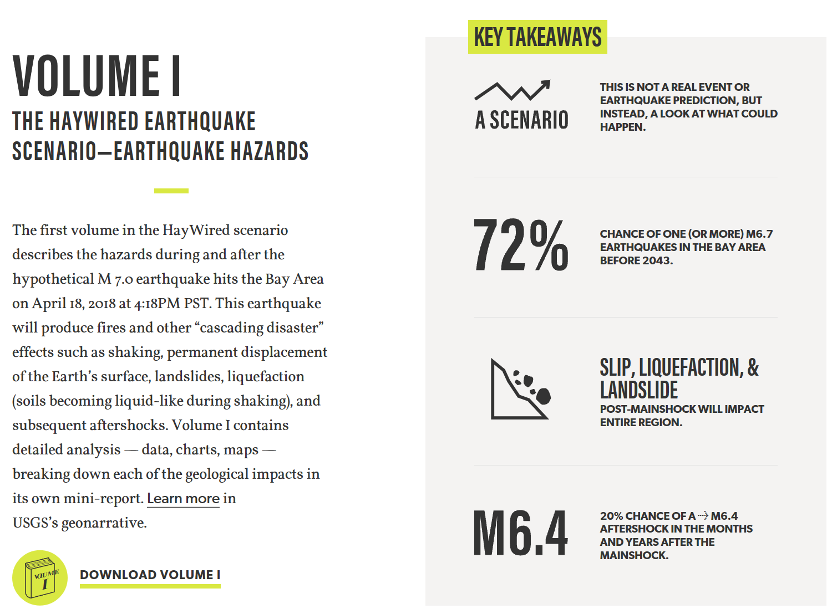

Tools & Resources

Slide 7
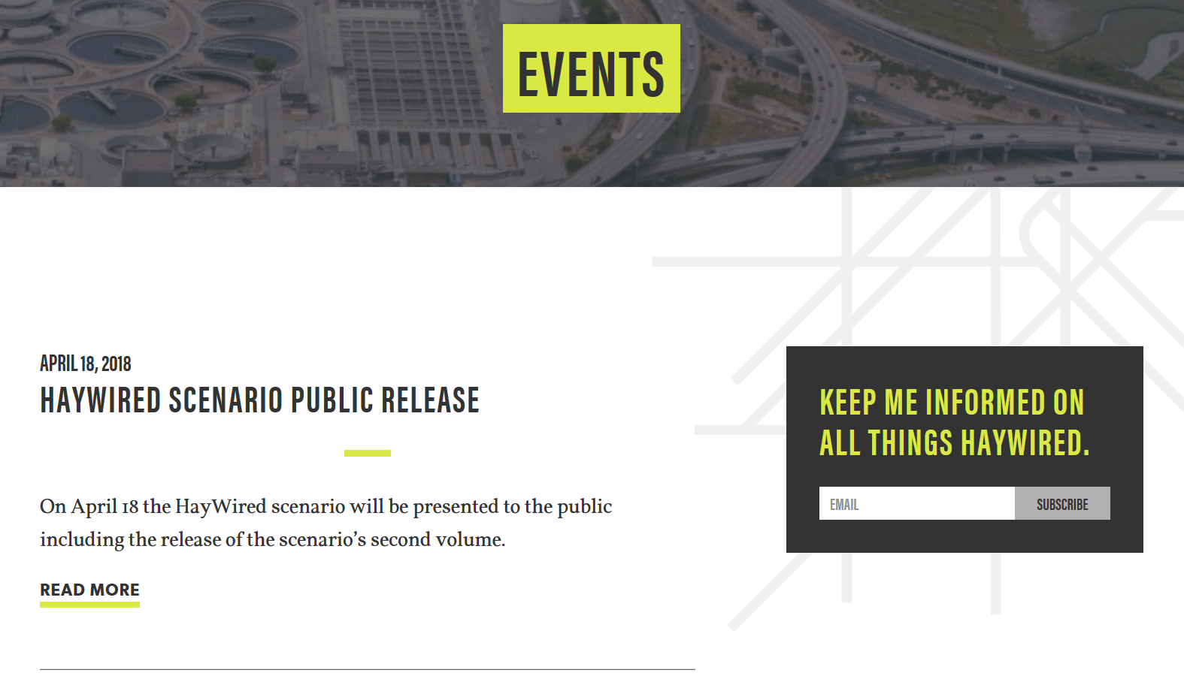
Tools & Resources

Slide 8
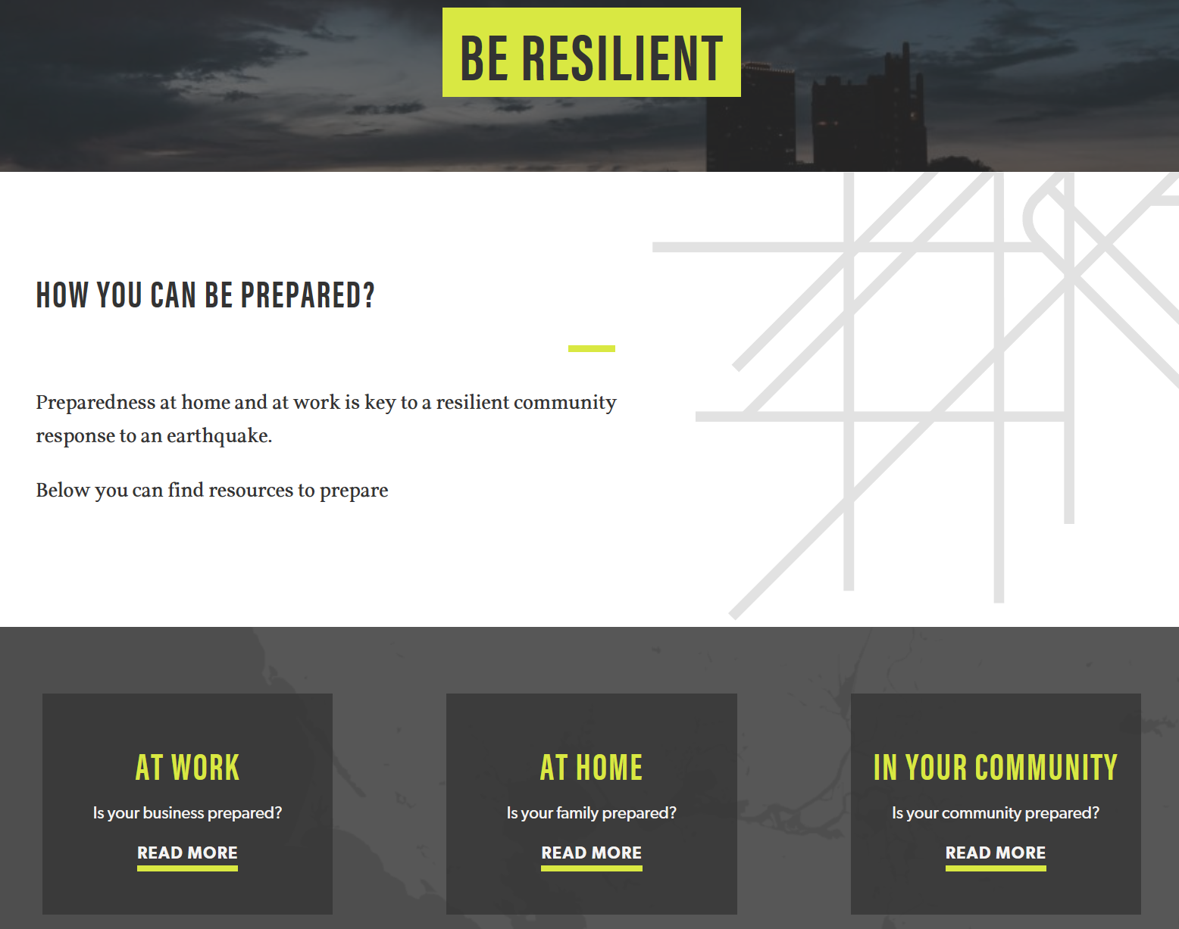
Tools & Resources

Slide 9
1st CALL TO ACTION:
RESILIENT BUSINESS CHALLENGE
The Campaign’s first “Call to Action”: Voluntary, free of charge, building block approach that invites California businesses new to resiliency investments to “step in” and well practiced companies to “step up” to assist their communities and foster innovation.
Online Challenge
Online process to become a Resilient Champion
BADGE
Businesses to promote participation
ONLINE REGISTRY
Listing of participating businesses

Slide 10
1
2
3
4
Resilient
Business
Business
Leader
Community Leader
State
Leader
Internal focus for small business or those new to resiliency
Internal focus to build on existing resiliency efforts
External focus to enhance resiliency of those around you
Thought-leading, innovative business practices put to action
Notes:
Flexible, non-prescriptive, process designed to start discussion and collectively increase state resiliency before and after a natural disaster.
Step 1: 5 small investment / big impact actions. Ideal for small businesses and organizations or those new to resiliency and business continuity planning.
Step 2: 10 areas of focus in enhance the business’ preparation, mitigation, response and recovery. Ideal for businesses or organizations with some existing resiliency and business continuity programing
Step 3: Actions taken by a business to support and enhance its community’s preparation, mitigation, response and recovery. Ideal for companies with a large presence in a community, large employee base and well-developed continuity program
Step 4: Actions taken by a business that push the leading edge of what it means to be a resilient business. Ideal for businesses that focus on innovative business practices that foster resilient whole communities.

Slide 11
Areas of Focus
Step 1 | Know your Exposure to Natural Hazards | Strengthen your Physical Workspace & Facilities | Safeguard your Data & Vital Documents | Understand your Insurance & Finances | Identify your Supply Chain Vulnerabilities
Step 2 | Establish a Process for Continuous Improvement | Strengthen your Facilities | Safeguard your Data and Vital Documents | Understand your Insurances and Finances | Collaborate & Communicate with Others
 | Document & Diagram your Business Processes & Dependencies | Identify Impacts of Disruption | Document your Contingency Options | Identify Alternatives | Train & Care for your Employees
Each Area of Focus supported by “Food for Thought” ideas and Resources
Webinars for each Area of Focus

Slide 12

Getting Involved to

Slide 13
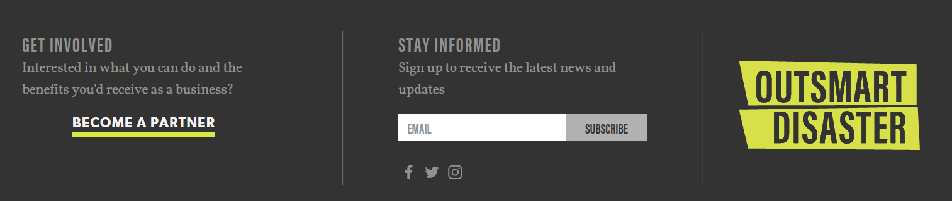
Sign Up
https://outsmartdisaster.com

Slide 14
Amplify the Message
Brand Handle and Hashtags:
@HayWiredCA
#HayWired
#OutsmartDisaster
HayWired Social Media Platforms:
Instagram: https://www.instagram.com/HayWiredCA
Twitter: https://twitter.com/HayWiredCA
Facebook: https://www.facebook.com/HayWiredCA/

Slide 15
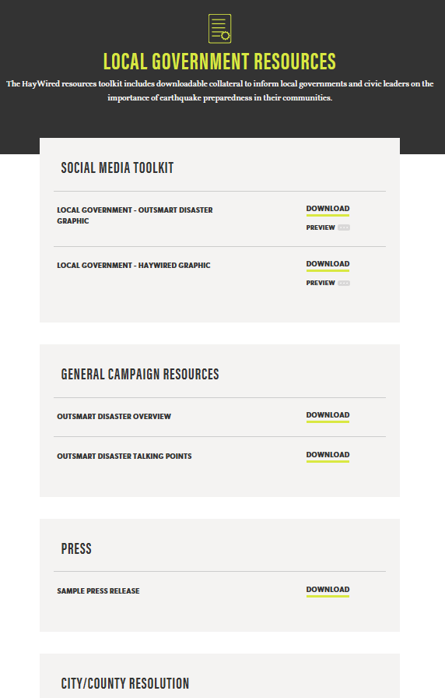
Endorse the Campaign (Local Gvts)
Sign the City/County Resolution
Promote the Challenge with Local Businesses
Promote Local Results

Slide 16
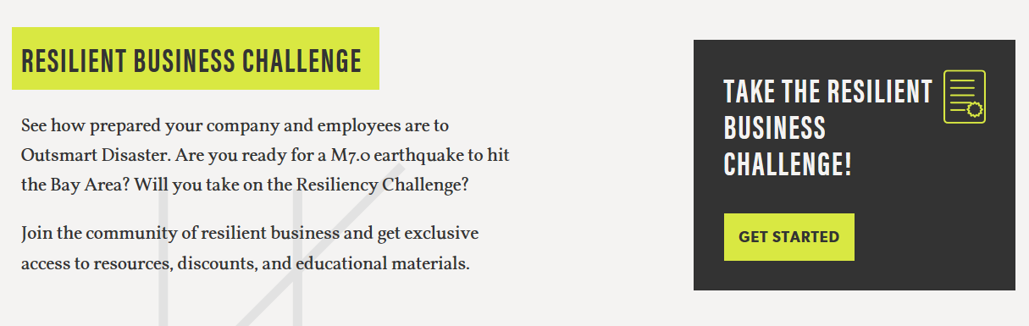
Register for the Challenge (Businesses)
https://outsmartdisaster.com

Slide 17

Become a Sponsor

Slide 18
CONTACT
Lynn von Koch-Liebert
Deputy Secretary
Business, Consumer Services,
and Housing Agency
Lynn.vonkoch-Liebert@bcsh.ca.gov
916-653-4090
General Inquiry
info@haywired.us
Salina Valencia
Director of Legislation & Communications
Seismic Safety Commission
Salina.Valena@ssc.ca.gov
916-263-5506.

Slide 19
Together we can

