Slide 1
The Pew-MacArthur Results First Initiative: INVESTING IN PROGRAMS THAT WORK
Sara Dube, Manager
Ashleigh Holand, Manager-State Policy
May 15, 2014

Slide 2
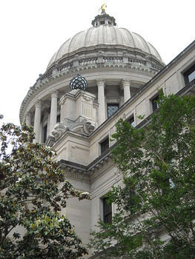
Critical Policy Challenge
Government leaders want to make strategic budget choices, but often don’t know:
What programs are currently funded
What each costs
What programs accomplish
How they compare to alternatives

Slide 3
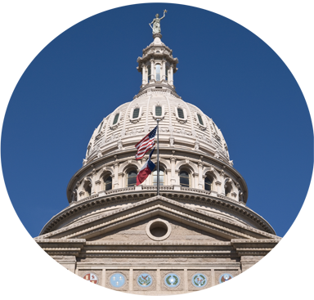
Results First Approach
1
Use the best national research to identify what works
2
Predict the impact in your jurisdiction
3
Calculate long-term costs and benefits

Slide 4
Compare Costs and Benefits
ADULT PROGRAMS | COST | LONG-TERM BENEFITS | COST/BENEFIT RATIO
Cognitive behavioral therapy | $419 | $9,954 | $24.72
Electronic monitoring | $1,093 | $24,840 | $22.72
Correctional education in prison | $1,149 | $21,390 | $19.62
Vocational education in prison | $1,599 | $19,531 | $13.21
Drug court | $4,276 | $10,183 | $3.38
Domestic Violence treatment | $1,390 | -$7,527 | -$4.41
JUVENILE PROGRAMS
Aggression replacement training | $1,543 | $55,821 | $37.19
Coordination of services | $403 | $6,043 | $16.01
Drug court | $3,154 | $11,539 | $4.66
Scared Straight | $66 | -$12,988 | -$195.61
*Washington State 2012 dollars

Slide 5
Participation in Results First
WA
ME
MT
ND
OR
MN
ID
SD
WI
NY
WY
MI
IA
PA
VT
CA
NV
NE
IN
OH
NH
IL
WV
UT
CO
VA
MA
KS
MO
KY
RI
TN
NC
CT
AZ
NM
OK
AR
SC
NJ
MS
AL
GA
DE
LA
MD
TX
AK
FL
AK
HI

Slide 6
What are Results First states doing?
3
enacted legislation incorporating Results First into their policy making process
2
used models to analyze legislation, avoiding millions in potential costs
5
used their models to target $75.5 million in funding

Slide 7
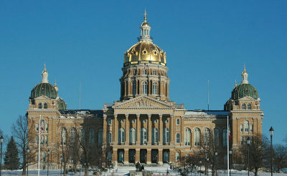
Iowa
Replaced ineffective domestic violence treatment program with new program statewide
Expanding Cognitive Behavioral Therapy (CBT) and vocational education programs
Received federal grant to train staff on new CBT program

Slide 8
Results First in California
Engage and inform Community Corrections Partnerships
Build county-specific cost-benefit tool
Develop analytical capacity
Target resources

Slide 9
Results First County Updates
Santa Barbara County
Santa Cruz County
Fresno County
Kern County
San Diego County

Slide 10
For more information
Sara Dube
The Pew-MacArthur Results First Initiative
sdube@pewtrusts.org
(202) 540-6410
Ashleigh Holand
The Pew-MacArthur Results First Initiative
aholand@pewtrusts.org
(202) 540-6789

