Slide 1
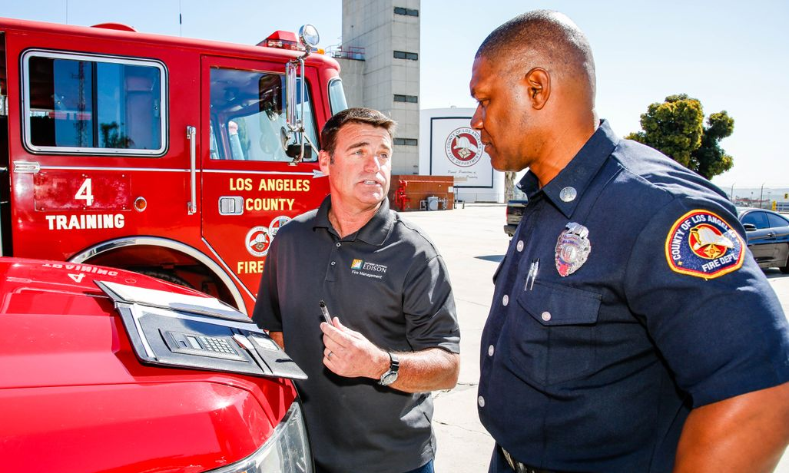
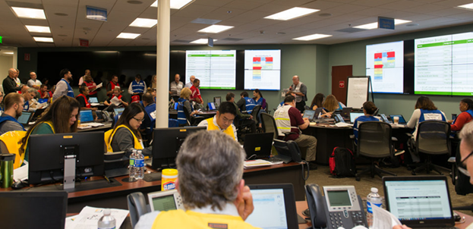
Working with Partners Before, During and After a Disaster
June 28, 2018

Slide 2
Overview of SCE
Pacificorp
PG&E
15 million people
180 incorporated cities
15 counties
125 years of reliable electric service
One of the nation’s largest IOU’s
50,000 square miles of service area
5,000 large businesses
280,000 small businesses
Leader in renewable energy
Focus on employee/public safety
SMUD
San Francisco
Edison
Glendale
Burbank
Pasadena
Los Angeles
LADWP
SDG&E
San Diego
IID

Slide 3
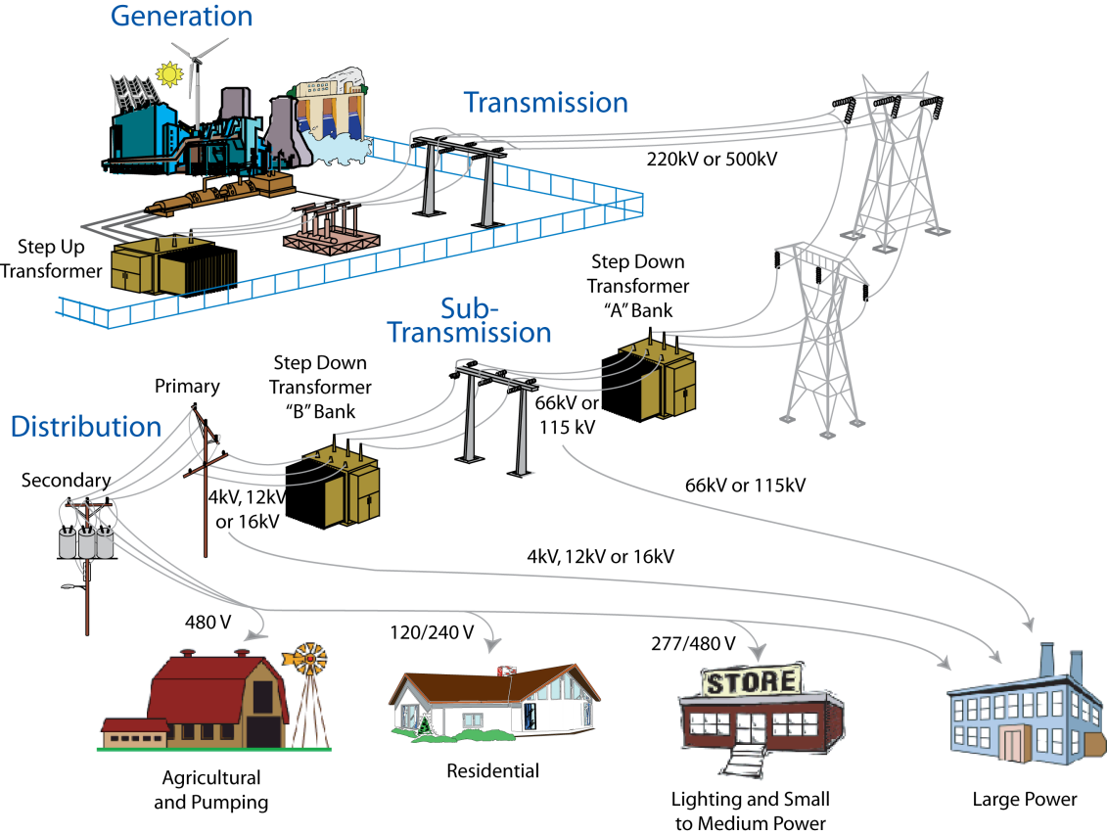
Electric System Overview
Grid Control Center
Distribution Grid
Transmission/Sub-transmission Grid
90,401 overhead and underground line miles
755 substations with 4,575 circuits
720,800 overhead & underground transformers
1,306,912 wood poles
11,488 circuit breakers (<161 kV)
12,782 transmission and sub-trans line miles
80 transmission substations
126,424 transmission/sub-trans wood poles
1,096 circuit breakers (500, 220 & 151 kV)

Slide 4
Emergency Operations- Guiding Principles
FEMA’s Incident Command (IC) System
Reliability Improvements, Wildfire Mitigation & Grid Resiliency
Information Sharing

Slide 5
FEMA Incident Command System
SCE currently has 26 Incident Management Teams consisting of 540 personnel that are trained in FEMA’s ICS and are ready to be activated in case of an emergency.
SCE conducts approximately 20 emergency response exercises annually
Mutual Aid Agreements with other utilities
PG&E
Puerto Rico
- SCE Emergency Operations Center

Slide 6
Emergency Operations - Coordination
Depending on nature of the emergency – SCE’s primary coordination may be with State and/or County Emergency Operations Centers
SCE’s Agency Representative (AREP)
Establish contact with cooperating agencies
Manage requests for specific information
Manage requests for prioritization of power restoration

Slide 7
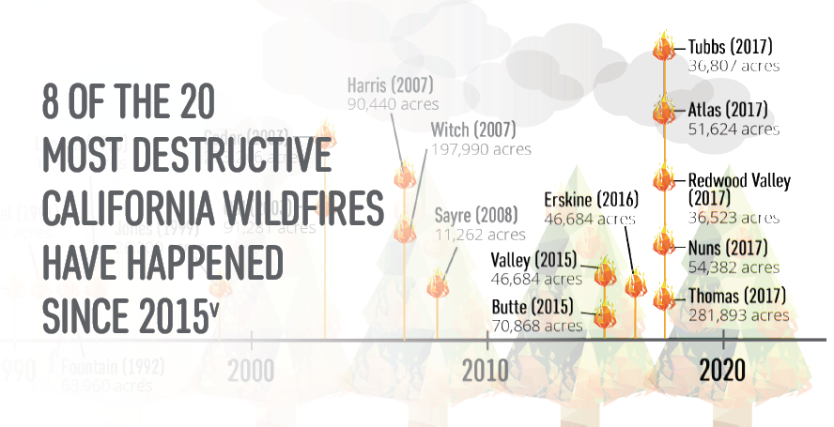
California's Wildfire Risk
Year-Round Fire Season: Changes to California’s climate mean that the traditional notion of a fire “season” no longer exists
Hazardous fuel is building up: 9M acres of land contain ready-to-burn kindling from nearly 129M trees that have been killed or weakened by drought and bark beetle infestation

Slide 9
An Example of System Hardening
Quick Fact: Since 2014, SCE has replaced more than 39,000 poles in high fire risk areas alone
Notes:
Our system serves 50,000 square miles of Southern, Central and Coastal California by way of more than 1.4 million power poles of which, approximately a quarter are located in high fire risk areas
SCE, in 2013, implement new pole designs and construction standards appropriate for unexpected conditions
More than 39,000 poles have been replaced, concentrating first on poles located in areas that posed both high wind and high fire risks
We are hardening the design of our infrastructure by
Increasing the use of:
fire-resistant poles
composite cross-arms
covered conductor in select high fire risk areas to reduce wildfire risk
We are hardening the design of our infrastructure by
Increasing the use of:
fire-resistant poles
composite cross-arms
covered conductor in select high fire risk areas to reduce wildfire risk

Slide 11
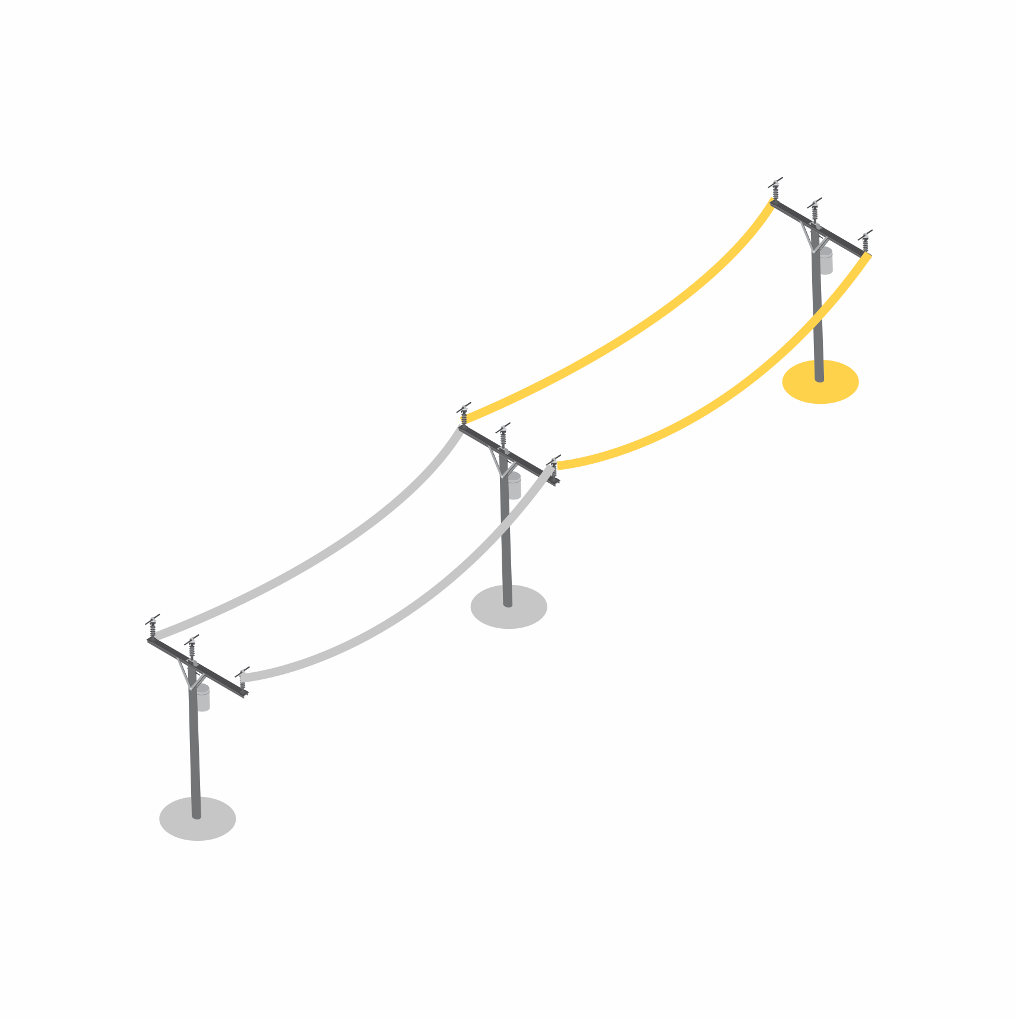
PRACTICE OF LAST RESORT: PUBLIC SAFETY POWER SHUTOFF (PSPS)
In alignment with its operational safety practices, SCE may proactively shut off power in high fire risk areas when weather conditions present a clear and imminent danger to public safety
Operational practice of last resort that may reduce fire risk in limited, high fire risk areas during extreme weather conditions
SCE is committed to service reliability: de-energizing customers is not something we take lightly and is only sparingly used in the most extreme conditions. This is after exhausting a number of other operational practices.
In light of increased wildfire risk and public safety, SCE is evaluating more frequent use of this measure
SCE will make every effort to notify local governments and customers ahead of time – especially critical care and medical baseline customers
Power restoration begins after local conditions have improved and safety checks have been performed
Notes:
Most electric circuit interruptions, or “faults,” are momentary, caused, for example, by a bird or metallic balloon making contact with power lines. Under normal conditions the grid automatically tests the circuit and, if the fault condition no longer exists, the circuit is quickly re-energized. During Red Flag conditions, affected circuits are not automatically re-energized and SCE crews physically inspect the lines before they are re-energized.
PSPS: In our operational toolkit, this is our last resort. We can do all those other things that we just mention to the best of our abilities, but extreme weather may require us to do more. Because extended power outages create additional risks for essential services and have significant impacts on utility customers, they are sparingly used. In light of increasing wildfire risk, however, SCE is evaluating the more frequent use of this measure during extreme conditions.
A Public Safety Power Shutoff (PSPS) is a practice that Southern California Edison (SCE) may use to shut off power in targeted areas during extreme and potentially dangerous weather conditions.
In considering whether to de-energize a line, SCE considers a wide variety of factors which may include, but are not limited to the following:
The National Weather Service has issued Red Flag Warnings for counties that contain SCE circuits in High Fire-Risk Areas
Ongoing assessments from the SCE in-house meteorologists regarding the local conditions related to wind speed, humidity, and temperature
Real time situational awareness information from highly trained personnel positioned locally in High Fire-Risk Areas identified as at risk for extreme weather conditions
Input from our Fire Management experts co-located with the Office of Emergency Management regarding any ongoing firefighting efforts
Specific concerns from local and state fire authorities regarding the potential consequences of wildfires in select locations
Awareness of mandatory or voluntary evacuation orders in place
Expected impact of de-energizing circuits on essential services such as water pumps, traffic controls, etc.
Other operational considerations to minimize potential wildfire ignitions
[MGE1] SCE will make every effort to notify local governments and customers ahead of time – especially our critical care and our medical baseline customers – to help them prepare for the potential de-energization. When a safety shutoff takes place, customers will see a loss of power similar to other types of outages. As conditions improve and safety checks have been performed in the field, SCE will begin to restore power depending on local conditions at the time. The order in which circuits are re-energized will depend on many factors such as safety conditions, equipment inspections, repair time, customer well-being and essential services.
We pride ourselves on service reliability and de-energizing our customers is not something we take lightly. Thus, we will only take this step if we feel that our system and our communities are safer de-energized and it is absolutely necessary for public safety.

Slide 12
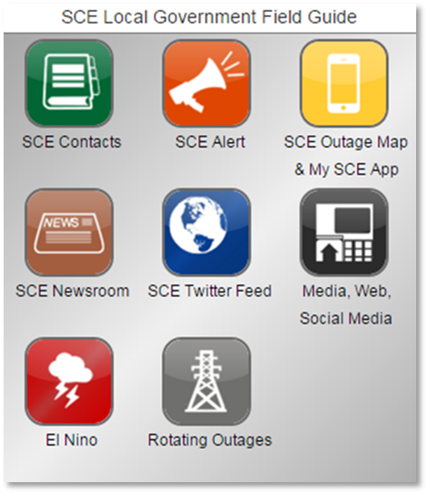
SCE Alert
Used by SCE during significant emergencies to share important information with our local government and emergency partners located in impacted areas.
SCE Alert Drills
Each city/county is exercised twice a year, by geographical area.
Drills have two elements:
Notification
Conference call

Slide 13
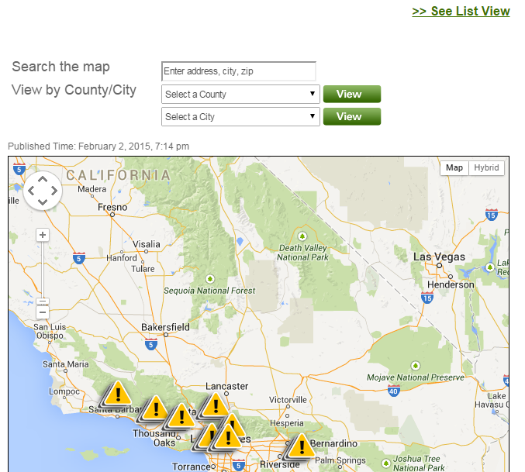
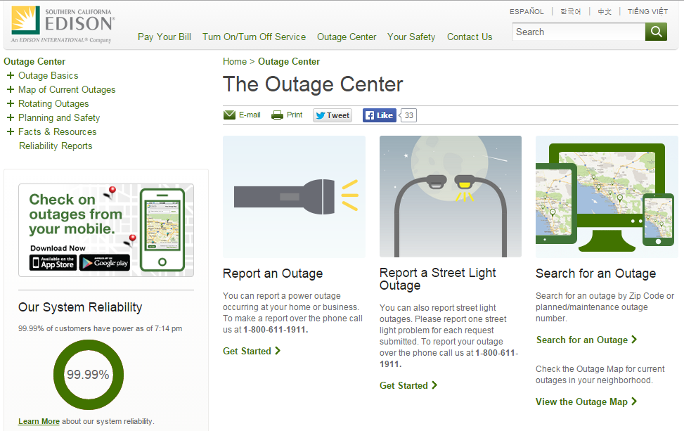
Customer Facing – Information Sources
Repair & Maintenance Outages
Outages may be related to emergency repairs – caused by wind or equipment problems, for example – or due to our continuous improvement cycle of maintenance and upgrades to the grid.
Events included on the outage map reflect both outage types.
13

Slide 14
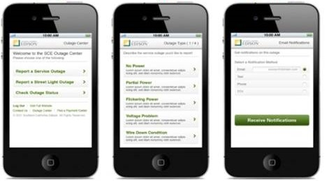
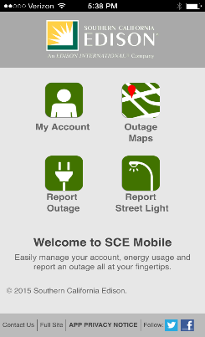
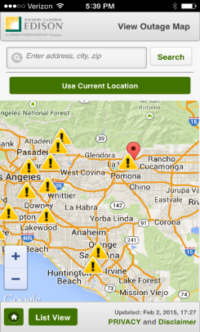
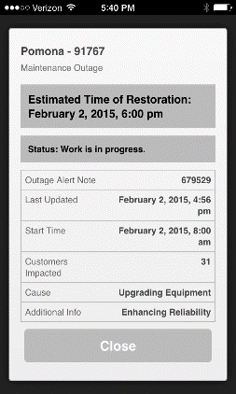
Customer Facing – Information Sources
Landing
Page
Outage
Map
Alert
Note
Easily manage your SCE account, monitor your energy usage, or report an outage.
Free to download for iPhones and Androids.
14

Slide 15
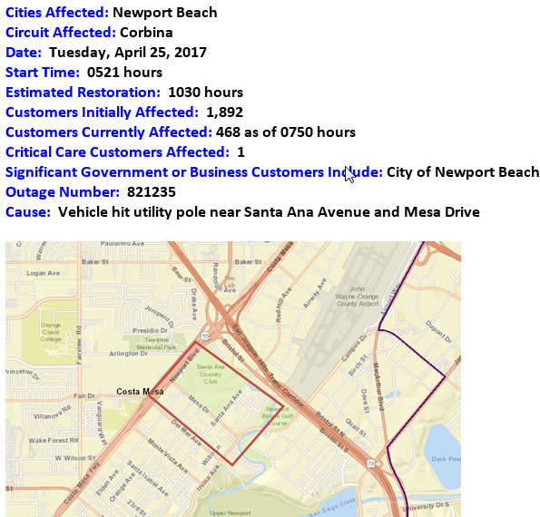
Local Government Outage Maps
Criteria for sending maps
Outage lasting more than 90 minutes
150 or more customers
No maps sent if T&D District is in “storm”- emergency operations conditions
15

Slide 16
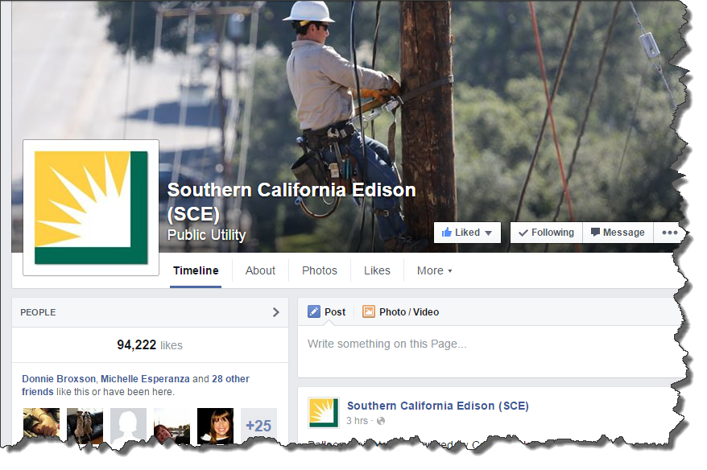
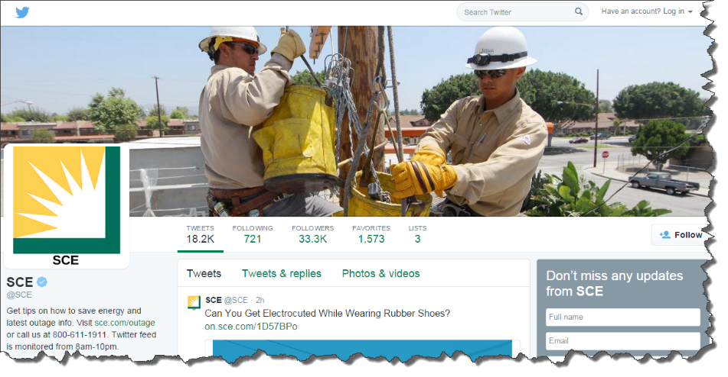
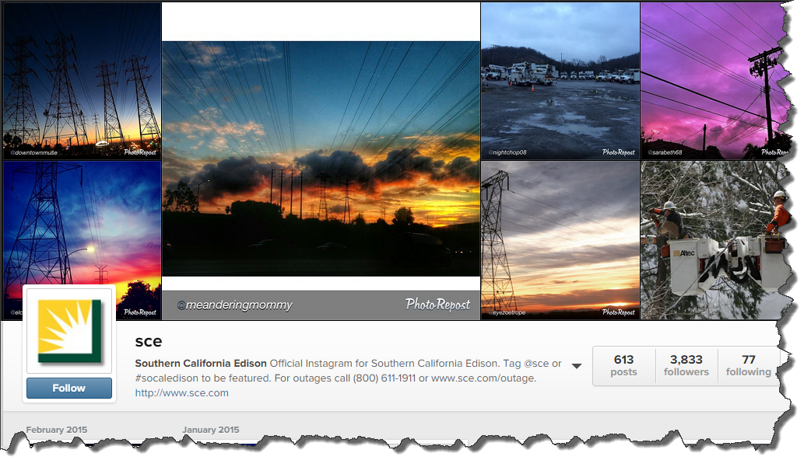
Web and Social Media
Social Media Engagement
SCE.com
Facebook
Twitter
Instagram
YouTube

Slide 17
Questions?

