Slide 1
San Joaquin Operational Area Emergency! What to do When Disaster Strikes-Webinar California State Association of Counties Wednesday, 16-December-2015
Michael R. Cockrell
Director of Emergency Operations
Office of Emergency Services
A Division of General Services
209-953-6208
mcockrell@sjgov.org

Slide 2
PRE-EMERGENCY

Slide 3
Authorities-Policies-Awareness
Authorities of Board, CAO’s, Emergency Manager
Establish Standby Emergency Orders
Ensure legal ability for access to vital resources
Established response/recovery policies
Set spending limits
Consider obtaining resources for multi-jurisdictions
Know the your role in the emergency organization

Slide 4
S.E.M.S Levels, where are you?
Field . . . . . . . (Incident Command)
Local Gov’t .. (City, County, District)
Operational Area ...(County, JPA, other agreement)
Region . . . . . . . . . . . . (SJC in Region IV)
State . . . . . . . . . . . . . . (Statewide Coordination)

Slide 5
DIRECTOR OF EMERGENCY SERVICES
Request Board to Proclaim Existence of Local Emergency
Issue Proclamation if Board not in session
Request Governor to Proclaim a “State of Emergency”
Control & direct the emergency organization
Direct cooperation between services, resolve conflicts
Represent County with public or private agencies

Slide 6
LINE OF SUCCESSION – SJC example
Chairman of the Board of Supervisors
Vice-Chairman of the Board of Supervisors
County Administrator
Assistant County Administrator
The Sheriff of San Joaquin County
County Health Officer
Standby Officers:
Legislative & Executive: Approved by Board
Dept. Heads: by CAO
Recommend annual orientation briefing: share contact info.

Slide 7
LOCAL EMERGENCIES: WHY? (Calif. Gov’t Code §8630, & San Joaquin County Muni Code §4-3005)
Full power to provide mutual aid to any affected area (SJC 4-3003, CGC§8631)
Promulgate orders, rules, and regulations; including curfews (SJC 4-3005A.(6)(a), CGC§8634)
Privileges and Immunities; for actions/non-action (Civil Code 1714.5, CGC §8655-8660)
Obtain vital resources, and commandeer resources and/or property if required (SJC 4-3005A.(6)(B), CGC§8572)
Require employees & materials assistance, command aid of citizens ((SJC 4-3005 A(6)(c & d) & 4-3005B. , CGC §8657)
Purchasing Agent make emergency purchase for jurisdictions, accept donations (SJC 4-3008, CGC §8647)
Remove inmates to place of safety or release (CGC §8658)
State/federal assistance/resources needed (SJC 4-3005A.(2), Public Law 93-288 Stafford Act, 42 USC 5121)
As Board of Equalization to reassess damaged property, provide tax relief (RTC§170-172, 194, SJC 3-5000-5007)
2009 CGC §8630(c) change allows “out-of-session review” to continue of emergency within 30-days. This can be done by a report detailing the situation and reason to continue. Board can terminate if needed.

Slide 8
Governor Proclamation “prior”
8625.
The Governor is hereby empowered to proclaim a state of emergency in an area affected or likely to be affected thereby when:
(a) He finds that circumstances described in subdivision (b) of Section 8558 exist; and either
(b) He is requested to do so (1) in the case of a city by the mayor or chief executive, (2) in the case of a county by the chairman of the board of supervisors or the county administrative officer; or
(c) He finds that local authority is inadequate to cope with the emergency.
8558.
Three conditions or degrees of emergency are established by this chapter:
(b) “State of emergency” means the duly proclaimed existence of conditions of disaster or of extreme peril to the safety of persons and property within the state caused by such conditions as air pollution, fire, flood, storm, epidemic, riot, drought, sudden and severe energy shortage, plant or animal infestation or disease, the Governor’s warning of an earthquake or volcanic prediction, or an earthquake, or other conditions, other than conditions resulting from a labor controversy or conditions causing a “state of war emergency,” which, by reason of their magnitude, are or are likely to be beyond the control of the services, personnel, equipment, and facilities of any single county, city and county, or

Slide 9
Draft Emergency Orders
Under the provisions of the Emergency Services Act, should a county and a city within that county proclaim local emergencies seeking to control the same event, and in so doing the two entities issue conflicting, overlapping, emergency ordinances and/or orders, the county emergency ordinances and/or orders are controlling. (62 Ops.Cal.Atty.Gen 701 (1979)
The County, as only single local agency which can proclaim total county area. (Id., at 707 & 708.)
County may promulgate rules and regulations applicable throughout the County.
Curfews - Disposal of livestock - Restricted area access

Slide 10
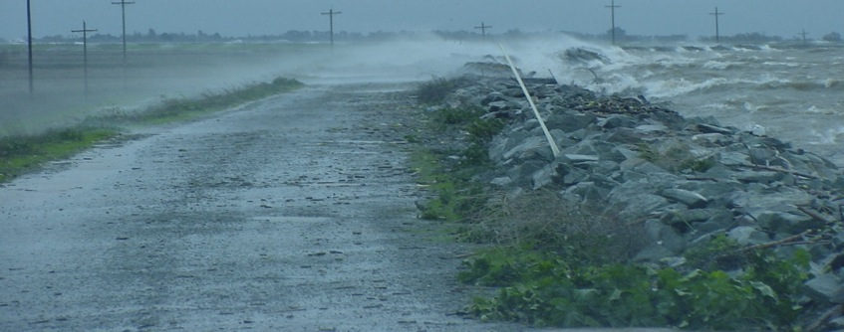
RESPONSE

Slide 11
FEDERAL RESPONSE CONCEPT
CRISIS MANAGEMENT
CONSEQUENCE MANAGEMENT
Response to cause:
ID, acquire vital resources
Anticipate threats
Act on threat
Prevent threat occurring
Conduct response:
Isolate-contain threat
Resolve threat
Effects upon people, property, and community:
Protect public health & safety
Restore essential gov’t services
Provide emergency relief to:
Governments
Businesses
Individuals

Slide 12
DIRECTOR-EXECUTIVE Briefings
INITIAL ASSESSMENT
ACTIONS NEEDED
Incident Size-up:
Type, Magnitude
Best/Worst case
Resources:
Command status
Committed/needed
Location of Incident
Consequences:
Human, Property
Economic Impact
Proclamations & declarations
Regulations, Orders
Resource mobilization
Mutual aid/pay for hire?
Emergency facilities
Unique fiscal needs
Buying for other jurisdictions
Response NOT your legal responsibility
Intervention-coordination

Slide 13
Legislative & Executive Members Roles
Initial:
Ongoing, includes recovery:
Mobilize Organization
Mobilize Resources
Coordinate Activities-Director
Governing Body meets ASAP
Reconstitute Board to quorum
Proclamations, Orders, Reg’s
Ascertain the damage
Political interface*
Preserve law & order
Community re-assurances*
Reconstitute local subdivisions
Furnishing of local services

Slide 14
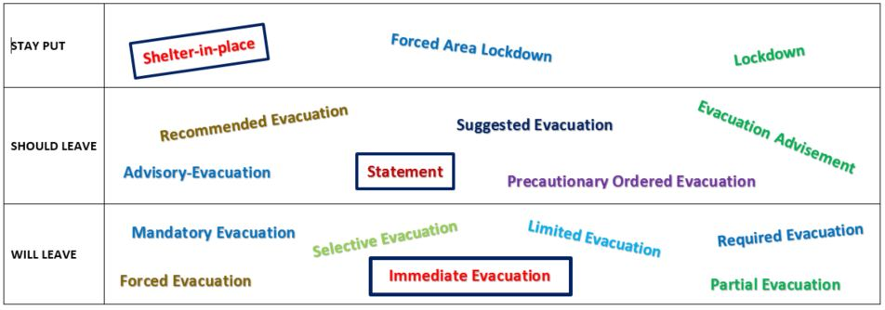
Evacuations
Whether Penal Code §409.5 permits law enforcement officers to forcibly evacuate an area is not clear. That only allows closing an area. 409.6 does allow forced removal for avalanche.
Rather than relying on Penal Code §409.5, local governing bodies should consider issuing an evacuation order that specifies criteria

Slide 15
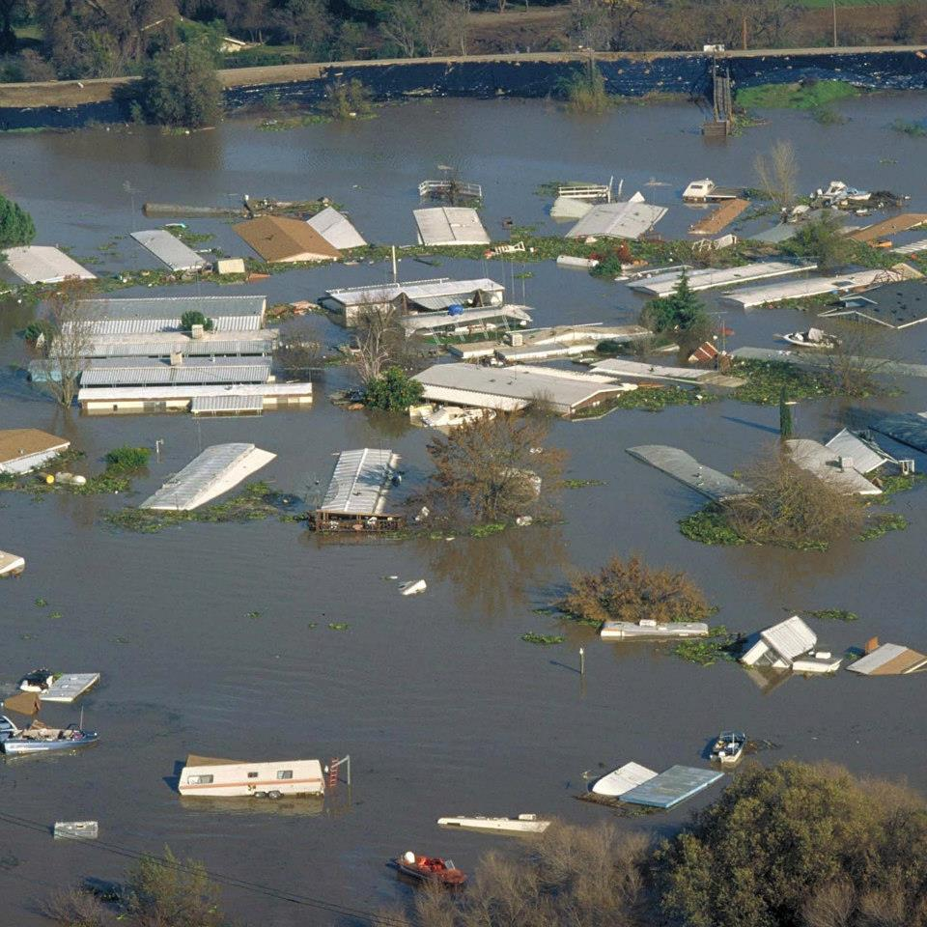
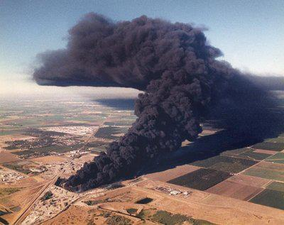
RECOVERY

Slide 16
RECOVERY STEPS
Board Actions
Terminate Proclamations
Confirm Termination of Health Declarations
Rescind active Orders & Regulations, rules
Consider special economic or recovery relief assistance, reduce-delay property taxes, job placement options, relocations, mitigation options
Board approval accepting state & federal programs

Slide 17
RECOVERY STEPS
CDAA & FEMA assistance is tightening criteria
Executive commitment, and senior manager increases a better result
Keep original documents, is the claim a central claim or each dept?
Is the Dept.-Purchasing-Auditor sync’d to documentation elements?
New 13-page procurement checklist
Recovery of funds can last 10-yrs. who reimburses CA & FEMA if each dept. claims & is audited?
Use contractors when possible
Waived fees is not eligible
Careful use to words: damage assessment-vs-safety inspection
FEMA proposes locals take on full costs of damage assessment & developing Project Worksheets, little admin. funding.

Slide 18
PRESERVATION OF GOVERNMENT CGC 8635-8644 San Joaquin Example
Importance of solid contact information:
Any Board member standing forms quorum
If NO member or Standby Officer available:
Board Chair of nearest & most pop–to-farthest & least pop in a 150-mi radius
If NO County contacted:
City mayor of nearest & most populated –to- farthest & least populated
Border Counties:
Alameda 1,554,720
Sacramento 1,450,121
Contra Costa 1,079,597
Stanislaus 521,726
Calaveras 44,742
Amador 37,035
0-50 Miles:
Santa Clara 1,837,504
Solano 420,757
Merced 262,305
Yolo 200,840
El Dorado 180,561
Tuolumne 54,008
Mariposa 17,905
51-100 Miles:
Fresno 947,895
San Francisco 825,863
San Mateo 739,311
Sonoma 491,829
Monterey 426,762
Placer 361,682
Santa Cruz 266,776
Marin 256,069
Butte 221,539
Madera 152,218
Napa 139,045
Nevada 98,292
Sutter 95,022
Yuba 72,155
Lake 63,983
San Benito 56,884
Colusa 21,411
Mono 14,348
Alpine 1,129
101-150 Miles:
Tulare 451,977
Kings 151,364
Mendocino 87,428
Tehama 63,406
Glenn 27,992
Plumas 19,399
Inyo 18,495
50-mi
100-mi
150-mi

