Slide 1
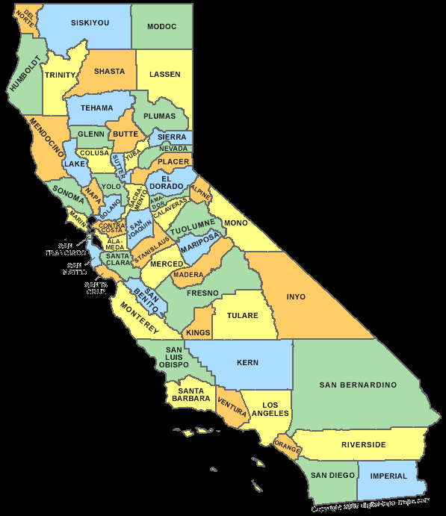
CSAC Annual Conference December 2, 2015

Slide 2
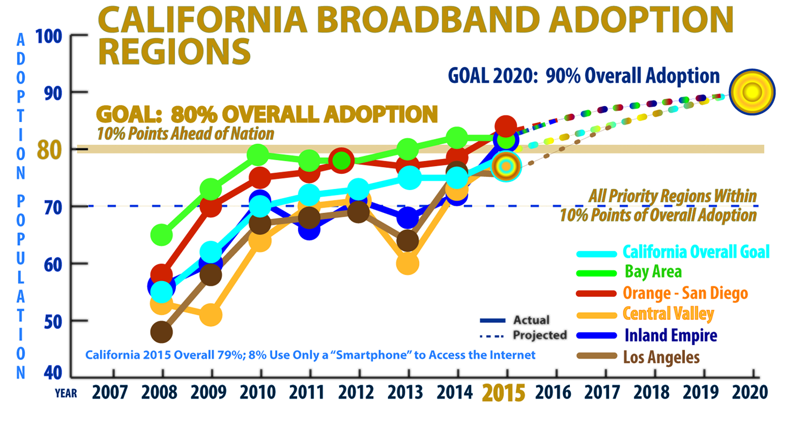
2015 Statewide Survey Results

Slide 3
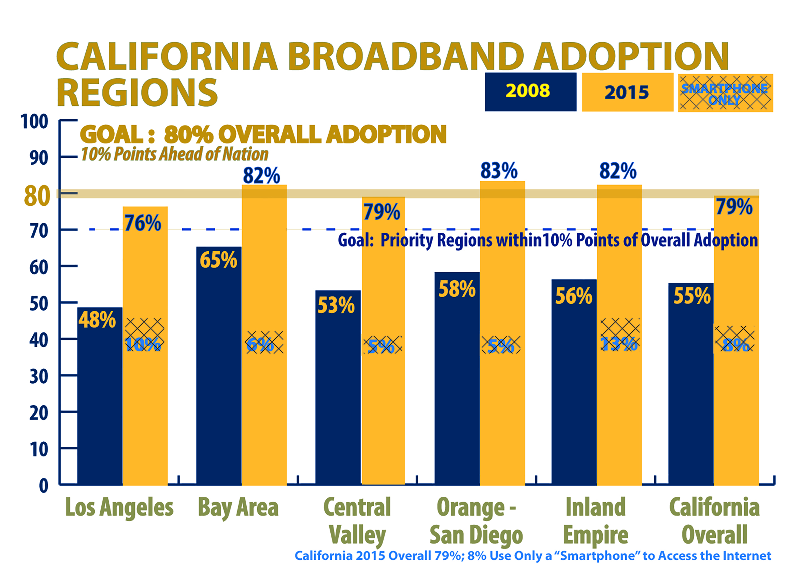
2015 Statewide Survey Results

Slide 4
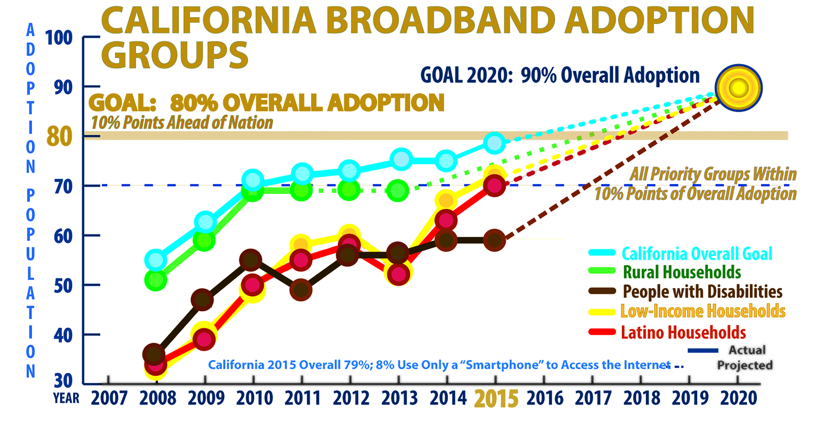
2015 Statewide Survey Results

Slide 5
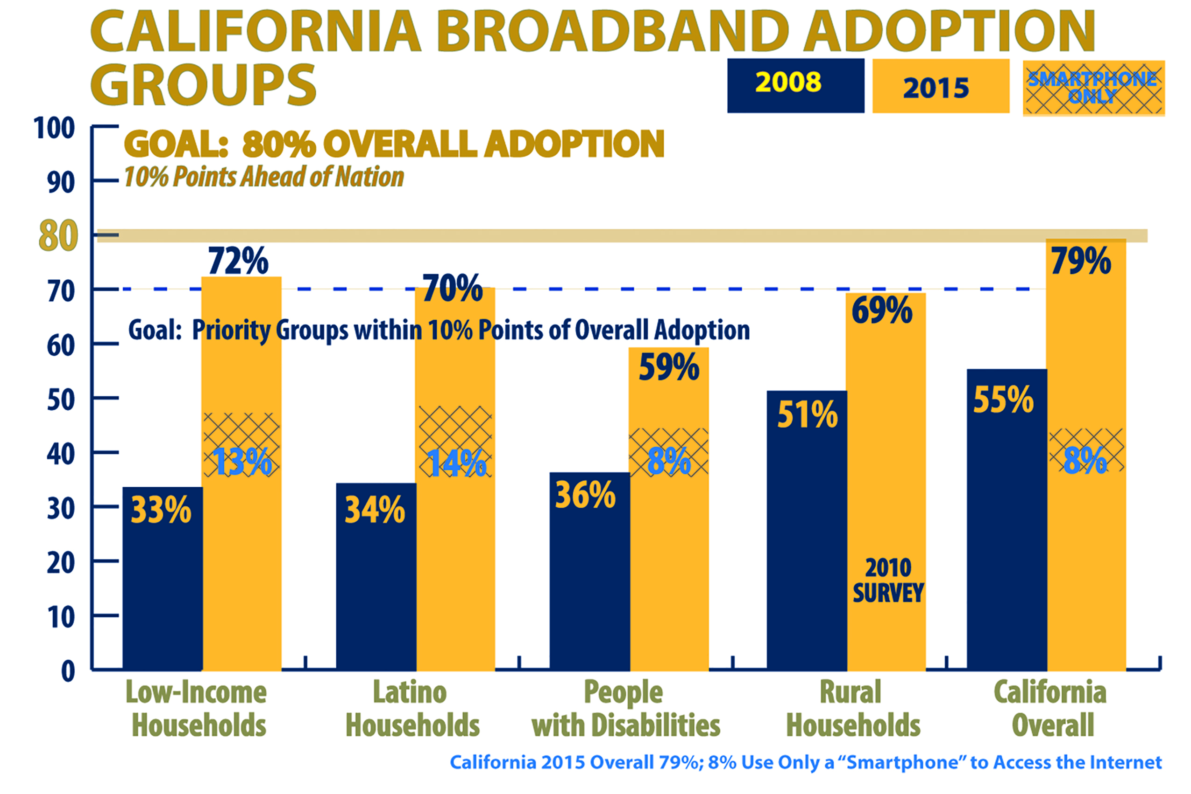
2015 Statewide Survey Results

Slide 6
Digital Divide is Greatest for the Disadvantaged
Percentage of Californians with Broadband at Home
65% of Households Earning Less Than $20,000 a Year (16% by smart phone only – 35% not connected)
63% of Households with Spanish-Speakers (21% by smart phone only – 37% not connected)
59% of People with Disabilities (8% by smart phone only – 41% not connected)
57% of Adults Age 65 or Older – Seniors (1% by smart phone only – 43% not connected)
52% of Non-High School Graduates (18% by smart phone only – 48% not connected)

Slide 7
Opportunities for County Leadership
Adopt a policy, include in General Plan (Sample Policy - Resource Guide for Local and Regional Government Leaders).
Promote “smart government” in all leadership roles:
Policy Leader – Participate in Broadband Regional Consortium.
Planner – Adopt “dig once” and other land use policies.
Regulator – Ensure broadband incorporated into all projects.
Consumer - Consolidate purchases for best networks.
Service Provider – Deliver services online, drive adoption.
Ensure that county health departments, hospitals and clinics join the California Telehealth Network.
Make libraries “digital hubs” and “ WiFi hot spots”.
Incorporate digital literacy in human services: integrate services with schools and cities for better outcomes.

