Slide 1
CSAC
Southern California Counties Regional Meeting
September 22, 2016

Slide 2

County of san diego Vision
Living Safely
Thriving
Building Better Health

Slide 3
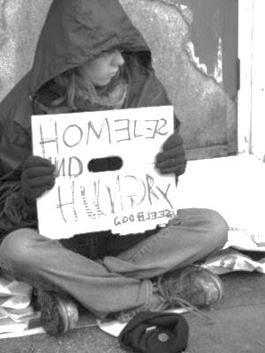
Homelessness in San Diego
2016 Point in Time Count:
  8,692 people were homeless
    55% unsheltered
    22% chronically homeless
    14% mental health issues
    8% substance abuse
Trends:
  Remaining relatively stable; however increase in unsheltered
Notes:
4,940 unsheltered, a 19% increase in unsheltered since 2015
13% decrease in chronic since 2015

Slide 4
Partnerships to achieve results
Healthy and Housed Individual
Housing Authorities
Treatment Providers
Continuum of Care
Cities with County
CBOs
Funders

Slide 5
Project one for all
Goal:
Provide treatment and housing for anyone who is experiencing homelessness and has a serious mental health illness
Notes:
Treatment – County, MHSA
Housing – Partnering with housing authorities, cities, and community based organizations

Slide 6
Project one for all
Outreach and Engagement
Treatment
Housing
Performance Measurements
Notes:
The beauty of Project One for All is that we will be building upon the groundwork that has been laid, dramatically expanding services that are proven to work, leveraging existing partnerships in new ways, and adding new programs to catalyze and sustain progress.
Project One for All is comprised of four main components:
Outreach and Engagement
Treatment
Housing – we have 1,103 voucher commitments, or 88%, of what we anticipate needing
Performance Measurements

Slide 7
Project one for all
Annual Investment
 | Fiscal Year 2016-17 | Fiscal Year 2017-18
County of San Diego | $16M | $19M
Regional Housing Vouchers | $4M | $9M
Total Annual Investment | $20M | $28M
Notes:
The investment that will be made for Project One for All is a significant one. In Fiscal Year 2016-17, the County will be investing $16 M in funding for the aforementioned treatment services, housing, and landlord engagement.
This, combined with the value of the regional housing vouchers from other authorities bring the grand total to a $20 M additional regional investment in Project One for All in 16-17.
That number increases to $28 million in the next fiscal year.

Slide 8

Project one for all
Challenges
Treatment Capacity/Workforce
Availability of Housing
Notes:
As with any innovative initiative of such a magnitude, Project One for All has challenges.
We have included funds for expansion of programs to support Project One for All, but there is always the danger that the need will exceed the capacity. Regionally, having a sufficiently trained and experienced workforce to work with this population may be a challenge.
Of course with a less than 3% vacancy rate in our county, a key risk is the availability of housing for Project One for All participants. It is critical that we actively partner with jurisdictions throughout the region and actively incentivize landlords and property managers to partner with us on this initiative
And, as always, we will be keeping an eye out for policy changes at the State and Federal level that could impact local operations. We closely monitor any possible changes to prepare for potential effects on our local programs.

Slide 9
Project one for all
Next steps
Fiscal Year 2016-17:
Expand outreach, engagement and treatment services
Secure resource commitments from cities and regional housing authorities
Launch landlord recruitment efforts
Collect baseline data
Fiscal Year 2017-18:
Assess utilization to determine additional service needs
Continue efforts with cities and regional housing authorities to commit additional resources
Report initial outcomes
Notes:
In the upcoming year, we plan to expand outreach, engagement and treatment services; work closely with cities and other public housing authorities to secure commitments for resources to support Project One for All; launch landlord recruitment efforts; and begin collecting baseline data. This will start the work to help individuals with serious mental illness get homes.
In the next year, we will assess utilization information to determine additional outreach, engagement and treatment needs; continue working with cities and regional housing authorities to fully meet the housing needs; and report initial outcomes.

Slide 10

OUR GOAL
Healthy
Safe
Thriving
Thriving

