Slide 1


Addressing Trauma When Working With Individual Mandated for Batterer Intervention Services
Sara Brammer, Ph.D. & Tony Dishman, Ph.D.

Slide 2
What We Do
We are a little complicated….
we take action to create a community
free of family violence.

Slide 3

Questions

Slide 4
Objectives
1. Define adverse childhood experiences and trauma informed care.
2. Be able to summarize the available work on adverse childhood experiences, trauma informed care and batterer intervention.
3. Understand how trauma informed care could augment a mandated batterer intervention program and still address accountability.
4. Analyze the ability of an agency to provide an accountability program that also allows for trauma to be addressed as part of the treatment course.

Slide 5
Domestic Abuse Definition
Intimate Partner Violence (IPV) is a pattern of assaultive and coercive behaviors that adults or adolescents use against their current or former intimate partner (MCADSV, 2015).
Abusive relationships are not violent all the time. Batterer’s weave together intimacy and abuse to both confuse and control their partners (MCADSV, 2015).

Slide 6
Traditional Batterer Intervention Programs
26 to 58 weeks of non clinical or limited clinical intervention.
Not flexible to the needs of the offending individual.
Focus on psycho education and accountability.
Co-occurring needs of offender (e.g. housing, mental health, past trauma) are not addressed or are referred out.
Often limited ability to support the adult and child victims of the abuse.

Slide 7
Child Abuse and Adverse Childhood Experiences
Any recent act or failure to act on the part of a parent or caretaker which results in death serious physical or emotional harm, sexual abuse or exploitation; or an act or failure to act which presents an imminent risk of serious harm (CA/N Prevention & Treatment ACT, 2017).
Four common types of child maltreatment: physical, sexual, emotional abuse and neglect.
Adverse Childhood Experiences (ACEs): all types of abuse or other traumatic experiences that occur to people under the age of 18 (CDC, 2019)

Slide 8
Adverse Childhood Experiences Assessment

Slide 9
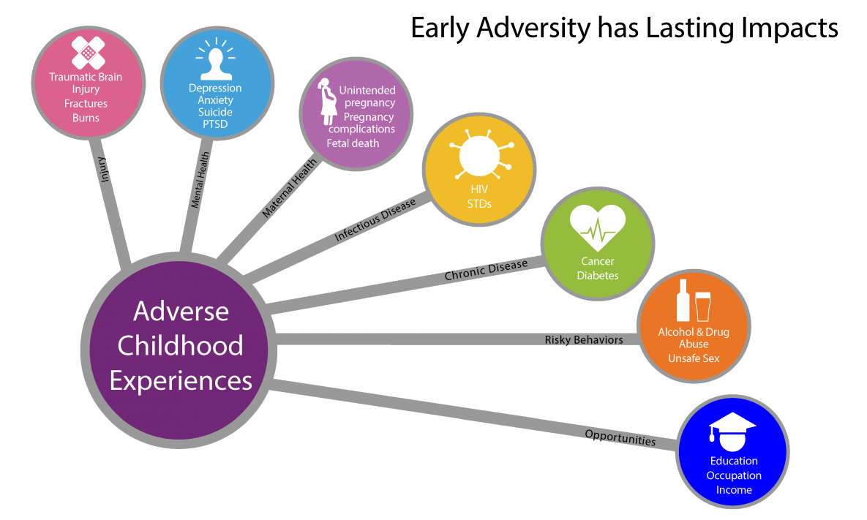
ACEs
Image Taken from CDC, 2019

Slide 10
Adverse Childhood Experience (ACEs)
As the Number of ACES increase so do the number of the following:
Alcoholism and alcohol abuse
Chronic obstructive pulmonary disease (COPD)
Depression
Fetal death
Health-related quality of life
Illicit drug use
Ischemic heart disease
Liver disease
Risk for intimate partner violence
Multiple sexual partners
Sexually transmitted diseases
Smoking
Suicide attempts
Unintended pregnancies
Early initiation of smoking
Early initiation of sexual activity
Adolescent pregnancy
Risk for sexual violence
Poor academic achievement
Poor work performance
Financial stress

Slide 11
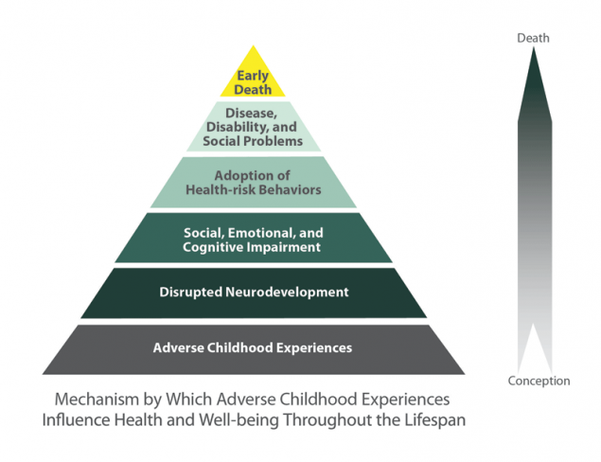
Adverse Childhood Experience (ACE)

Slide 12
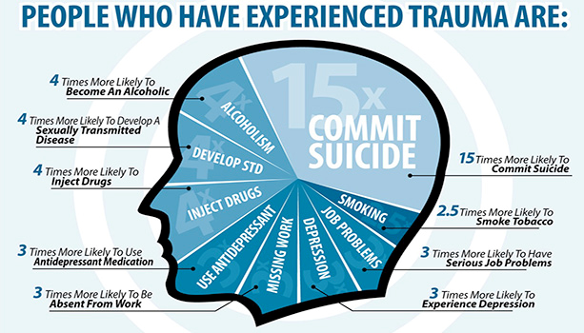
Unprocessed Trauma

Slide 13
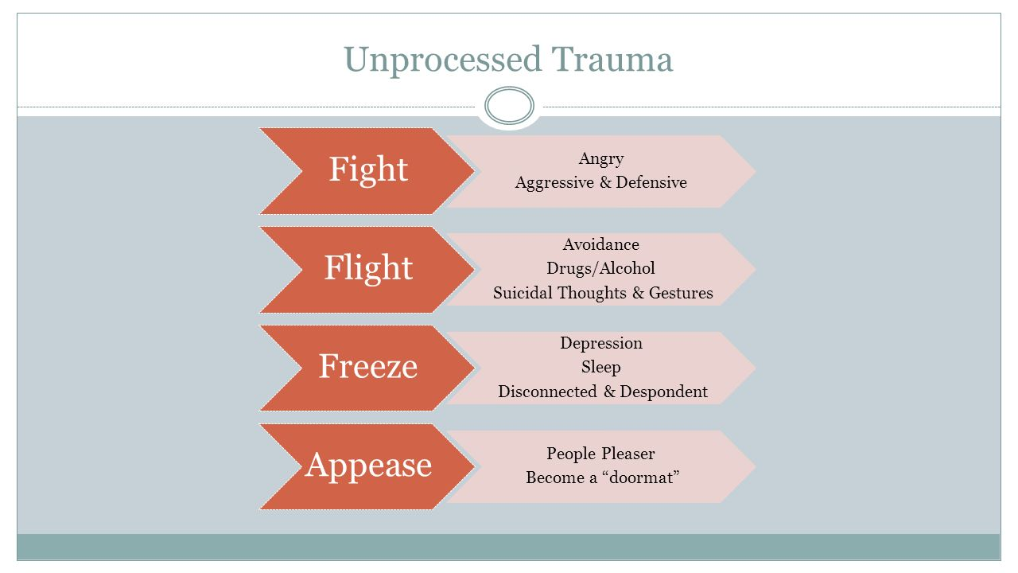
Why?

Slide 14
BIP clients report ACEs
In 2018 the Center for Disease Control indicated:
  2/3 of adults surveyed reported 1 or more ACE
  With 1 in 5 (20%) reporting 3 or more
We began collecting ACEs data January, 2018.
  Of the 126 individuals reporting for BIP:
    Average reported ACE was 4.83 (range = 0-11)
    Most reported 5 ACEs.

Slide 15

The Intersection of Trauma and Batterer Intervention

Slide 16
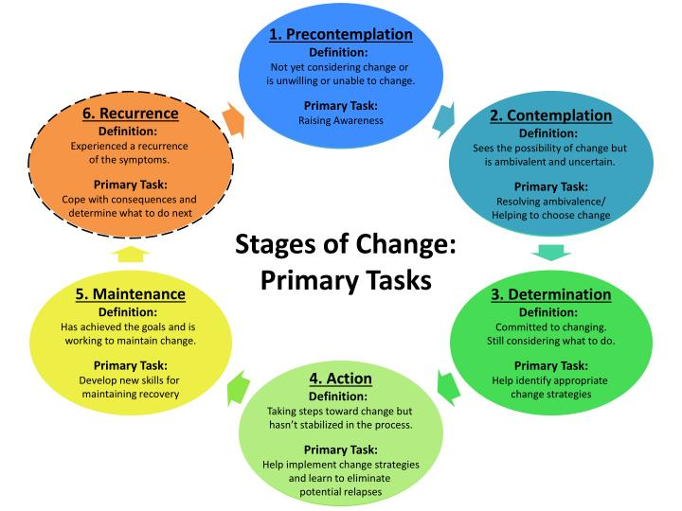
Treatment Steps for a Stages of Change Perspective

Slide 17
Steps of Treatment
Precontemplation:
  Assessment:
    relationship building, information gathering, treatment planning, orientation
  Multi-disciplinary team review
Contemplation:
  Motivational Interviewing, Narrative Claiming, Confrontation and Education
Determination:
  Provide non-abusive behavior options (skill development), empathy building

Slide 18
Steps of Treatment
Action:
  Strategy, routine, safety planning
Maintenance:
  Continued safety planning, practice and distress tolerance
Reoccurrence:
  Safety planning

Slide 19
Small Group Activity

Slide 20
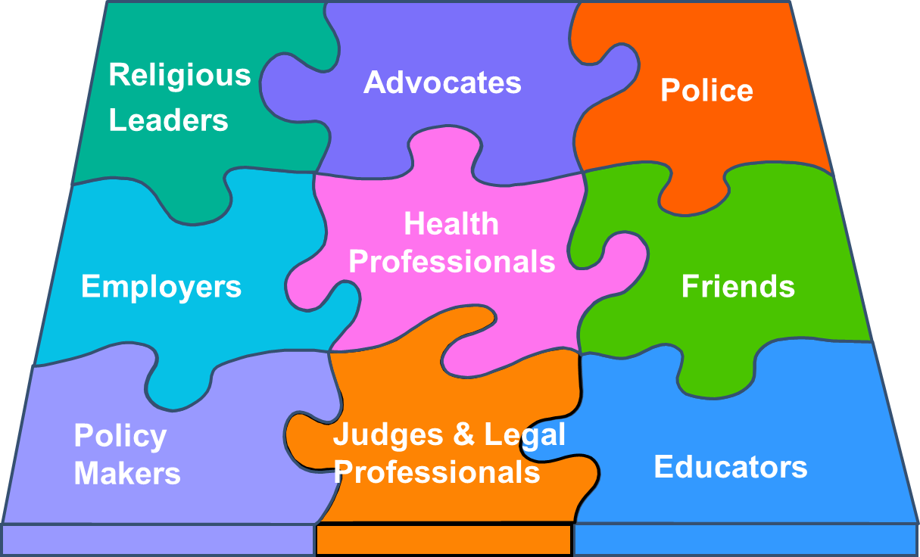
Collaboration is Essential

